Slide 1
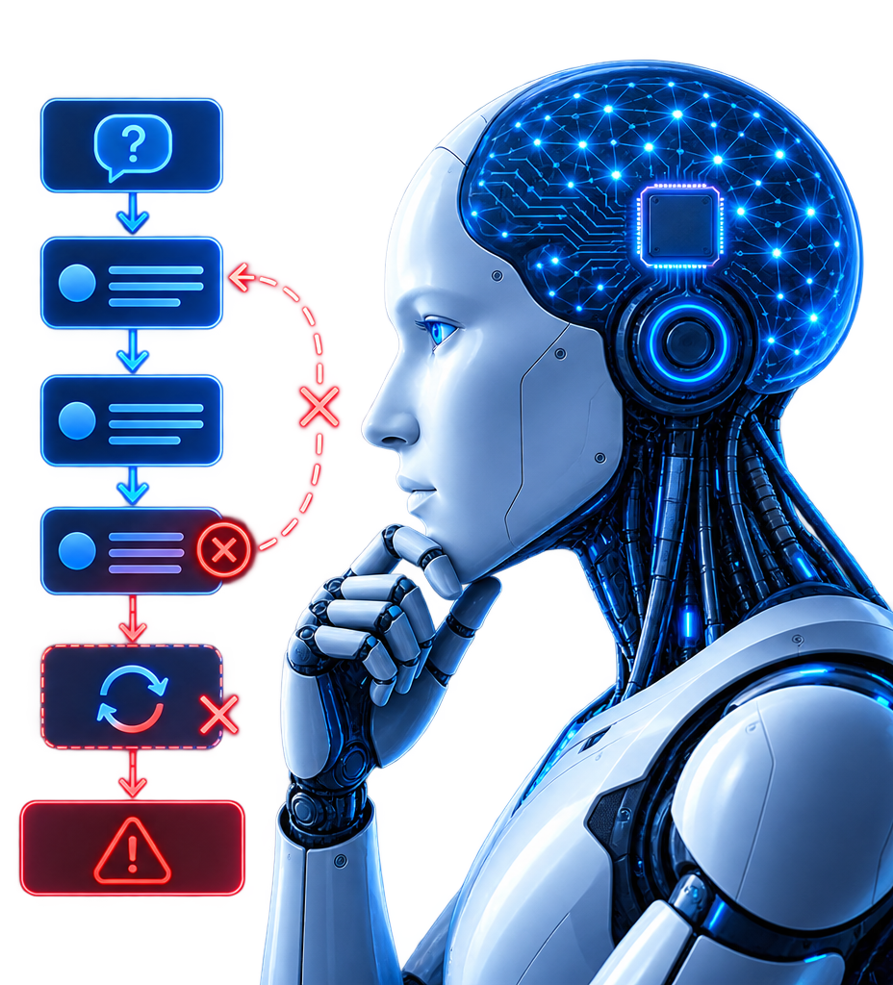
ICLR 2024 CONFERENCE PAPER
Large Language Models
Cannot Self-Correct Reasoning Yet
Jie Huang (UIUC), Xinyun Chen, Swaroop Mishra, Huaixiu Steven Zheng, Adams Wei Yu, Xinying Song, Denny Zhou (Google DeepMind)
PRESENTED BY
1. MRM MUBASHSHIRUL HAQUE (2303127)
2. REFAYET HOSSAIN ANANDA (2303148)
3. MD JEBON SHEIKH (2303160)
4. MD MASFIE AMIN SRIJON (2303179)
5. NAFIS ISLAM KABBO (2303180)
6. ANINDO CHAMA (2303181)
Large Language Models Cannot Self-Correct Reasoning Yet | ICLR 2024
01/23
Notes:
Speaker: Nafis Islam Kabbo welcomes the audience, introduces the ICLR 2024 paper, and presents the group members.

Slide 2
OVERVIEW
Presentation Outline
Six sections tracing motivation to constructive future work
1
Introduction
2
Background & Related Work
Why multi-step reasoning fails and what self-correction promises.
RCI, Reflexion, Self-Refine, Debate and their evaluation flaws.
3
Methodology
4
Results
GSM8K, CSQA, HotpotQA across GPT-3.5, GPT-4, Turbo, Llama-2.
Accuracy declines after self-correction, net negative flips.
5
Analysis
6
Conclusion & Future Work
Why gains vanish at equal compute and without feedback.
External tools, verifiers, and fair evaluation standards.
Large Language Models Cannot Self-Correct Reasoning Yet | ICLR 2024
02/23
Notes:
Speaker: Nafis Islam Kabbo outlines the roadmap across six core sections.

Slide 3
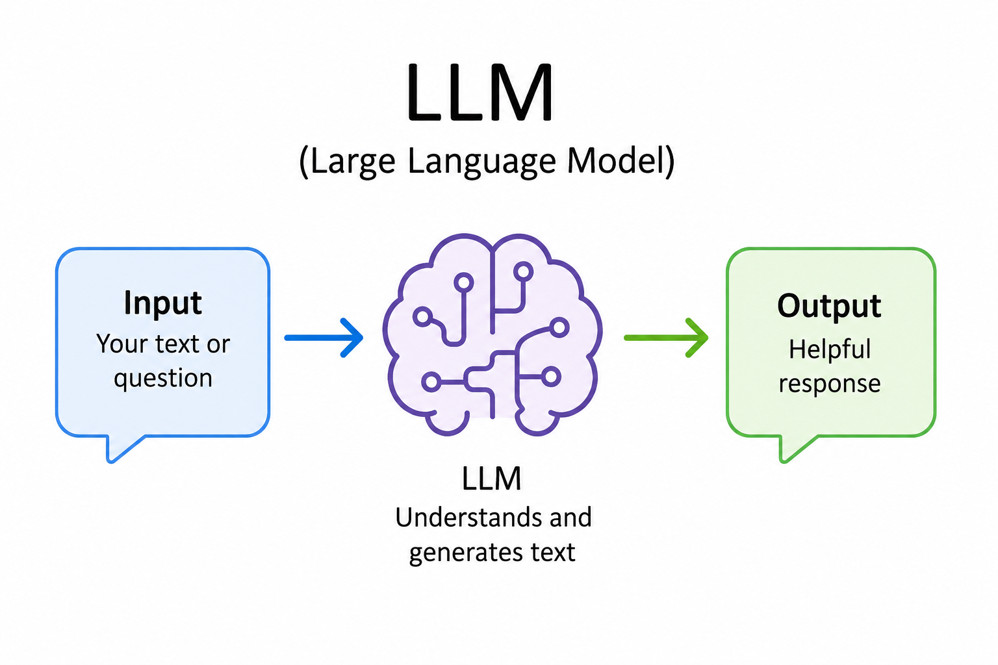
1. INTRODUCTION
Large Language Model (LLM)
1
Next-Token Prediction
Predicts the next token, one at a time.
2
Pattern Learning
Learns patterns and relationships from large amounts of text.
3
Text Generation
Generates human-like text based on the given input.
Figure-1:Large Language Model
Large Language Models Cannot Self-Correct Reasoning Yet | ICLR 2024
03/23
Notes:
Speaker: Nafis Islam Kabbo explains the 3-step closed-loop self-correction pipeline.

Slide 4
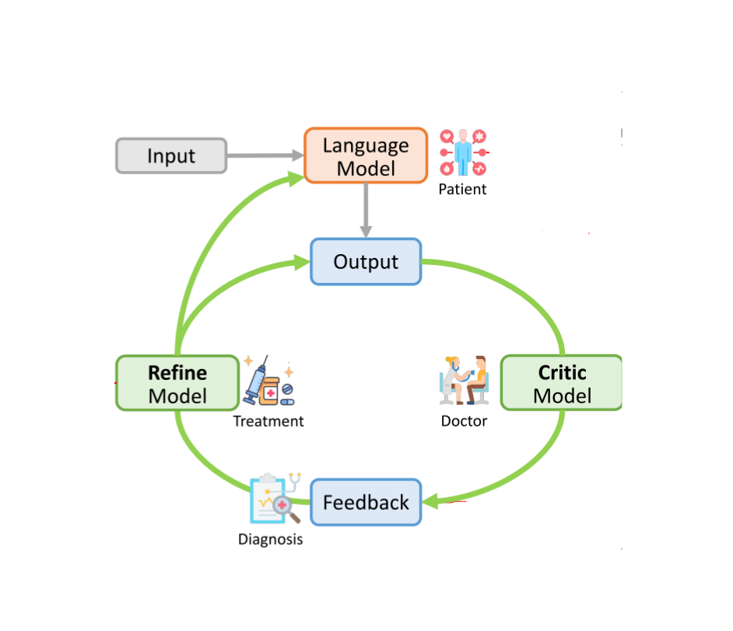
1. INTRODUCTION
LLM Self-Correction
Large Language Models (LLMs) generate text and solve problems by predicting likely word sequences, but their reasoning steps can contain errors.
1
Initial response
Model answers the question on its own.
2
Self-review
Model is asked to check its own answer and flag problems.
3
Revised response
Model answers again, using its own feedback.
Figure-2: Large Language Model Self correction procedure
Large Language Models Cannot Self-Correct Reasoning Yet | ICLR 2024
04/23
Notes:
Speaker: Nafis Islam Kabbo explains why autoregressive generation causes error cascades in multi-step reasoning.

Slide 5
1. INTRODUCTION
The Central Question
“If an LLM possesses the ability to self-correct, why doesn’t it simply offer the correct answer in its initial attempt?”
Paraphrased from Huang et al., ICLR 2024, Section 1.
WHAT'S AHEAD
Prior work and its evaluation gaps
How the paper tests self-correction fairly
The results: accuracy drops, not rises
Why the drop happens, and what to do instead
Preview: across GSM8K, CommonSenseQA, and HotpotQA, the paper's answer is no. Left alone, LLMs do not reliably catch their own reasoning errors, and accuracy often falls after self-correction.
Large Language Models Cannot Self-Correct Reasoning Yet | ICLR 2024
05/23
Notes:
Speaker: Nafis Islam Kabbo presents the central paradox that motivates the study.

Slide 6
2. BACKGROUND & RELATED WORK
Timeline of Claims
How 2023 was packed with self-correction hype
◉
RCI
◎
Reflexion
⬢
Self-Refine
⬣
Debate
Kim et al.
Shinn et al.
Madaan et al.
Du et al.
Recursive
critic
Verbal
reinforcement
Feedback
refine
Multi-agent
debate
+7% claimed
+11% claimed
+10% claimed
+4% claimed
Q1 2023
Q2 2023
Q3 2023
Q4 2023
WHAT THE TIMELINE HIDES
◉
Oracle leakage
◈
Prompt trick
⬢
Compute gap
Only wrong answers
are critiqued
Rules omitted
then re-added
Debate uses 3 to 6x
calls vs single shot
Large Language Models Cannot Self-Correct Reasoning Yet | ICLR 2024
06/23
Notes:
Thank you, Srijon. I will now examine the prior literature and why earlier claims looked so convincing on paper.
"If you followed AI research throughout 2023, it felt like every quarter brought a shiny new framework claiming language models could fix their own mistakes. It was the same excitement we see today whenever rumors drop about unreleased models like Fable 5.1 or secret codenames. Everyone wanted to believe that self-correction was a solved problem."
Look at the four timeline cards across 2023 on our slide.
In Q1, Kim and colleagues published RCI, claiming a 7% boost on math and reasoning by prompting the model to recursively critique its own code.
In Q2, Shinn and colleagues introduced Reflexion, claiming an 11% improvement by storing verbal reflections across multiple trials.
In Q3, Madaan and colleagues introduced Self-Refine, reporting a 10% gain using structured feedback checklists.
And in Q4, Du and colleagues claimed Multi-Agent Debate gave another 4% boost by having multiple instances debate divergent answers.
On the surface, these numbers looked great. But look at the callout at the bottom of the slide: what the timeline hides.
When you inspect the experimental setups, none of these gains came from intrinsic self-correction. Both RCI and Reflexion relied on oracle leakage, meaning the test harness secretly told the model when it got an answer wrong. Self-Refine relied on a prompt trick, where rules were omitted in the initial prompt and only provided during feedback. And Multi-Agent Debate simply burned three to six times more compute.

Slide 7
2. BACKGROUND & RELATED WORK
Closed Loop vs Grounded Loop
Same model, different information: why internal reflection fails but external verification works
INTRINSIC : Closed Loop (Paper Focus)
EXTERNAL : Grounded Loop (Tool-Assisted)
1. Generate
2. Self-Critique
LLM
Executes
Frozen Weights
LLM
TOOL
Drafts Code / Solution
Traceback
Python / Oracle
3. Revise Blind
ACCURACY CHANGE
ACCURACY CHANGE
-1.3% to -27.5%
+7.0% to +15.0%
No new facts. Shared models can hallucinate errors.
Deterministic truth. Execution errors give precise correction signals.
Core Principle: A frozen model cannot act as an independent verifier of its own output without external grounding.
Large Language Models Cannot Self-Correct Reasoning Yet | ICLR 2024
07/23
Notes:
This slide illustrates the core distinction that prior literature often conflated: a closed loop versus a grounded loop.
Look at the red box on the left. This is the closed loop, which is the exact focus of our paper. The model generates an initial answer, receives an unguided prompt to find flaws, and attempts a blind revision.
Notice the fundamental flaw: zero new information enters the system. The weights of the model are frozen. You are asking the exact same network that made the error to spot its own error.
"Anyone who has experimented with language models knows what happens next. If you ask an LLM, 'Are you sure about that?', it immediately panics, apologizes for a mistake it never made, and turns a correct answer into a completely broken one."
Because of this compliance bias and lack of external truth, intrinsic self-correction consistently decreases accuracy by 1.3% to 27.5%.
Now look at the green box on the right. This is the grounded loop, and this is where self-correction genuinely works.
Here, the model writes executable code or equations and runs them in a deterministic environment like a Python interpreter. When the execution fails with an exact traceback, the model conditions its update on objective ground truth. That produces real gains between 7% and 15%.

Slide 8
2. BACKGROUND & RELATED WORK
Forensic: Reported vs Controlled
1. Oracle Leakage
+10.5% → -2.5%
Shield correct answers, only fix wrong ones.
2. Compute Gap
+4.0% → -1.5%
Accuracy Change (%)
Debate loses to Self-Consistency at equal cost.
3. Prompt Trick
+10.0% → 0.0%
Weak start vs rule rich feedback.
Confounder Type
Figure-3: Accuracy Change (%) by Confounder Type
Insights: Red collapses to green at or below zero. No confounder survives a fair test.
Large Language Models Cannot Self-Correct Reasoning Yet | ICLR 2024
08/23
Notes:
On this slide, we present the forensic breakdown of prior claims.
Look at the paired bar chart on the left. The red bars represent the claimed accuracy improvements from earlier literature. The green bars represent what happens when you run a controlled, scientifically rigorous test.
Notice the striking pattern: every single red bar collapses straight down into green, ending up at or below zero.
Let us walk through the three cards on the right.
First, Oracle Leakage. Papers like RCI and Reflexion reported gains of around 10.5%. But their evaluation harness secretly used ground truth labels to shield correct answers. The model was only prompted to self-correct when its answer was already wrong.
"That is like taking a multiple choice exam where the teacher only taps your desk when you pick the wrong answer and lets you guess again. In real applications, you do not have an oracle. When you prompt the model on all questions, accuracy drops by 2.5%."
Second, the Compute Gap. Multi-Agent Debate claimed a 4% gain. But running three agents through rounds of debate consumes 6x the token budget. When the authors matched compute by giving single-agent Self-Consistency the exact same number of sample calls, standard majority voting beat debate by 1.5%.
Third, the Prompt Trick. Self-Refine reported a 10% gain. However, the initial prompt omitted critical formatting rules, which were only introduced in the feedback prompt. When you provide the complete prompt from the start, the self-correction gain drops to exactly 0.0%.

Slide 9
3. METHODOLOGY
Benchmarks Used to Test Reasoning
Test a model's step-by-step logical and mathematical reasoning ability:
Dataset | Reasoning Task | Test Size | Prior Gain Claimed
GSM8K | Grade-school math word problems | 1,319 questions | ~7% (Kim et al., 2023)
CommonSenseQA | 5-choice commonsense reasoning | 1,221 questions (dev set) | ~15% (Kim et al., 2023)
HotpotQA | Open-domain, multi-hop Q&A | 100 questions | Sizeable gain (Shinn et al., 2023)
Why these three?
Each dataset was chosen because earlier self-correction papers reported their biggest improvements on it, giving this study the fairest and most challenging test of whether those gains hold up without oracle answer labels.
Large Language Models Cannot Self-Correct Reasoning Yet | ICLR 2024
09/23
Notes:
Speaker: Anindo introduces the three evaluation tasks, covering arithmetic on GSM8K, logic on CommonSenseQA, and multi-hop reasoning on HotpotQA.

Slide 10
3. METHODOLOGY
Models & Test Conditions
Minor changes in these settings can shift benchmark scores significantly:
Model | Settings Tested | Temperature | Sample Size
GPT-3.5-Turbo | Oracle + Intrinsic | 1.0 | Full test set
GPT-4 | Oracle + Intrinsic | 1.0 | 200 / 100 Qs
GPT-4-Turbo | Intrinsic only | 0 | 200 Qs
Llama-2-70B-Chat | Intrinsic only | 0 | 200 Qs
2
Max 2 rounds of self-correction were allowed per question, keeping inference cost comparable across models.
Large Language Models Cannot Self-Correct Reasoning Yet | ICLR 2024
10/23
Notes:
Speaker: Anindo presents the evaluated models and strict experimental controls.

Slide 11
3. METHODOLOGY
Prompting Procedures
Flow: intrinsic vs oracle regimes
1
Iniitial
2
Critique
3
Revise
4
Iterate
Generate draft
Review logic
New reasoning
Round 2 repeat
✓
With Oracle (Flawed)
✗
Intrinsic (Realistic)
• Verifier checks answer
• Tells model when wrong
• Correct answers untouched -> inflated
• No external signal
• Model judges itself blindly
• Flips correct -> wrong -> drops
Large Language Models Cannot Self-Correct Reasoning Yet | ICLR 2024
11/23
Notes:
Speaker: Anindo contrasts the oracle feedback procedure against intrinsic blind self-correction.

Slide 12
3. METHODOLOGY
Keeping the Evaluation Fair
Beyond accuracy numbers, the authors built two extra checks into their methodology:
Equal Inference Cost
Equal Prompt Effort
Self-correction uses multiple model calls, so it is compared against self-consistency and multi-agent debate using the same number of responses, rather than against a single-call baseline.
The initial-answer prompt and the feedback prompt are given the same level of detail, so gains can't come from simply hiding instructions in the correction step.
Multi-agent debate vs. self-consistency, and prompt-design comparisons both use this same fairness lens.
Large Language Models Cannot Self-Correct Reasoning Yet | ICLR 2024
12/23
Notes:
Speaker: Anindo contrasts the oracle feedback procedure against intrinsic blind self-correction.

Slide 13
4. RESULTS
Intrinsic Self-Correction Fails
Main Finding: Performance declines after self-correction
CENTRAL EMPIRICAL FINDING
Intrinsic self-correction does NOT improve accuracy. Scores drop across all models and tasks.
1
Universal
2
Task-Agnostic
3
Oracle Illusion
All models
All tasks
Prior artifact
GPT-3.5, GPT-4, Turbo, Llama-2 all decline after R1 and R2.
Math (GSM8K), logic (CSQA), QA (HotpotQA) all fail.
Gains only with external labels guiding when to fix.
↓
↓
!
Large Language Models Cannot Self-Correct Reasoning Yet | ICLR 2024
13/23
Notes:
Speaker: Mahid presents the headline empirical finding that intrinsic correction fails across all models.

Slide 14
4. RESULTS
GPT-3.5 & GPT-4 Benchmark Results
Accuracy drops across rounds (Table 2)
Key Drops
GPT-3.5 on CSQA
-17.2%
72.5% -> 55.3% (R2)
GPT-4 on HotpotQA
-11.0%
53.0% -> 42.0%
GPT-4 on GSM8K
-4.0%
92.0% -> 88.0%
Table-1: GPT-3.5 and GPT-4 accuracy across two self-correction rounds
Large Language Models Cannot Self-Correct Reasoning Yet | ICLR 2024
14/23
Notes:
Speaker: Mahid details the numerical drops across GPT-3.5 and GPT-4.

Slide 15
4. RESULTS
GPT-4-Turbo & Llama-2 Results
Failure generalizes across open and proprietary models
Llama-2 Collapse
GSM8K: 62.0% -> 36.5% (-25.5%)
CSQA: 64.0% -> 36.5% (-27.5%)
Open-weight models are highly prompt-compliant: they abandon correct answers when asked to "find flaws".
!
Extreme compliance vulnerability
Table-2: GPT-4-Turbo and Llama-2 results across self-correction rounds
Large Language Models Cannot Self-Correct Reasoning Yet | ICLR 2024
15/23
Notes:
Speaker: Mahid highlights the severe collapse of Llama-2 under self-correction prompting.

Slide 16
4. RESULTS
Answer Transition Dynamics
Why accuracy drops: net-negative flips (Figure 1)
74.7%
Unchanged
Kept initial answer
8.9%
Correct -> Wrong
Harmful flip
7.6%
Wrong -> Correct
Beneficial fix
-1.3%
Net Loss
Harm > help
Figure-4: Answer transition dynamics after two self-correction rounds on GSM8K (GPT-3.5)
Large Language Models Cannot Self-Correct Reasoning Yet | ICLR 2024
16/23
Notes:
Speaker: Mahid shows that harmful flips exceed beneficial fixes, explaining the net decline in accuracy.

Slide 17
5. ANALYSIS
Why Does Self-Correction Fail?
What self-correction means, and the question this paper puts to the test.
Self-correction: an LLM revises its own answer using feedback on a prior output.
This paper studies intrinsic self-correction, where the model corrects itself using only its own knowledge, with no external feedback or oracle labels.
Central question: if a model can self-correct, why not answer correctly the first time?
Finding: without external feedback, LLMs largely fail to self-correct reasoning and often get worse.
1
Generate answer
2
Self-review
(no oracle)
3
Revised answer
Large Language Models Cannot Self-Correct Reasoning Yet | ICLR 2024
17/23

Slide 18
5. ANALYSIS
Multi-Agent Debate ≈ Self-Consistency
At an equal number of model responses, debate offers no real advantage over simple majority voting (GSM8K).
Method | # Resp. | GSM8K Acc.
Standard Prompting | 1 | 76.7
Self-Consistency | 3 | 82.5
Multi-Agent Debate (r1) | 6 | 83.2
Self-Consistency | 6 | 85.3
Multi-Agent Debate (r2) | 9 | 83.0
Self-Consistency | 9 | 88.2
Takeaway: Debate is really "self-consistency with model-driven voting”. With the same number of responses, plain majority-vote self-consistency matches or beats it.
Large Language Models Cannot Self-Correct Reasoning Yet | ICLR 2024
18/23

Slide 19
5. ANALYSIS
Case Study: The Gaslighting Effect
How critique prompts force correct reasoning into hallucination
Terry eats 2 yogurts a day. They are sold in 4-packs at $5.00 per pack. How much does he spend on yogurts in 30 days?
GSM8K TASK
ROUND 1: CORRECT
SELF-CRITIQUE PROMPT
ROUND 2: WRONG FLIP
$75
"Review your answer and find flaws."
$150
1. Total yogurts needed:
30 days x 2 = 60 yogurts
2. 4-packs required:
60 / 4 = 15 packs
3. Total expenditure:
15 packs x $5 = $75
The Compliance Trap:
1. Model doubts previous logic
2. Hallucinates new rule:
"Terry buys 1 pack daily"
3. Calculates 30 x $5 = $150
(Flipped from 100% correct to 0%)
• Instruction-following bias
• Model assumes prompt implies an error occurred
• Model invents non-existent flaws to comply
Insight: Asking an LLM to 'find flaws' acts as destructive noise because the model lacks an internal truth verifier.
Large Language Models Cannot Self-Correct Reasoning Yet | ICLR 2024
19/23
Notes:
Speaker: Jebon walks through the concrete Yogurt problem case study from Figure 2, demonstrating how self-critique prompts cause models to hallucinate errors and flip correct $75 answers to incorrect $150 answers.

Slide 20
6. CONCLUSION & FUTURE WORK
Key Takeaways
1
2
3
Intrinsic Self-Correction Fails
Prior Gains Were Evaluation Artifacts
Grounded Feedback Is Essential
Without external feedback or grounding, accuracy consistently drops after self-correction across GPT-3.5, GPT-4, GPT-4-Turbo, and Llama-2, on every reasoning benchmark tested.
Reported improvements traced back to three confounders: oracle-label leakage (RCI, Reflexion), unfair compute parity (Debate vs. Self-Consistency), and sub-optimal initial prompts (Self-Refine).
A frozen model cannot reliably verify its own reasoning. Genuine gains require external signals, such as code execution, tool use, or trained verifiers, not more self-reflection.
CORE PRINCIPLE: A model that cannot generate the correct answer cannot reliably judge its own answer. Self-correction needs a verifier outside the generator.
Large Language Models Cannot Self-Correct Reasoning Yet | ICLR 2024
20/23
Notes:
Speaker: Refayet synthesizes the paper's three main conclusions.

Slide 21
6. CONCLUSION & FUTURE WORK
Study Limitations & Methodological Boundaries
Scope and boundaries of this research
SCOPE LIMITATIONS
METHODOLOGICAL BOUNDARIES
Reasoning-Specific : Findings cover math, commonsense, and multi-hop QA, not style, tone, or safety self-correction.
Sample-Size Constraints : HotpotQA evaluated on 100 questions to control API cost, limiting statistical resolution.
Frozen Models Only : Models were prompted, not fine-tuned, for self-correction; training-time approaches are untested.
Non-Exhaustive Prompts : Multiple feedback prompts were tested per model, but the space of possible phrasings is unbounded.
2023 Model Snapshots : GPT-3.5, GPT-4, GPT-4-Turbo, Llama-2-70B. Newer reasoning-focused models were not evaluated.
Closed-Book Setting : No retrieval (RAG) or external documents were permitted during self-correction.
KEY INSIGHT: These findings apply to intrinsic reasoning repair — not to style, safety, or preference alignment, where models may self-judge more reliably.
Large Language Models Cannot Self-Correct Reasoning Yet | ICLR 2024
21/23
Notes:
Speaker: Refayet discusses the study's scope limitations and methodological boundaries.

Slide 22
6. CONCLUSION & FUTURE WORK
Future Directions & Fair Evaluation Standards
Constructive paths forward
1
Tool-Augmented Execution
2
Learned Verifiers & PRMs
Route reasoning through Python REPLs, SQL engines, or solvers so an external, deterministic system, not the model itself, verifies correctness.
Train process-supervised reward models to judge intermediate reasoning steps, giving the corrector a grounded signal for where an error actually occurred.
3
Training-Time RL & Search
4
Fair Evaluation Standards
Invest in reinforcement learning and search (e.g., MCTS, test-time compute) so correction is learned during training, not bolted on as a prompting loop.
Report inference-cost-matched baselines against self-consistency, and disclose any oracle or ground-truth signal used to gate the correction loop.
Large Language Models Cannot Self-Correct Reasoning Yet | ICLR 2024
22/23
Notes:
Speaker: Refayet outlines future research directions including tool integration and learned process reward models.

Slide 23
6. CONCLUSION & FUTURE WORK
Thank You
Open Discussions
We welcome questions from the professor and audience.
1
Why does asking a model to find flaws often make it hallucinate errors where none exist?
2
When should we rely on external tools like Python or verifiers instead of prompting alone?
3
How can we design a fair self-correction benchmark that avoids oracle leakage?
Large Language Models Cannot Self-Correct Reasoning Yet | ICLR 2024
23/23
Notes:
Speaker: Refayet concludes the presentation and opens the floor for questions.

