Slide 1
ICLR 2024 CONFERENCE PAPER
Large Language Models
Cannot Self-Correct Reasoning Yet
Jie Huang (UIUC) · Xinyun Chen · Swaroop Mishra · Huaixiu Steven Zheng
Adams Wei Yu · Xinying Song · Denny Zhou (Google DeepMind)
Group Presentation · Student Presenters
1. Nafis Islam Kabbo — 2303180
2. Srijon — 2303179
3. Anindo — 2303181
4. Mahid — 2303127
5. Jebon — 2303160
6. Refayet — 2303148
Large Language Models Cannot Self-Correct Reasoning Yet | ICLR 2024
01/24
Notes:
Welcome the audience. Introduce the paper 'Large Language Models Cannot Self-Correct Reasoning Yet' (ICLR 2024) by Google DeepMind and UIUC researchers, and introduce the six group members.

Slide 2
OVERVIEW
Presentation Outline
Core narrative structure and argument flow across six sections
1
Introduction
2
Background & Related Work
Motivation → Research Problem → Research Question
LLM Reasoning → Self-Correction → Previous Findings → Research Gap
LLM reasoning foundations, autonomous refinement premise, and the central self-correction paradox.
Taxonomy of RCI, Reflexion, Self-Refine, and isolating intrinsic vs oracle-guided feedback.
3
Methodology
4
Results
Models → Tasks → Experimental Setup → Evaluation
Main Finding: Intrinsic Self-Correction Fails
GSM8K, CSQA, and HotpotQA benchmarks across GPT-3.5, GPT-4, GPT-4-Turbo, and Llama-2-70B.
Empirical proof: Accuracy consistently declines across all reasoning tasks without oracle feedback.
5
Analysis
6
Conclusion & Future Work
Why Does Self-Correction Fail? → Error Persistence → Possible Causes
Key Takeaways → Limitations → Future Directions
Multi-Agent Debate compute parity, the prompt design trap, and why verification limits generation.
Summary of claims, boundaries of study, external tool integration, and fair benchmarking standards.
Large Language Models Cannot Self-Correct Reasoning Yet | ICLR 2024
02/24
Notes:
Outline overview: Walk the audience through the 6 core sections. Note how the presentation moves logically from foundational concepts to empirical results, deep-dive analysis, and constructive future directions.

Slide 3
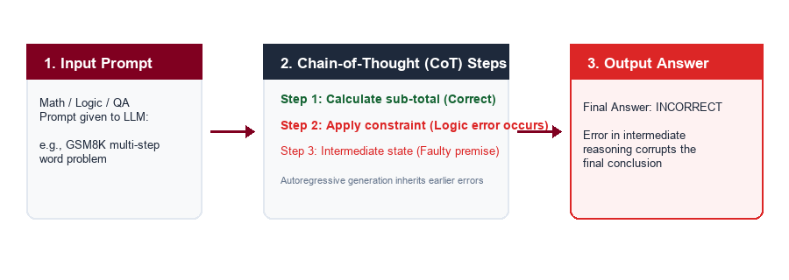
1. INTRODUCTION
Large Language Models & Reasoning
Motivation: High utility of autoregressive LLMs paired with multi-step reasoning vulnerabilities
What are Large Language Models?
Neural networks trained on massive internet corpora using autoregressive next-token prediction.
Chain-of-Thought (CoT) Prompting
Prompting LLMs to output intermediate reasoning steps enables them to solve complex math and logic benchmarks (e.g. GSM8K, CSQA).
The Compounding Error Vulnerability
Because tokens are generated sequentially, a single erroneous step in the reasoning chain irreversibly corrupts the final answer.
Large Language Models Cannot Self-Correct Reasoning Yet | ICLR 2024
03/24
Notes:
Presenter 1: Nafis Islam Kabbo. Explain what LLMs are, how Chain-of-Thought reasoning works, and why reasoning error propagation is a critical bottleneck for reliable AI systems.

Slide 4
1. INTRODUCTION
The Concept of Self-Correction
Research Problem: Can LLMs autonomously detect and repair reasoning flaws in post-processing?
A
B
C
The Self-Correction Hypothesis
Post-Processing Refinement Loop
The High Stakes of Autonomous Correction
Theoretical Promise
Standard Workflow
Industry Impact
The expectation that an LLM, given its initial draft, can adopt a 'critic' mindset, identify errors in its own logic chain, and iteratively revise its output toward ground truth.
1. Prompt → Initial Answer
2. Feedback Prompt: 'Review your answer, find mistakes, and rewrite'
3. Revised Answer → Final Output
If true intrinsic self-correction works, autonomous AI agents could solve complex tasks without costly human supervision, external verifiers, or specialized domain tools.
Large Language Models Cannot Self-Correct Reasoning Yet | ICLR 2024
04/24
Notes:
Presenter 1: Nafis Islam Kabbo. Detail the theoretical appeal of self-correction. Explain why the AI community was enthusiastic about self-correction loops and the potential benefits if models could self-refine.

Slide 5
1. INTRODUCTION
The Central Research Question
The Self-Correction Paradox: Can an LLM fix its reasoning without external signals?
THE CORE PARADOX
"If an LLM has the intrinsic knowledge and reasoning capability to correct a mistake, why didn't it produce the correct answer in the first attempt?"
Intrinsic Self-Correction (Paper Focus)
External-Feedback Self-Correction
• Model relies strictly on its internal frozen weights
• Zero external feedback: No oracle labels, humans, or tool outputs
• Central Question: Does intrinsic self-correction improve reasoning accuracy?
• Model receives outside verification signals (e.g. unit test failure)
• Ground-truth labels or code execution results guide revision
• Effective in practice, but NOT true intrinsic self-correction
Large Language Models Cannot Self-Correct Reasoning Yet | ICLR 2024
05/24
Notes:
Presenter 1: Nafis Islam Kabbo. Articulate the central research paradox. Distinguish intrinsic self-correction (the core focus of this study) from systems relying on external oracles and tools.

Slide 6
2. BACKGROUND & RELATED WORK
Prior Self-Correction Frameworks
Previous Findings: Leading paradigms in recent literature proposing self-correction methods
RCI
Recursive Critique
Reflexion
Verbal Reinforcement
Kim et al. (NeurIPS 2023)
Shinn et al. (NeurIPS 2023)
Recursive Criticism and Improvement. The model sequentially critiques its reasoning and modifies responses based on its own critique.
Maintains an episodic memory buffer of past failures and generates verbal self-reflections to guide subsequent trial iterations.
Self-Refine
Iterative Refinement
Multi-Agent Debate
Multi-Agent Consensus
Madaan et al. (NeurIPS 2023)
Du et al. (2023)
Multi-turn framework where an LLM generates structured feedback on its output and refines its response over successive turns.
Multiple LLM instances propose candidate solutions, read peer critiques, and debate over multiple rounds to converge on an answer.
Large Language Models Cannot Self-Correct Reasoning Yet | ICLR 2024
06/24
Notes:
Presenter 2: Srijon. Cover the major self-correction papers in literature (RCI, Reflexion, Self-Refine, Multi-Agent Debate). Note how each proposed an architectural loop claiming performance improvements.

Slide 7
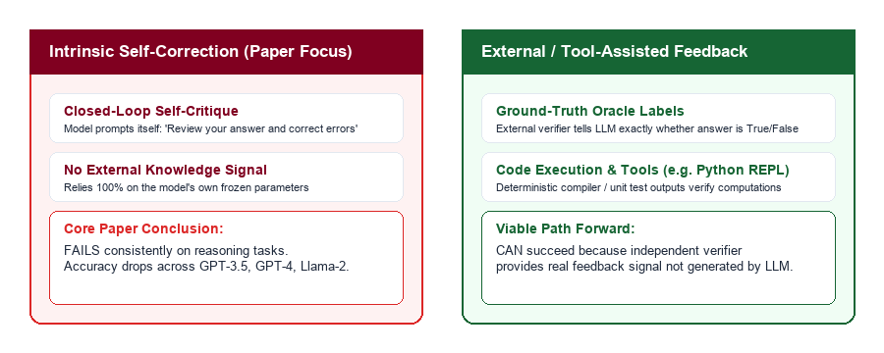
2. BACKGROUND & RELATED WORK
Intrinsic vs. External Feedback
Research Gap: Deconstructing the boundary between pure model reasoning and external guidance
Large Language Models Cannot Self-Correct Reasoning Yet | ICLR 2024
07/24
Notes:
Presenter 2: Srijon. Emphasize the crucial taxonomy distinction. Explain that external feedback (like code execution or ground truth) introduces genuine new information, whereas intrinsic self-correction relies solely on the model's existing internal weights.

Slide 8
2. BACKGROUND & RELATED WORK
Flaws in Prior Evaluations
Critical Analysis: Summary of evaluation confounders identified by Huang et al. (Table 1)
Method | Identified Evaluation Flaw | Mechanism of Distortion | Paper Ref.
RCI (Kim et al., 2023) | Oracle Label Leakage | Model is only prompted to correct when ground truth indicates the answer is wrong, acting as an external filter. | Section 3
Reflexion (Shinn et al., 2023) | Oracle Label Leakage | Reflections are triggered exclusively upon receiving environment failure signals (binary ground-truth labels). | Section 3
Multi-Agent Debate (Du et al., 2023) | Unfair Inference Cost | Compared multi-agent debate (N agents × M rounds) against single-attempt baseline rather than equal-compute sampling. | Section 4
Self-Refine (Madaan et al., 2023) | Sub-Optimal Initial Prompt | Initial prompt omitted task constraints that were only added in the feedback prompt, creating an illusion of improvement. | Section 5
Takeaway: When these methodological confounders are eliminated, reported gains disappear.
Large Language Models Cannot Self-Correct Reasoning Yet | ICLR 2024
08/24
Notes:
Presenter 2: Srijon. Review Table 1 from the paper. Explain how prior literature gave the false impression that self-correction worked because of oracle leakage, unequal compute comparison, or incomplete initial prompts.

Slide 9
3. METHODOLOGY
Evaluation Reasoning Benchmarks
Tasks: Standard reasoning datasets spanning mathematics, commonsense logic, and multi-hop QA
1,319 Problems
1,221 Problems
100 Samples (Closed-Book)
GSM8K
CommonSenseQA
HotpotQA
Grade School Math
Commonsense Logic
Information Synthesis
Requires 2–8 steps of arithmetic reasoning. Evaluates whether LLMs can track arithmetic state and logical constraints over sequential derivations.
5-choice questions requiring complex real-world commonsense reasoning designed with subtle semantic distractors.
Open-domain multi-hop questions requiring combining facts across multiple Wikipedia sources, evaluated in a challenging closed-book setting (Exact Match).
Kim et al. claimed +7% gain using oracle labels.
Kim et al. claimed +15% gain with oracle guidance.
Shinn et al. reported improvements via reflection.
Large Language Models Cannot Self-Correct Reasoning Yet | ICLR 2024
09/24
Notes:
Presenter 3: Anindo. Detail the three reasoning benchmarks (GSM8K, CSQA, HotpotQA). Explain why these datasets are standard for evaluating multi-step reasoning capabilities.

Slide 10
3. METHODOLOGY
Models & Experimental Controls
Models & Setup: Rigorous evaluation across leading proprietary and open-weight LLMs
Evaluated Models
Experimental Controls & Rigor
1
GPT-3.5-Turbo
Standard Prompting:
gpt-3.5-turbo-0613
Zero-shot and few-shot Chain-of-Thought (CoT) baselines to elicit step-by-step reasoning.
Full dataset evaluations on GSM8K (1,319) and CSQA (1,221).
Temperature Controls:
2
GPT-4
Temperature = 1.0 for GPT models (standard exploration) and 0.7 for Llama-2-70B.
Snapshot 2023/08/29
Flagship proprietary model evaluated on standard benchmark splits.
Correction Horizon:
GPT-4-Turbo
Standardized to a maximum of 2 sequential rounds of self-correction per question.
3
gpt-4-1106-preview
Matched Feedback Prompts:
Updated frontier model with enhanced reasoning capabilities.
Generic self-correction prompts: 'Review your previous answer and find reasons why your answer could be wrong...'
4
Llama-2-70B-Chat
Open-weight baseline
Comparison Regimes:
Leading open-weight foundation model evaluated with greedy & sampling.
Controlled comparison: Intrinsic self-correction vs. Oracle-guided filtering.
Large Language Models Cannot Self-Correct Reasoning Yet | ICLR 2024
10/24
Notes:
Presenter 3: Anindo. Explain the models tested and the experimental setup. Highlight that this study evaluated both proprietary frontier models (GPT-4) and open models (Llama-2) under strict controlled conditions.

Slide 11
3. METHODOLOGY
Prompting Procedures & Protocols
Evaluation: Contrasting the step-by-step workflow of oracle vs intrinsic correction
1
Initial Generation
2
Self-Review / Critique
3
Revised Output
4
Iteration (Round 2)
Model receives question and generates an initial reasoning chain and answer.
→
Feedback prompt asks model to critique its logic and verify intermediate steps.
→
Model generates a revised reasoning path and final answer.
→
Process repeats for up to 2 rounds to test multi-turn stability.
With Oracle Feedback (Prior Flawed Setup)
Intrinsic Self-Correction (Realistic Setup)
• External verifier checks answer correctness after Step 1.
• Model is told WHEN its answer is wrong → triggers Step 2.
• Correct answers are never touched → Performance artificially inflates.
• No external signals provided. Model must decide if it is right.
• Model blindly critiques itself across all problems.
• Model frequently changes correct answers into incorrect ones → Performance drops.
Large Language Models Cannot Self-Correct Reasoning Yet | ICLR 2024
11/24
Notes:
Presenter 3: Anindo. Explain the prompting workflow. Clarify how oracle feedback acts as a cheat sheet telling the model when to stop, whereas intrinsic correction forces the model to evaluate itself without guidance.

Slide 12
4. RESULTS
Intrinsic Self-Correction Fails
Main Finding: Empirical proof that intrinsic self-correction degrades reasoning performance
CENTRAL EMPIRICAL FINDING
Across all tested benchmarks and models, intrinsic self-correction does NOT improve reasoning accuracy — performance consistently declines after self-correction.
1
Universal Degradation
2
Task-Agnostic Failure
3
The Oracle Illusion
All Models Affected
Math, Logic & QA
Prior Artifacts
Whether testing GPT-3.5, GPT-4, GPT-4-Turbo, or Llama-2-70B, accuracy drops after Round 1 and often drops further after Round 2.
Failures occur across math word problems (GSM8K), commonsense multiple-choice (CSQA), and open-domain multi-hop QA (HotpotQA).
Performance only improves when external oracle labels guide when to correct, proving prior reported gains were evaluation artifacts.
Large Language Models Cannot Self-Correct Reasoning Yet | ICLR 2024
12/24
Notes:
Presenter 4: Mahid. Present the core empirical takeaway. Emphasize that this failure is universal across both proprietary and open-weight models and across all three reasoning domains.

Slide 13
4. RESULTS
GPT-3.5 & GPT-4 Results
Detailed Results: Benchmark accuracy across rounds of intrinsic self-correction (Table 3)
Model | Correction Setting | GSM8K (Math) | CommonSenseQA | HotpotQA (EM)
GPT-3.5-Turbo | Standard (CoT) | 77.0% | 72.5% | 29.0%
 | Self-Correction Round 1 | 75.2% ▼ (-1.8) | 63.5% ▼ (-9.0) | 26.0% ▼ (-3.0)
 | Self-Correction Round 2 | 72.6% ▼ (-4.4) | 55.3% ▼ (-17.2) | 25.0% ▼ (-4.0)
GPT-4 | Standard (CoT) | 92.0% | 78.5% | 53.0%
 | Self-Correction Round 1 | 88.5% ▼ (-3.5) | 72.5% ▼ (-6.0) | 42.0% ▼ (-11.0)
 | Self-Correction Round 2 | 88.0% ▼ (-4.0) | 72.0% ▼ (-6.5) | 42.0% ▼ (-11.0)
Key Trend: GPT-3.5 on CSQA drops 17.2% by Round 2; GPT-4 drops 11.0% on HotpotQA.
Large Language Models Cannot Self-Correct Reasoning Yet | ICLR 2024
13/24
Notes:
Presenter 4: Mahid. Walk through Table 3. Point out that even GPT-4 (the strongest model available at publication) loses 3.5–11% accuracy when prompted to self-correct intrinsically.

Slide 14
4. RESULTS
GPT-4-Turbo & Llama-2 Results
Generalizability: Extending evaluation confirms failure across open and proprietary LLMs (Table 4)
Model | Correction Setting | GSM8K (Math) | CommonSenseQA
GPT-4-Turbo (gpt-4-1106-preview) | Standard (CoT) | 91.5% | 84.0%
 | Self-Correction Round 1 | 88.0% ▼ (-3.5) | 81.5% ▼ (-2.5)
 | Self-Correction Round 2 | 90.0% ▼ (-1.5) | 83.0% ▼ (-1.0)
Llama-2-70B-Chat (Open-Weight) | Standard (CoT) | 62.0% | 64.0%
 | Self-Correction Round 1 | 43.5% ▼ (-18.5) | 37.5% ▼ (-26.5)
 | Self-Correction Round 2 | 36.5% ▼ (-25.5) | 36.5% ▼ (-27.5)
Critical Observation: Llama-2-70B accuracy collapses by nearly half (62.0% → 36.5% on GSM8K).
Large Language Models Cannot Self-Correct Reasoning Yet | ICLR 2024
14/24
Notes:
Presenter 4: Mahid. Emphasize the dramatic degradation in Llama-2-70B. Explain that open-weight models suffer even more severe instability when subjected to intrinsic self-correction loops.

Slide 15
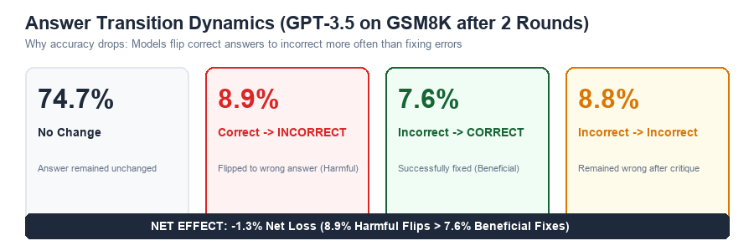
4. RESULTS
Answer Transition Dynamics
Error Persistence: Why accuracy drops — net negative answer flipping (Figure 1)
THE ROOT CAUSE OF PERFORMANCE DEGRADATION
Models flip correct answers into incorrect ones (8.9%) more frequently than they fix incorrect answers (7.6%). The self-correction prompt acts as a negative bias, inducing unwarranted self-doubt on sound reasoning.
Large Language Models Cannot Self-Correct Reasoning Yet | ICLR 2024
15/24
Notes:
Presenter 4: Mahid. Analyze Figure 1 from the paper. Explain that 74.7% of answers stay unchanged, but among the answers that do change, more correct answers get corrupted (8.9%) than wrong answers get fixed (7.6%), resulting in a net negative score.

Slide 16
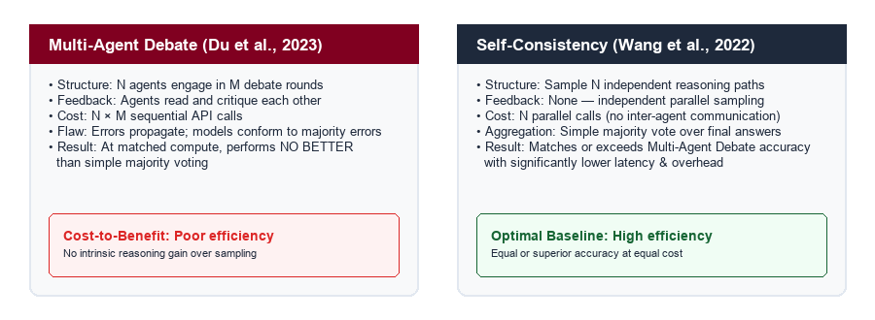
5. ANALYSIS
Multi-Agent Debate vs. Self-Consistency
Why Does Self-Correction Fail?: Equal-compute comparison with simple majority voting (Table 7)
EMPIRICAL FINDING AT EQUAL INFERENCE COST
When controlling for inference cost (number of generated responses), Multi-Agent Debate achieves NO statistically significant advantage over Self-Consistency (majority voting across N parallel samples), while introducing significant latency and complexity.
Large Language Models Cannot Self-Correct Reasoning Yet | ICLR 2024
16/24
Notes:
Presenter 5: Jebon. Compare Multi-Agent Debate against Self-Consistency. Explain that prior claims of debate superiority were flawed because they compared multi-agent debate against single-shot baselines rather than compute-equivalent sampling.

Slide 17
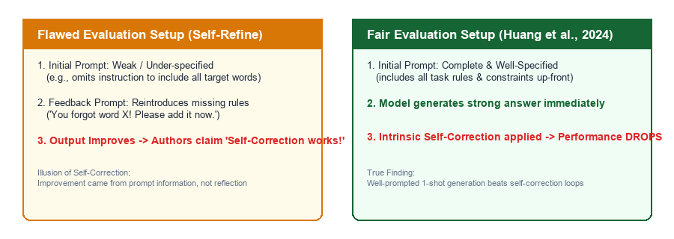
5. ANALYSIS
The Prompt Design Trap
Possible Causes: Misleading evaluation gains caused by asymmetric prompt information
CASE IN POINT: CONSTRAINED GENERATION (TABLE 8)
Self-Refine evaluated on CommonGen using an initial prompt that omitted target word constraints, then re-added them in the feedback prompt. When all constraints are included in the initial prompt, 1-shot generation beats the self-correction loop.
Large Language Models Cannot Self-Correct Reasoning Yet | ICLR 2024
17/24
Notes:
Presenter 5: Jebon. Explain the prompt engineering confounder in Self-Refine. Show how weak initial prompts artificially create headroom that gets credited to 'self-correction' when it was simply better prompting.

Slide 18
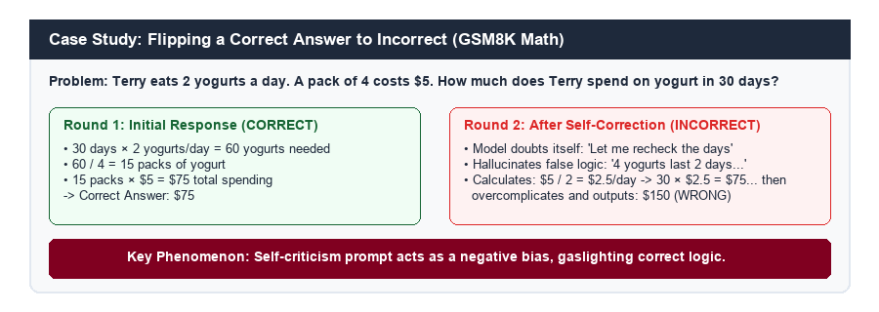
5. ANALYSIS
Case Study: The Gaslighting Effect
Error Persistence: Concrete breakdown of how self-critique corrupts sound reasoning (Figure 4)
PSYCHOLOGY OF LLM SELF-DOUBT
When prompted 'Review your answer and find problems', the model assumes the user knows the prior response was wrong. It hallucinated an erroneous edge case (4 yogurts for 2 days) and replaced its correct $75 calculation with $150.
Large Language Models Cannot Self-Correct Reasoning Yet | ICLR 2024
18/24
Notes:
Presenter 5: Jebon. Walk the audience through the real example from GSM8K. Explain step-by-step how the model solved the problem perfectly in Round 1, but overcomplicated and hallucinated a wrong answer in Round 2.

Slide 19
5. ANALYSIS
The Verification Barrier
Underlying Mechanism: Why intrinsic verification is as hard as initial generation
1
2
3
Shared Parameter Bounds
Negative Prompt Bias
Lack of Grounded Verifiers
Knowledge Parity
Compliance Bias
No Grounding
The critic and generator share the exact same weights and representations. If the model lacks the knowledge to generate the correct step initially, it lacks the knowledge to verify that step.
Instruction-tuned LLMs are optimized to follow user instructions. Prompts asking 'find errors' bias the model toward modifying answers even when the original derivation was completely correct.
Without an external ground-truth oracle, deterministic code interpreter (e.g. Python), or reward model, the model cannot distinguish genuine logical errors from valid steps.
Large Language Models Cannot Self-Correct Reasoning Yet | ICLR 2024
19/24
Notes:
Presenter 5: Jebon. Synthesize the theoretical barriers. Explain that generation and verification are fundamentally bounded by the same model capacity, making unguided self-verification inherently unstable.

Slide 20
6. CONCLUSION & FUTURE WORK
Key Takeaways
Summary: Core conclusions established by Huang et al. (ICLR 2024)
1
Intrinsic Self-Correction Does Not Work for Reasoning
Without external feedback, LLMs cannot reliably identify and correct their reasoning errors. Performance consistently degrades across benchmarks and model families.
2
Prior Claims Were Methodological Artifacts
Reported gains in earlier studies were driven by oracle label leakage (telling the model when to stop), unfair compute baselines, or incomplete initial prompts.
3
External Feedback is Essential for Reliable Correction
Self-correction is highly effective when paired with external grounding signals, such as code execution environments, calculators, unit tests, or human verifiers.
Large Language Models Cannot Self-Correct Reasoning Yet | ICLR 2024
20/24
Notes:
Presenter 6: Refayet. Summarize the paper's three main conclusions. Emphasize that while unguided intrinsic correction fails, external-feedback correction remains a vital tool for AI engineering.

Slide 21
6. CONCLUSION & FUTURE WORK
Study Limitations
Scope & Boundaries: Contextualizing the empirical boundaries of this research
Scope Limitations
Methodological Boundaries
Reasoning-Specific Scope
HotpotQA Sample Size
Focuses exclusively on reasoning benchmarks (math, logic, multi-hop QA). Does not evaluate stylistic writing, translation, or text summarization.
HotpotQA closed-book evaluation was restricted to 100 samples due to API cost constraints, limiting statistical power on multi-hop QA.
Prompt-Only Paradigm
Prompt Variation Sensitivity
Examines frozen, off-the-shelf LLMs via prompting. Does not evaluate fine-tuned verifier models or RL-trained self-correction agents.
While multiple feedback prompt templates were tested, the space of all possible prompt variations cannot be exhaustively evaluated.
Temporal Model Snapshot
Closed-Book Assumptions
Evaluated on models available in mid-to-late 2023 (GPT-3.5, GPT-4, Llama-2). Newer reasoning-focused models (e.g. OpenAI o1/o3, Gemini 2.0 Flash Thinking) warrant future study.
Models operated without retrieval augmentation (RAG), which could provide factual grounding for knowledge verification.
Large Language Models Cannot Self-Correct Reasoning Yet | ICLR 2024
21/24
Notes:
Presenter 6: Refayet. Review study limitations. Discuss reasoning domain scope, prompt-only constraints, and the distinction between frozen LLM prompting and newer RL-based test-time compute reasoning.

Slide 22
6. CONCLUSION & FUTURE WORK
Future Directions & Fair Standards
Future Work: Constructive pathways forward and recommendations for fair evaluation
Tool-Augmented Verification
Deterministic Execution
Learned Verifiers & Reward Models
Specialized Discriminators
Integrate deterministic Python interpreters, symbolic math solvers, and SQL execution engines to verify calculations externally.
Train separate specialized discriminator models (e.g. Process Reward Models / PRMs) to evaluate step-by-step reasoning quality.
Training-Time Self-Correction
RL & Search
Fair Evaluation Standards
Research Best Practices
Train models via Reinforcement Learning with search (e.g. Monte Carlo Tree Search, test-time compute) rather than superficial prompt loops.
Mandate equal inference-cost baselines (Self-Consistency), prohibit oracle leakage, and ensure baseline prompts include all constraints.
Large Language Models Cannot Self-Correct Reasoning Yet | ICLR 2024
22/24
Notes:
Presenter 6: Refayet. Present constructive future directions. Emphasize tool augmentation (code sandboxes), trained PRM verifiers, and the authors' proposed standards for evaluating future self-correction claims.

Slide 23
REFERENCES
References
Academic literature and baseline studies cited in this presentation (IEEE Format)
[1]
J. Huang, X. Chen, S. Mishra, H. S. Zheng, A. W. Yu, X. Song, and D. Zhou, "Large Language Models Cannot Self-Correct Reasoning Yet," in Proc. International Conference on Learning Representations (ICLR), 2024.
[2]
G. Kim, P. Baldi, and S. McAleer, "Language Models Can Solve Computer Tasks," in Advances in Neural Information Processing Systems (NeurIPS), vol. 36, 2023.
[3]
N. Shinn, F. Cassano, A. Gopinath, K. Narasimhan, and S. Yao, "Reflexion: Language Agents with Verbal Reinforcement Learning," in Advances in Neural Information Processing Systems (NeurIPS), vol. 36, 2023.
[4]
A. Madaan, N. Tandon, P. Gupta, et al., "Self-Refine: Iterative Refinement with Self-Feedback," in Advances in Neural Information Processing Systems (NeurIPS), vol. 36, 2023.
[5]
Y. Du, S. Li, A. Torralba, J. B. Tenenbaum, and I. Mordatch, "Improving Factuality and Reasoning in Language Models through Multiagent Debate," arXiv preprint arXiv:2305.14325, 2023.
[6]
X. Wang, J. Wei, D. Schuurmans, et al., "Self-Consistency Improves Chain of Thought Reasoning in Language Models," in Proc. International Conference on Learning Representations (ICLR), 2023.
[7]
K. Cobbe, V. Kosaraju, M. Bavarian, et al., "Training Verifiers to Solve Math Word Problems," arXiv preprint arXiv:2110.14168, 2021.
Large Language Models Cannot Self-Correct Reasoning Yet | ICLR 2024
23/24
Notes:
References: Complete IEEE numbered bibliography of all cited foundational and comparative papers.

Slide 24
THANK YOU & QUESTIONS
Thank You & Questions
Discussion, Q&A, and Group Acknowledgments
Open Questions for Discussion
Group Presenters & Sections
1. Do newer reasoning models with test-time compute (e.g. OpenAI o1/o3, Gemini 2.0 Flash Thinking) overcome this verification barrier?
Nafis Islam Kabbo (2303180)
1. Introduction
Srijon (2303179)
2. Background & Related Work
2. How can we best integrate lightweight deterministic verifiers (e.g. Python REPL) into general AI agent architectures?
Anindo (2303181)
3. Methodology
Mahid (2303127)
4. Results
3. Is true intrinsic self-correction theoretically possible without external ground truth?
Jebon (2303160)
5. Analysis
We invite questions and comments from the audience.
Refayet (2303148)
6. Conclusion & Future Work
Large Language Models Cannot Self-Correct Reasoning Yet | ICLR 2024
24/24
Notes:
Conclude the presentation. Thank the professor and audience, invite questions, and initiate discussion on the open questions.

