Slide 1
House Price Prediction
By: Md. Nafiul Islam

Slide 2
Contents
Introduction
Objectives
Workflow
Exploratory Data Analysis
Data Cleaning and Preprocessing
Modeling
Performance Analysis
Findings
Recommendation
Conclusion

Slide 3
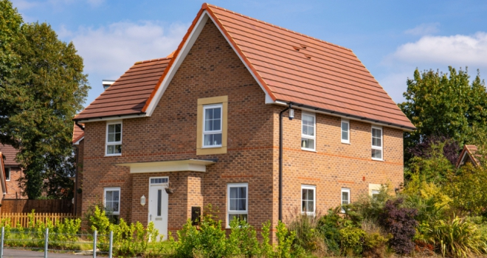
Introduction
Connected to or constructed on land
Any improvement in relation to the land that
rises or lowers the house price
Ownership and usage rights
Residential, Commercial, Industrial, Raw Land,
and Special use

Slide 4
Introduction (Cont.)
Challenges:
No control over the market
Stressful to both buyer and seller
Setting the price
Confliction of unrealistic home buyers
Tackles:
Automated system
Investigating the most useful features
AI and Machine learning

Slide 5
Objectives
Identifying the essential features influencing the cost of a house using Exploratory Data Analysis
Understanding the aspects affecting the cluster model for houses and estimate house prices based on the attributes

Slide 6
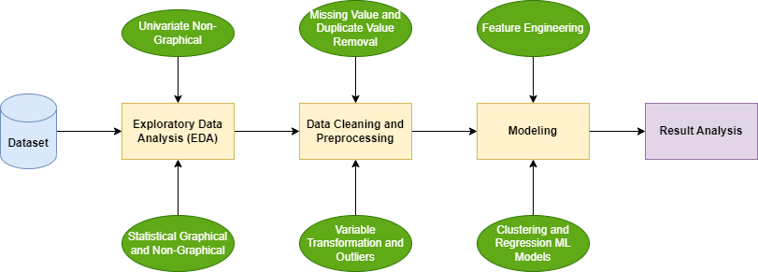
Workflow
Dataset
Collected from the kaggle
3,320 instances with 9 attributes
Attributes are: area type, location, society type, availability, room counts, bathrooms, balconies, total square size and price

Slide 7
Exploratory Data Analysis
Univariate Non-Graphical
Unique value analysis for each columns
Skewness of data
Statistical Graphical and Non-Graphical
Univariate analysis
Bivariate analysis

Slide 8
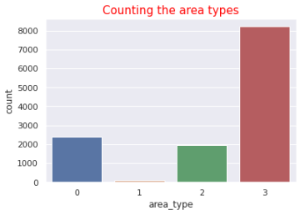
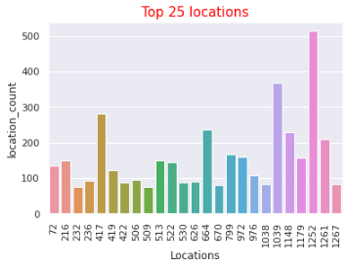
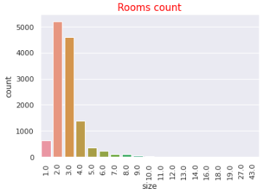
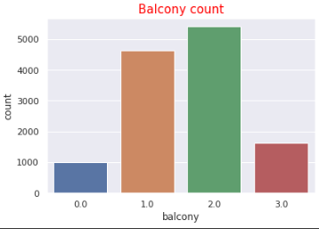
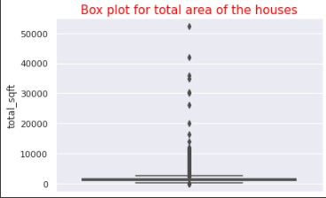
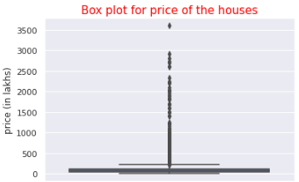
Exploratory Data Analysis (Cont.)
Univariate Analysis

Slide 9
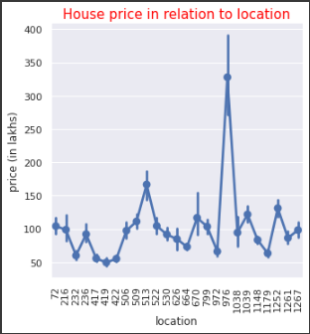
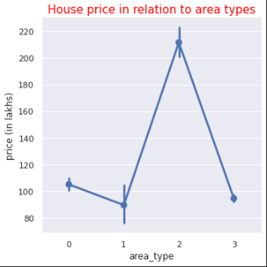
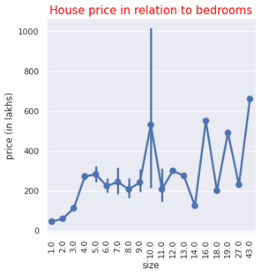
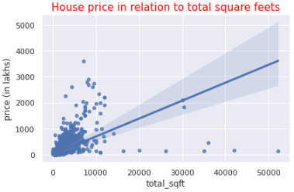
Exploratory Data Analysis (Cont.)
Bivariate Analysis

Slide 10
Data Cleaning and Preprocessing
Handling the missing data
Duplicate data removal
Data transformation
Outlier detection and handling the outliers

Slide 11
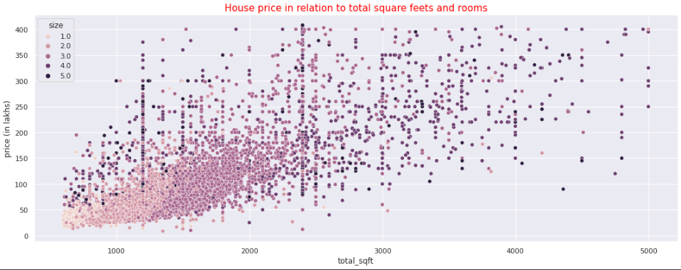
Data Cleaning and Preprocessing (Cont.)
After Data Cleaning

Slide 12
Modeling
Clustering
Regression models of machine learning

Slide 13
Modeling (Cont.)
Clustering
Silhouette analysis and sum of squared distance to find the optimal clusters
Elbow plot
K-means clustering algorithm
Sklearn module
Own function
Hierarchical clustering
Dendrogram

Slide 14
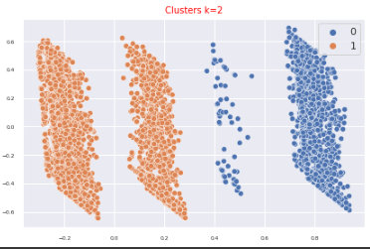
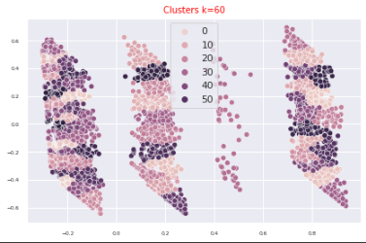
Modeling (Cont.)
With 2 clusters
With 60 clusters

Slide 15
Modeling (Cont.)
Regression Models
Checking multicollinearity
Heat map
Variation Inflation Factor
Creating final features
ML regression models
15 regression models
Linear models
Ensemble models
Hyper-parameter tuning

Slide 16
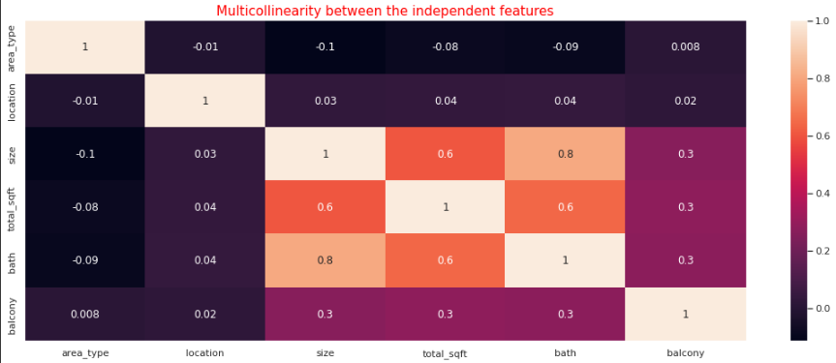
Modeling (Cont.)
Heat map

Slide 17
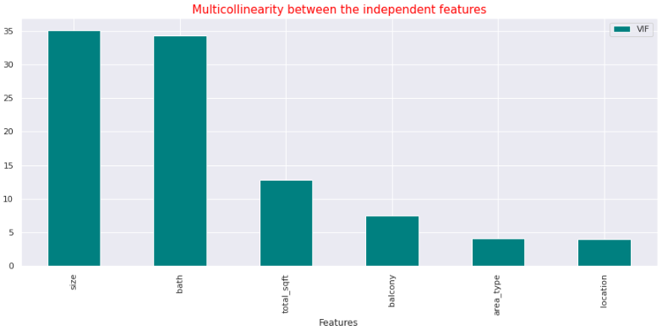
Modeling (Cont.)
Variation Inflation Factor
Final features are:
Size, Total square size,
Number of balconies,
Area type and location

Slide 18
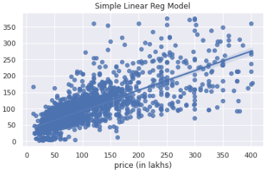
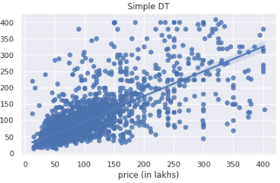
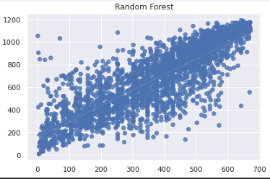
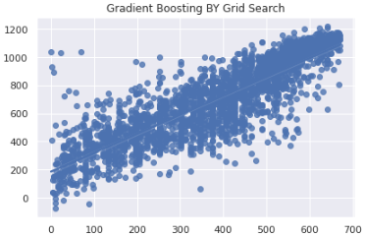
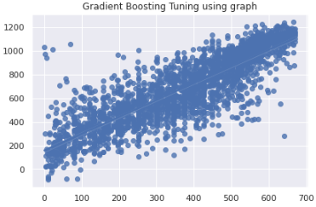
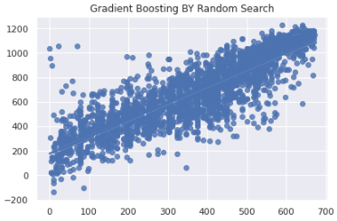
Modeling (Cont.)
Relationship between true and predicted value for unseen data for some model

Slide 19
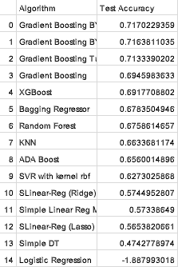
Performance Analysis
Gradient Boosting with Random
Search gives best performance
Logistic Regression gives the
worst performance

Slide 20
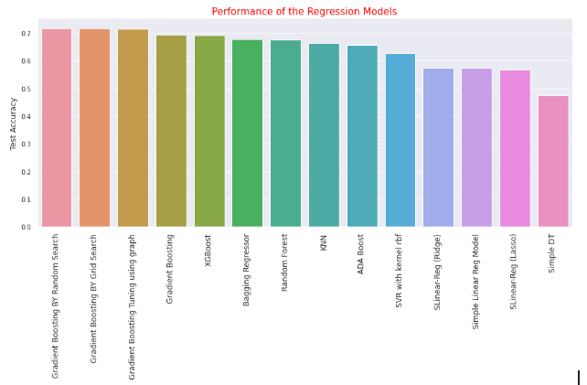
Performance Analysis (Cont.)
Performance comparison excluding the Logistic Regression as it gives (-ve) accuracy value

Slide 21
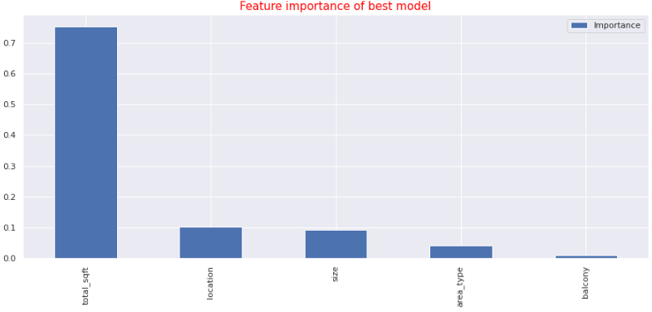
Performance Analysis (Cont.)
Feature importance of the best model

Slide 22
Findings
Clustering
The silhouette approach generates two clusters, but the sum of squared method generates thirty to sixty or more clusters. However, the silhouette method is more efficient
Hard to find the optimal clusters. With the 60 clusters all the clusters almost same in kind

Slide 23
Findings (Cont.)
Machine Learning Regression Models
Simple ml models like linear regression, KNN, SVR, decision tree performed poor but ensemble models performed better
Gradient boosting algorithm is performed well by performing the hyper parameter tuning using randomized search cv

Slide 24
Recommendation
Clustering
DBSCAN, TSNE methods could be better
RICA or SFT to apply unsupervised feature learning to input data
Agglomerative clustering method can improve the performance

Slide 25
Recommendation (Cont.)
Machine Learning Regression Models
Hyper parameter tuning of neural networks or simple linear models can improve the performance
Can be model how two or model independent factors combined to interact with the house price
Polynomial regressions could be used to improve the performance

Slide 26
Conclusion
A rigorous process of data analysis to clean and ready the data
Tried to create the clusters carefully
No multicollinearity
10-fold cross validation used for the regression models
Simple linear to advanced ensemble method are performed to estimate the cost of the house

