Slide 1

NIKE
Inspiring Athletes Worldwide.

Slide 2
Founded: 1964 (as Blue Ribbon Sports), renamed Nike in 1971.
Founders: Bill Bowerman and Phil Knight.
Headquarters: Beaverton, Oregon, USA.
Mission: "To bring inspiration and innovation to every athlete* in the world

Slide 3
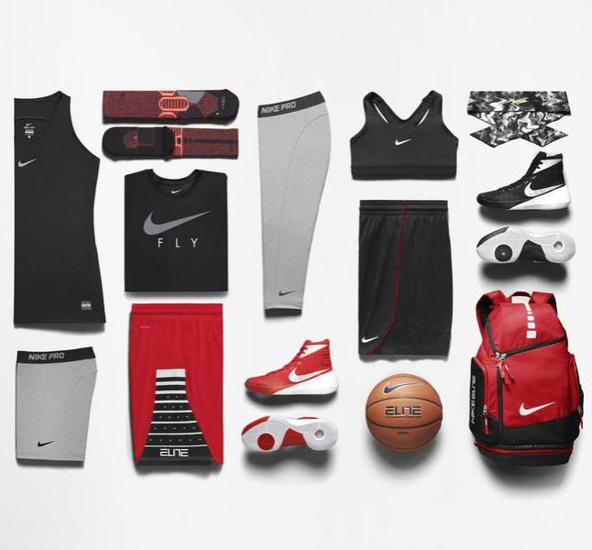
Products and Services

Slide 4
Market Presence
Global Reach: Operates in over 170 countries.
Revenue (2023): Approximately $46 billion.
Target Audience: Athletes, fitness enthusiasts, and casual wear consumers.
Competitors: Adidas, Puma, Under Armour, etc.

Slide 5
Social Responsibility
Sustainability Initiatives:
Move to Zero campaign: Zero carbon, zero waste.
Use of recycled materials in products.
Community Engagement:
Nike Community Impact Fund.
Partnerships with schools and communities for sports development.

Slide 6
Achievements and Future Goals
Achievements:
Sponsors of global athletes like Cristiano Ronaldo, Serena Williams, and LeBron James.
Creator of the Air Jordan brand, a cultural icon.
Ranked consistently among the world’s most valuable brands.
Future Goals:
Expand eco-friendly product lines.
Broaden digital innovation (e.g., Nike Training Club app).
Strengthen global market share, especially in emerging markets.

