Slide 1
Digital Portfolio
STUDENT NAME : J.NAFIZAA
REGISTER NO AND NMID : 24131040500122019 AND BE9448DE240CE8CB84545597486BF27E
DEPARTMENT : BCA( Bachelor Of Computer Application )
COLLEGE : JAWAHAR .SCIENCE .COLLEGE / ANNA MALAI UNIVERSITY

Slide 2

PROJECT TITLE
DIGITAL PORTFOLIO

Slide 3
AGENTA
Problem Statement
Project Overview
End Users
Tools And Technologies
Portfolio Design And Layout
Features And Functionality
Results And Screenshots
Conclusion
Github Link

Slide 4
PROBLEM STATEMENT
In Today’s Digital era , Traditional Techniques alone are not enough to show there skills and other Activities .Many students or participate in many online presentation to highlight their Skills and Work

Slide 5
PROJECT OVERVIEW
Portfolio Contain About me , Projects , Skills , Contact
It contain About My details , My Skills and Project Work .If Any Queries There is My Contact Details .You can also Contact Me
Main idea : Showcase Personal Achievements , Skills , and Project Details

Slide 6
WHO ARE THE END USERS
STUDENTS (Academic Project ,Resumes)
JOB SEEKERS(To Share With Recruiters)
PROFESSIONAL(To Highlight Experience and Achievements)
FREELANCERS(To Show Clients)
AND SO ON …….

Slide 7
POTFOLIO DESIGN AND LAYOUT
SECTION
HOME
PROJECT
SKILLS
CONTACT
MOBILE / DESKTOP TABLET
DETAILED EXPLANATION

Slide 8
TOOLS AND TECHNIQUES
HTML →Structure(pages , section)
CSS →Styling(Colors , Layouts)
JAVASCRIPT →Interactivity(Navigation menu , Form Validation and Animination)
Mention Code Editor(VS Code) and Hosting Platform ( GitHub Pages )

Slide 9

FEATURES AND FUNCTIONALITY
Navigation BAR with smooth scrolling
Image Details / Hyperlink
Interactive Elements – Animations, Hover effect , Background
Color Change
Contract Form Validation
Responsive Design for Different Devices

Slide 10
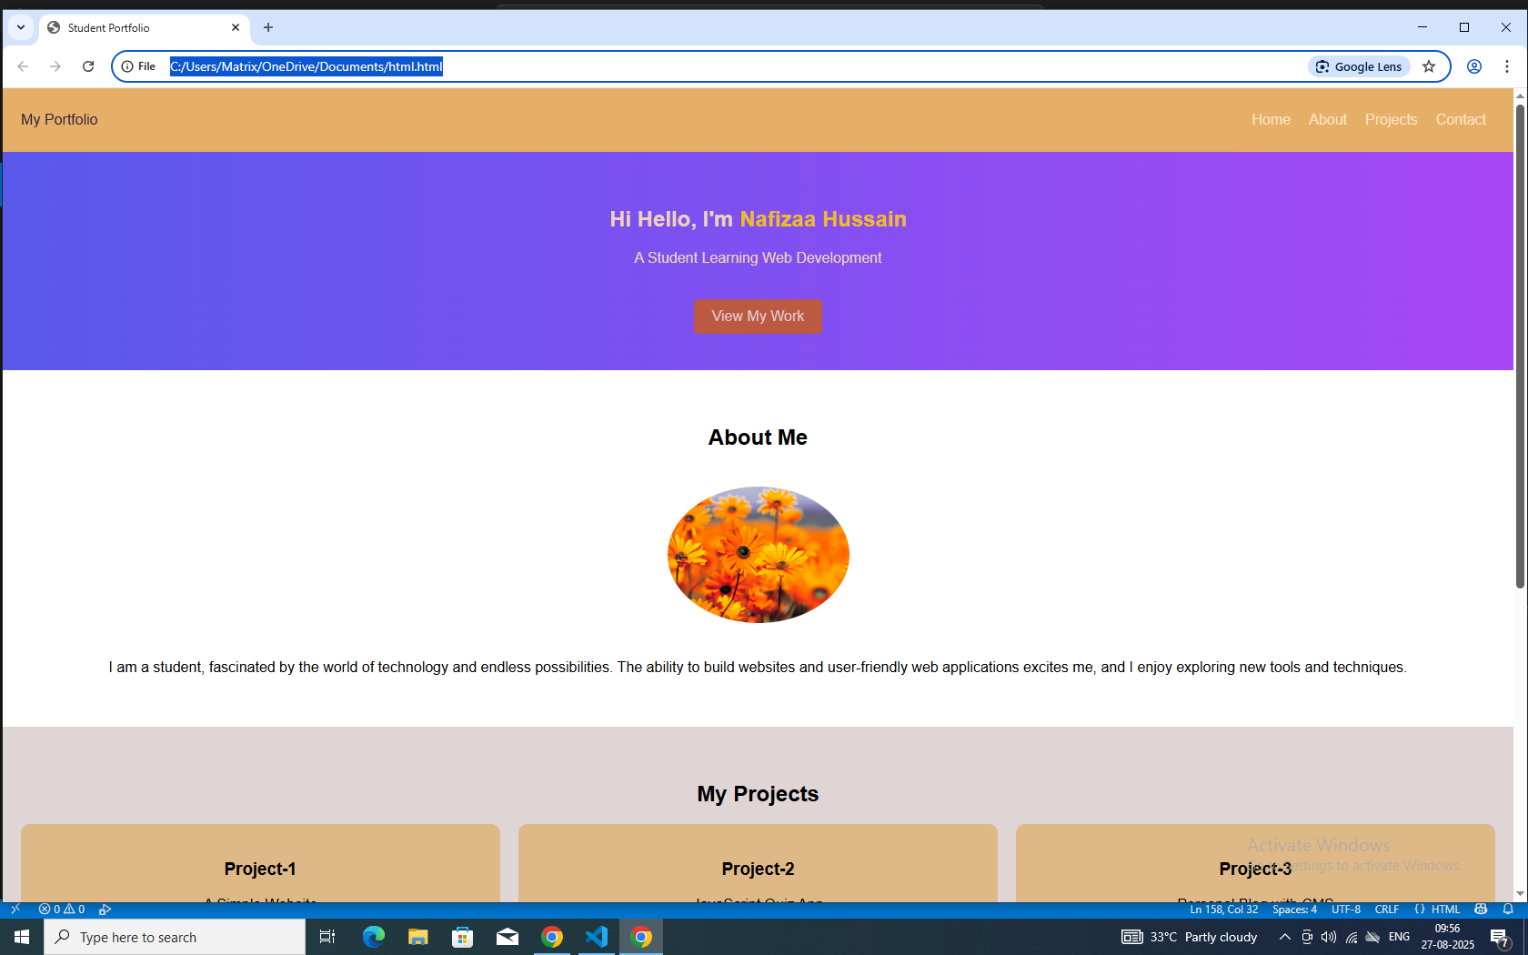
Results and screenshots

