Slide 1


BREAST CANCER DIAGNOSIS PREDICTION
Presented To
DR. IFTIKHAR AHMED
Presented By
NAFEESATH PARAPPURATH PUTHIYAPURAYIL (64729663)
LOLITA ANCILLA MIRANDA (94172214)
PS-24 MACHINE LEARNING DS (B)
SUMMER 2024

Slide 2
AGENDA
INTRODUCTION
PROBLEM STATEMENT
DATASET
DATA ISSUES AND PREPROCESSING
MODEL TRAINING AND MODEL EVALUATION
RESULT
FUTURE SCOPE

Slide 3
INTRODUCTION
Breast cancer is a common and deadly disease among women globally.
Early detection is crucial for improving survival rates and treatments outcomes.
There are two types of tumor – Benign Tumors, Malignant Tumors
A benign tumor does not spread to other parts of the body, while a malignant tumor can spread and invade other tissues and organs.
This is a classification problem.

Slide 4

PROBLEM STATEMENT
“Develop a machine learning model using python to accurately classify breast masses as benign (non-cancerous) or malignant (cancerous) using various clinical measurements.”

Slide 5
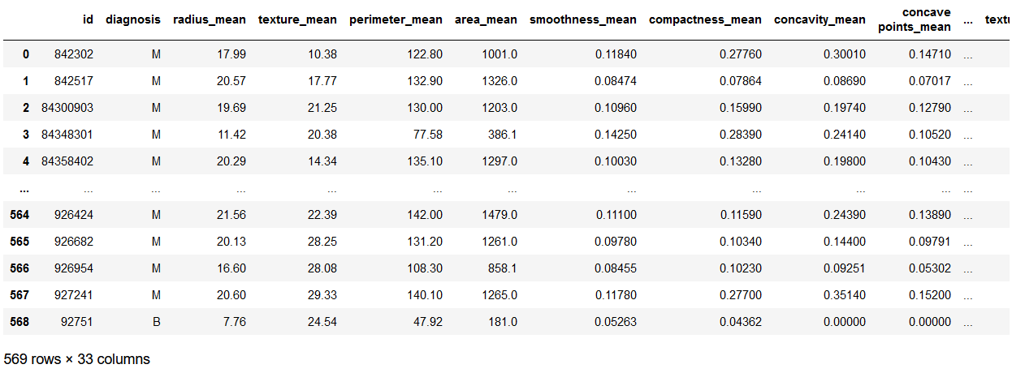
DATASET
Used dataset from Kaggle - “Breast cancer Wisconsin (Diagnostic) Dataset”. (https://www.kaggle.com/datasets/uciml/breast-cancer-wisconsin-data)
This data is from the ‘Fine Needle Aspiration Test’, a type of biopsy procedure to make a diagnosis such as cancer.
This dataset contains 569 rows and 33 columns.
Features: Radius, texture, perimeter, area, smoothness, compactness, concavity, concave points, symmetry, and fractal dimension. The mean, standard error, and worst features were computed for each image, resulting in 33 columns.
Target: Diagnosis (M= Malignant, B= Benign)

Slide 6
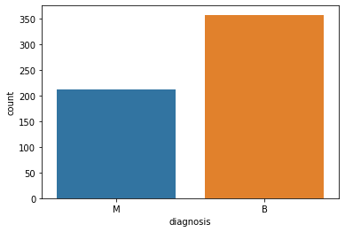
DATA ISSUES AND PREPROCESSING
Issues:
Missing values: None, except one column ‘Unnamed:32’.
Checked Imbalances.
Preprocessing:
Dropped ‘Unnamed: 32’ column.
Used ‘describe()’ function to get an overview of the statistical properties of the data.
Plot the count of diagnosis categories, 357 Benign (B), 212 Malignant (M).
Converted diagnosis labels to numerical values (B= 0, M= 1) using LabelEncoder.
Standardized features to a range of -1 to 1 using StandardScaler.

Slide 7
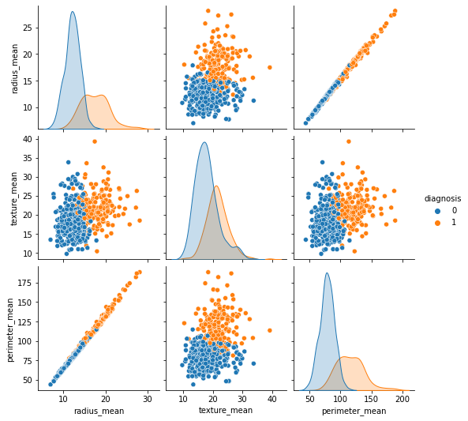
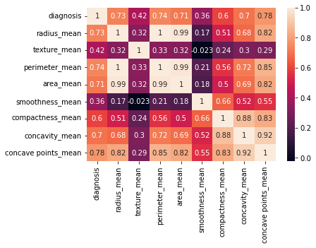
Fig.1 shows Pairplot, which used to analyze which algorithm will be best fit for this dataset.
Fig.2 shows the relationship between the input features (clinical measurements)and target variable (diagnosis), where positive correlation is noted.
Fig.1
Fig.2

Slide 8
MODEL TRAINING AND EVALUATION
Model Training:
Split the dataset into training (80%) and testing (20%) sets.
The training set is used to train the ML model.
The testing set is used to evaluate the model’s performance.
Model Evaluation:
Logistic Regression is preferred due to high accuracy and suitability for binary classification.
Logistic Regression - 98%

Slide 9
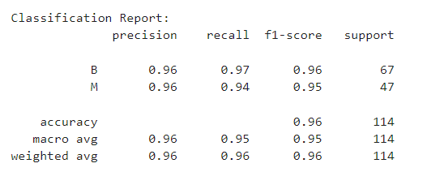
RESULT
The classification report shows that our model performs exceptionally well, with high precision, recall, and F1 scores, ensuring reliable and balanced predictions
The overall accuracy of 95% reflects the models effectiveness in distinguishing between benign and malignant tumors.
Successfully built a predictive model, where the model demonstrates high accuracy and reliability in predicting breast cancer, making it a valuable tool for medical diagnosis.

Slide 10
FUTURE SCOPE
Explore advanced models and techniques like Random Forest or Neural Networks, and validate the model on external datasets to ensure robustness and generalizability.
Develop mobile applications for accessible remote monitoring and initial assessments, and create visualization tools to help doctors and patients understand prediction results.
Integrate the model with Electronic Health Records (EHR) for real-time cancer risk assessments and enhance decision support systems for oncologists.
Conduct further research on feature importance and its implications.

Slide 11

THANK YOU

