Slide 1

Design Example: Binary Multiplier
ECE 2372 | Modern Digital System Design | Texas Tech University

Slide 2
Lecture Overview
Design Specification
Shift-Register
Adder
Control Circuit
System Integration

Slide 3

Design Specification
Binary Multiplier | Modern Digital System Design

Slide 4
Design Specification
Design a sequential circuit capable of performing multiplication on 4-bit binary numbers to get an 8-bit product.
Multiplication involves successive addition and shifting operations.

Slide 5
Design Specification
Multiplicand
1101
1011
(13)
Multiplier
(11)

Slide 6
Design Specification
Multiplicand
1101
1011
00001101
(13)
Multiplier
(11)
Shift Left 0-bits

Slide 7
Design Specification
Multiplicand
1101
1011
00001101
00011010
(13)
Multiplier
(11)
Shift Left 0-bits
Shift Left 1-bit

Slide 8
Design Specification
Multiplicand
1101
1011
00001101
00011010
00100111
(13)
Multiplier
(11)
Shift Left 0-bits
Shift Left 1-bit
Add

Slide 9
Design Specification
Multiplicand
1101
1011
00001101
00011010
00100111
00000000
(13)
Multiplier
(11)
Shift Left 0-bits
Shift Left 1-bit
Add
Zeros

Slide 10
Design Specification
Multiplicand
1101
1011
00001101
00011010
00100111
00000000
00100111
(13)
Multiplier
(11)
Shift Left 0-bits
Shift Left 1-bit
Add
Zeros
Add

Slide 11
Design Specification
Multiplicand
1101
1011
00001101
00011010
00100111
00000000
00100111
01101000
(13)
Multiplier
(11)
Shift Left 0-bits
Shift Left 1-bit
Add
Zeros
Add
Shift Left 3-bit

Slide 12
Design Specification
Multiplicand
1101
1011
00001101
00011010
00100111
00000000
00100111
01101000
10001111
(13)
Multiplier
(11)
Shift Left 0-bits
Shift Left 1-bit
Add
Zeros
Add
Shift Left 3-bit
(143)
Add

Slide 13
Design Specification
We’ll need to design 5 components
A 4-bit shift register to hold the multiplier
A 5-bit shift register to hold the multiplicand
The product will come from the multiplier register and the least 4-bits of the multiplicand register.
4-bit binary adder
Good old-fashioned ripple-carry adder.
Control Circuit

Slide 14
Design Specification
Product
Control
LD
LD
LD
SH
SH
SH
SI
AD
>
SO
SI
>
>
Multiplier
(B)
Binary
Adder
Done
ST
Multiplicand
(A)
M

Slide 15

What questions do you have?

Slide 16
Shift Registers
Binary Multiplier | Modern Digital System Design

Slide 17
Shift Registers
For the two shift registers, we’ll implement the same PIPO registers that we’ve used previously.

Slide 18
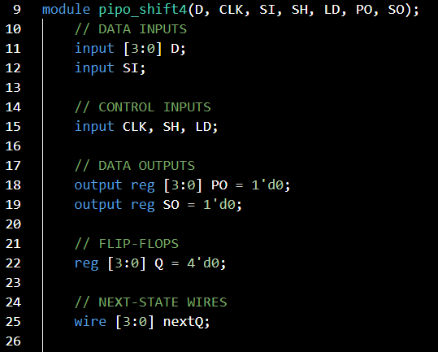
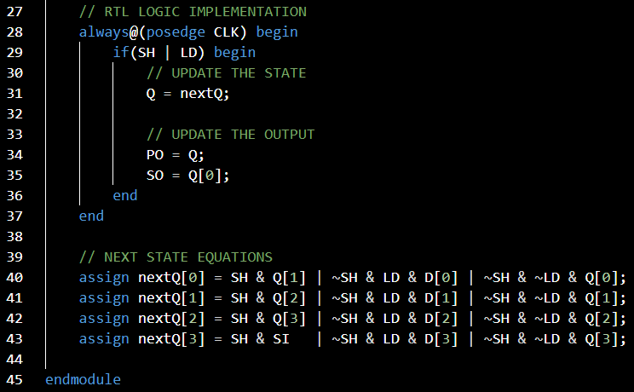

Slide 19
What questions do you have?

Slide 20
Binary Adder
Binary Multiplier | Modern Digital System Design

Slide 21
Binary Adder
For the binary adder, we’ll simply implement a 4-bit ripple-carry adder.

Slide 22
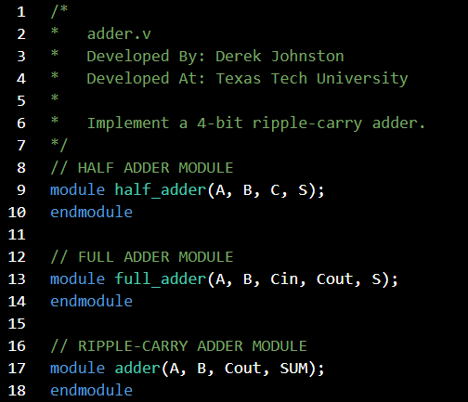

Slide 23
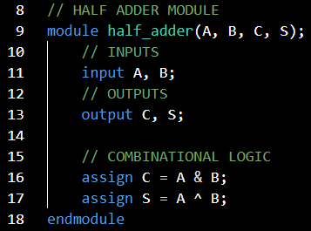
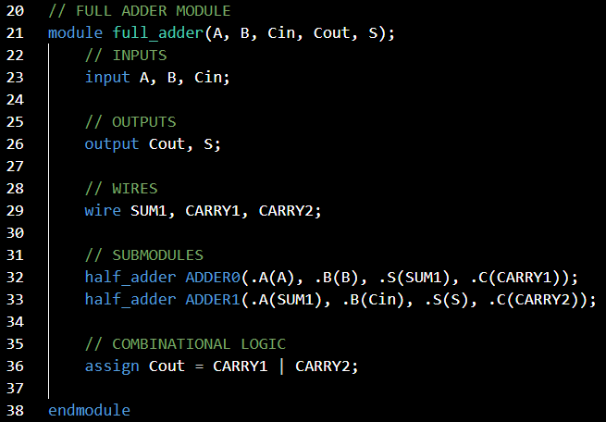

Slide 24
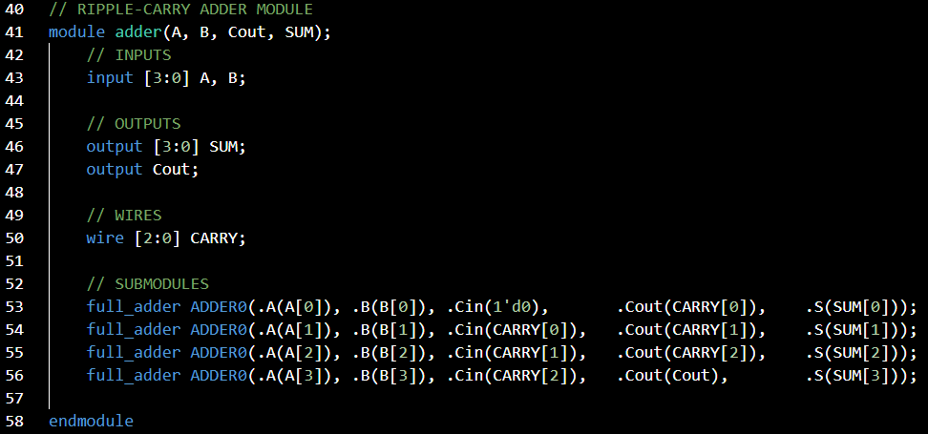

Slide 25
What questions do you have?

Slide 26
Control Circuit
Binary Multiplier | Modern Digital System Design

Slide 27
Control Circuit
ST
SH
LD
M
CONTROLLER
AD
>
EN
DONE
BINARY COUNTER
>

Slide 28
Control Circuit: Counter
We need to count that a shift has occurred 4 times.
We’ll implement a synchronous binary counter.

Slide 29
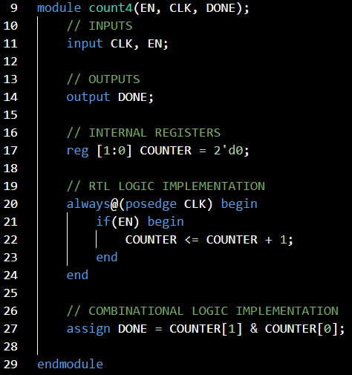
Control Circuit: Counter
Notes:
Notice that the DONE signal is just an AND of both state bits.

Slide 30
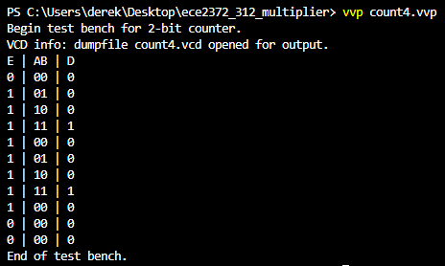
Control Circuit: Counter
Notes:
Notice that the DONE signal is just an AND of both state bits.

Slide 31
Control Circuit
The controller circuit will need to manage the behavior of the shift registers to ensure that the multiplication algorithm is followed.

Slide 32




ST, M, D/EN, LD, AD, SH
$$S_{1}$$
LOAD
$$S_{0}$$
$$S_{2}$$
REST
ADD
$$S_{3}$$
SHIFT

Slide 33
ST, M, D/EN, LD, AD, SH
$$S_{1}$$
LOAD
0XX/0000
$$S_{0}$$
$$S_{2}$$
REST
ADD
$$S_{3}$$
SHIFT

Slide 34
ST, M, D/EN, LD, AD, SH
$$S_{1}$$
1XX/0100
LOAD
0XX/0000
$$S_{0}$$
$$S_{2}$$
REST
ADD
$$S_{3}$$
SHIFT

Slide 35
ST, M, D/EN, LD, AD, SH
$$S_{1}$$
1XX/0010
LOAD
0XX/0000
$$S_{0}$$
X0X/1001
$$S_{2}$$
REST
ADD
$$S_{3}$$
SHIFT

Slide 36
ST, M, D/EN, LD, AD, SH
$$S_{1}$$
1XX/0010
X1X/0010
LOAD
0XX/0000
$$S_{0}$$
X0X/1001
$$S_{2}$$
REST
ADD
$$S_{3}$$
SHIFT

Slide 37
ST, M, D/EN, LD, AD, SH
$$S_{1}$$
1XX/0010
X1X/0010
LOAD
0XX/0000
$$S_{0}$$
X0X/1001
$$S_{2}$$
REST
ADD
XXX/1001
$$S_{3}$$
SHIFT

Slide 38
ST, M, D/EN, LD, AD, SH
$$S_{1}$$
1XX/0010
X1X/0010
LOAD
0XX/0000
$$S_{0}$$
X0X/1001
$$S_{2}$$
REST
ADD
XXX/1001
$$S_{3}$$
X00/1001
SHIFT

Slide 39
ST, M, D/EN, LD, AD, SH
$$S_{1}$$
1XX/0010
X1X/0010
LOAD
0XX/0000
$$S_{0}$$
X0X/1001
$$S_{2}$$
REST
X10/0010
ADD
XXX/1001
$$S_{3}$$
X00/1001
SHIFT

Slide 40
ST, M, D/EN, LD, AD, SH
$$S_{1}$$
1XX/0010
X1X/0010
LOAD
0XX/0000
$$S_{0}$$
X0X/1001
$$S_{2}$$
XX1/0000
REST
X10/0010
ADD
XXX/1001
$$S_{3}$$
X00/1001
SHIFT

Slide 41
Control Circuit
This circuit has 3 inputs and 4 states (2 Flip-Flops).
This means that our next-state and output equations will be Boolean functions of 5 variables.
We have two options:
Try and reduce the input space by 1
Utilize a different design pattern.

Slide 42
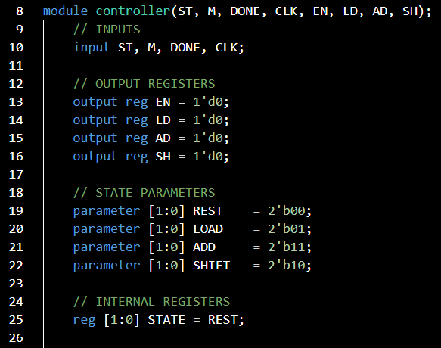

Slide 43
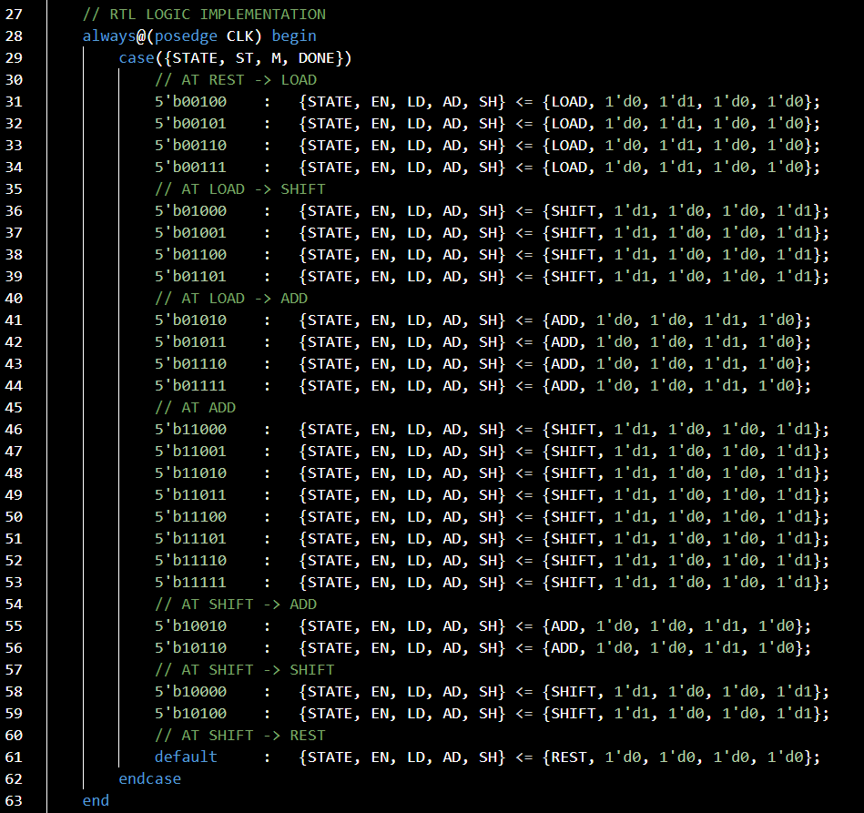
We can hard-code our state table using case syntax.
This is great for sequential circuits that are too large for our traditional design pattern.
However, we must hardcode each entry in the table.
We’d like to use some don’t cares.

Slide 44
ST, M, D/EN, LD, AD, SH
$$S_{1}$$
1XX/0010
X1X/0010
LOAD
0XX/0000
$$S_{0}$$
X0X/1001
$$S_{2}$$
XX1/0000
REST
X10/0010
ADD
XXX/1001
$$S_{3}$$
X00/1001
SHIFT

Slide 45
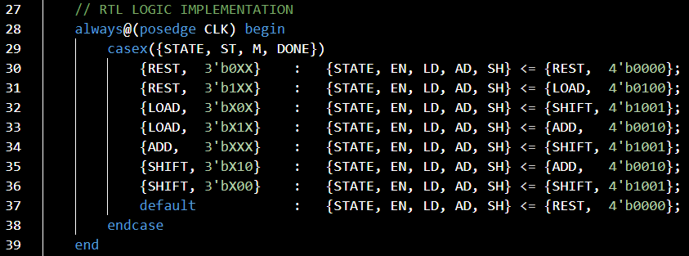

Slide 46
System Integration
Binary Multiplier | Modern Digital System Design

Slide 47
Design Specification
Product
Control
LD
LD
LD
SH
SH
SH
SI
AD
>
SO
SI
>
>
Multiplier
(B)
Binary
Adder
Done
ST
Multiplicand
(A)
M

Slide 48
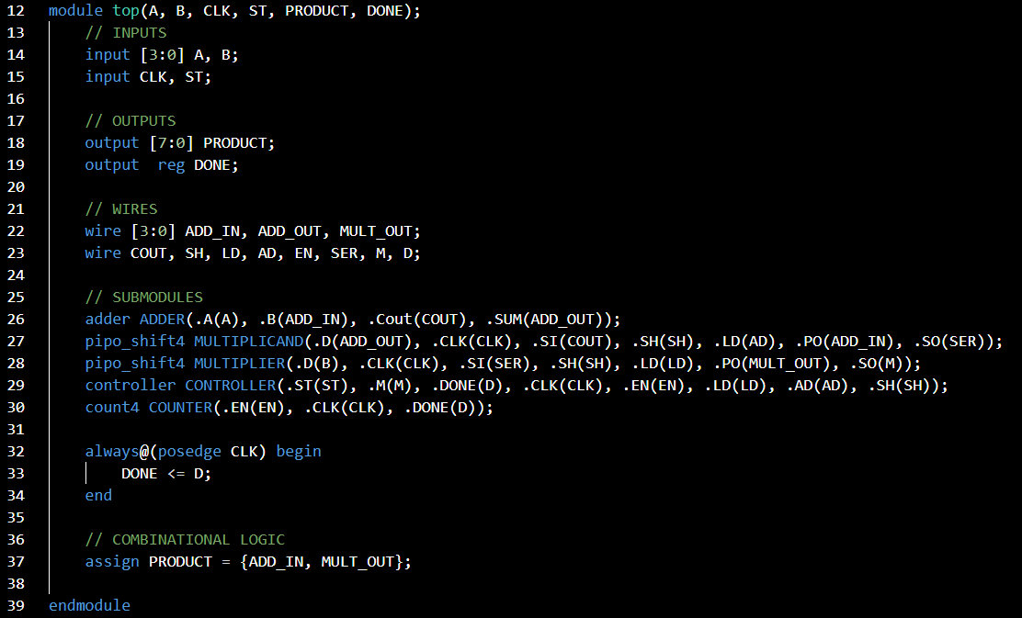

Slide 49
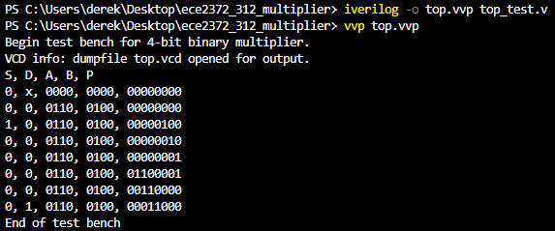

Slide 50
What questions do you have?

Slide 51
Lecture Recap
Design Specification
Shift-Register
Adder
Control Circuit
System Integration

Slide 52
What questions do you have?

Slide 53
Design Example: Binary Multiplier
ECE 2372 | Modern Digital System Design | Texas Tech University

