Slide 1
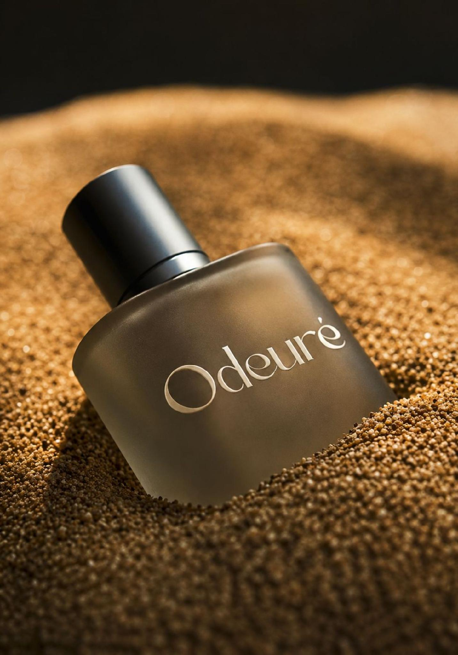
ODEURE
Luxury, Reimagined.

Slide 2
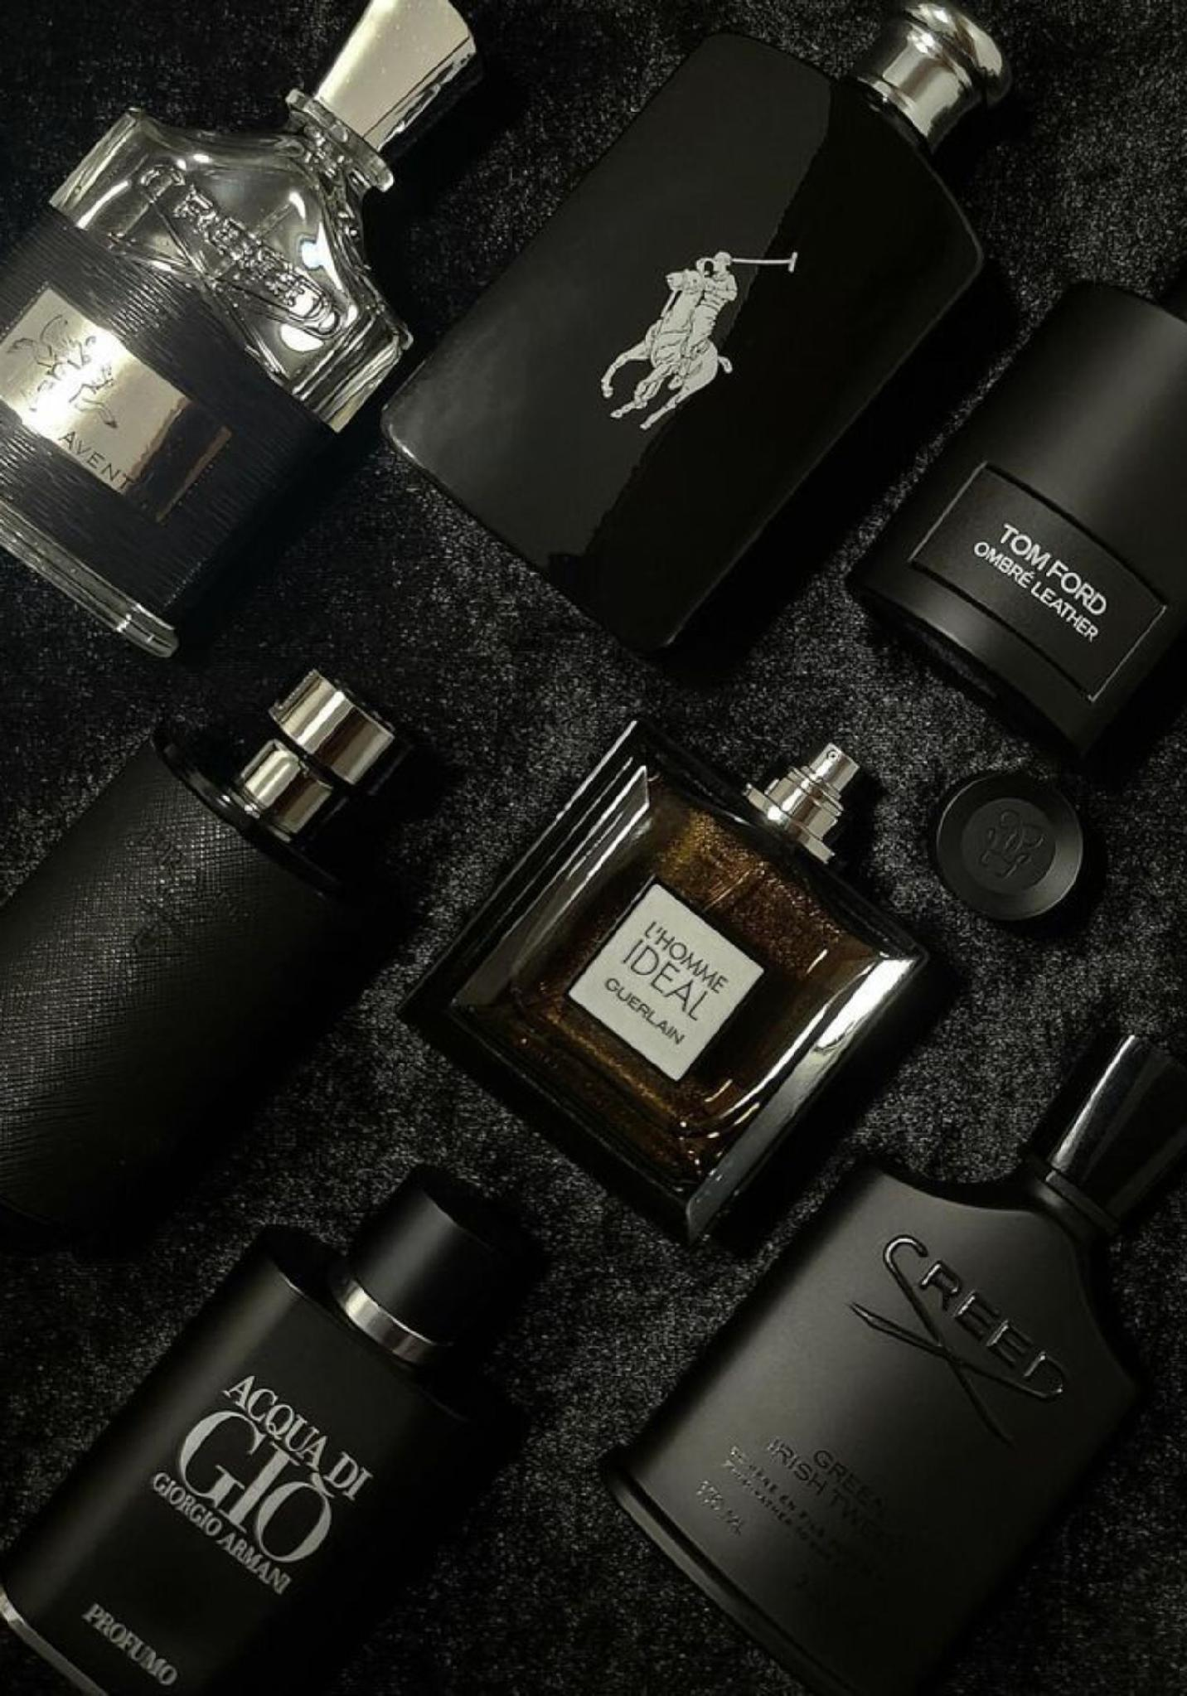
Would you spend a month's allowance on one bottle?
৳20K
৳35K
Entry Level
Mid Range
Tom Ford · Dior
Creed · Maison Francis Kurkdjian
৳45K
Premium
Niche designer houses

Slide 3
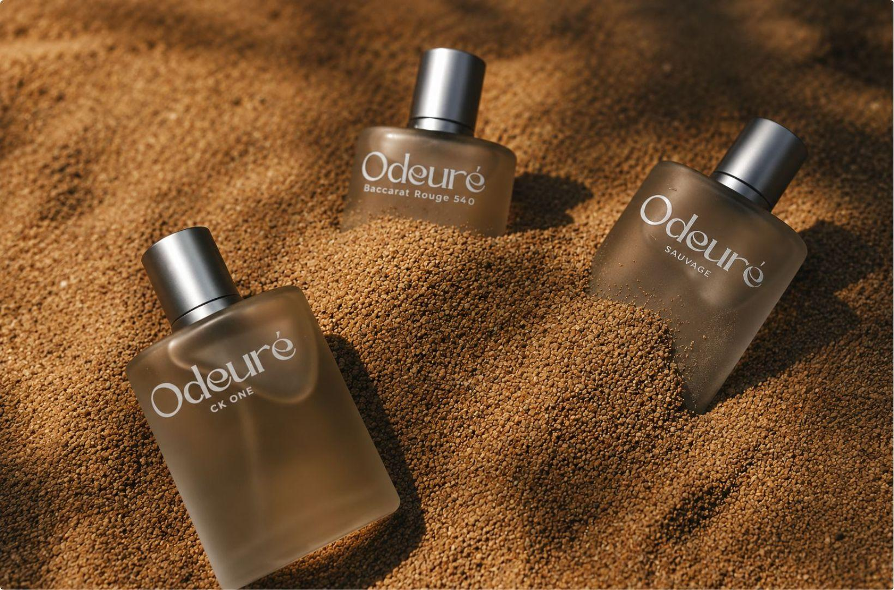
INTRODUCING
Meet Odeure.
A premium Bangladeshi fragrance house - inspired by the world's most iconic designer and niche perfumes. Crafted for those who refuse to compromise on quality, or budget.
30ml
50ml
100ml

Slide 4





Why Odeure?
Long-Lasting EDP
Premium Ingredients
Affordable Luxury
Eau de Parfum concentration for all-day wear.
Curated notes sourced for depth and richness.
Designer-level quality at a fraction of the cost.
Elegant Bottles
Proudly Bangladeshi
Sleek, premium packaging that feels as good as it smells.
Homegrown craftsmanship with global ambition.

Slide 5

THE COLLECTION
The Signature Collection
Four iconic scents, each one a confident tribute to the world's most celebrated fragrances.
Golden Veil
Velvet Noir
Inspired by CC Blonde Amber - deep, mysterious, unforgettable.
Inspired by Portrait of a Lady - fresh, confident, timeless.
Reflection Man
Babycat
Inspired by Amouage Reflection Man - radiant, warm, luxurious.
Inspired by YSL Babycat- bold, powerful, commanding.

Slide 6
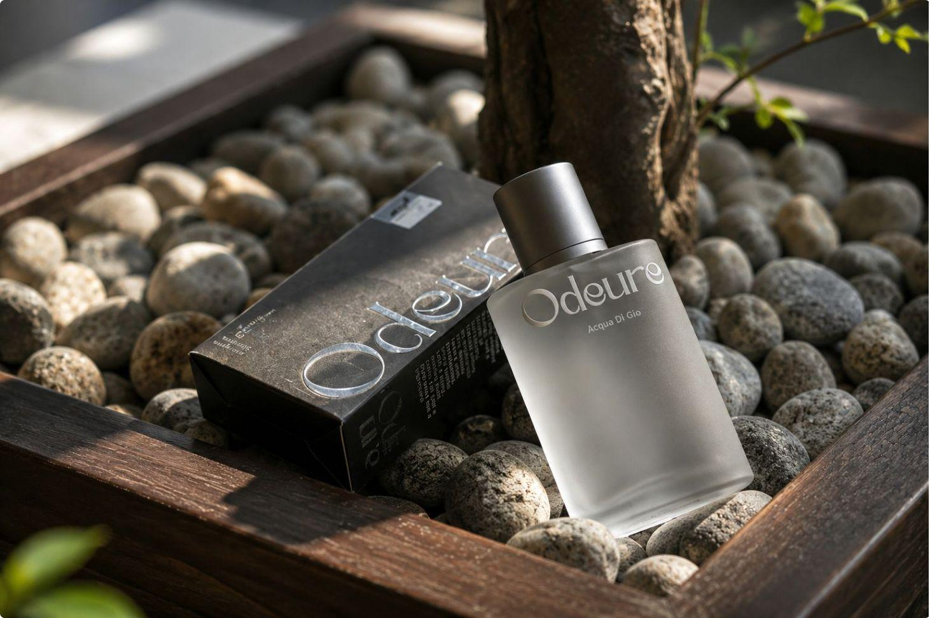

PERFORMANCE
Built to Last.
Odeure's Eau de Parfum formula is engineered for endurance — from your morning routine to your midnight exit.
EDP Concentration
Strong Projection
All-Day Wear
Higher oil content for richer, longer-lasting scent.
Leaves a trail without overpowering.
Designed to stay from sunrise to sunset.

Slide 7
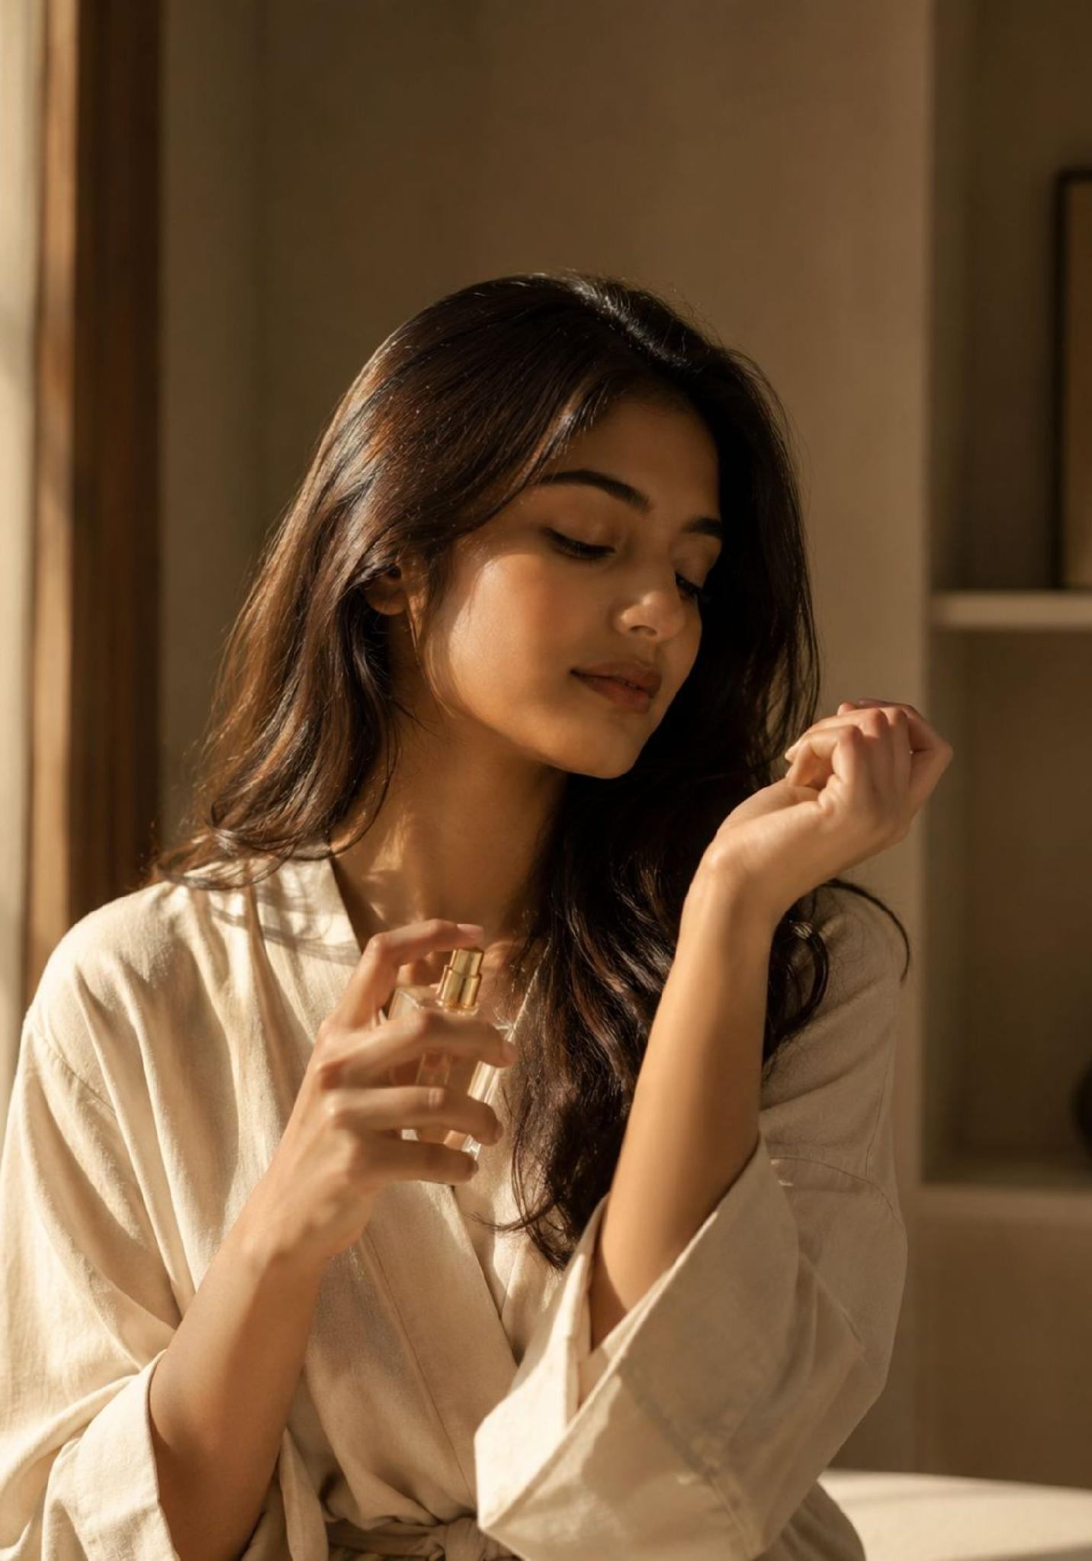


SOCIAL PROOF
Loved by Real People.
Real reviews. Real customers. Real Odeure.
"Noir smells exactly like my Tom Ford ,but at a price I can actually afford. I'm obsessed."
"Finally, a Bangladeshi brand that doesn't compromise on quality. Velvet is my new signature."
"Bought Ocean for my boyfriend. He gets compliments every single day. Worth every taka."

Slide 8
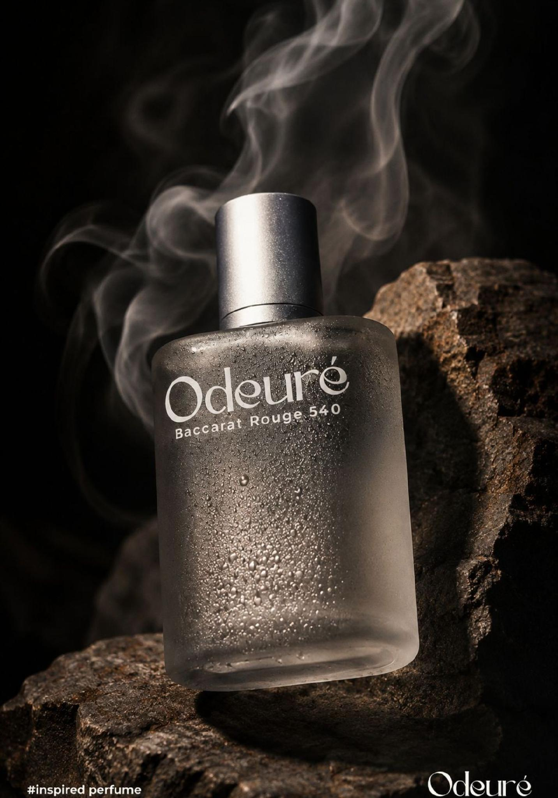
Experience Luxury Without Compromise.
Your scent is your signature. Wear it with confidence.
📲 Follow
🛒 Shop Now
@odeure.bd on Instagram & Facebook
Browse the full collection online
🎓 Students
Get 10% off with your student ID

Slide 9
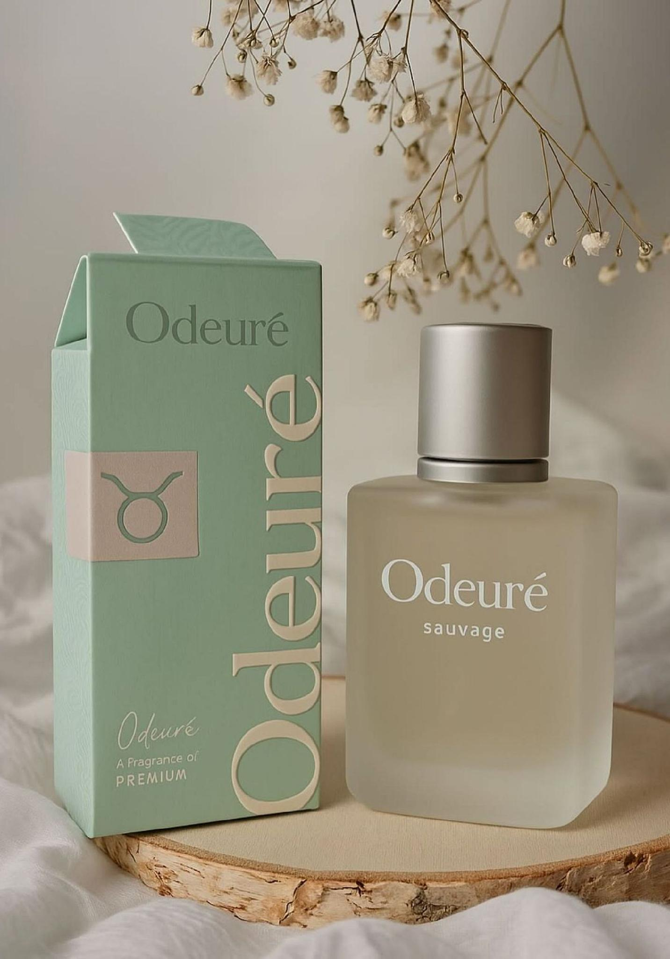
ODEURE
Questions? We'd love to hear from you.
Reach out to us and discover your perfect scent. Luxury is closer than you think.

