Slide 1
Satisfiability Modulo Finite Fields
The Certora Prover
Gereon Kremer
Certora // Stanford

Slide 2
Agenda
Formal Verification
Satisfiability Modulo Finite Fields
Finite Fields
Satisfiability Modulo Theories
SMT for Finite Fields
Certora Prover
Architecture
Specifications

Slide 3
Formal Verification

Slide 4
Why do you trust your code?
Good programmers
Reviews
It works for you
Unit tests
Fuzzing
White-box testing
White-box fuzzing
Prove it correct!

Slide 5







Formal Verification
Proof of Correctness
System
Violation / Bug
Specification
Select a suitable logical framework
Encode System and Specification to a formula
Decide / Solve that logical statement
Interpret results
A lot of math, work, sweat and tears
Sometimes slow
The only way to do it
Great results when it works

Slide 6
Satisfiability Modulo Finite Fields
Think: Verification of Zero-Knowledge-Proofs (ZoKrates, CirC, zkSNARKs, …)
“Satisfiability Modulo Finite Fields”, Ozdemir et.al., CAV’23

Slide 7
zkSNARK: Zero-Knowledge Succinct Non-Interactive ARgument of Knowledge
Zero-Knowledge: prove you know something without revealing anything
Succinct: only a few hundred bytes, verified in milliseconds
Non-interactive: only a single message
Applications:
Privacy of transaction info
Verify off-chain operations (zkRollups, heavy AMM logic, …)
Mitigate MEV attacks (by keeping info private)
Verifier technology:
Simple circuits over finite field elements
Solve circuit to find violations

Slide 8
Finite Fields
Field: a set with addition, multiplication and inverses You probably know ℂ, ℝ, ℚ, ℤ, but maybe also ℤ₇ = ℤ/7ℤ or ℚ(√2)
Finite Field: a field with finitely many elements 𝔽_{q} with q = p^{k}, p prime and k ≥ 1, unique (up to isomorphism)
k = 1: ℤ modulo a (big) prime
k ≥ 2: somewhat unintuitive construction (𝔽_{p}[x]/f(x), f irreducible of degree k) In particular: 𝔽_{q} ≠ ℤ_{q} and 𝔽_{2^64} ≠ uint64
We only care about 𝔽_{p} with p a big prime (≈ 256 bits)

Slide 9




Satisfiability Modulo Theories
∃x. φ(x)
SAT Solver
Theory Solvers

Slide 10




Satisfiability Modulo Finite Fields
SAT = Violated
f₁(X)=0
⁞
f_{n}(X)=0
1∉GB
Construct model
p^{k} possibilities
Surprisingly efficient
Gröbner Basis
Backtracking Search
1∈GB
1∈GB?
Main work horse of Computer Algebra
Doubly exponential yet efficient
Incomplete (except for ℂ)
UNSAT = Verified

Slide 11
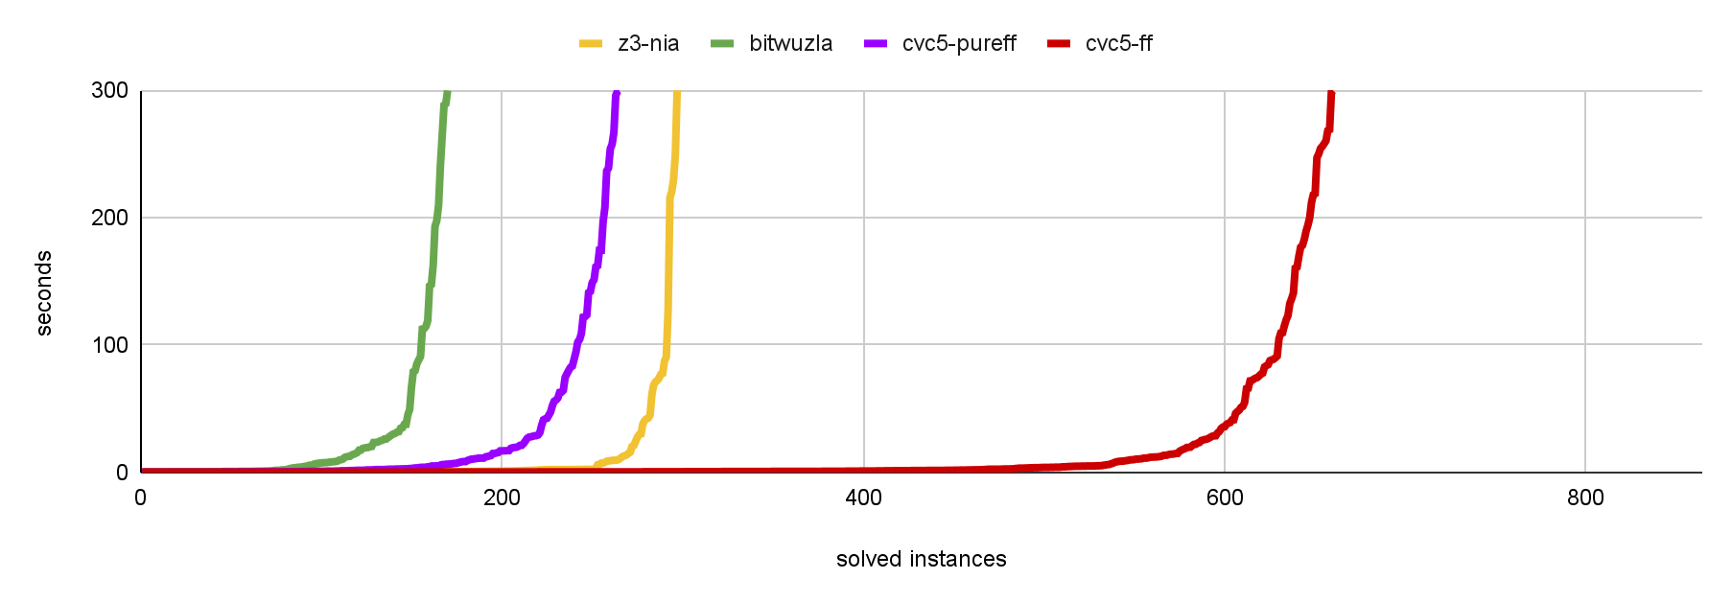

Alternative Encodings & Experiments
Three compilers (ZoKrates, ZoKCirC, CirC), two conditions (soundness, correctness)
Integers + %p z3-nia
BitVectors + %p bitwuzla
Computer Algebra cvc5-pureff
Finite Fields cvc5-ff
github.com/cvc5/cvc5

Slide 12

Certora Prover

Slide 13
Bird’s-eye view
Proof of all behaviors meeting the spec
.SOL
.SPEC
A behavior which violates the spec

Slide 14






Certora Prover Architecture
Standard Compiler Toolchain
Can support other EVM languages (Vyper)
Helps find compiler bugs!
.SOL
Compiler
.EVM Bytecode
Decompile
TAC
Static
analyzer
One operation per TAC instruction
Only a small number of instructions in TAC
Easier to analyze
Memory layout & segmentation
Pointer relations
Hooks & Summaries
Pruning & Inlining
…
Integrate Spec into TAC
Encode to Verification Condition
Solve with SMT solvers
Interpret results
SMT solver
Logical
Formula
VC Gen.
Static
analyzer
TAC
Counterexamples
.SPEC

Slide 15
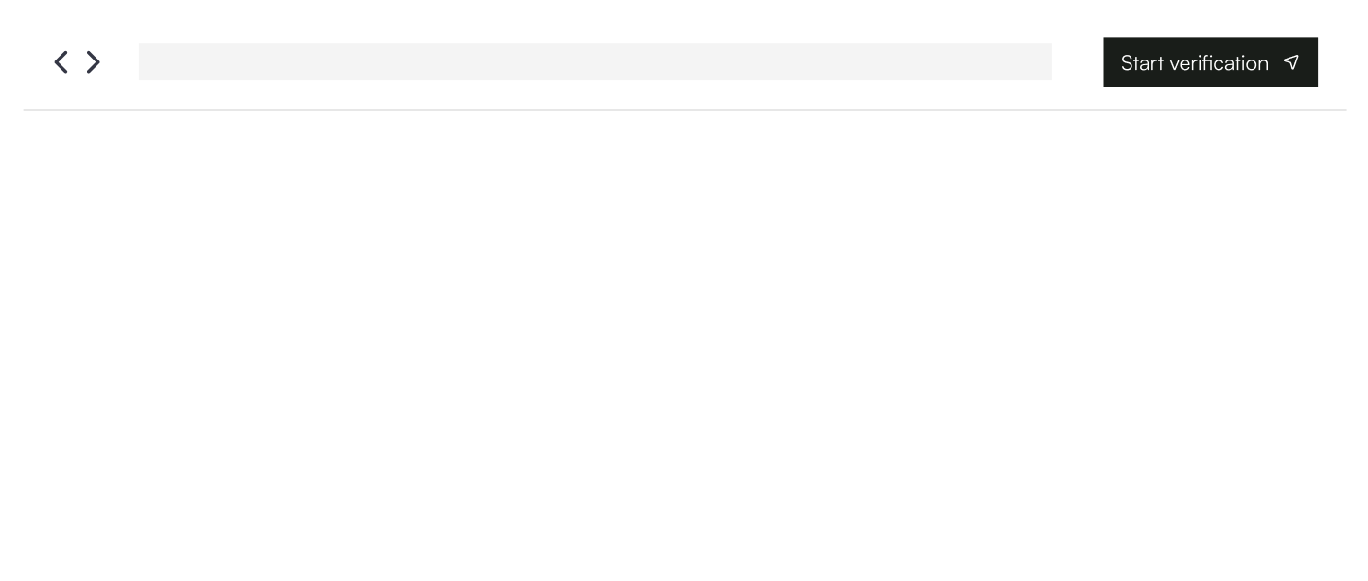
Example: SmallBank
SmallBank.sol
contract SmallBank {
mapping (address => uint256) private funds;
function getfunds(address account) public view returns (uint256) {
return funds[account];
}
function deposit(uint256 amount) public {
require(funds[msg.sender] + amount < 0x10000000000000000);
funds[msg.sender] += amount;
}
function transfer(address to, uint256 amount) public { … }
function withdraw(uint256 amount) public { … }
function withdraw_from(address from, uint256 amount) public { … }
}

Slide 16
SmallBank: is deposit ok?
SmallBank.sol
How do we know that deposit works?
contract SmallBank {
mapping (address => uint256) private funds;
function getfunds(address account) public view returns (uint256) {
return funds[account];
}
function deposit(uint256 amount) public {
require(funds[msg.sender] + amount < 0x10000000000000000);
funds[msg.sender] += amount;
}
function transfer(address to, uint256 amount) public { … }
function withdraw(uint256 amount) public { … }
function withdraw_from(address from, uint256 amount) public { … }
}
Check that depositing actually increases the funds as we would expect

Slide 17
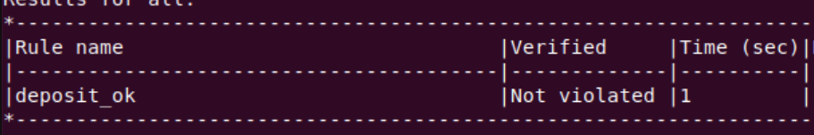
SmallBank: is deposit ok?
SmallBank-deposit.spec
rule deposit_ok(uint256 amount) {
env e;
uint256 before_deposit = getfunds(e.msg.sender);
deposit(e, amount);
uint256 after_deposit = getfunds(e.msg.sender);
assert(after_deposit == before_deposit + amount);
}

Slide 18
SmallBank: can others withdraw?
SmallBank.sol
contract SmallBank {
mapping (address => uint256) private funds;
function getfunds(address account) public view returns (uint256) {
return funds[account];
}
function deposit(uint256 amount) public {
require(funds[msg.sender] + amount < 0x10000000000000000);
funds[msg.sender] += amount;
}
function transfer(address to, uint256 amount) public { … }
function withdraw(uint256 amount) public { … }
function withdraw_from(address from, uint256 amount) public { … }
}
I’d expect that only I can withdraw from a bank…

Slide 19
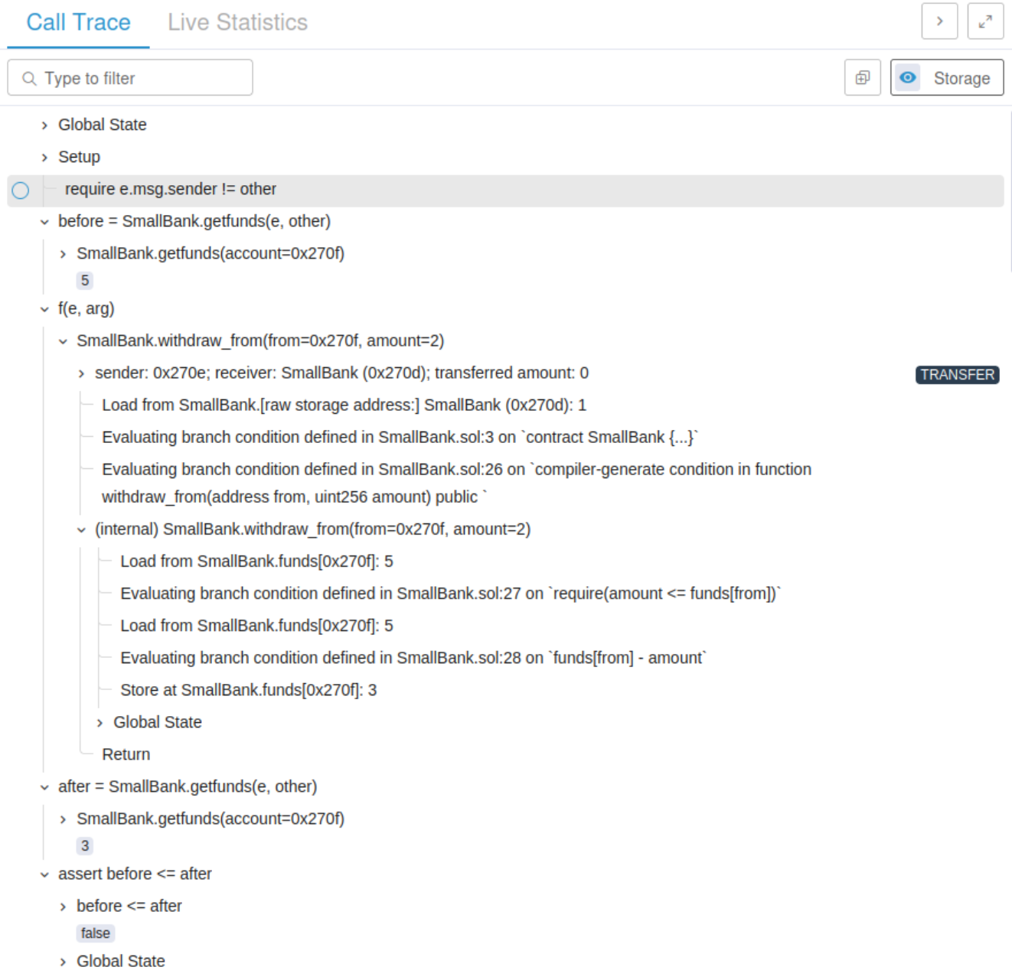
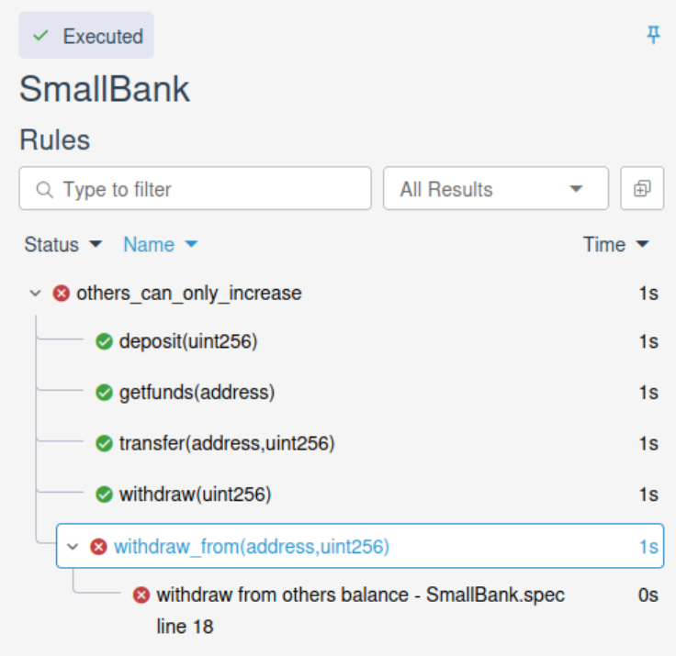
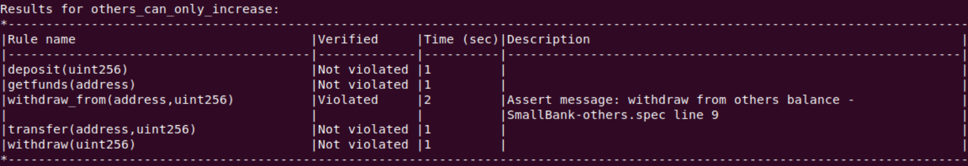
SmallBank: can others withdraw?
SmallBank-others.spec
rule others_can_only_increase(method f) {
env e;
address other;
require(e.msg.sender != other);
uint256 before = getfunds(e, other);
calldataarg arg;
f(e,arg);
uint256 after = getfunds(e, other);
assert(before <= after, "withdraw from others balance");
}

Slide 20
SmallBank: does it stay small?
SmallBank.sol
How do we know that the funds stay small?
contract SmallBank {
mapping (address => uint256) private funds;
function getfunds(address account) public view returns (uint256) {
return funds[account];
}
function deposit(uint256 amount) public {
require(funds[msg.sender] + amount < 0x10000000000000000);
funds[msg.sender] += amount;
}
function transfer(address to, uint256 amount) public { … }
function withdraw(uint256 amount) public { … }
function withdraw_from(address from, uint256 amount) public { … }
}
Check that funds never grow beyond 0x10000000000000000.

Slide 21
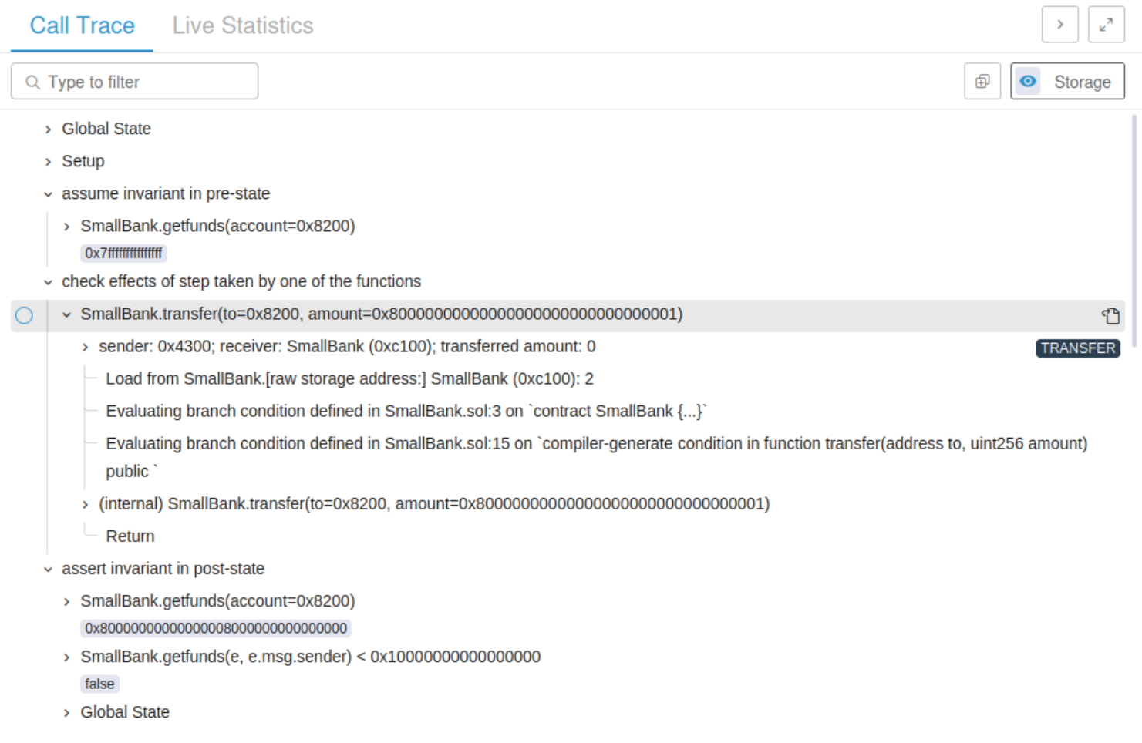
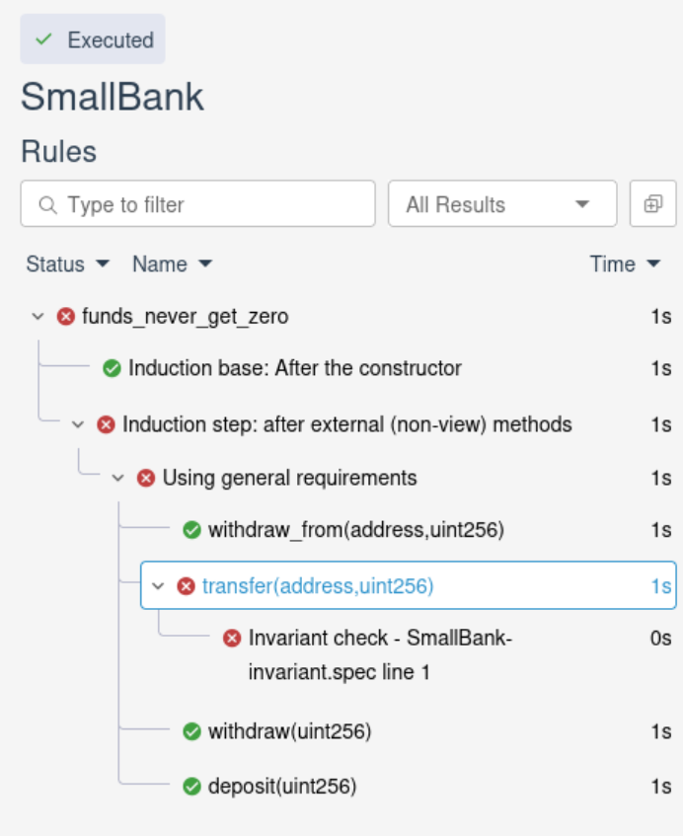
SmallBank: does it stay small?
SmallBank-invariant.spec
invariant funds_never_get_zero(env e)
getfunds(e, e.msg.sender) < 0x10000000000000000;

Slide 22

Thank You

