Slide 1

Python for Data Analysis
INNOMATICS RESEARCH LABS

Slide 2

About me
B-tech Graduate
I choose data science to build-up my career
Worked as E-commerce operations manage for 4years
I like the flexibility of Teaching with Innomatics
Nagamalleshwararao Ch

Slide 3
Agenda
History of Python
Why Python and its Applications
How Python is useful Data Science
Data Science Life Cycle
Business Problem
Scrape Data from internet using Python

Slide 4
HISTORY OF PYTHON
Python developed by Guido van Rossum in late 1980
Write some thing about python like
Why it is called general purpose language
Libraries in python
Application where python is used
Why python is used in Data Science
Add more like above

Slide 5
Project Title: Web Scraping on Flipkart Mobiles
Problem Statement:
Which Brand is offering better product at better price.

Slide 6
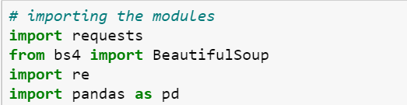
Data Extraction
Importing all the necessary modules for extracting data
Here we are using Beautiful Soup to extract data from Flipkart Website

Slide 7
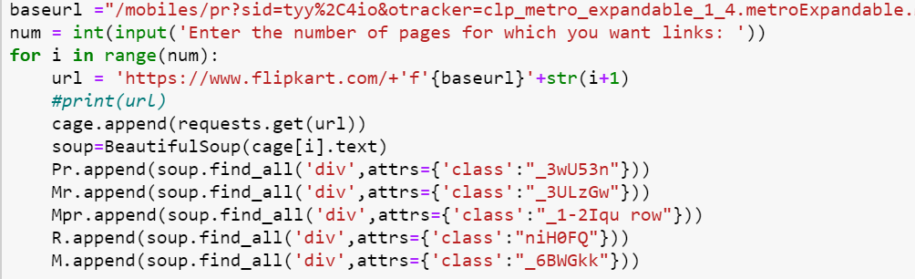
Data Extraction
- We are gathering the information of each page and dividing the classes and storing the information in to lists.
- Where each list of starting cell consisting of page1 information.
- 2 cell of list containing of page 2 information and 3 cell containing of page 3 information and so one.

Slide 8
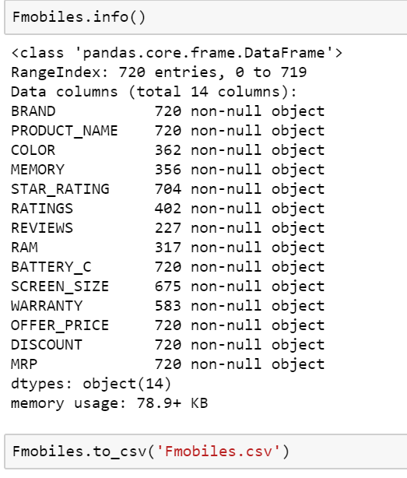
Data Extraction
We have extracted and imported around 14 Features and saved as .csv file

Slide 9
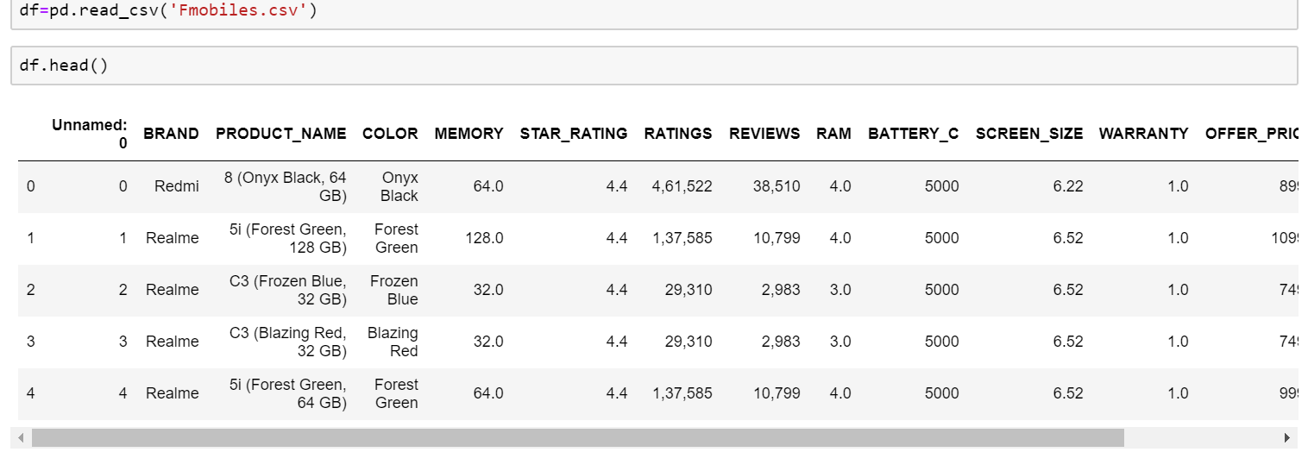
Data Cleaning
We are reading the saved .csv files and saving it in a df variable.

Slide 10
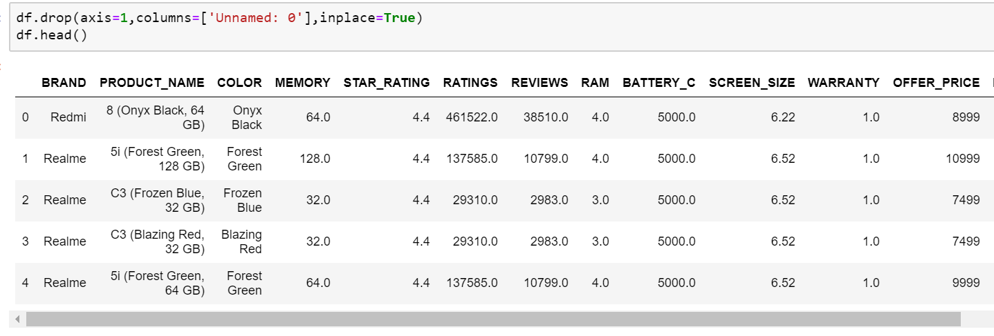
Data cleaning
- While import the CSV file we found that index column is added to data frame.
- We drop the unnamed column us drop() method.

Slide 11
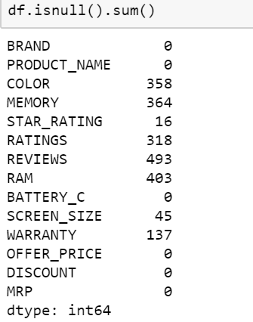
Data Cleaning
Checking for the total values which are missing in the dataframe column wise

Slide 12
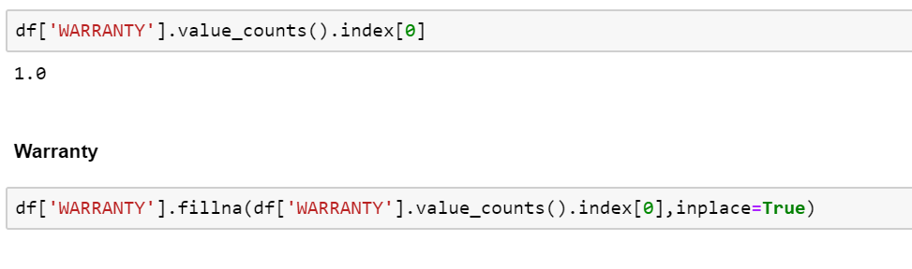
Data Cleaning
- Let's impute Warranty with the most frequently occurring value.
- Because warranty is containing less no. of missing values and max. mobiles are have min warranty so we are filling the data with the most frequently occurring value.

Slide 13
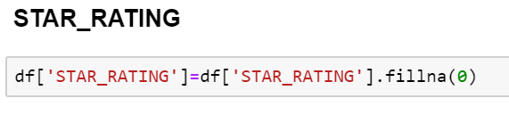
Data Cleaning
- Since some mobiles are not having star rating that means those were not rated yet.
- We can assume zero rating rather than deleting the column

Slide 14
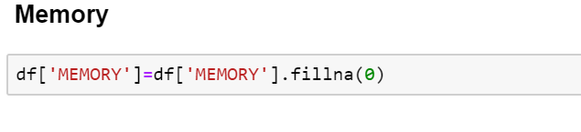
Data Cleaning
- We observe that some mobiles are not having Memory because for feature mobiles Memory will not present.
- We can assume zero as memory rather than deleting the column

Slide 15
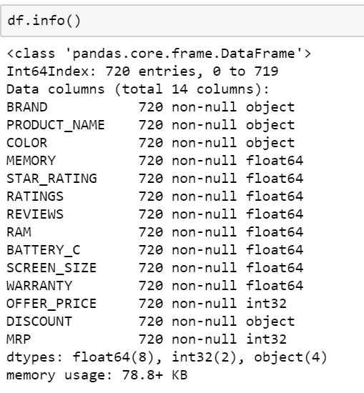
Data Cleaning
Found max data after cleaning and we are saving this in a .csv five which will be used in data Analysis

Slide 16
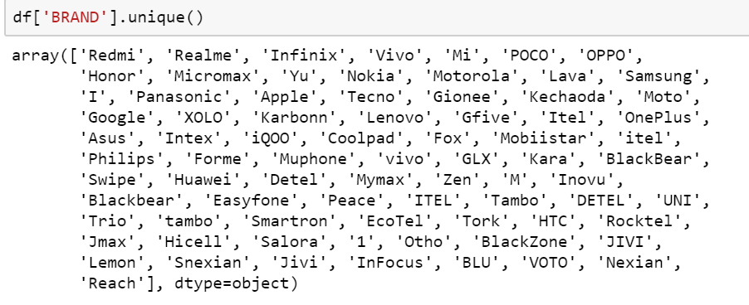
Data Analysis
We found these many brands from the collected data

Slide 17
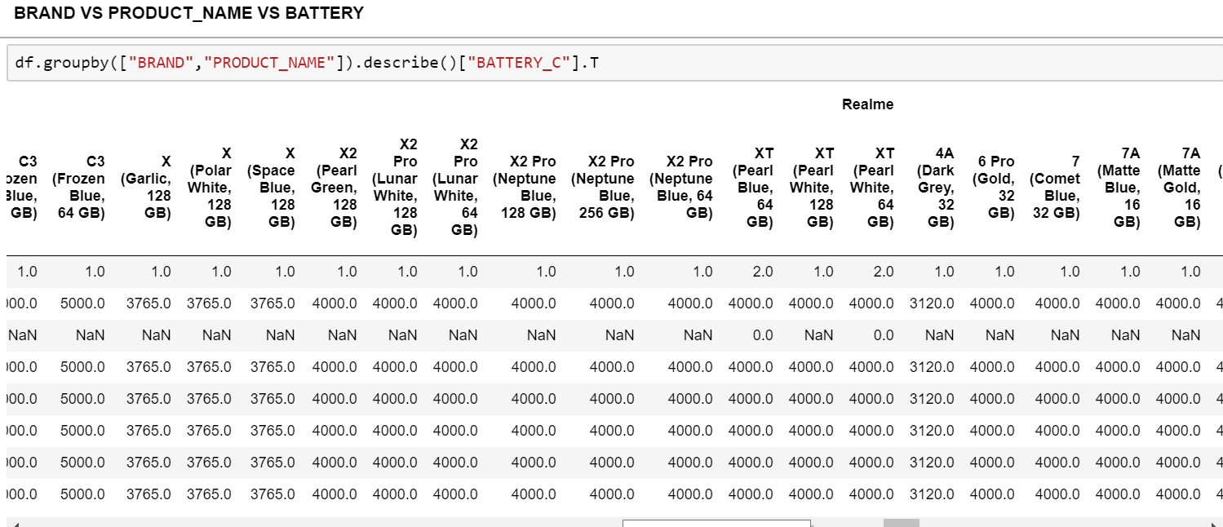
Data Analysis
- It is observed that BRAND Apple is not mentioned about Battery Capacity
- Asus is offering 3300 to 4000 capacity batteries for their mobiles.
- It is observed that Realmi is offering up to 4000 mah Battery capacity.
- It is observed that Redmi is offering up to 5000 mah Battery capacity.

Slide 18
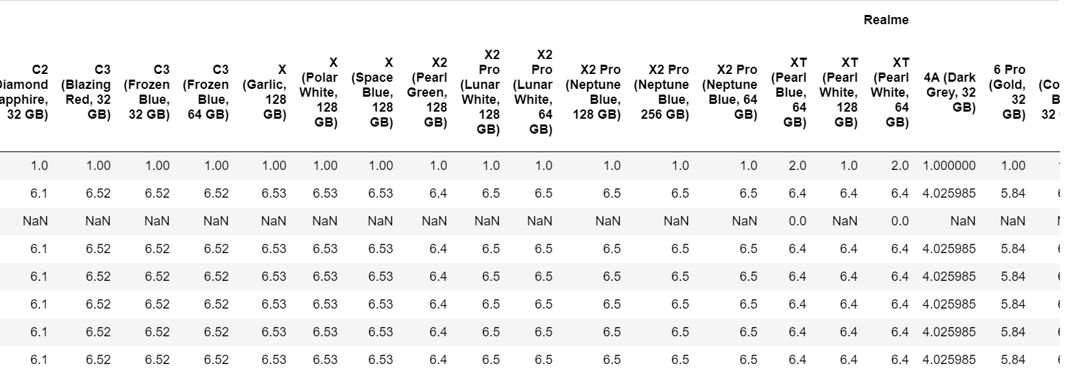
Data Analysis
- It is observed that Brand Apple is offering 4.7 inch screen for lowest mobile and 6.5 inch screen for their highest spec mobile.
- Google is offering 5.5 inch for lower price mobile and 6.3 inch for higher price mobile.
- It is observed that Brand oppo is offering 6.5 inch for their most of mobiles
- It is observed that poco is offering 6.67 inch screen for their mobile.
- Samsung is offering up to 6.7 inch for their mobiles.
- Realme x2 pro is offering 6.5 inch screen.

Slide 19
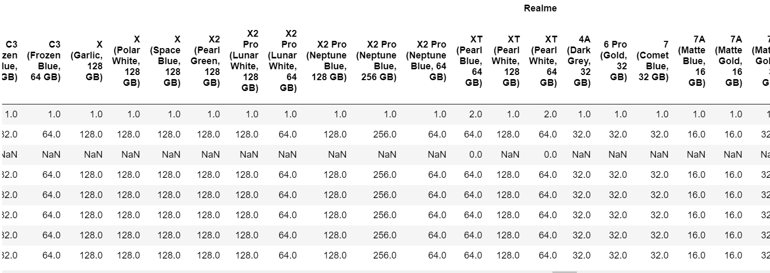
Data Analysis
- It is observed that from the brand Apple product iPhone 11 pro and 11 pro max are offering from the base 64 GB to the top 512 GB.
- From the other Brands like samsung, Realme ,Poco, oppo, vivo are offering max up to 256 GB for their products like Realme x2 pro,poco x2,Samsung s20-s20+-s20ultra,and others.
- It is observed that Realme,poco also offering 256 GB for lowest prices.

Slide 20
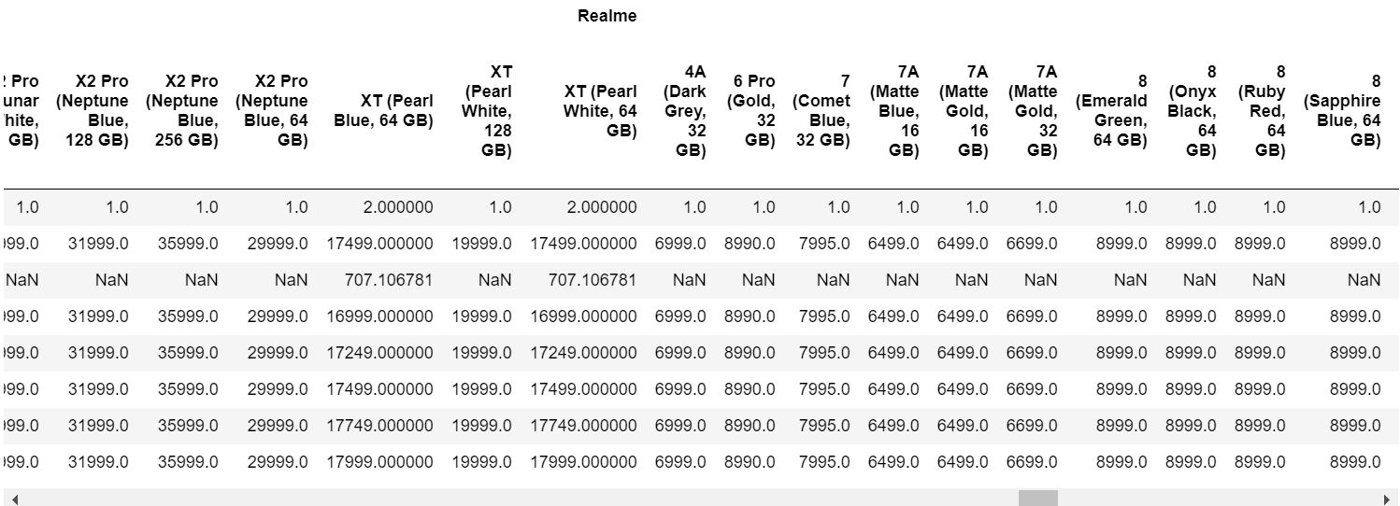
Data Analysis
- We observe that iPhone 11pro-max is at same as MRP and the products from Apple are not offered prices.
- Here the offer price are same as MRP.

Slide 21
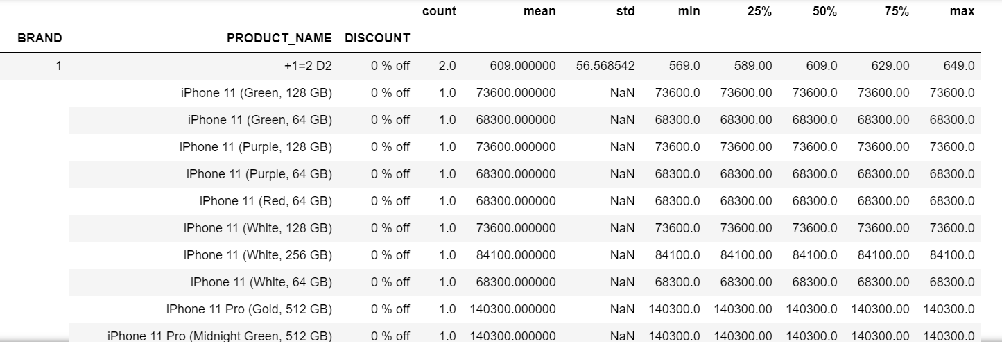
Data Analysis
- We can observe that 0% discount is offered on Apple products
- We also observe that the products from Apple like iPhone 6s at 15% discount and 7 at 47% discount ant rest 6,7,8 are offered less than 10@ discount.
- we also observe that the Brand ASUS is offering more than 30% discount to all of its products.
- We observe that google offering up to 30% discount to its products.
- We observe that Honor is offering above 40% and for some products 50% on its products.
- We also observe that Micromax is offering greater than 50% discount on its products.
- The other Brands are offering less than 10% discounts.

Slide 22
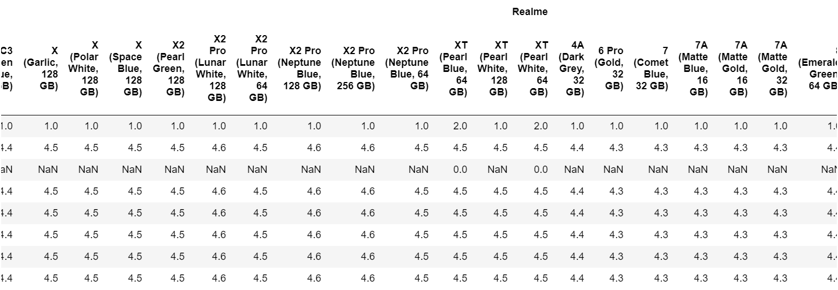
Data Analysis
- It is observed that Apple with highest rating 4.7 for all of its products.
- It is also Observed that from the Brand Asus is with greater than 4 star rating.
- It is also observed that the Brands like Samsung ,Vivo, Oppo, Realme, Redmi, Poco, Infocus, Infinix are with 4 and above 4 rating.
- The rest brands with 3.7 and 3.5 below ratings.

Slide 23
Conclusion
Through overall Analysis:
It is found that the best specification and better memory is offering by Apple.
But the cost of Apple products are up to 1.5 lac.
Which was not be affordable for all.
The next smartphone Brand Samsung is offering better specifications but the prices are compitative to Apple products.
Samsung mobile top spec phones are also not Affordable to all.
The other brands like Oppo, Vivo, Redmi are also offering mobiles at top specs missing some features like battery capacity and memory at mid range prices.
So these were also considered to purchase alternatives to Samsung and Apple.
The Brand Realme which is found offering 12 GB RAM and 256 GB ROM.
Which is priced at 35999 which has become competitive to top spec mobiles of other brands which are priced at double to this product.
The products from Realme are offering Class specifications at lowest prices.
Hence we conclude Realme is the Brand offering Better product for Better value.

Slide 24
THANK YOU!

