Slide 1
Zoom
Designed for Hosting & Management of virtual meetings, webinars, and online events.
Purpose: Enable seamless & reliable communication, allowing users to connect anywhere and anytime.
Audience: Individuals, small businesses, large enterprises, and educational institutions.

Slide 2
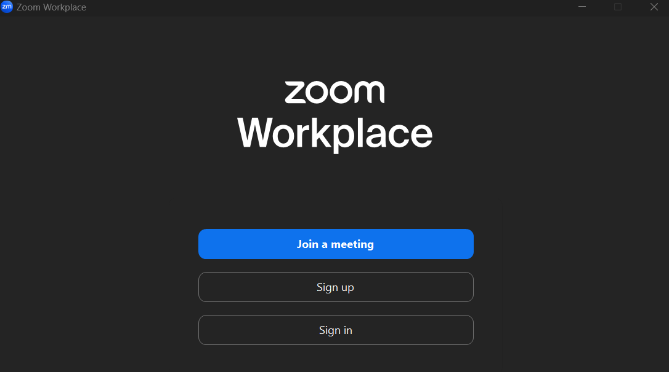
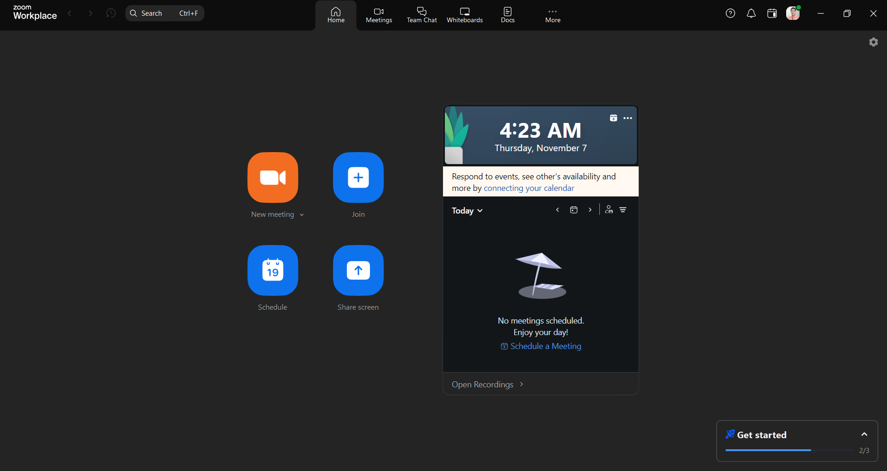
Simplicity
Clean & Simple, showing only important buttons. Extra features are hidden
Clear Primary Options, Minimal Text and Visuals(uncluttered) & Organized Layout.

Slide 3

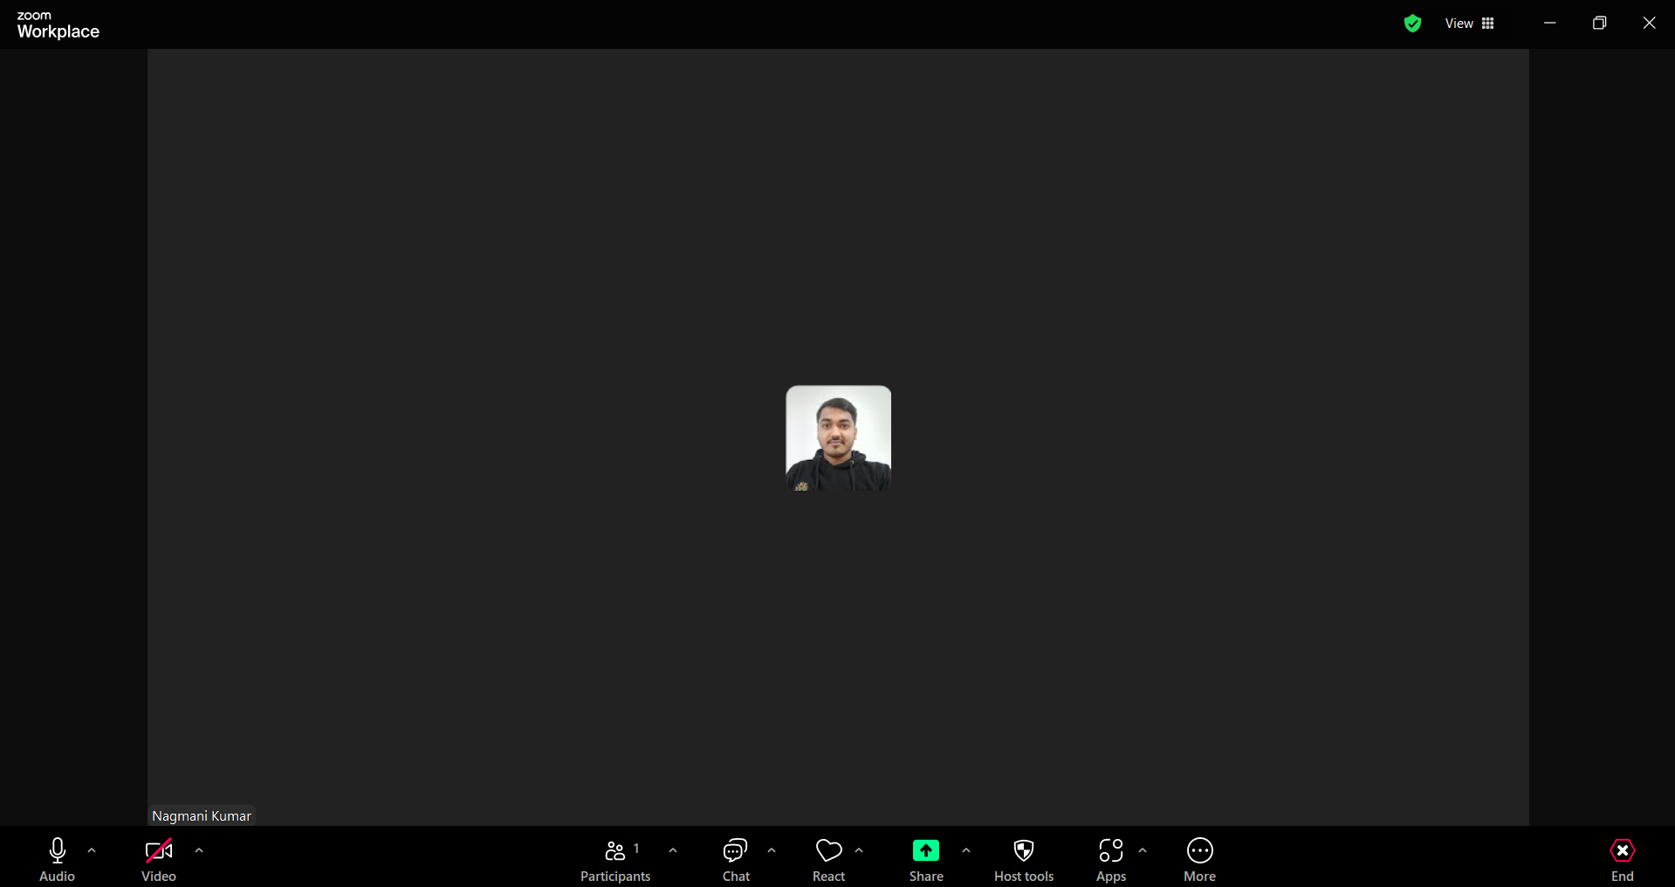
Consistency
Affordance
Zoom uses the same icons, layout, and words across all its platforms.
Buttons and icons are clearly labeled and use familiar symbols, like the microphone and camera
Benefit: Users can quickly understand Zoom’s controls, making it easier for them to focus on their meetings instead of struggling to find features.
For Example;
The microphone & Camera controls are in the same place.
Benefit: No Relearn

Slide 4

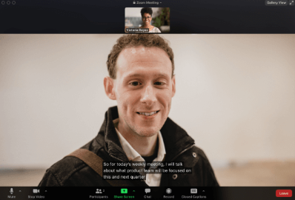
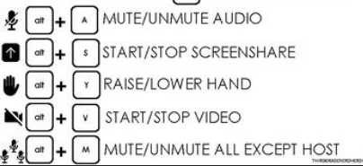

Feedback
Accessibility
Zoom provides feedback to show the result of users’ actions like when the microphone or camera is clicked then it removes the slash mark.
Ensure the app is usable for people with disabilities by including features like screen reader, Caption, and keyboard shortcuts.

Slide 5
Zoom’s focus on key UX design principles—simplicity, consistency, affordance, feedback, and accessibility—plays a significant role in its success.
CONCLUSION
Simplicity reduces cognitive load.
Consistency helps users navigate intuitively across platforms.
Affordance and Feedback provide visual and auditory cues, guiding users smoothly through each action.
Accessibility ensures all users, including those with disabilities, can participate fully.

