Slide 1
NEST SIR Kickoff & Live Demo
Jose A. Duran

Slide 2
Agenda
Current Contract Information
SIR Walkthrough
Live Demo

Slide 3
Current Contract Information
693KA9-25-C-00020
  One (1) Base Year & Two (2) Six (6) Month Options
  Performance End Date: 9/10/2027
  Vendor: Business Process and Automation Services (BPA Services), LLC
  Operation, Maintenance, and Upgrading FAA databases:
    Contract Management Information System (retired)
    NISC Information Management System (active)

Slide 4
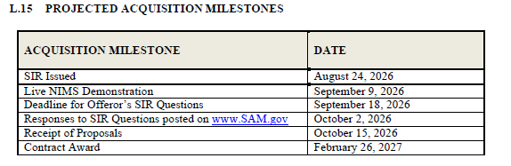
SIR Walkthrough
Competitive “Best Value” procurement set-aside for Women-Owned Small Business (WOSB) concerns
FAA intends to award a single contract for up to five (5) years

Slide 5
Any Questions?
Submit questions in writing, citing the SIR (page, paragraph, section, subsection, etc.) to:
  9-AWA-AAQ410-Contracting-Team@faa.gov

