Slide 1
Tracking Maternal Health Progress Toward SDG - A Global Data Analysis
CAPSTONE PROJECT
Presented By:
1. NAGAIAH VASUNURI - Madanapalle institute of technology and Science

Slide 2
OUTLINE
Problem Statement (Should not include solution)
Proposed System/Solution
System Development Approach (Technology Used)
Algorithm & Deployment
Result (Output Image)
Conclusion
Future Scope
References

Slide 3
Problem Statement
The Sustainable Development Goal 3.1 aims to reduce the global maternal mortality
ratio to less than 70 per 100,000 live births by 2030. Monitoring progress towards this
goal requires analyzing country-wise data on maternal mortality and associated health
indicators such as antenatal care coverage, births attended by skilled personnel,
adolescent birth rates, and healthcare expenditures. Despite global efforts, maternal
health outcomes vary drastically between regions and income groups, raising the need
for data-driven insights into the factors influencing maternal health.

Slide 4
Proposed Solution
The objective is to analyze global maternal health data to monitor progress toward SDG 3.1.
SDG 3.1 aims to reduce maternal mortality to less than 70 per 100,000 live births by 2030.
1. Data Collection:
Gather data from global databases (WHO, UN, World Bank).
Include maternal mortality ratio (MMR), antenatal care, skilled birth attendance, etc.
Collect socio-economic indicators (GDP, health spending, literacy rates).
2. Data Preprocessing:
Handle missing values and inconsistent records.
Normalize indicators to a standard scale for comparison.
3. Exploratory Data Analysis (EDA):
Identify trends in MMR by region, year, and income level.
Visualize correlations between MMR and key indicators.
4. Statistical Analysis:
Use correlation analysis and regression to identify influencing factors.
Cluster countries based on risk levels or healthcare performance.
5. Predictive Modeling:
Apply time-series models to forecast MMR for 2030.
Predict impact of improved healthcare access on maternal outcomes.
6. Insights & Reporting:
Highlight high-risk regions needing urgent intervention.
Recommend policy changes based on data-driven evidence.
7. Dashboard & Visualization:
Create an interactive dashboard using tools like Power BI or Tableau.
Track SDG progress by country with dynamic filters and graphs.
8. Continuous Monitoring:
Update data regularly to measure yearly improvements.
Use feedback to refine models and improve prediction accuracy

Slide 5
System Approach
The system approach outlines the strategy for analyzing maternal health data to track global progress toward SDG 3.1. The system leverages data analytics and machine learning techniques to gain insights into maternal mortality trends and related health indicators.
System requirements
Library required to build the model
Technology – Use of IBM cloud lite services is mandatory.

Slide 6
Algorithm & Deployment
Algorithm Selection:
The algorithm will be deployed on IBM Cloud using Watson Studio for scalable and secure data analysis. Data is imported from cloud storage, cleaned, and analyzed using Python notebooks. Machine learning models (e.g., regression, time-series) are trained to forecast maternal mortality trends. Results are visualized using integrated dashboards for real-time SDG 3.1 progress tracking..
Data Input:
Data.scv
Output
Analysis of data

Slide 7
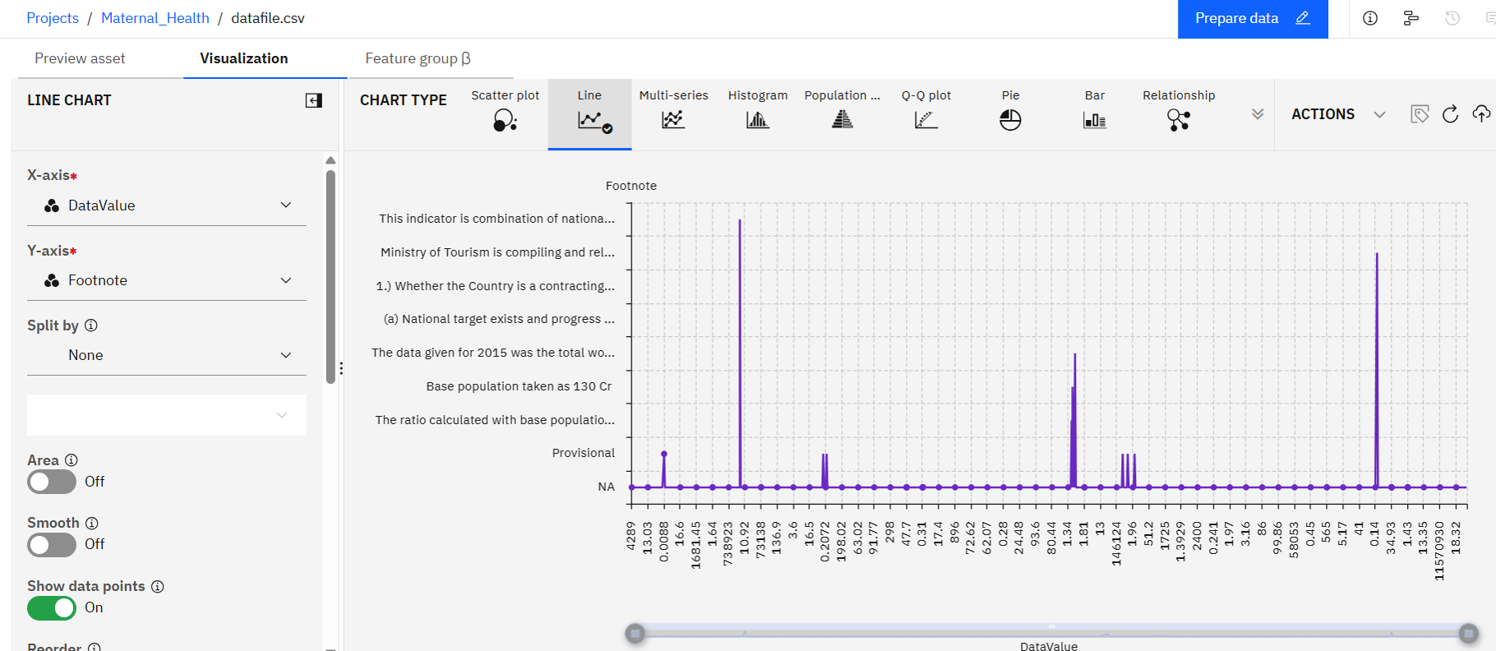

Slide 8
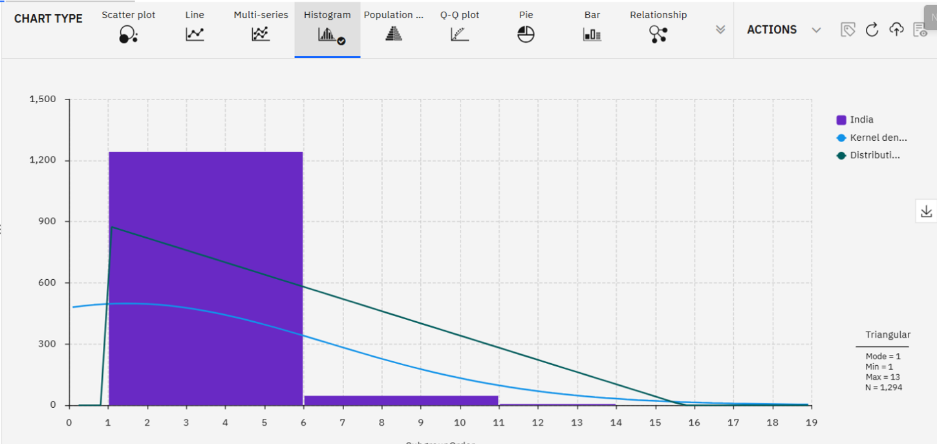

Slide 9
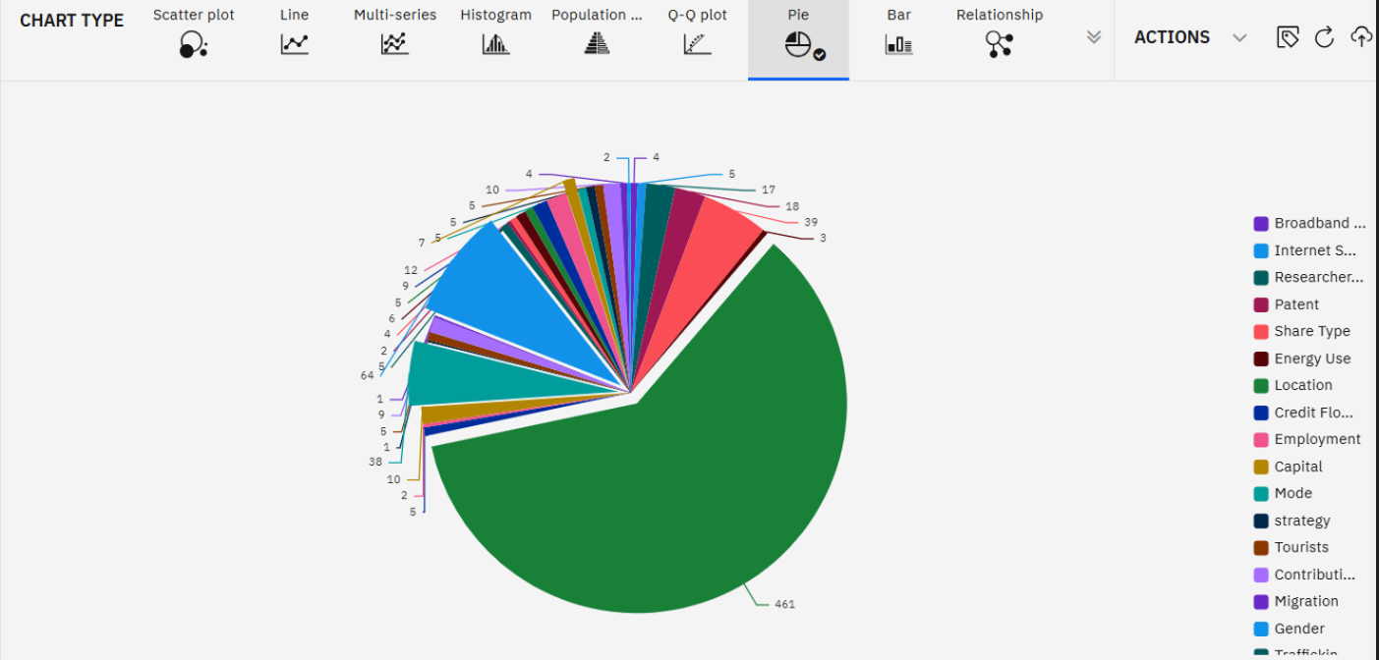

Slide 10
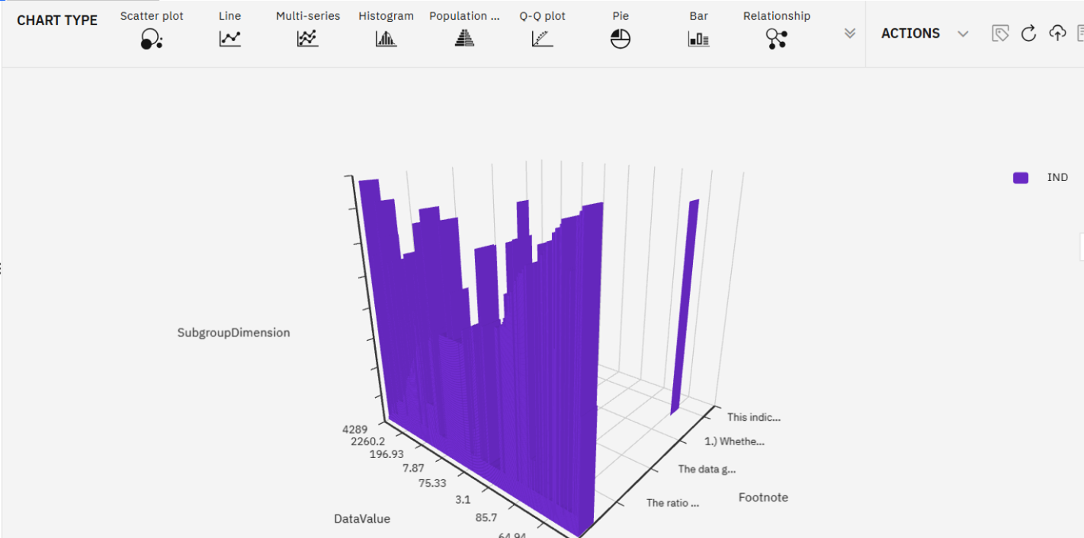

Slide 11
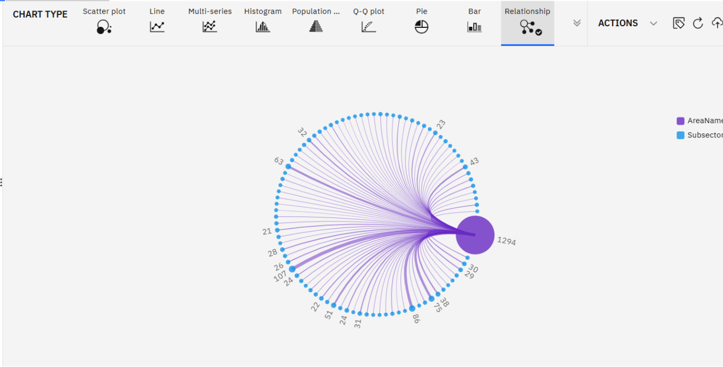

Slide 12
Result
Maternal health data from global sources was successfully ingested, processed, and analyzed using IBM Cloud services.Using IBM Watson Studio, we built and trained predictive models to forecast maternal mortality trends.The models revealed that low-income countries with poor healthcare access are at the highest risk.Real-time, interactive visualizations were created to track SDG 3.1 progress using IBM's data visualization tools.

Slide 13
Conclusion
The IBM Cloud environment enabled scalable, secure, and efficient execution of the entire data analysis pipeline.Watson Studio and IBM Cloud Object Storage simplified collaboration, data handling, and model deployment.

Slide 14
Future scope
Integrate real-time health monitoring data and satellite health mapping to improve prediction accuracy.Extend the model to analyze other SDG health goals and support policy-making at national and local levels.

Slide 15
References
IBM Cloud & Watson Studio Documentation for data science, model training, and deployment.

Slide 16
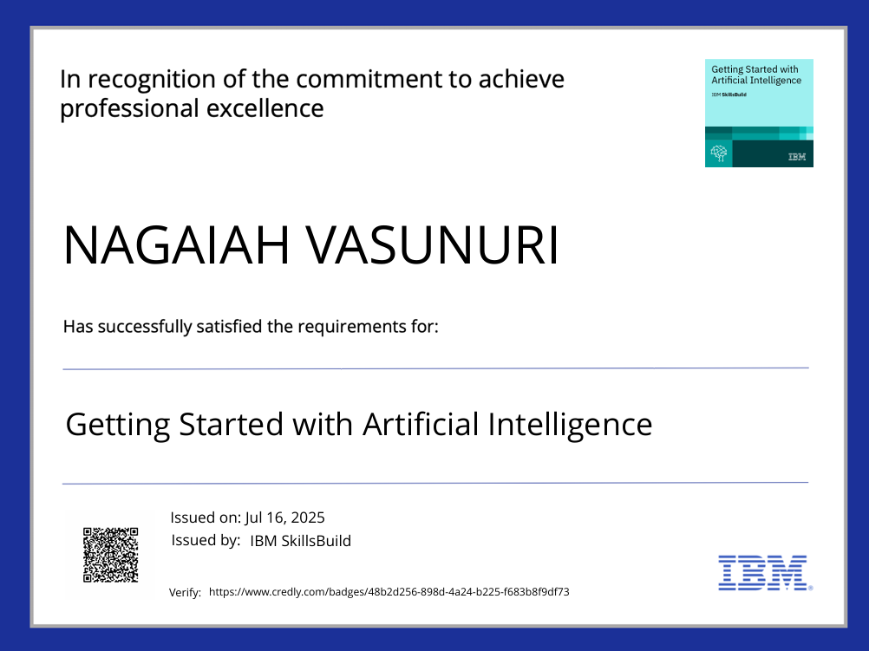
IBM Certifications
Screenshot/ credly certificate( getting started with AI)

Slide 17
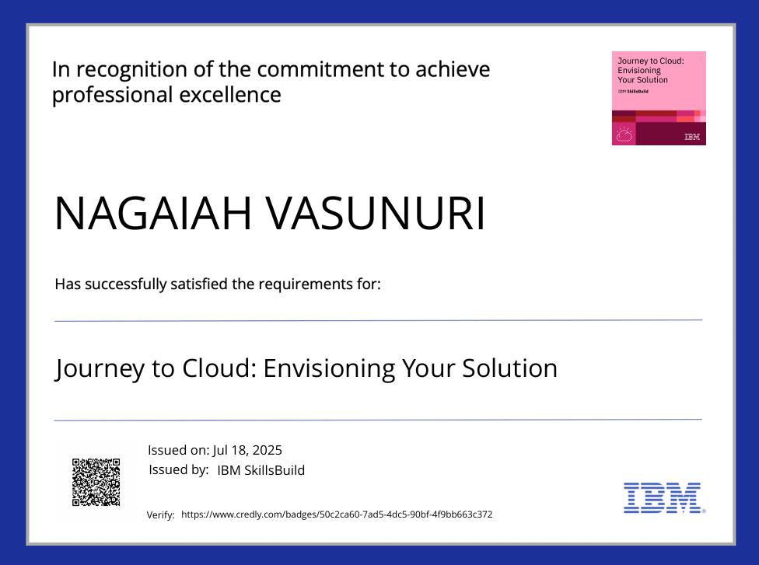
IBM Certifications
Screenshot/ credly certificate( Journey to Cloud)

Slide 18
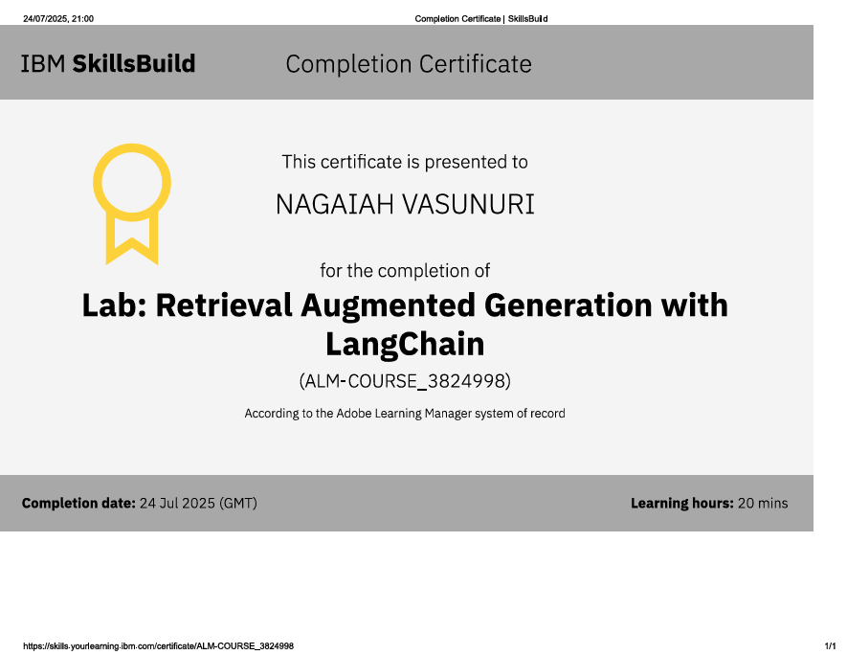
IBM Certifications
Screenshot/ credly certificate( RAG Lab)

Slide 19
THANK YOU

