Slide 1
RAILWAY TRACK
Defect detection
YOLOv8n on Raspberry Pi 4
Computer vision prototype for identifying defective track regions
Project review • Validation results and edge deployment
Notes:
Source: project files supplied in railway_pi_deployment.zip and training dataset folder. Validation values use the best saved validation mAP50–95 row (epoch 86).

Slide 2
Model architecture
YOLOv8n detects track defects in each camera frame
Image input
Backbone
Neck
Detection head
640 × 640 RGB
Pi Camera Module 1.3
CSP / C2f feature
extraction + SPPF
FPN + PAN
multi-scale features
Anchor-free, decoupled
class + box outputs
Output classes
Each detection returns a class label, confidence score and bounding box.
defective
non-defective
Training input: 640 px | Deployment runtime: NCNN on Raspberry Pi CPU
Notes:
Architecture summary based on Ultralytics YOLOv8 documentation: https://docs.ultralytics.com/guides/yolo-architecture. The model runs as an exported NCNN artifact on the Raspberry Pi. Diagram elements are editable PowerPoint shapes.

Slide 3
Validation results
Best saved validation row: epoch 86 of 100
Precision
Recall
mAP50
mAP50–95
92.0%
89.4%
92.7%
62.7%
Validation mAP by epoch
Validation split
101 images
mAP50 uses IoU 0.50. mAP50–95 averages AP from IoU 0.50 through 0.95.
Held-out test metrics are not included in the supplied deployment package.
Notes:
Source: results.csv from railway_pi_deployment.zip. Metrics shown are from epoch 86, the row with the highest saved validation mAP50–95: precision 0.92005, recall 0.89361, mAP50 0.92704, mAP50–95 0.6267. Dataset split counts from data.yaml: 1,198 train, 101 validation, 54 test. The test split score is unavailable; do not present validation values as test performance. Metric definitions: https://docs.ultralytics.com/guides/yolo-performance-metrics

Slide 4
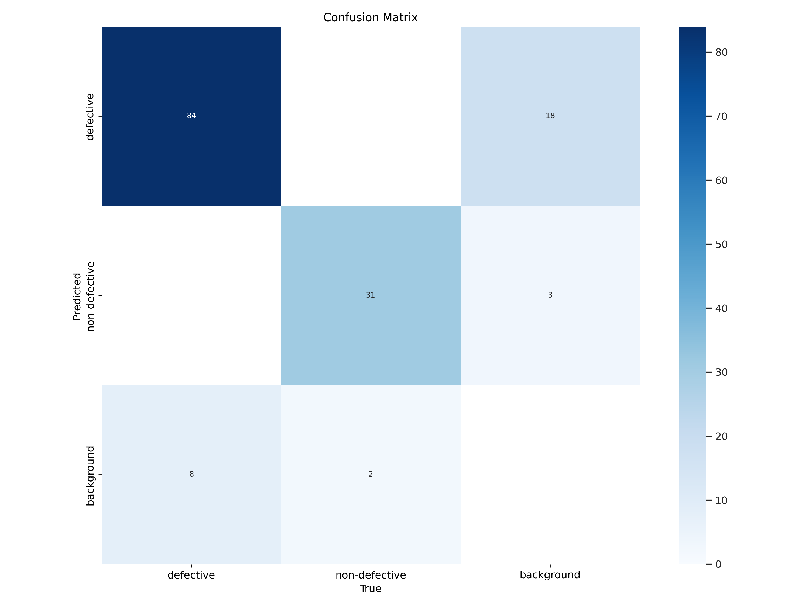
Validation confusion matrix
Saved YOLO validation diagnostic
How to read it
Rows show predicted class. Columns show ground-truth class. The background row and column capture unmatched detections and missed objects.
Use the matrix to discuss the two error types: false alarms and missed defects.
Source image preserved from the training output.
Notes:
Original confusion_matrix.png from railway_pi_deployment.zip. This is a validation diagnostic. Preserve its normalization/labels as shown; do not infer a test-set result from it.

Slide 5
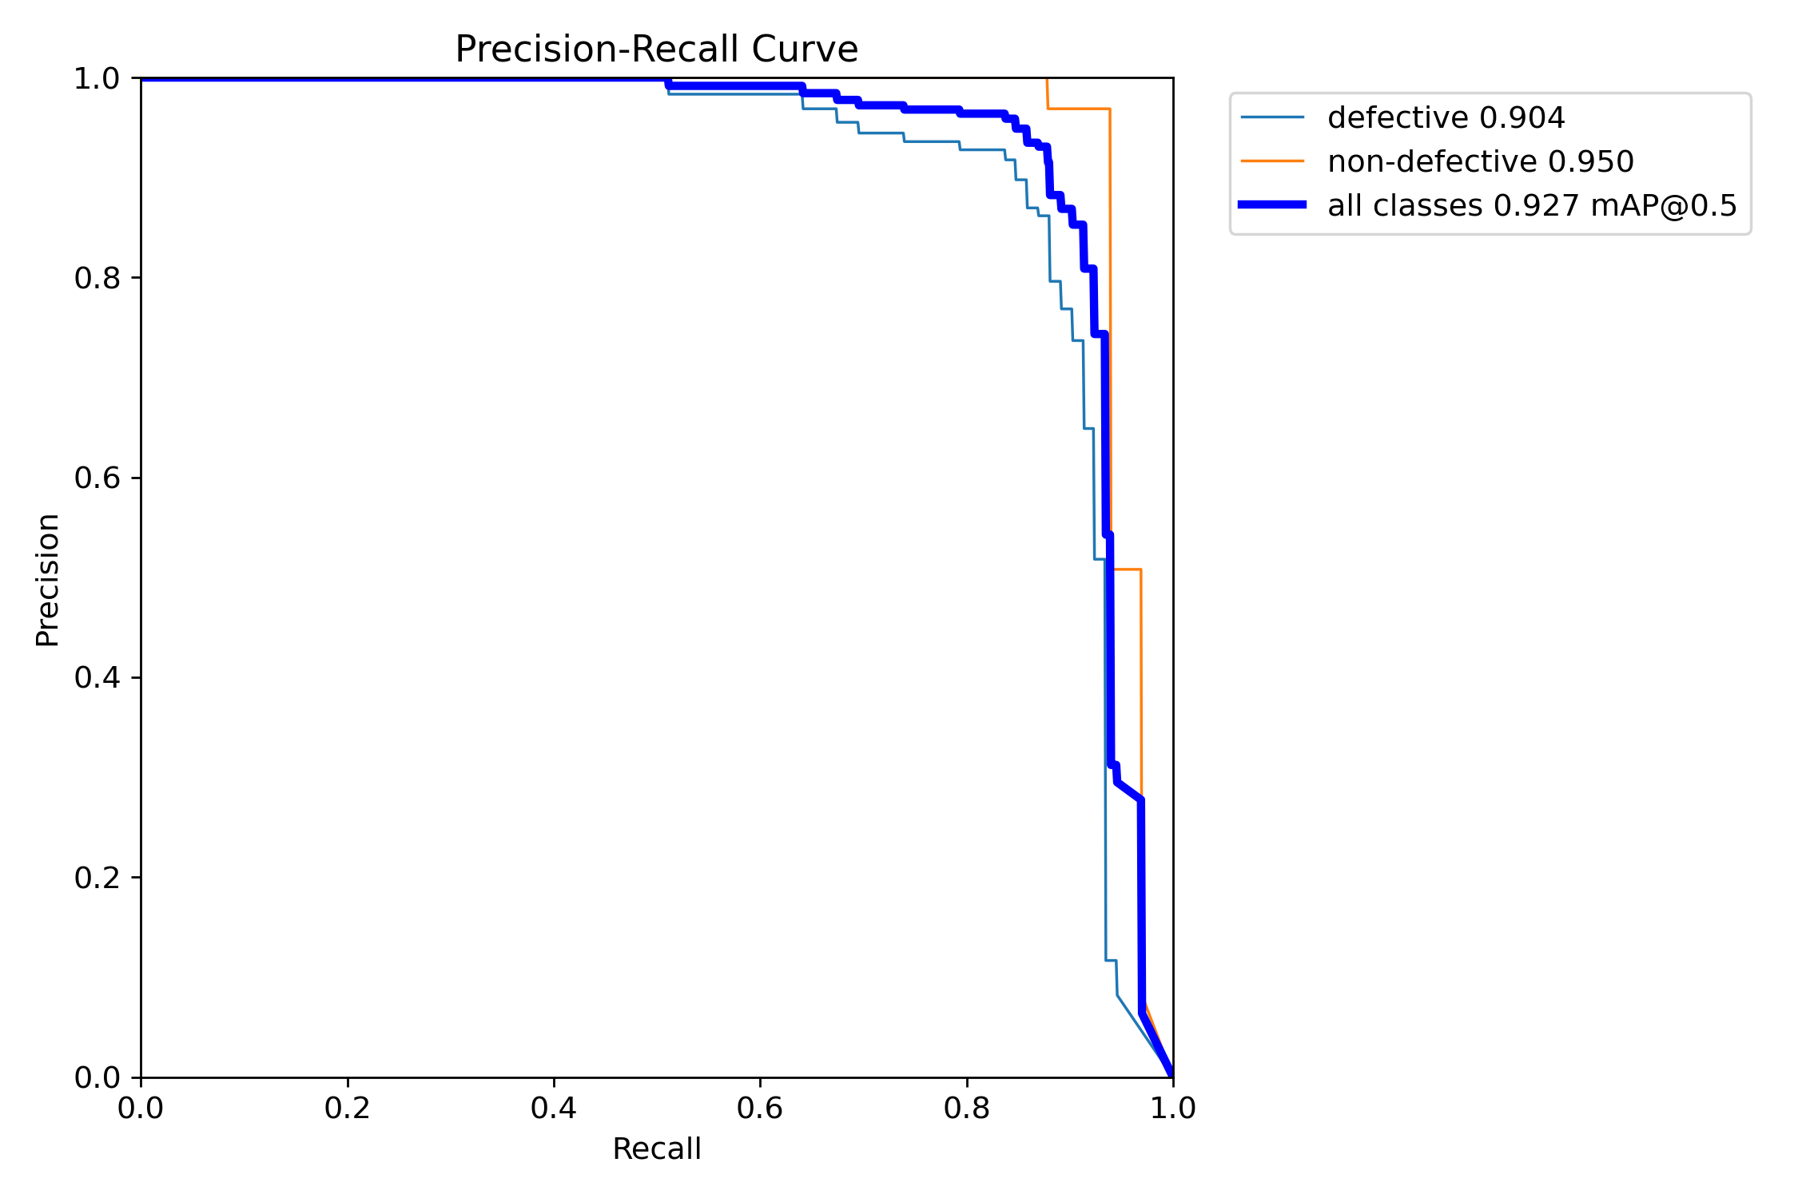
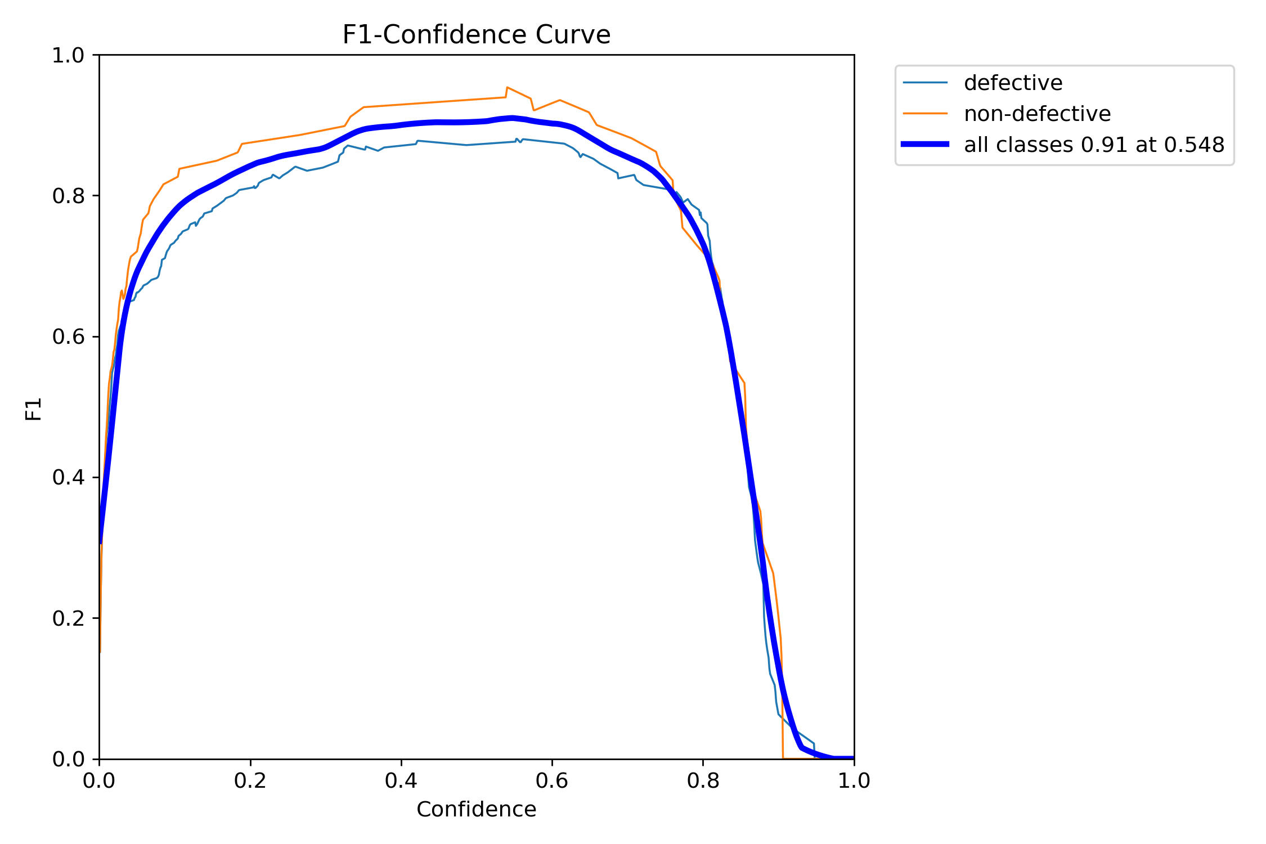
Precision–recall and confidence curves
Saved validation diagnostics
PR curve: defective AP50 0.904; non-defective AP50 0.950; combined mAP50 0.927.
F1 curve: peak shown at 0.91 near confidence 0.548.
Notes:
Original PR_curve.png and F1_curve.png from the supplied deployment package. Values on these plots are validation results. AP values are read directly from the plot legend; F1 peak and confidence threshold are read from the plot annotation.

Slide 6
Raspberry Pi inference profile
Observed on one still image using the NCNN model
Preprocess
Inference
Postprocess
64.0 ms
754.7 ms
9.0 ms
~827.7 ms
~1.2 FPS
measured total per image
theoretical rate from that single run
Evaluation limit
This is a single still-image timing, not a sustained live-camera benchmark. Confirm long-run frame rate, temperature and missed-defect rate during track testing.
Notes:
Timing copied from the user-provided Raspberry Pi console log: preprocess 64.0 ms, inference 754.7 ms, postprocess 9.0 ms. Sum is 827.7 ms; reciprocal is approximately 1.21 images/s. This was a single still-image prediction and does not establish sustained video performance. Device: Raspberry Pi 4 Model B, 4 GB; Raspberry Pi Camera Module 1.3; NCNN exported model.

