Slide 1
Billing Events Cube Proof of Concept
Author: Peter A. Peterson

Slide 2

Agenda
High level overview of Billing Events
Proof of Concept Context
Cube Demo
Next Steps
Questions

Slide 3
What is Billing Events

Slide 4
The Logical Data Model
The measures collected in the Billing Events Fact Table are:
Quantity
Local Currency Amount
Currency Amount USD
Currency Amount GBP
Business Questions Answered What amount of usage occurred for what accounts, by product, during what time period? What was the monetary value of usage that occurred for what accounts, by product, for what time period? What is the historical trend of usage and discounts, by account, by product? What is the historical trend of the monetary value of usage, by account, by product? What account began using what product(s), and during what time period?

Slide 5

What is a CUBE
A cube can be considered a multi-dimensional generalization of a two- or three-dimensional spreadsheet. For example, Rackspace might wish to summarize Billing Event data by product, by time-period, and by Team to analyze trends,
Cube is a shortcut for multidimensional dataset, given that data can have an arbitrary number of dimensions.

Slide 6
Why a Cube?
Speed:
Aggregating (Summarizing) the data for performance: During cube processing SSAS will pre-calculate and physically stores aggregations of facts (Amounts, Quantities, Money). These aggregations, for example Turnover by Year and Region, are used when a business user queries the cube for this type of information. Therefore the query response time can be very short. When the query is fired SSAS does not have to calculate the outcome from the underlying details (like T-SQL has to do), but can take the values directly from the stored aggregations. Besides that SSAS stores query-results in a cache. So the next time the same type of query is fired, it will try to get it from the cache. Speed is especially important for a dashboard that an executive is using to slice-and-dice as any mouse click that takes more than a few milliseconds to return data will draw complaints
Multidimensional analysis
Slice, dice, drilldown: This very much depends on the tool or front end that is layered over the data, but the idea is that you can very quickly navigate around the data, finding trends, spotting patterns, ‘drilling down’, ‘slicing and dicing’ – all key to the concept of cubes. Allowing the user to intuitively ‘wander’ around the data, not even realizing that they performing analysis
Can store Hierarchies
Built-in advanced time-calculations
12-month rolling average: It’s very easy to implement advanced time calculations like 12-month rolling average, year-to-date and references to parallel periods in previous years. This is typically the stuff decision-makers in the organization want to have. Imagine how many T-SQL queries are required for calculating rolling averages for each of the previous 12 months (2009-May..2010 April) => 12. Using the cube as a data source => Only 1
Easily use Excel to view data via Pivot Tables
Ability to automatically link and display the records that make up an aggregation (“Show Details”)
Reinforces best practice by requiring you to build a good data model (star schema) that’s created for business reporting and analysis
Can use tools PerformancePoint and Power View
Can use Analysis Services Data Mining

Slide 7
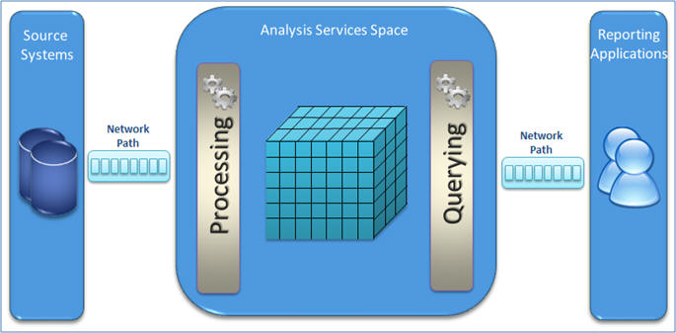
What has been done for the POC
Billing Events
Spun up an isolated VM in Development Environment
Sample Data
Imported 6 weeks of sample data
Created all the dimensions
Created some sample hierarchies
Created the CUBE
Processed all dimensions
Processed the CUBE
Attached Excel to the SSAS Server
Sample Data

Slide 8
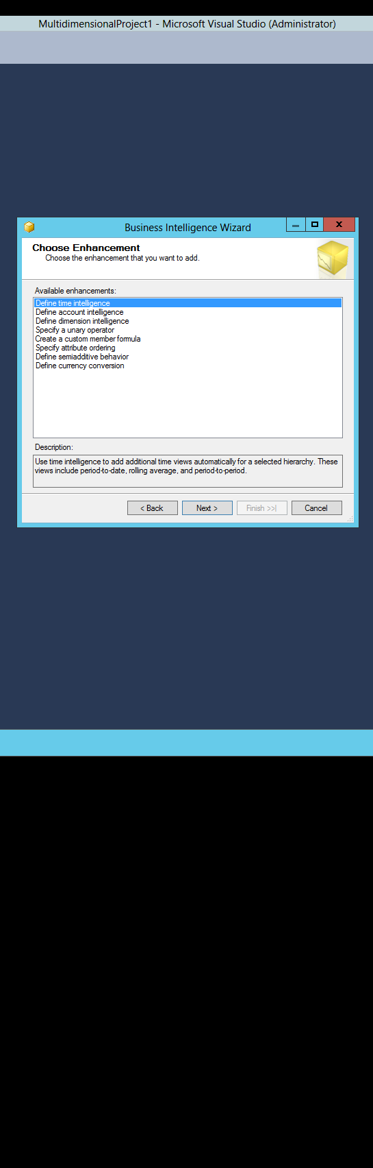
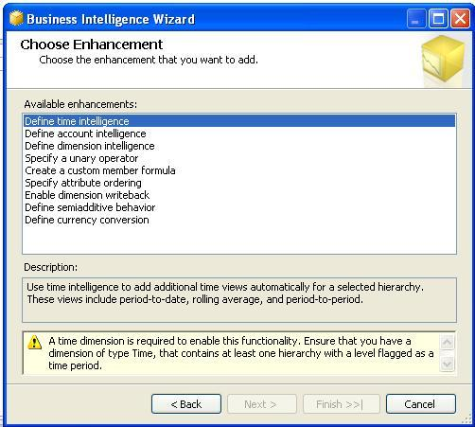
What has not been done for the POC?
Have not met with the business to understand the hierarchies they want created
Have not given business friendly name to any attributes
Have not added the new functionality in Billing Events:
Ability to see Instance Configuration Data
Ability to see the Invoice number the usage was eventually billed on
Ability to see Cloud teams and segments
Have not added Business Intelligence features of the CUBE.
Time Intelligence (week over week, etc.)
Multi Currency Conversion
Security
Perspectives

Slide 9
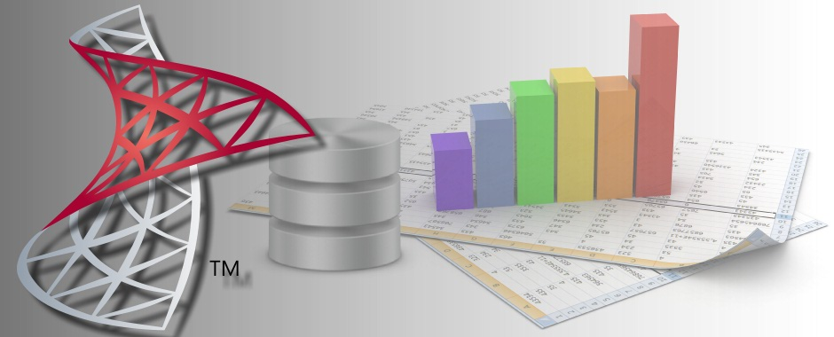
Lets take a look

Slide 10
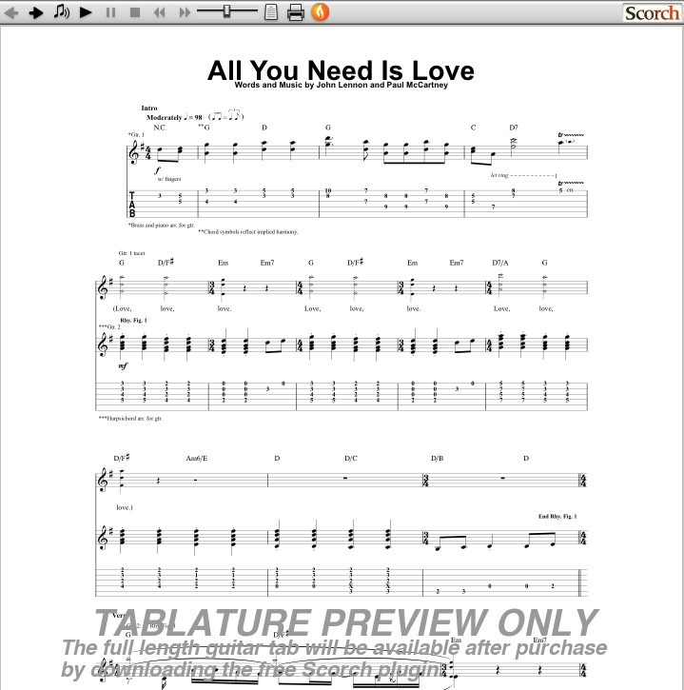
What we need from key stake holders
Confirmation that this is the type of functionality you want us to provide to you.
Time from your organizations to help us understand your requirements.

Slide 11
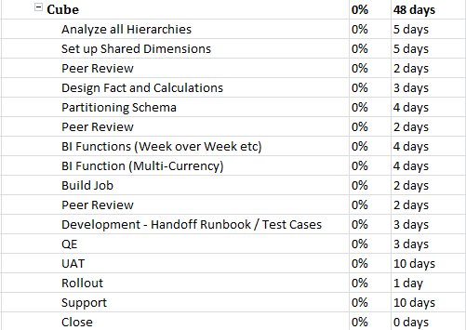
Next Steps

Slide 12

Questions

