Slide 1
Electric Vehicle Charge & Range Analysis
Tableau & MySQL Project
Presented by: Naga Lakshmi Kuppala

Slide 2
Project Introduction
Analysis of Electric Vehicle performance metrics.
Comparison of Efficiency, Range, and Price.
Visualization using Tableau Dashboard.

Slide 3
SQL Query – Top Efficient Brands
SELECT Brand, AVG(Efficiency_WhKm) AS AvgEfficiency
FROM ElectricCarData
GROUP BY Brand
ORDER BY AvgEfficiency ASC
LIMIT 10;

Slide 4
SQL Query – Highest Range Cars
SELECT Brand, Model, Range_Km
FROM ElectricCarData
ORDER BY Range_Km DESC
LIMIT 10;

Slide 5
SQL Query – Charging Stations by Region
SELECT region, COUNT(*) AS TotalStations
FROM ChargingStations
GROUP BY region
ORDER BY TotalStations DESC;

Slide 6
SQL Query – Average Price by Brand
SELECT Brand, AVG(PriceEuro) AS AvgPrice
FROM ElectricCarData
GROUP BY Brand
ORDER BY AvgPrice DESC;

Slide 7
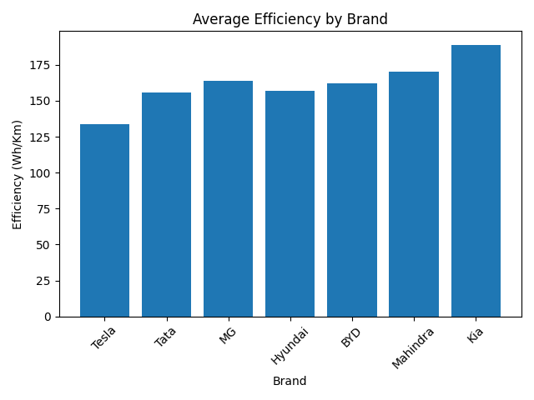
Average Efficiency by Brand

Slide 8
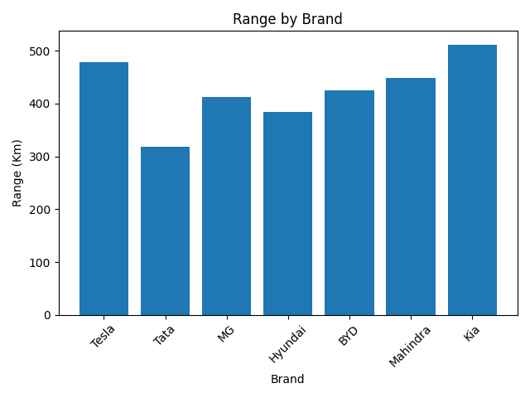
Range by Brand

Slide 9
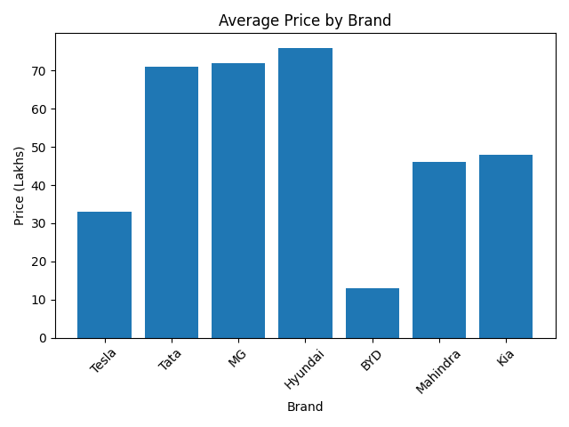
Average Price by Brand

Slide 10
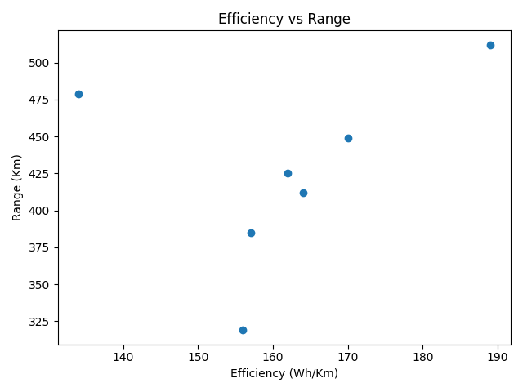
Efficiency vs Range (Scatter Plot)

Slide 11
Conclusion
SQL used for backend data analysis.
Tableau used for dashboard visualization.
Project demonstrates Business Intelligence skills.
Useful for EV market insights.

