Slide 1
REST

Slide 2
WWW
Tim Berners-Lee
the inventor of the World Wide Web

Slide 3
WWW
Tim Berners-Lee had invented and implemented
URI
HTTP
HTML
web-server
web-browser ( www ) ( Nexus )

Slide 4
web
Web was growing too large, too fast, and it
was heading toward collapse
Web’s traffic outgrowing the capacity of the Internet infrastructure

Slide 5
web
Web’s core protocols were not uniformly implemented.
They lacked support for caches and other stabilizing intermediaries.
With such rapid expansion, it was unclear if the Web would scale to meet the increasing demand.

Slide 6
Web Architecture
In late 1993, Roy Fielding, co-founder of the Apache HTTP Server Project, recognized that the Web’s scalability was governed by a set of key constraints.
Fielding grouped into six categories and collectively referred to as the “Web’s architectural style”

Slide 7
Architectural Styles
An architectural style is a coordinated set of architectural constraints that restricts the roles and features of architectural elements, and the allowed relationships among those elements, within any architecture that conforms to that style
‣ A style can be applied to many architectures.
‣ An architecture can consist of many styles.

Slide 8
Web’s architectural style, are
1. Client-server
2. Uniform interface
3. Layered system
4. Cache
5. Stateless
6. Code-on-demand

Slide 9
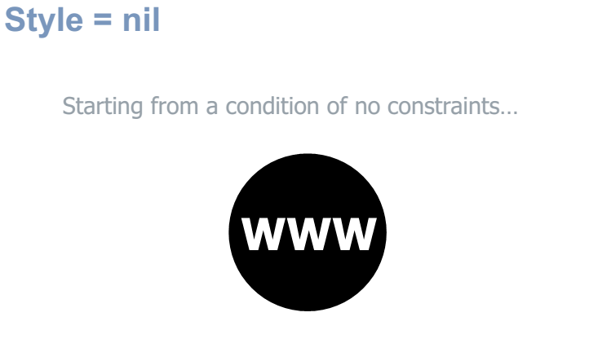

Slide 10
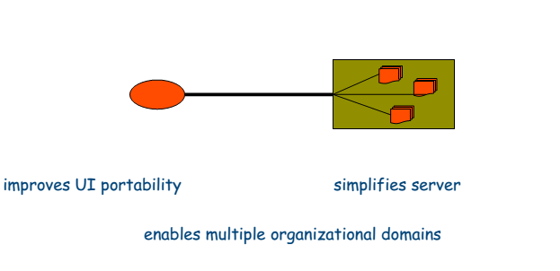
Style : Client/Server
Apply separation of concerns: Client-Server

Slide 11
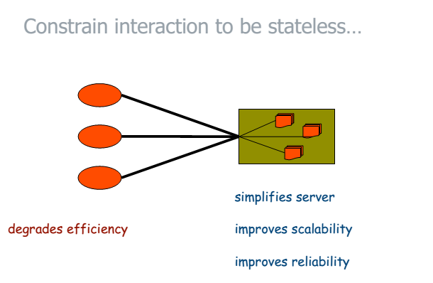
Style : Stateless

Slide 12
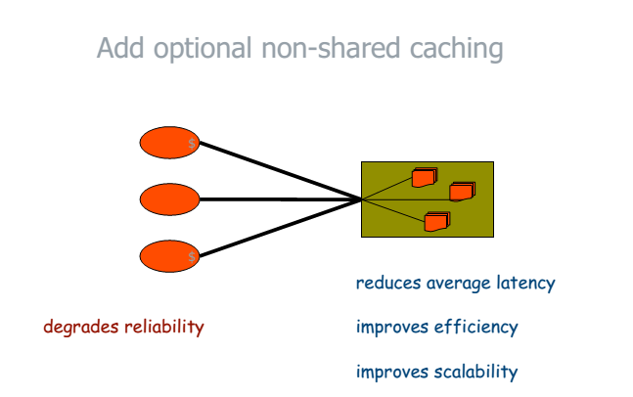
Style : Caching

Slide 13
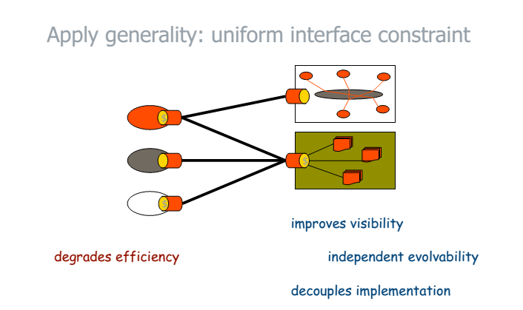
Style : Uniform Interface

Slide 14
Uniform interface’s four constraints
1. Identification of resources
2. Manipulation of resources through representations
3. Self-descriptive messages ( headers )
4. Hypermedia as the engine of application state (HATEOAS)

Slide 15
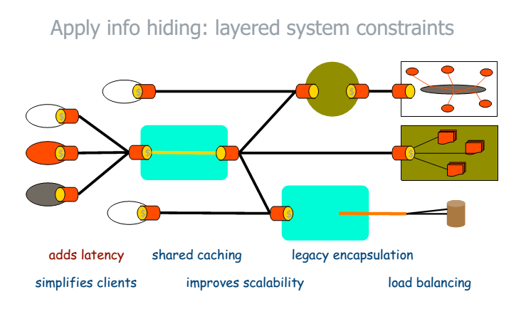
Style : Layered System

Slide 16
Style : Layered System
Enable network-based intermediaries such as proxies and gateways to be transparently deployed between a client and server using the Web’s uniform interface.
commonly used for enforcement of security, response caching, and load balancing

Slide 17
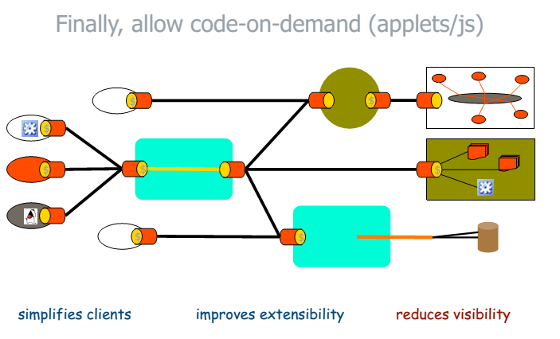
Style : Code-on-demand

Slide 18
REST
In the year 2000, after the Web’s scalability crisis was averted, Fielding named and described the Web’s architectural style in his Ph.D. dissertation.
“Representational State Transfer” (REST)
“REST” is the name of the description, or derivation, of the Web’s architectural style

Slide 19

Web Service – Web API

Slide 20
REST API
The REST architectural style is commonly applied to the design of APIs for modern web services.
A Web API conforming to the REST architectural style is a REST API.
Having a REST API makes a web service “RESTful.”

Slide 21
REST API
A REST API consists of an assembly of interlinked resources.
This set of resources is known as the REST API’s resource model.
Well-designed REST APIs can attract client developers to use web services.

Slide 22
REST API Design
Some best practices for REST API design are implicit in the HTTP while other have emerged over the past few years.

Slide 23
Rules for ‘REST API’ Design

Slide 24
Identifier Design with URIs
REST APIs use Uniform Resource Identifiers (URIs) to address resources.
REST API designers should create URIs that convey a REST API’s resource model to its potential client developers.

Slide 25
URI Format
URI = scheme "://" authority "/" path [ "?" query ] [ "#" fragment ]

Slide 26
URI - Rules
Forward slash separator (/) must be used to indicate a hierarchical relationship
http://api.canvas.restapi.org/shapes/polygons/quadrilaterals/squares
A trailing forward slash (/) should not be included in URIs
http://api.canvas.restapi.org/shapes/
http://api.canvas.restapi.org/shapes

Slide 27
URI - Rules
Hyphens (-) should be used to improve the readability of URIs
http://api.example.restapi.org/blogs/mark-masse/entries/this-is-my-first-post
Underscores (_) should not be used in URIs
Lowercase letters should be preferred in URI paths
http://api.example.restapi.org/my-folder/my-doc
http://api.example.restapi.org/My-Folder/my-doc

Slide 28
URI - Rules
File extensions should not be included in URIs
http://api.college.restapi.org/students/3248234/transcripts/2005/fall.json
http://api.college.restapi.org/students/3248234/transcripts/2005/fall

Slide 29
URI Authority Design - Rules
Consistent sub-domain names should be used for your APIs
http://api.soccer.restapi.org
http://developer.soccer.restapi.org

Slide 30
Resource Modeling
The URI path conveys a REST API’s resource model
with each forward slash separated path segment corresponding to a unique resource within the model’s hierarchy
http://api.soccer.restapi.org/leagues/seattle/teams/trebuchet
http://api.soccer.restapi.org/leagues/seattle/teams
http://api.soccer.restapi.org/leagues/seattle
http://api.soccer.restapi.org/leagues
http://api.soccer.restapi.org

Slide 31
URI Path Design
A singular noun should be used for document names
http://api.soccer.restapi.org/leagues/seattle/teams/trebuchet/players/claudio
A plural noun should be used for collection names
http://api.soccer.restapi.org/leagues/seattle/teams/trebuchet/players

Slide 32
URI Path Design
A plural noun should be used for store names
http://api.music.restapi.org/artists/mikemassedotcom/playlists
A verb or verb phrase should be used for controller names
http://api.college.restapi.org/students/morgan
/register

Slide 33
URI Path Design
Variable path segments may be substituted with identity-based values
http://api.soccer.restapi.org/leagues/{leagueId}/teams/{teamId}/players/{playerId}

Slide 34
URI Path Design
CRUD function names should not be used in URIs
GET /deleteUser?id=1234
GET /deleteUser/1234
DELETE /deleteUser/1234
POST /users/1234/delete

Slide 35
URI Query Design
The query component of a URI may be used to filter collections or stores
GET /users
GET /users?role=admin
The query component of a URI should be used to paginate collection or store results
GET /users?pageSize=25&pageStartIndex=50

Slide 36
Interaction Design with HTTP
GET and POST must not be used to tunnel other request methods.

Slide 37
HTTP - Methods
GET must be used to retrieve a representation of a resource
HEAD should be used to retrieve response headers

Slide 38
HTTP Methods
PUT must be used to both insert and update a stored resource
PUT must be used to update mutable resources

Slide 39
HTTP Methods
POST must be used to create a new resource in a collection
POST must be used to execute controllers

Slide 40
HTTP Methods
DELETE must be used to remove a resource from its parent
OPTIONS should be used to retrieve metadata that describes a resource’s available interactions

Slide 41
Response Status Codes
1xx: Informational -Communicates transfer protocol-level information.
2xx: Success - Indicates that the client’s request was accepted successfully.
3xx: Redirection - Indicates that the client must take some additional action in order to complete their request.
4xx: Client Error - This category of error status codes points the finger at clients.
5xx: Server Error - The server takes responsibility for these error status codes

Slide 42
Response Status Codes
200 (“OK”) should be used to indicate nonspecific success
200 (“OK”) must not be used to communicate errors in the response body
201 (“Created”) must be used to indicate successful resource creation
202 (“Accepted”) must be used to indicate successful start of an asynchronous action

Slide 43
204 (“No Content”) should be used when the response body is intentionally empty
301 (“Moved Permanently”) should be used to relocate resources
302 (“Found”) should not be used
304 (“Not Modified”) should be used to preserve bandwidth
304 (“Not Modified”) should be used to preserve bandwidth

Slide 44
400 (“Bad Request”) may be used to indicate nonspecific failure
401 (“Unauthorized”) must be used when there is a problem with the client’s credentials
403 (“Forbidden”) should be used to forbid access regardless of authorization state
404 (“Not Found”) must be used when a client’s URI cannot be mapped to a resource
405 (“Method Not Allowed”) must be used when the HTTP method is not supported

Slide 45
406 (“Not Acceptable”) must be used when the requested media type cannot be served
409 (“Conflict”) should be used to indicate a violation of resource state
415 (“Unsupported Media Type”) must be used when the media type of a request’s payload cannot be processed

Slide 46
500 (“Internal Server Error”) should be used to indicate API malfunction

Slide 47
Metadata Design- HTTP Headers
Content-Type must be used
Content-Length should be used
Last-Modified should be used in responses
Location must be used to specify the URI of a newly created resource
Cache-Control, Expires, and Date response headers should be used to encourage caching

Slide 48
Cache-Control, Expires, and Pragma response headers may be used to discourage caching
Caching should be encouraged

Slide 49
Media Types
Media Type Syntax
type "/" subtype *( ";" parameter )
Content-type: text/html; charset=ISO-8859-4
Content-type: text/plain; charset="us-ascii"

Slide 50
Vendor-Specific Media Types
application/vnd.ms-excel
application/vnd.lotus-notes
text/vnd.sun.j2me.app-descripto

Slide 51
Media Type Design
Application-specific media types should be used
Media type negotiation should be supported when multiple representations are available
Media type selection using a query parameter may be supported

Slide 52
Representation Design
JSON should be supported for resource representation
JSON must be well-formed
XML and other formats may optionally be used for resource representation

Slide 53
Hypermedia Representation
A consistent form should be used to represent links
A consistent form should be used to represent link relations

