Slide 1
Transition Slide in Primary Teal Green
Insert Transition Title and Subtitle (title case for both)
Product Development Release Calendar

Slide 2
Product Development Release Calendar
A calendar application that provides easy access to track the statuses of all the Releases of an Application with just a button click
A single page application that is designed to reduce the work of Scrum Master to enter minimal information required to Add/Manage and track the status of a Release and access it anywhere/anytime
Title and Content Slide
For Bullets
Type your text, then use the tab key to display the pre-formatted bullets.
Or select the text level and use the Decrease List Level Indent or Increase List Level Indent buttons on the Home tab to indent the pre-formatted bullets.
Use ctrl z key to undo.

Slide 3
What this Application does?
Product Development Release Calendar
Add a new Release to an Application
Add a new Release Status to the newly created Release( EX: Dev, Test , Stage and Live)
Update the Release Details
Update the Release Status Details
Delete the Release
Delete the Release Status
View the Release Statuses of a single/all Applications Release wise
Generate an Excel Report of a single/all Applications
Title and Content Slide
For Bullets
Type your text, then use the tab key to display the pre-formatted bullets.
Or select the text level and use the Decrease List Level Indent or Increase List Level Indent buttons on the Home tab to indent the pre-formatted bullets.
Use ctrl z key to undo.

Slide 4
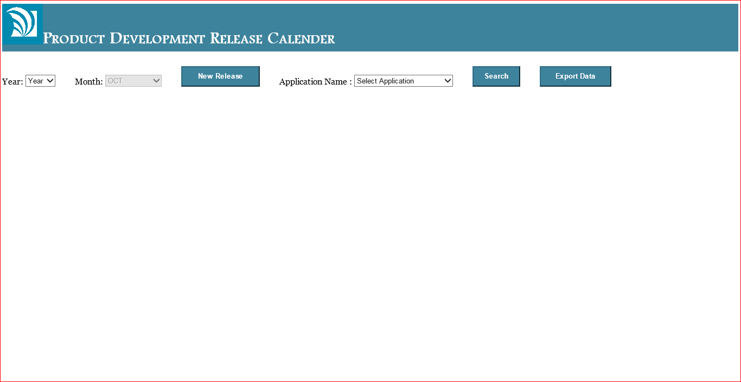
Product Development Release Calendar
Title and Content Slide
For Bullets
Type your text, then use the tab key to display the pre-formatted bullets.
Or select the text level and use the Decrease List Level Indent or Increase List Level Indent buttons on the Home tab to indent the pre-formatted bullets.
Use ctrl z key to undo.

Slide 5
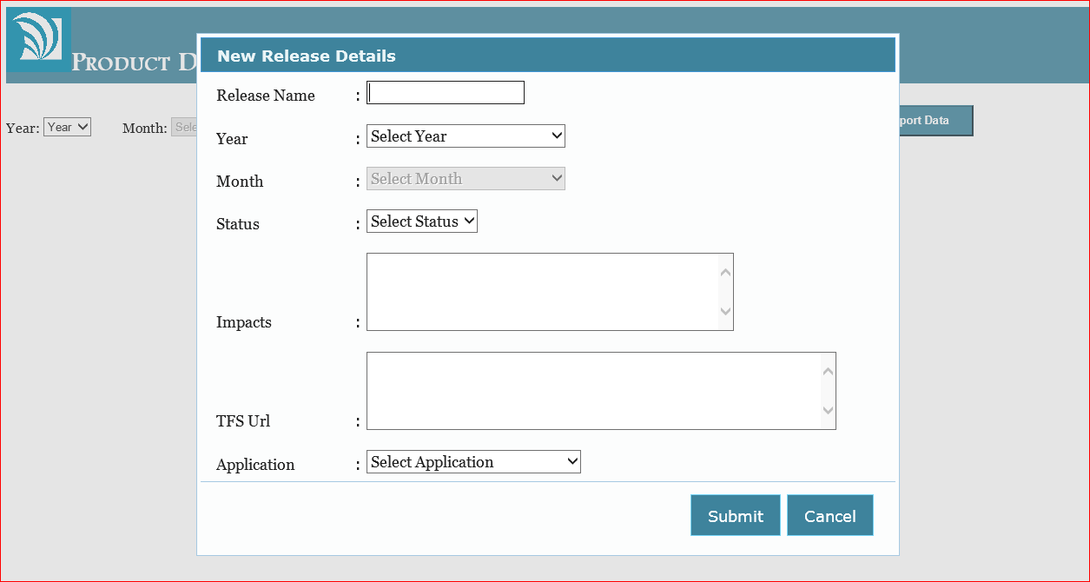
Add a new Release to an Application
Title and Content Slide
For Bullets
Type your text, then use the tab key to display the pre-formatted bullets.
Or select the text level and use the Decrease List Level Indent or Increase List Level Indent buttons on the Home tab to indent the pre-formatted bullets.
Use ctrl z key to undo.

Slide 6
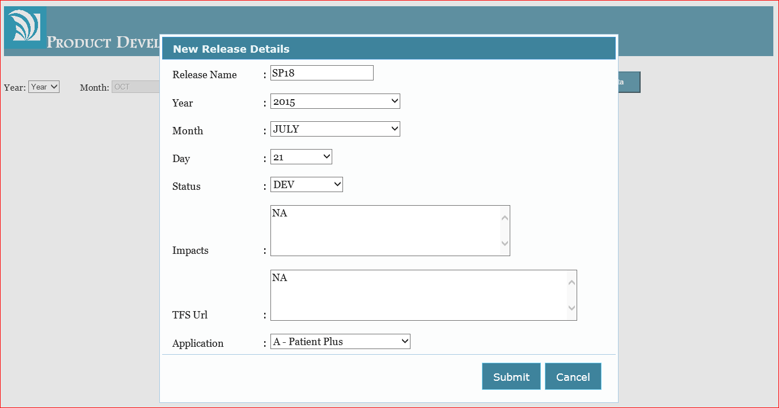
Add a new Release Status to the newly created Release( EX: Dev, Test , Stage and Live)
Title and Content Slide
For Bullets
Type your text, then use the tab key to display the pre-formatted bullets.
Or select the text level and use the Decrease List Level Indent or Increase List Level Indent buttons on the Home tab to indent the pre-formatted bullets.
Use ctrl z key to undo.

Slide 7
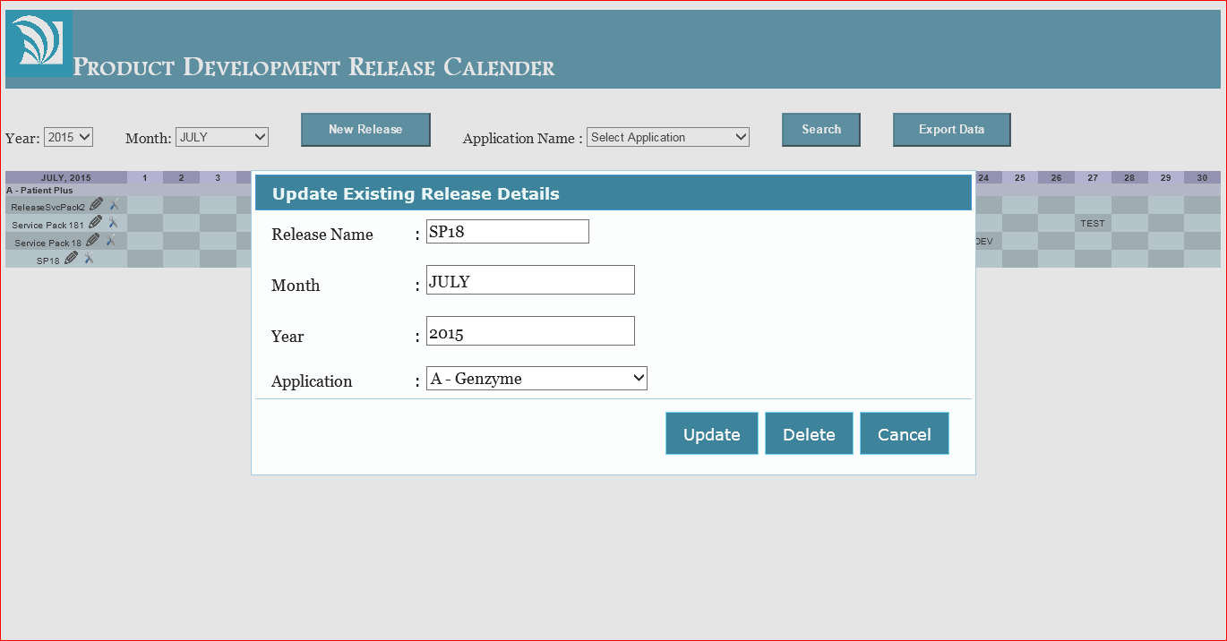
Update the Release Details
Title and Content Slide
For Bullets
Type your text, then use the tab key to display the pre-formatted bullets.
Or select the text level and use the Decrease List Level Indent or Increase List Level Indent buttons on the Home tab to indent the pre-formatted bullets.
Use ctrl z key to undo.

Slide 8
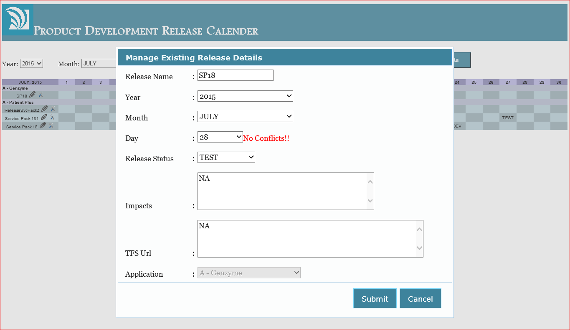
Update the Release Status Details
Title and Content Slide
For Bullets
Type your text, then use the tab key to display the pre-formatted bullets.
Or select the text level and use the Decrease List Level Indent or Increase List Level Indent buttons on the Home tab to indent the pre-formatted bullets.
Use ctrl z key to undo.

Slide 9
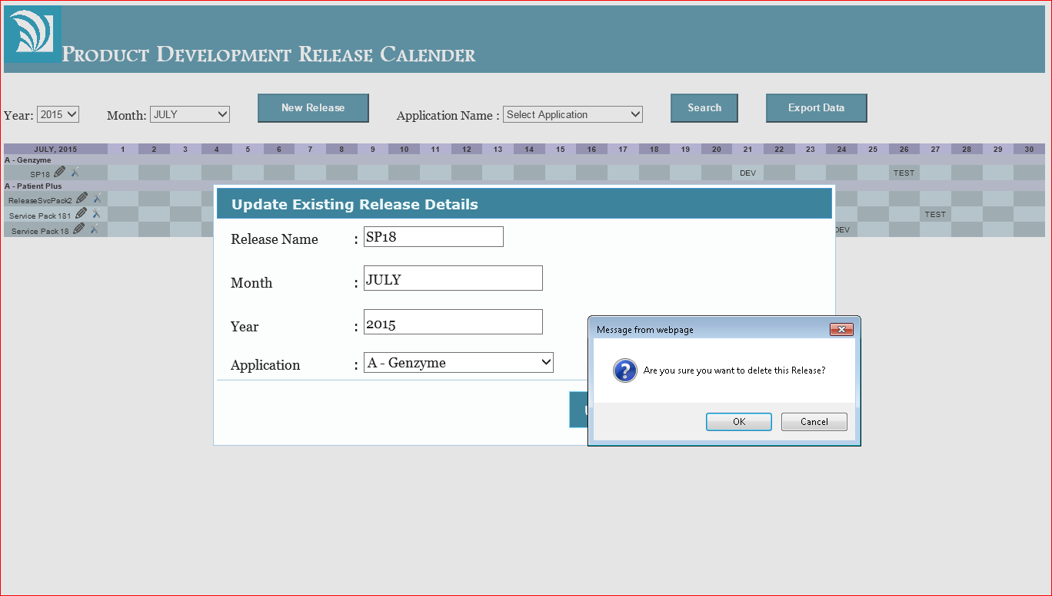
Delete the Release
Title and Content Slide
For Bullets
Type your text, then use the tab key to display the pre-formatted bullets.
Or select the text level and use the Decrease List Level Indent or Increase List Level Indent buttons on the Home tab to indent the pre-formatted bullets.
Use ctrl z key to undo.

Slide 10
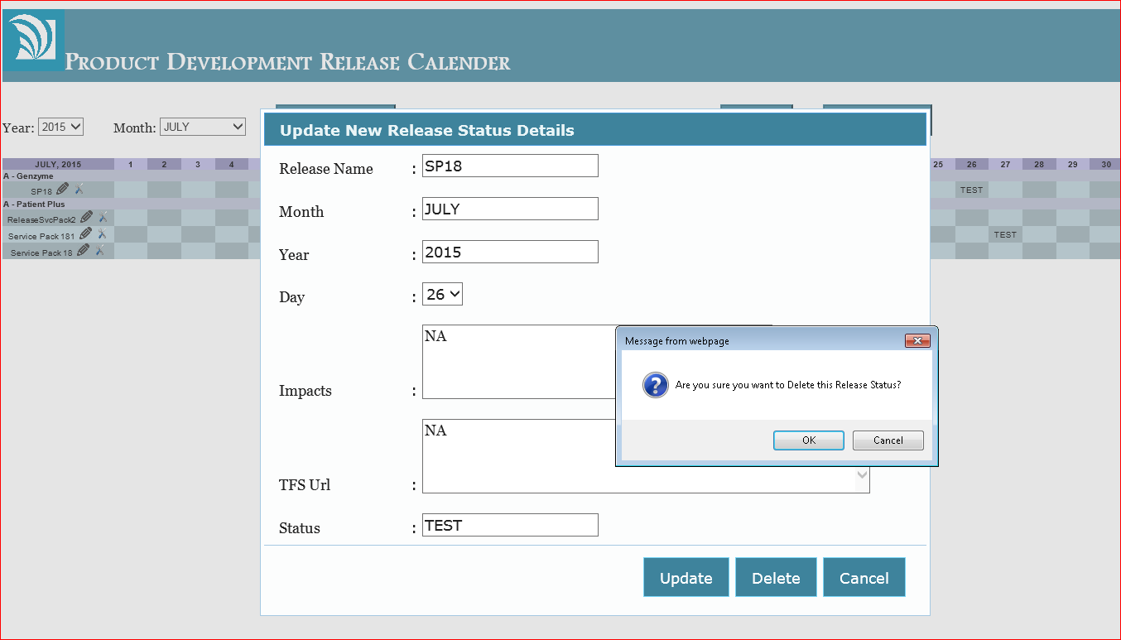
Delete the Release Status
Title and Content Slide
For Bullets
Type your text, then use the tab key to display the pre-formatted bullets.
Or select the text level and use the Decrease List Level Indent or Increase List Level Indent buttons on the Home tab to indent the pre-formatted bullets.
Use ctrl z key to undo.

Slide 11
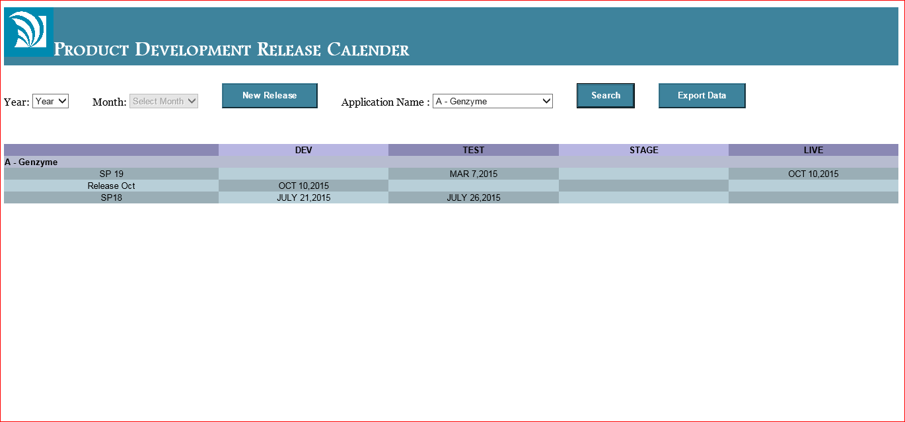
View the Release Statuses of a single/all Applications Release wise
Title and Content Slide
For Bullets
Type your text, then use the tab key to display the pre-formatted bullets.
Or select the text level and use the Decrease List Level Indent or Increase List Level Indent buttons on the Home tab to indent the pre-formatted bullets.
Use ctrl z key to undo.

Slide 12
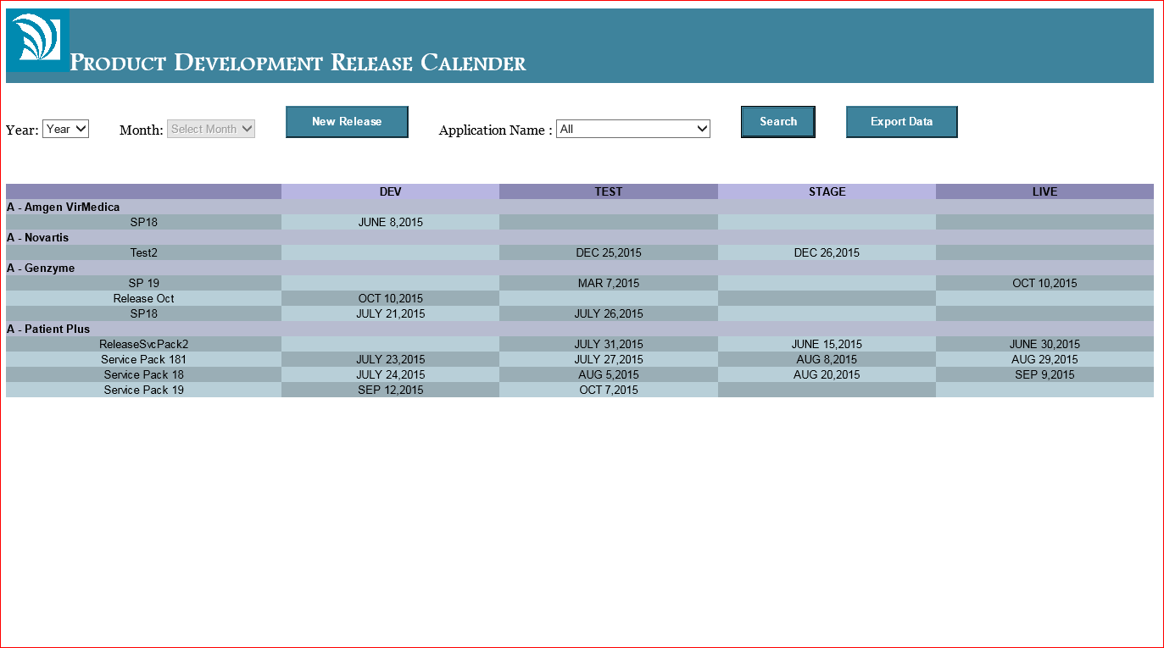
View the Release Statuses of a single/all Applications Release wise
Title and Content Slide
For Bullets
Type your text, then use the tab key to display the pre-formatted bullets.
Or select the text level and use the Decrease List Level Indent or Increase List Level Indent buttons on the Home tab to indent the pre-formatted bullets.
Use ctrl z key to undo.

Slide 13
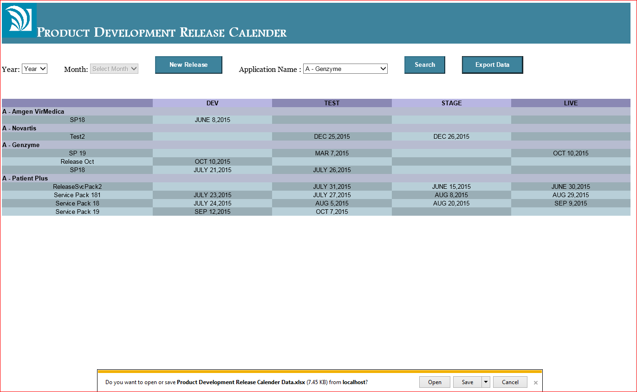
Generate an Excel Report of a single/all Applications
Title and Content Slide
For Bullets
Type your text, then use the tab key to display the pre-formatted bullets.
Or select the text level and use the Decrease List Level Indent or Increase List Level Indent buttons on the Home tab to indent the pre-formatted bullets.
Use ctrl z key to undo.

Slide 14
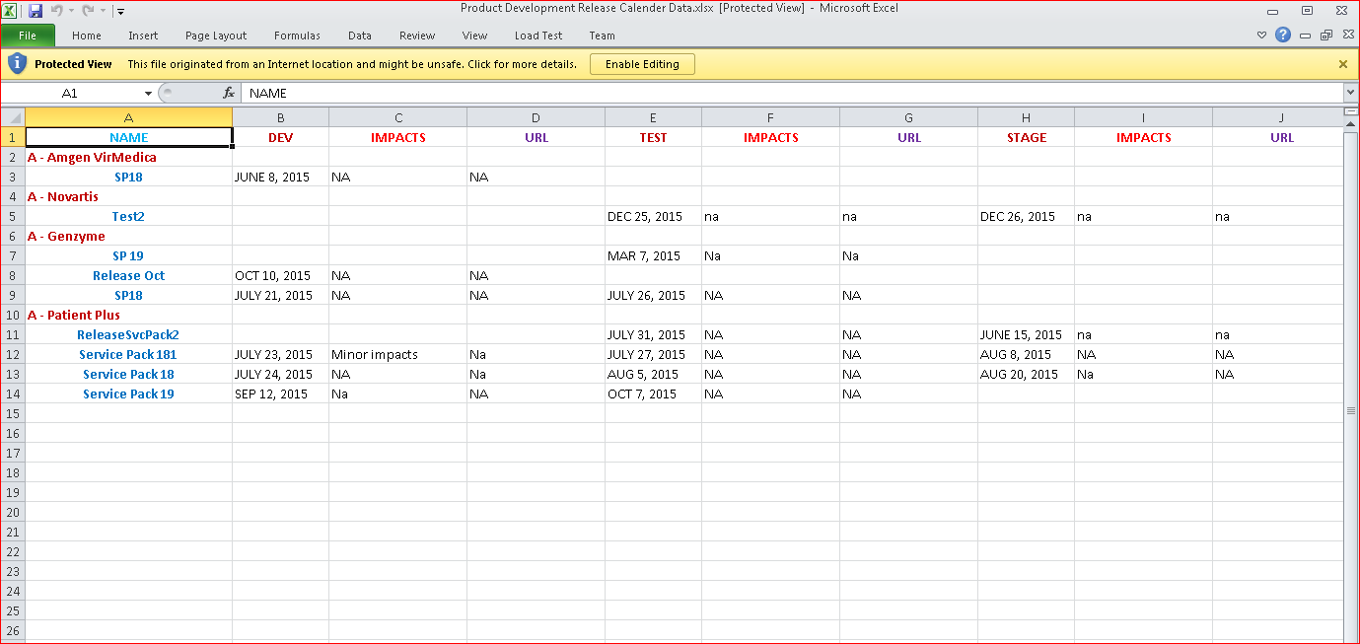
Generate an Excel Report of a single/all Applications
Title and Content Slide
For Bullets
Type your text, then use the tab key to display the pre-formatted bullets.
Or select the text level and use the Decrease List Level Indent or Increase List Level Indent buttons on the Home tab to indent the pre-formatted bullets.
Use ctrl z key to undo.

Slide 15
Why should we use this Application?
UI Features
Reporting Capability
Custom Graphic Example
This is an example of a custom graphic that aligns with the brand standards such as:
Solid square
No shadow
Flat shape
Primary brand color
Color can be changed as well by updating both “fill” and “line” options.
Allows the user to create a new Release and add status to it
The GUI provides the users to track the status of a release on selecting a month and an year
Checks for the date conflict with other Release statuses of a particular Release
Excel export can be done very easily with just a single button click after selecting an application
Maintains record of all the Release details in the database and can be accessed at anytime

Slide 16
Transition Slide in Primary Gray
Insert Transition Title and Subtitle (Title Case)
Questions & Comments

Slide 17
Thank you slide – use to provide name and contact information
Naga Bijesh Roy Raya Information Technology Intern bijesh.roy@lashgroup.com
Annamani Alli Lead Developer annamani.alli@lashgroup.com

Slide 18
AmerisourceBergen Positioning Line Always use as your final slide.
Non-editable.
To Print your presentation deck select the File tab and under Print there are settings for printing in color or B/W and options to print slides, notes or handouts.

