Slide 1
NEW RETAIL STORE CREATION AND MAINTANENCE
GROUP 2
BINDHU KOMALLA
LAVANYA LOGANARAYANAN
NAGA BIJESH ROY RAYA
RAJIV MUSUNURU
SINGA RAJU NADIMPALLI

Slide 2
AGENDA
MOTIVATION & PROBLEM DEFINITION
_{PROPOSED SOLUTION}
_{FUNCTIONAL REQUIREMENTS}
_{NON-FUNCTIONAL REQUIREMENTS}
_{USE CASE SCENARIOS}

Slide 3
AGENDA
OVERVIEW OF ARCHITECTURE AND DEPLOYMENT
_{DESIGN ISSUES}
_{STATUS,} PROBLEMS FACED, LESSONS LEARNED
_{FUTURE WORK}

Slide 4
MOTIVATION AND PROBLEM DEFINITION
Factors that determines the growth of retail business
How are those factors measured
Problems faced by retail industries
How do these problems affect their business
Example- Problems faced by Wal-Mart in the year 2009

Slide 5
PROPOSED SOLUTION
Giving web access to a store that is newly created
The system would enable the store employees to access all the services offered by newly store created store

Slide 6
FUNCTIONAL REQUIREMENTS
Creation of new store
Inventory Management
Promotions and Clearances
Customer Points system
Point of sales

Slide 7
NON-FUNCTIONAL REQUIREMENTS
Security Requirements
Authentication Requirements, Authorization Requirements
Product Requirements
Portability requirements
Organizational Requirements
Delivery Requirements, Implementation Requirements
Standard Requirements
Intuitive names, camel case convention are used

Slide 8
CREATION OF NEW STORE
Objective
Actors involved
Preconditions
Post conditions
Use case description

Slide 9
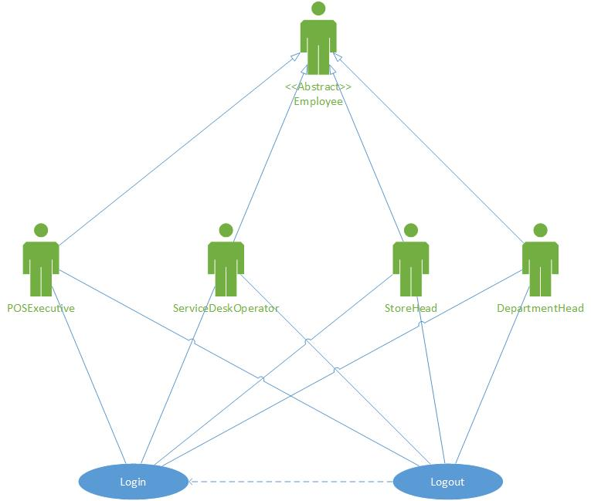
USE CASE DEPICTING LOGIN SCENARIO

Slide 10
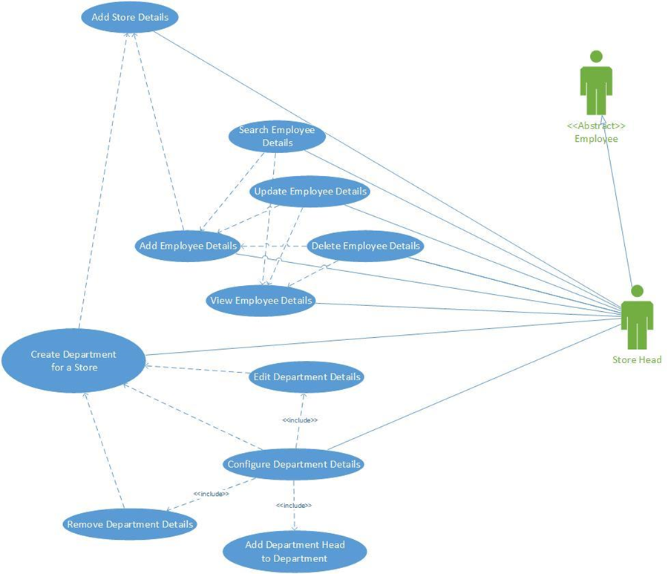
USE CASE DEPICTING CREATION OF NEW STORE

Slide 11
INVENTORY MANAGEMENT
Objective of Inventory Management
Actors - Store Head, Department Head
Preconditions/Post conditions
Description, flow of events

Slide 12
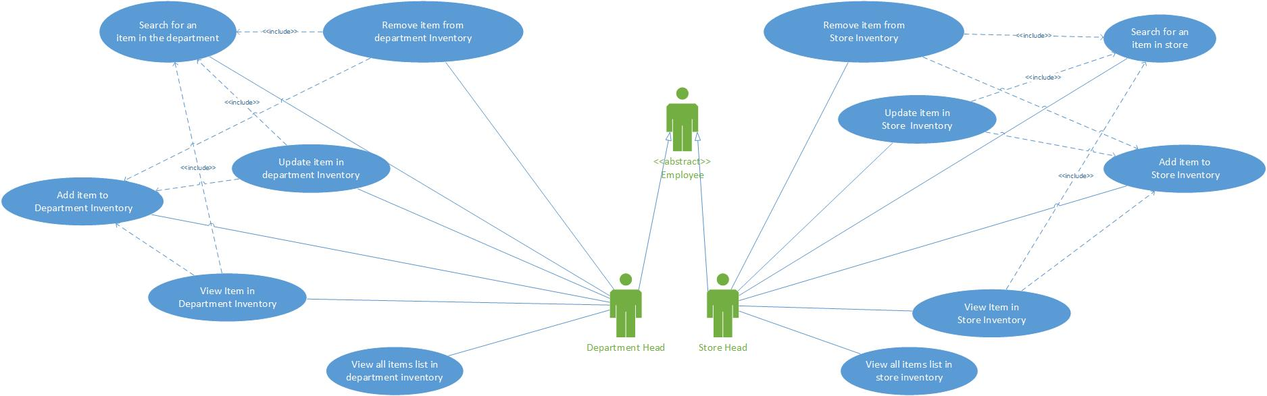
USE CASE OF INVENTORY MANAGEMENT

Slide 13
PROMOTIONS AND CLEARENCE
Objective of Promotions and Clearance
Actor - Store Head
Preconditions/Post conditions
Description, flow of events

Slide 14
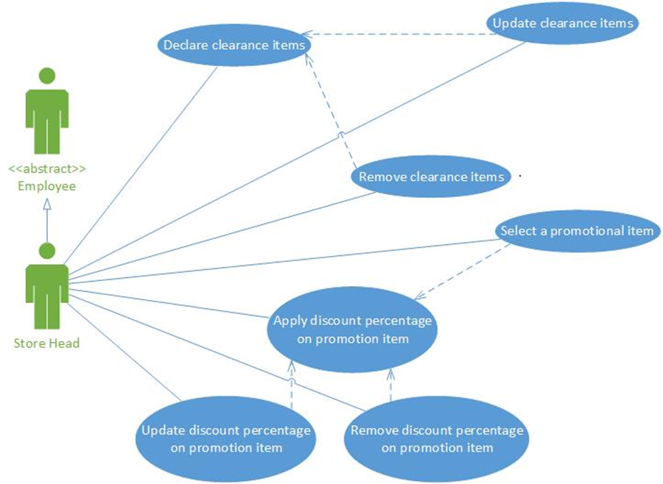
PROMOTION AND CLEARENCE

Slide 15
CUSTOMER POINT SYSTEM
Objective of Customer point system
Actor – Service Desk Operator
Preconditions/Post conditions
Description, flow of events

Slide 16
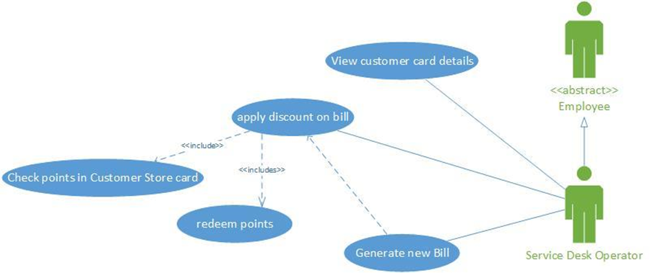
CUSTOMER POINT SYSTEM

Slide 17
POINT OF SALES
Objective of Point of sales
Actor – POS Executive
Preconditions/Post conditions
Description, flow of events

Slide 18
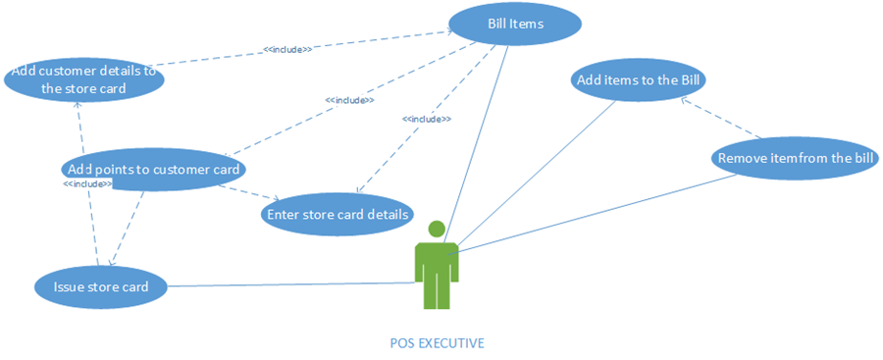
POINT OF SALES

Slide 19
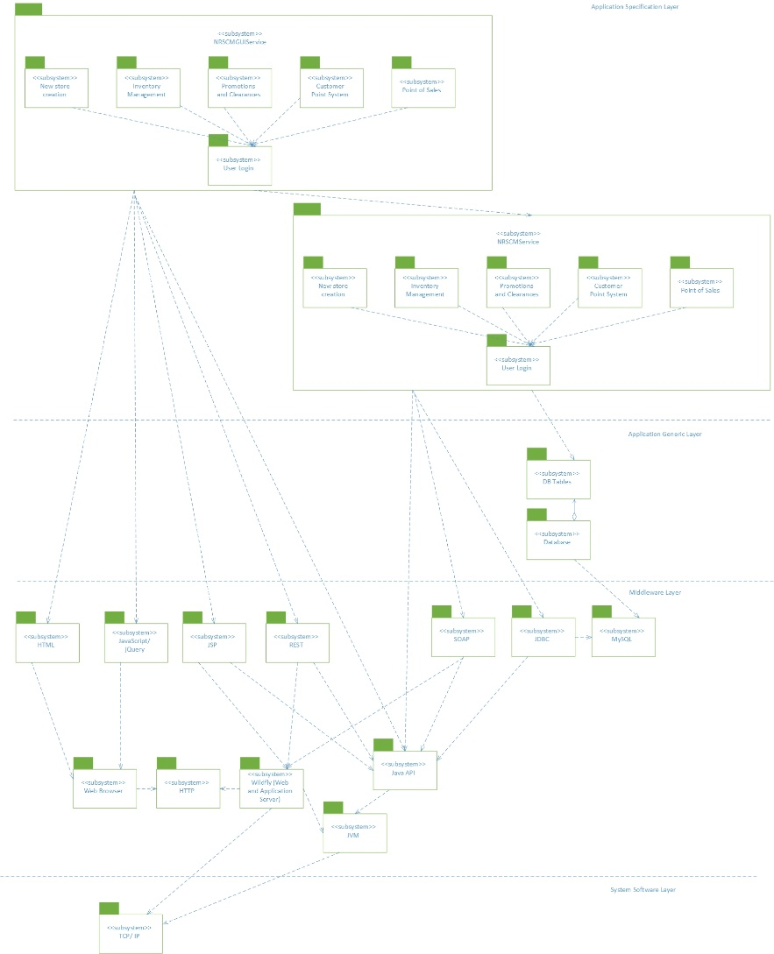
SUBSYSTEM ARCHITECHTURE

Slide 20
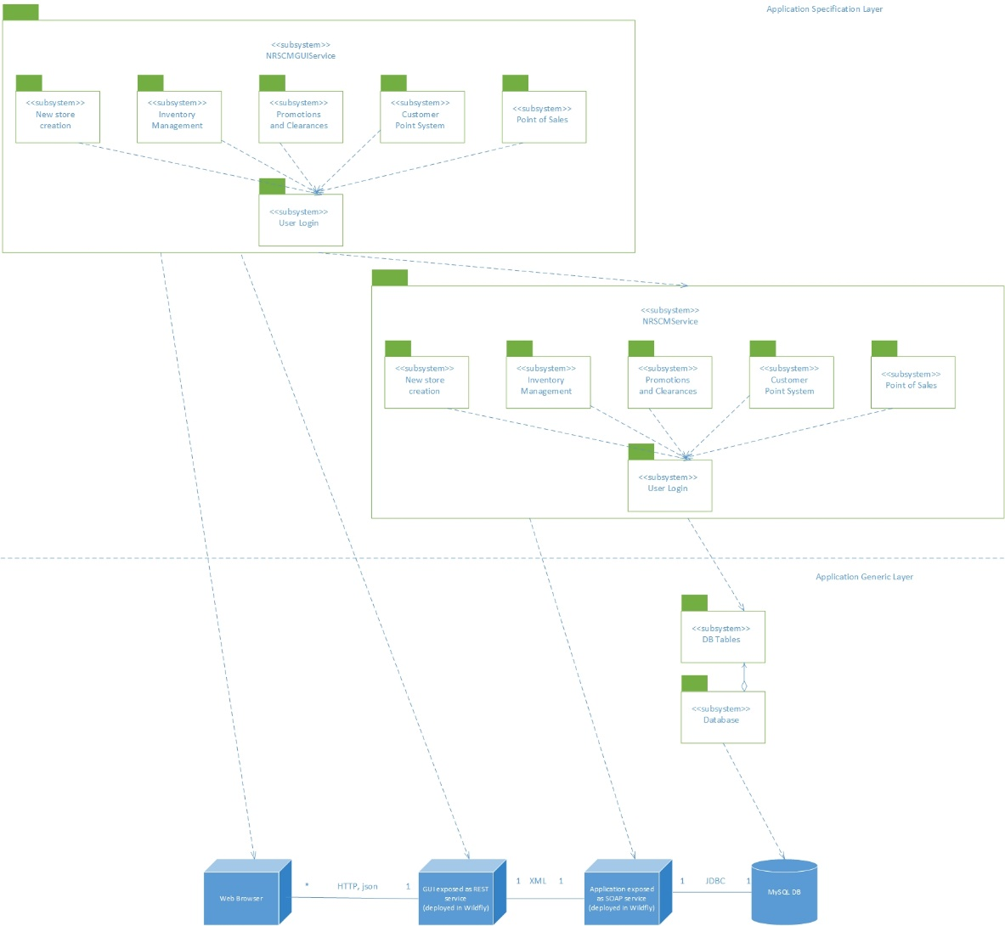
DEPLOYMENT DIAGRAM

Slide 21
DESIGN ISSUES/ DECISIONS
Separating web front end from business logic
Applying appropriate design patterns – A variation of Front Controller, Facade, Table Module, Table Data Gateway

Slide 22
STATUS, PROBLEMS FACED & LESSONS LEARNED
Status:
Requirements are identified and specified
Design has been completed
Currently under development
Problems Faced:
Identifying the appropriate actors in the System
Identifying the dependency between the functional requirements

Slide 23
STATUS, PROBLEMS FACED & LESSONS LEARNED
Lessons Learned:
Inconsistency between the requirements and design should be avoided
Calculated estimations should be made for delivering the product

Slide 24
FUTURE WORK
Adding support for hardware such as card readers and bar code scanners.
Adding support for data analytics to help make managerial decisions such as discounts on items and identifying items that need to be put special promotions.
Adding support to multiple currency transactions.

Slide 25
FUTURE WORK
Expanding the application's support to store credit cards by help deciding the customers eligible for allocating store credit
Different types of store credit cards based on the frequency and amount of purchases
Adding support to buy one get one offers apart from discounts on price.

Slide 26
Questions … ?

