Slide 1
UNCC Alumni
Group-4 Team Connect
Naga Bijesh Praharsha Trinadh Rohan
Teja Kashyap Praneeth

Slide 2
Overview…
Introduction
Technologies used
E-E-R Diagram – Explanation
Business Functionalities
Performance
Questions

Slide 3
Technologies Used….
Dia
HTML
CSS
Php
jQuery
MySQL
MySQL Work Bench
XAMPP
Apache
Netbeans

Slide 4
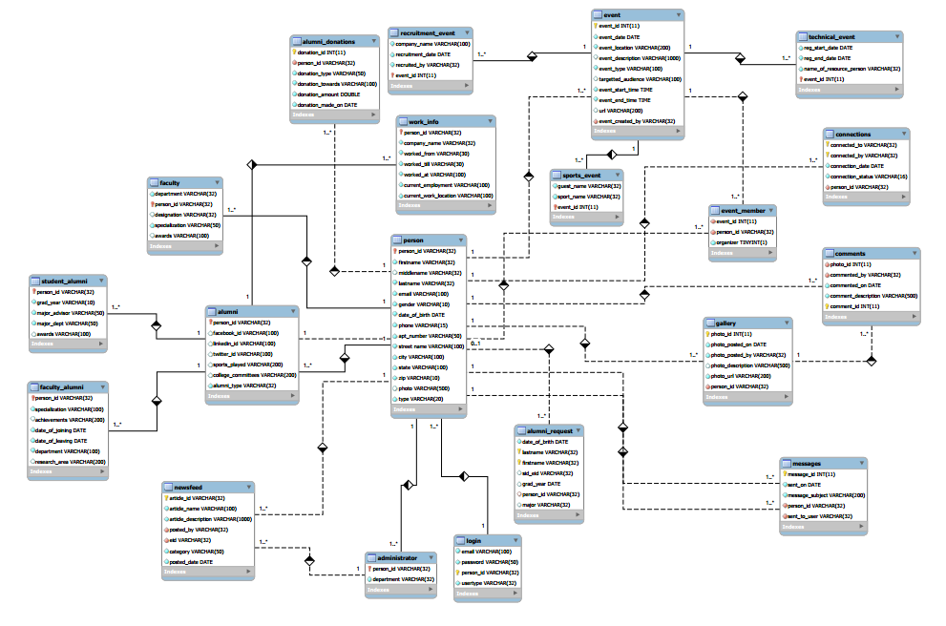
E-E-R Diagram

Slide 5
Business Functionalities…
Login
Alumni Request
Search Alumni
View and Upload Pictures to Gallery
Send connection invite
Donation by Alumni
Faculty can search alumni

Slide 6
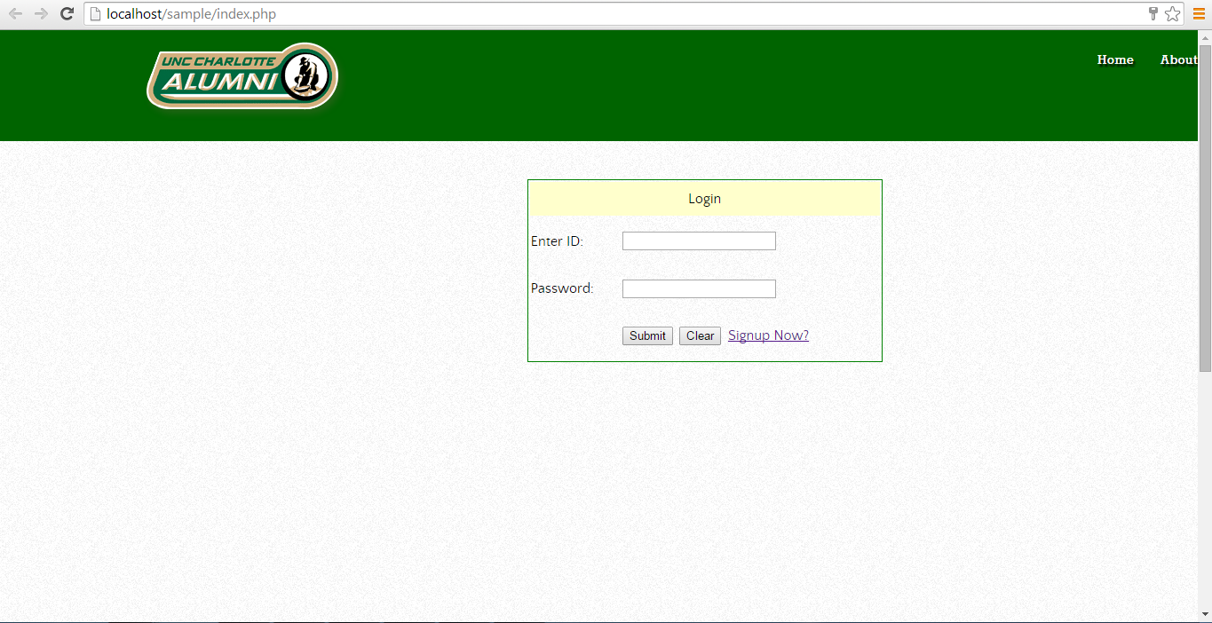
Login
User sends a request for registration
Administrator validates the credentials and accepts/declines the request

Slide 7
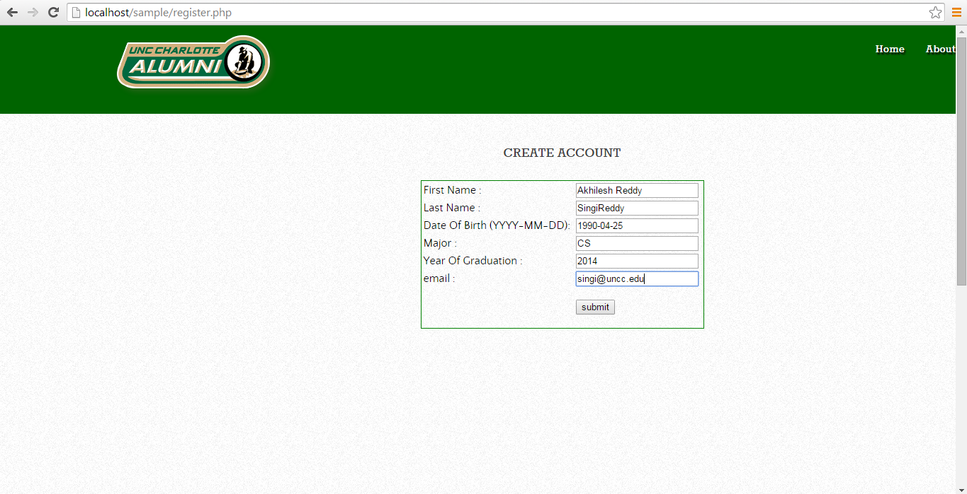
Register

Slide 8
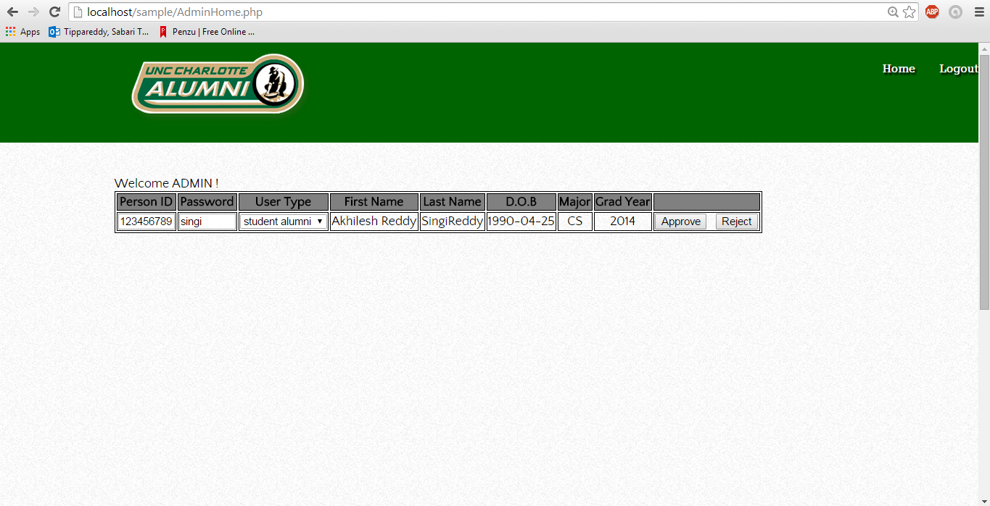
Admin View

Slide 9
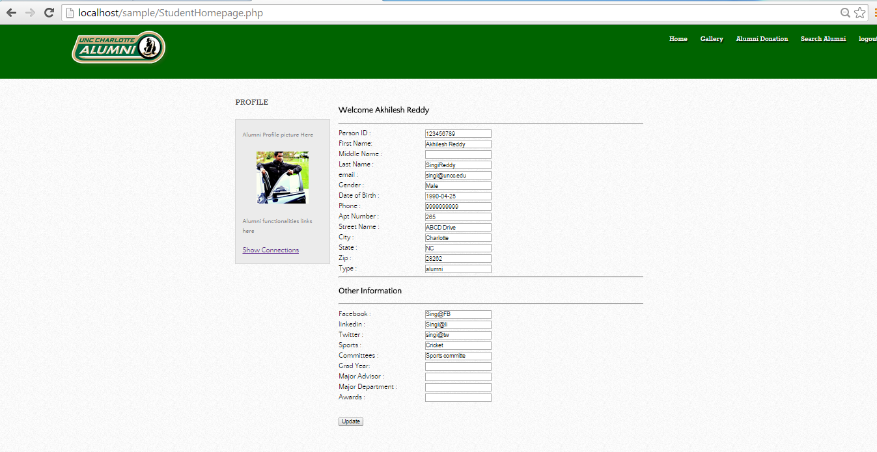
Home

Slide 10
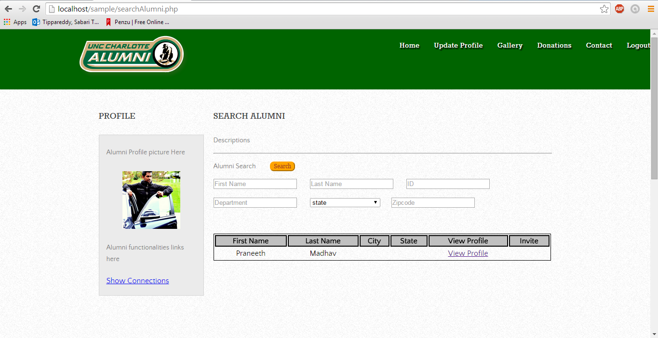
Search Alumni
Person can search based on firstname, lastname and geography
Login is necessary to search the Alumni

Slide 11
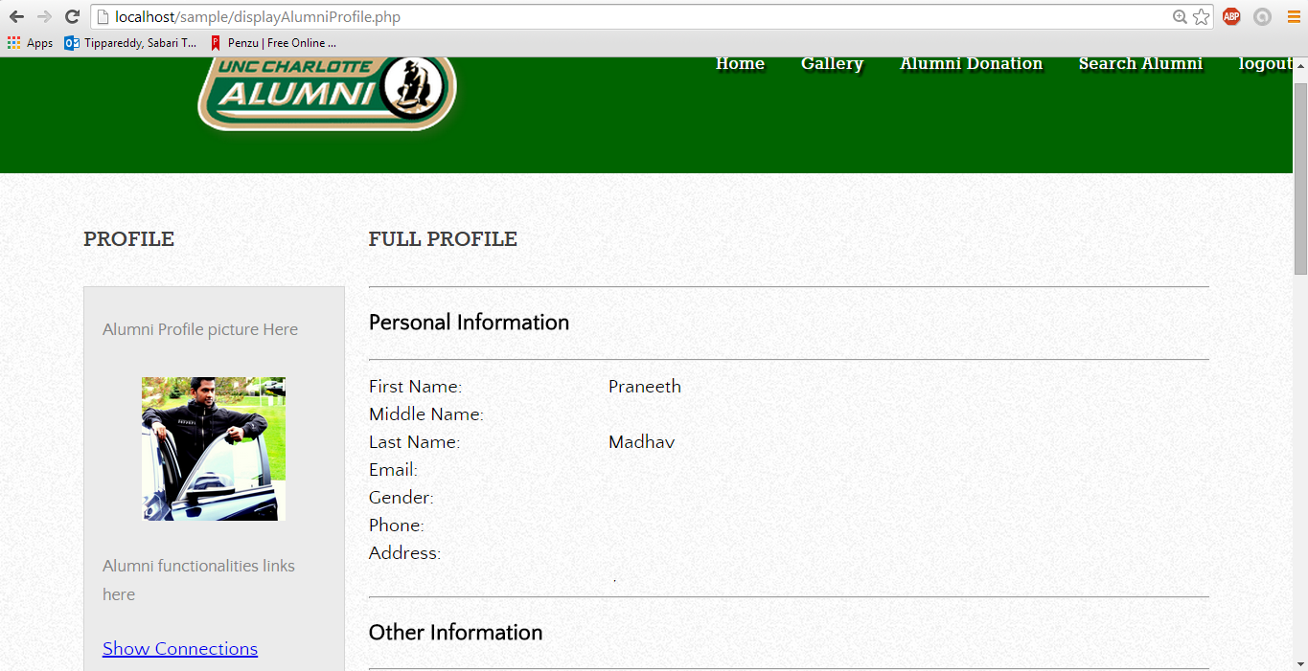
View Alumni Profile

Slide 12
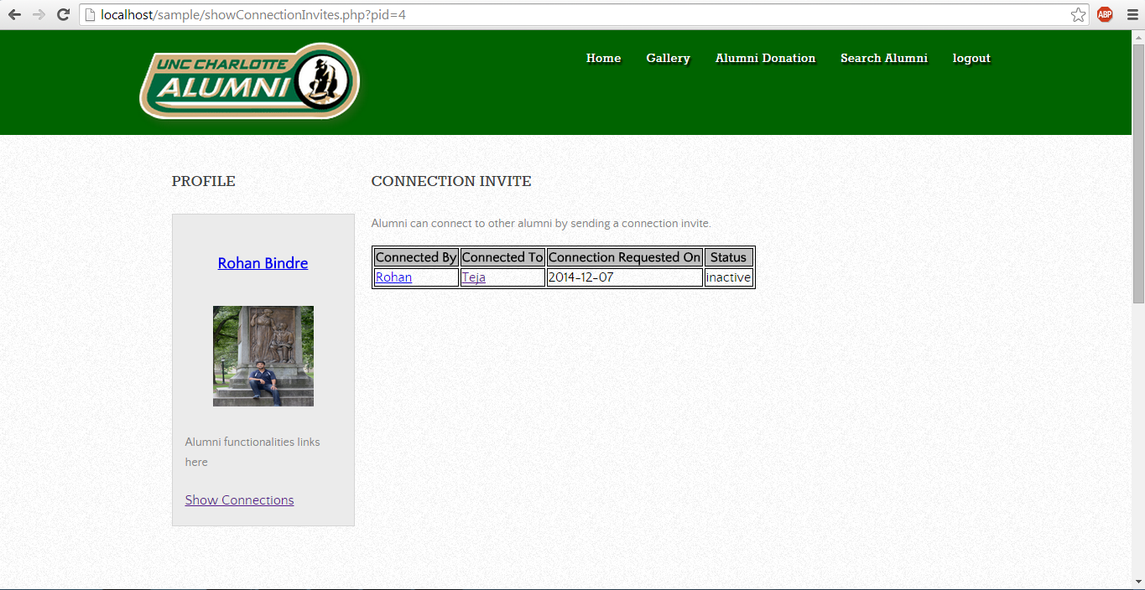
Connection Invites
Alumni can send connection invite to other alumni (similar to linkedin Connections)

Slide 13
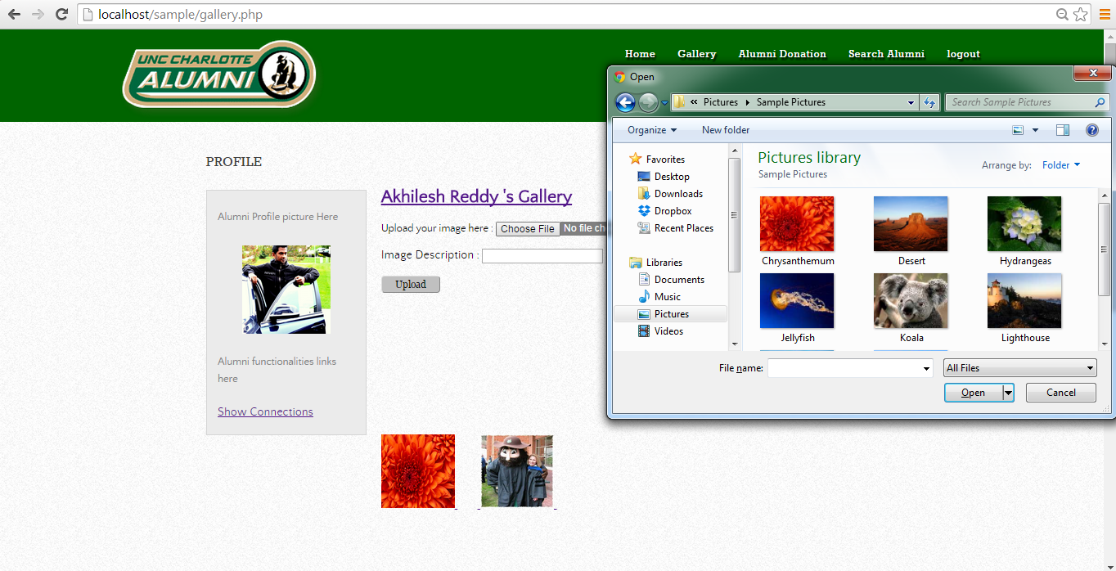
Gallery
Alumni can upload the photo to gallery
Connections of alumni can view this gallery
Comments can be added/deleted to the photos uploaded

Slide 14
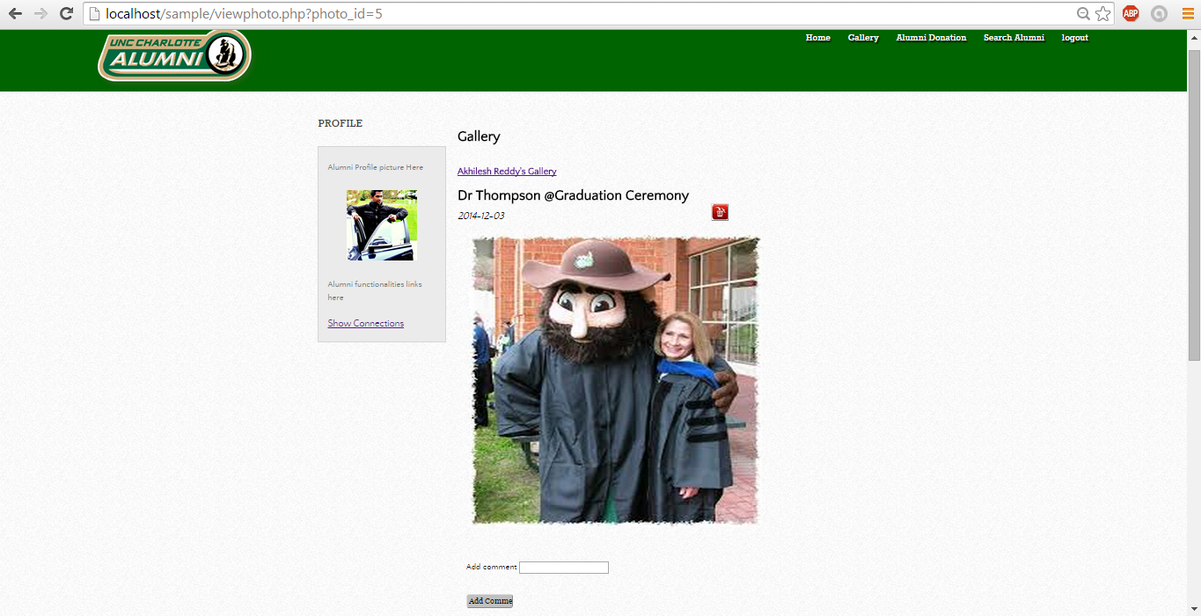
Comments on Images

Slide 15
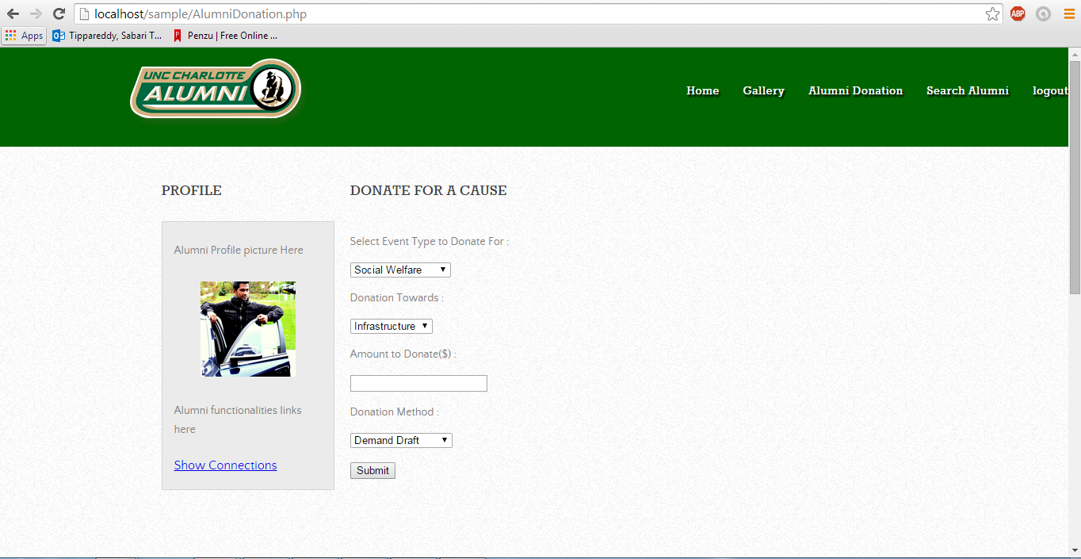
Donations
Alumni can view the current and future events
Alumni can donate to any of these events

Slide 16
Database Performance…
Indexes and Views are created to improve the database performance
Views are created on Search Alumni
view query:
create view search_dept_view as
select
p.firstname, p.lastname, p.city, p.state, fa.department, p.person_id
from
person p , faculty_alumni fa, student_alumni sa
where
p.type = 'alumni' and fa.department = sa.major_dept;
Index is created on username, firstname and lastname

Slide 17
Future Work…
RSS Feeds
Messages between Alumni
Track the donation history of the alumni
Manage Connections

Slide 18

Questions…

