Slide 1
Module 1

Slide 2
Agenda
Agenda
1
2
Cloud Computing
1
AWS Suite (with analogy)
1
3
4
1
Deployments & Models
1
Virtualization in AWS
5
6
1
1
Advantages
XEN Hypervisor

Slide 3
Cloud Computing
Cloud Computing

Slide 4
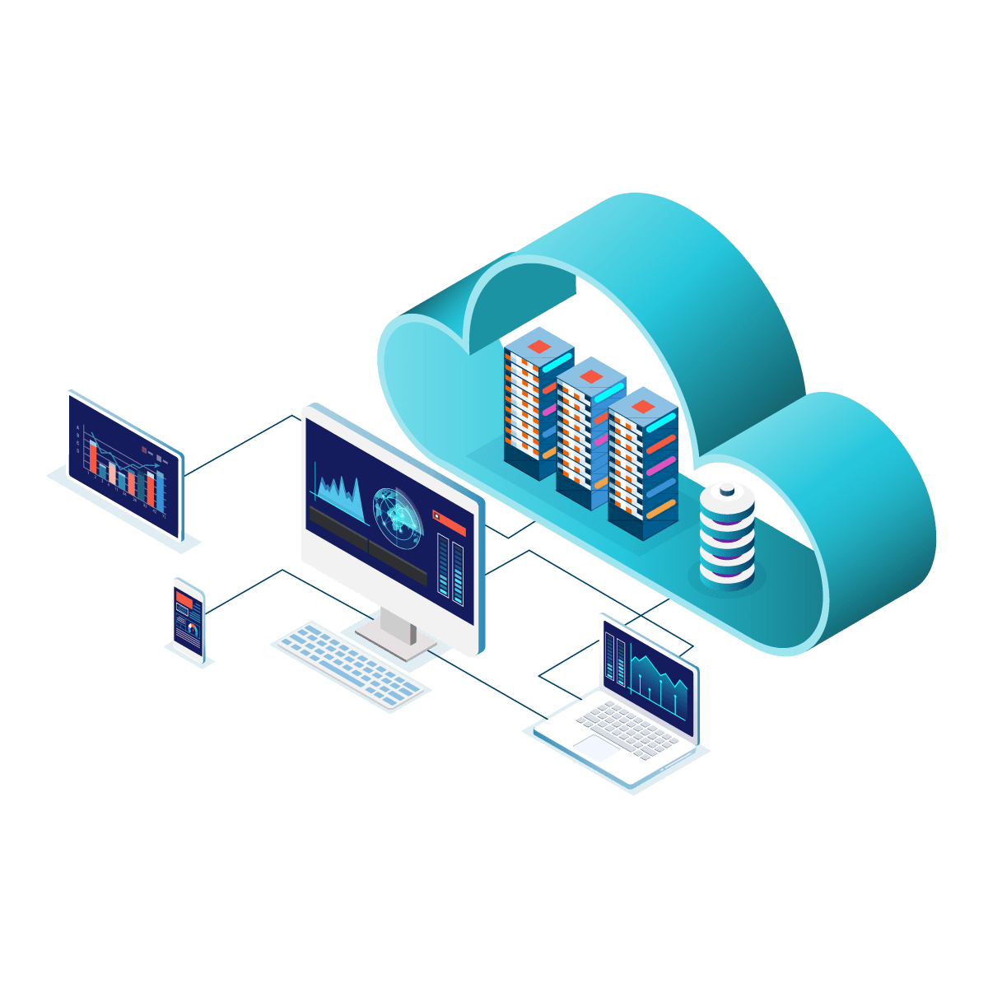
Cloud Computing
The “NET”
What is Internet/Intranet
A global computer network using standardized communication protocols (e.g. UDP, TCP/IP) providing information and communication facilities, consisting of interconnected networks
Intranet is a local private network created using World Wide Web.

Slide 5
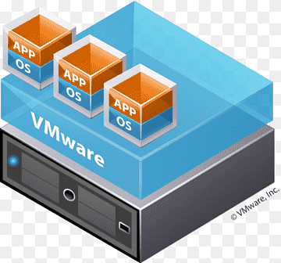
Cloud Computing
Virtualization
Virtualization is the primary technology that supports cloud
computing.
A service that results from virtualization, which is software that
modifies hardware, is referred to as cloud computing. Virtualization is
necessary for cloud computing to exist.

Slide 6


















Models & Deployments
Cloud Service Models
IaaS (Infrastructure as a Service): AWS, Rackspace, MS Azure etc.
PaaS (Platform as a Service): AWS Elastic Beanstalk, Heroku etc.
SaaS (Software as a Service): Google drive, Google docs, MS Office 365 etc.
+
+
=
Product
Cooking
Infrastructure
Platform

Slide 7
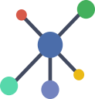



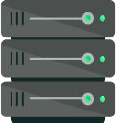


Models & Deployments
Cloud Service Models
IaaS (Infrastructure as a Service): AWS, Rackspace, MS Azure etc.
PaaS (Platform as a Service): AWS Elastic Beanstalk, Heroku etc.
SaaS (Software as a Service): Google drive, Google docs, MS Office 365 etc.
OS
JVM
+
+
=
Product
Java
Coding
IDE
Infrastructure
Platform
Users

Slide 8
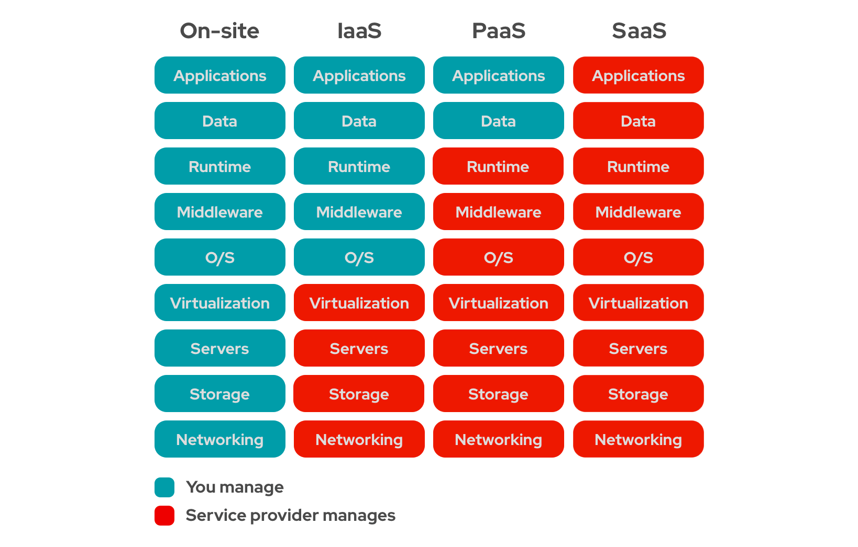
Models & Deployments
On-Site
v/s
IaaS
v/s
PaaS
v/s
SaaS

Slide 9
Cloud Service Models
IaaS (Infrastructure as a Service): AWS, Rackspace, MS Azure etc.
PaaS (Platform as a Service): AWS Elastic Beanstalk, Heroku etc.
SaaS (Software as a Service): Google drive, Google docs, MS Office 365 etc.
Cloud Deployment Models
Public Cloud (AWS, MS Azure, Google Platform, IBM Bluemix etc.)
Private Cloud (HPE, VMware, RedHat OpenStack, Dell EMC etc.)
Hybrid Cloud

Slide 20
Azure vs AWS vs GCP

Slide 21
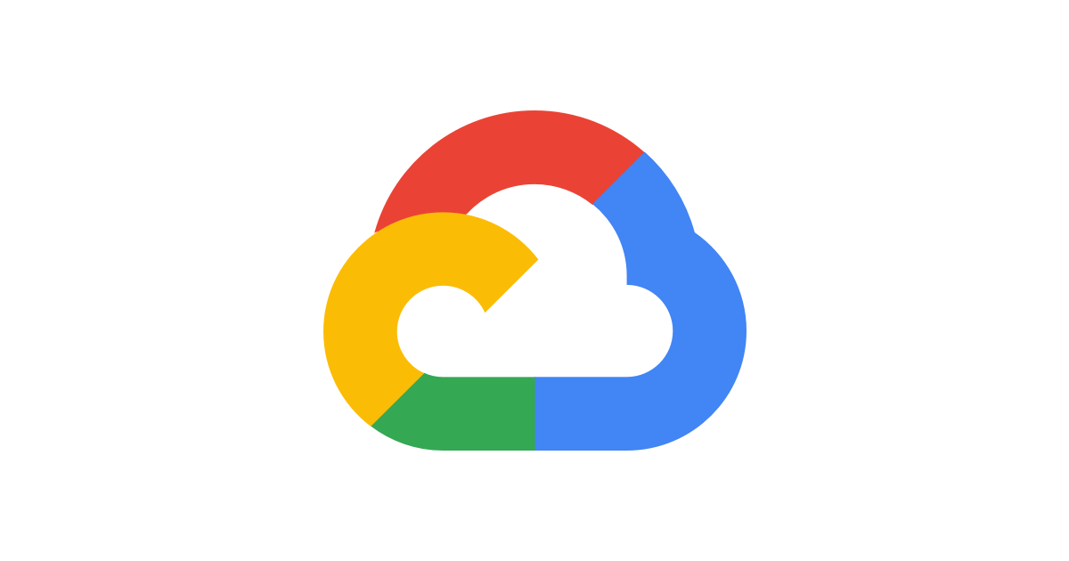
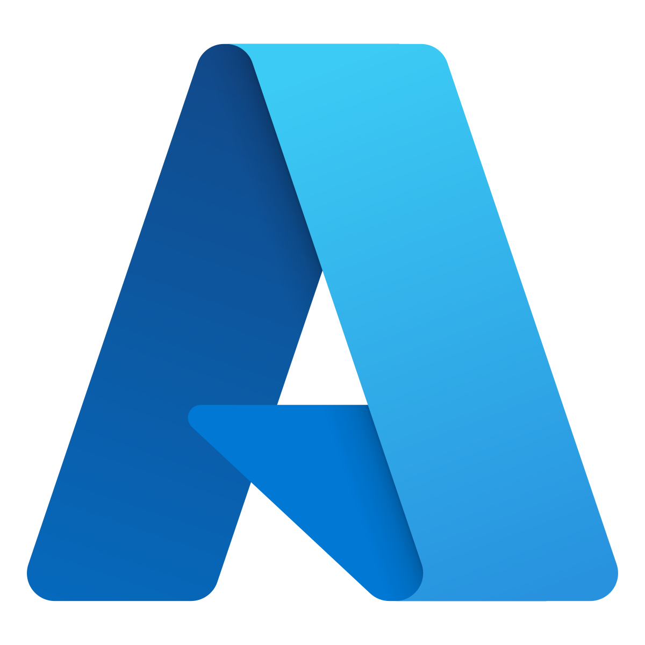
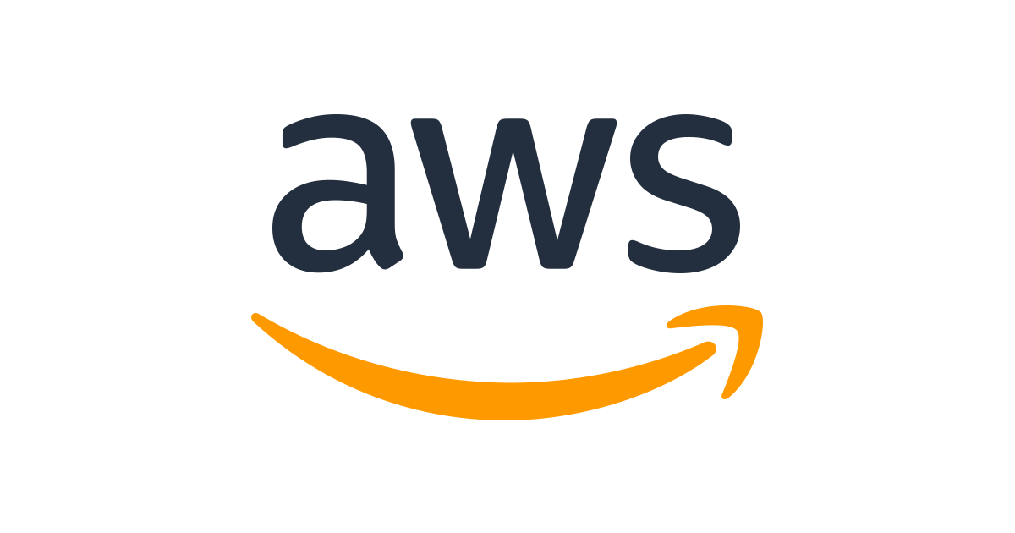
Azure Vs AWS Vs GCP
Microsoft Azure initially called
Azure, was launched in 2010 with the intent to provide competent Cloud Computing platform for businesses.
Amazon Web Services is a subsidiary of amazon.com,
which provides an on-demand Cloud Computing platform to individuals , companies and government on a paid-subscription basis.
Google Cloud Platform , which is offered by
Google is a suite of Cloud Computing services that runs on the same infrastructure that Google uses internally for its end user products such as Google search engine.

Slide 22
Azure Vs AWS Vs GCP
Availability Zones
AWS has 66 availability zones with 12 more on the way.
Azure has 54 regions worldwide and is available in 140 countries all around the world.
Google Cloud Platform has been made available in 20 regions around the world with 3 more on their way.

Slide 23

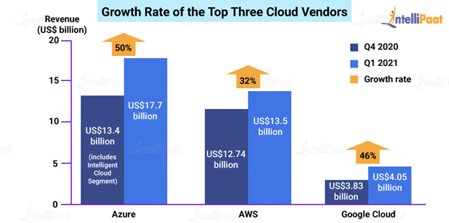
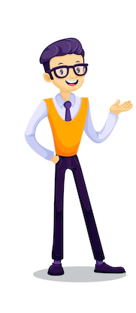
Azure Vs AWS Vs GCP
Market Shares and Growth Rate

Slide 24
Azure Vs AWS Vs GCP
Who uses them ?
Since AWS is the oldest player in the cloud market, it comparatively has a bigger community support and user base. Therefore, AWS has more high-profile and well-known customers like Netflix, Airbnb, Unilever, BMW, Samsung, MI, Zynga, etc..

Slide 25
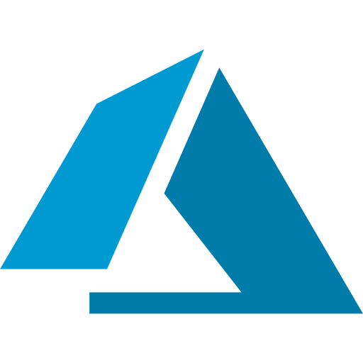
Azure Vs AWS Vs GCP
Who uses them ?
Azure is also gaining its share of high-profile customers with time. As of now, Azure has almost 80 percent of Fortune 500 companies as its customers. Some of its major customers are Johnson Controls, Polycom, Fujifilm, HP, Honeywell, Apple, etc..

Slide 26
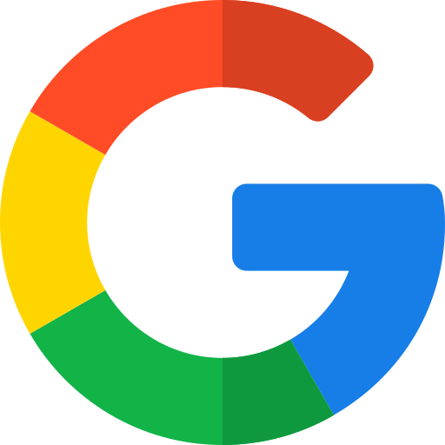
Azure Vs AWS Vs GCP
Who uses them ?
Google, on the other hand, shares the same infrastructure as that of Google Search and YouTube and, as a result, many high-end companies have put their faith in Google Cloud. Major clients of Google Cloud are HSBC, PayPal, 20th Century Fox, Bloomberg, Dominos, and more.

