Slide 1


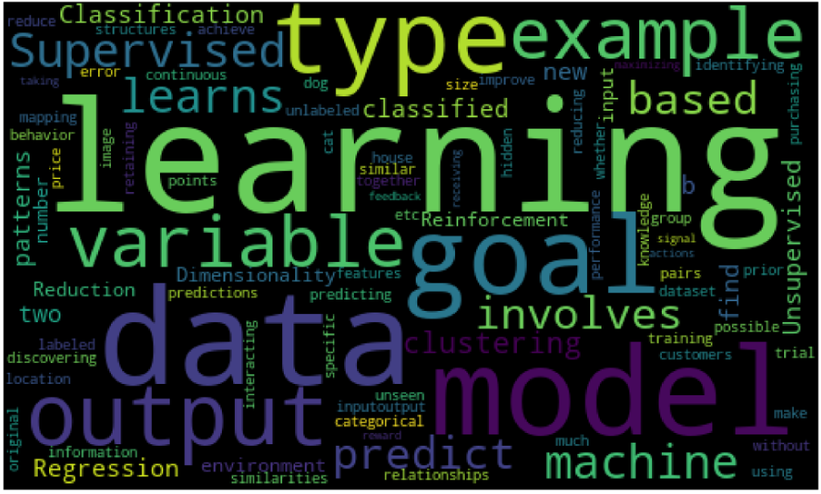

Overview of WordCloud
Nagamohan Kumar

Slide 2


What is a wordcloud?
The wordcloud is a visual representation of a text or corpus of text, where the most frequently occurring words are represented in larger fonts and displayed in a random arrangement. Wordclouds are used to help visualize and analyze large amounts of text data and are commonly used in fields such as data analysis, data visualization, and text mining.
The purpose of a wordcloud is to provide a quick, visual summary of the most important or frequently used words in a text or corpus of text. By analyzing the most prominent words in a wordcloud, researchers and analysts can gain insights into patterns, trends, and themes in the data.

Slide 3
Understanding Stopwords: Why Removing Them is Important for Accurate Text Analysis
Stopwords are common words that appear frequently in a language but do not carry much meaning or value when it comes to analyzing text data. Examples of stopwords in English include "the", "and", "a", "an", "in", "of", etc.
When working with text data, it's often necessary to remove stopwords because they can have a negative impact on the accuracy of text analysis tasks like sentiment analysis, topic modeling, and keyword extraction. This is because they can skew the results of these tasks by causing noise in the data and making it harder to identify the most important words and phrases.
By removing stopwords, we can improve the accuracy of text analysis models by reducing the noise in the data and making it easier to identify the most relevant and meaningful words and phrases. This can help us to extract more meaningful insights from our text data and make better-informed decisions based on those insights.
Note : We also remove the punctuations before we proceed with the text analysis

