Slide 1
Attrition Modeling at the IRS
Naga Deepak Chelluri and Erin Mather

Slide 2
The Problem
The IRS’ budget is 21% below its 2010 level after adjusting for inflation
Money allocated at the beginning of a fiscal year cannot easily be reallocated
The Situation
Labor costs represent 75% of total annual funding
Since 2010, between 4,600 and 6,100 employees have left the IRS each year

Slide 3
The Opportunity
If the IRS can accurately predict the number of departures, they can properly allocate funding between personnel and critical unfunded requirements.

Slide 4
The Project
Main Goals
Discover the historical attrition rate in each Fund/Business Unit category
Elicit existing methods of attrition modeling through interviews
Compare each attrition modeling method for accuracy and sensitivity (where applicable)
Suggest process improvements.
Low Priority Goals
What percentage of the Fiscal Year an employee works before departing
Evaluate Statement “One Third of Annual Attrition Occurs in the first quarter of the Fiscal Year”

Slide 5
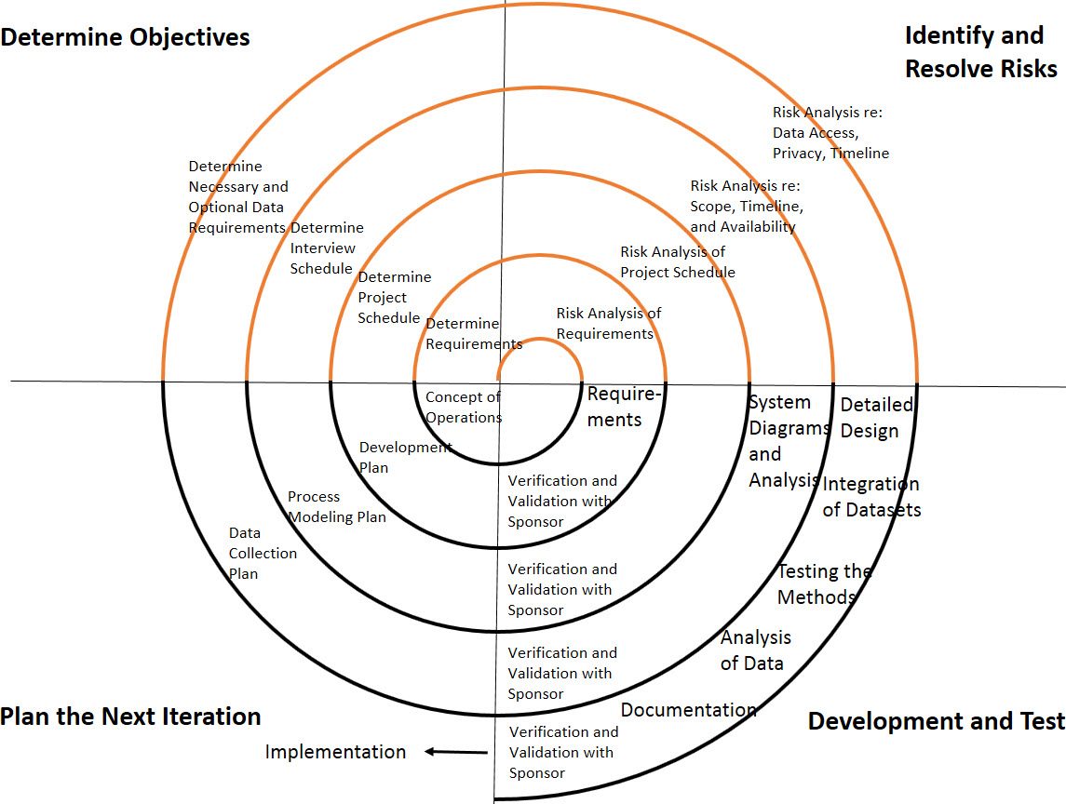
The Methodology

Slide 6
The Technical Approach
Requirements Management
Stakeholder Requirements Elicitation
Requirements Definition and Analysis
Risk Management
System Elicitation, Documentation, and Analysis
Technical Assessment
Decision Analysis – How/Why were the methods chosen?
Analysis of Method Alternatives
Verification and Validation
Implementation
Using: ExcelTM, PowerPointTM , TableauTM

Slide 7
The Challenges
Changing Requirements
Access to Data
Structural access either not given or given after significant delay
Project is High Priority for us but Low Priority for interviewees
Structural Issues
Government Shutdowns
IRS-employees can only meet during normal working hours
Privacy Concerns

Slide 8
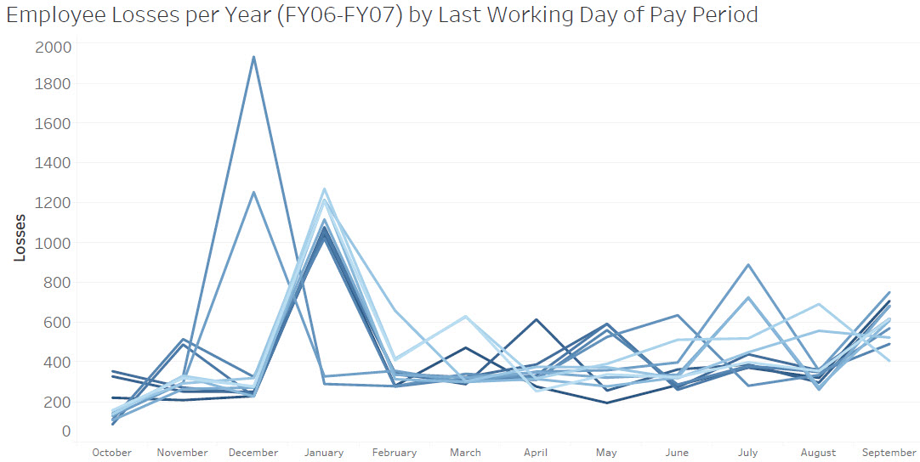
The Attrition

Slide 9
List of Typical Modeling Processes
Method of Estimating Attrition
Previous Attrition
Previous Attrition + 0.5%
Lower of Previous Attrition in past two years
Previous Attrition 2-year Average
Previous Attrition 3-year Average
Previous Attrition 5-year Average
Linear Regression->Straight-Line Projection of 8-year Attrition %
Linear Regression->Straight-Line Projection of 5-year Attrition %
% of Year Loss Factor (Cumulative Distribution Function)
RAAS Model

Slide 10
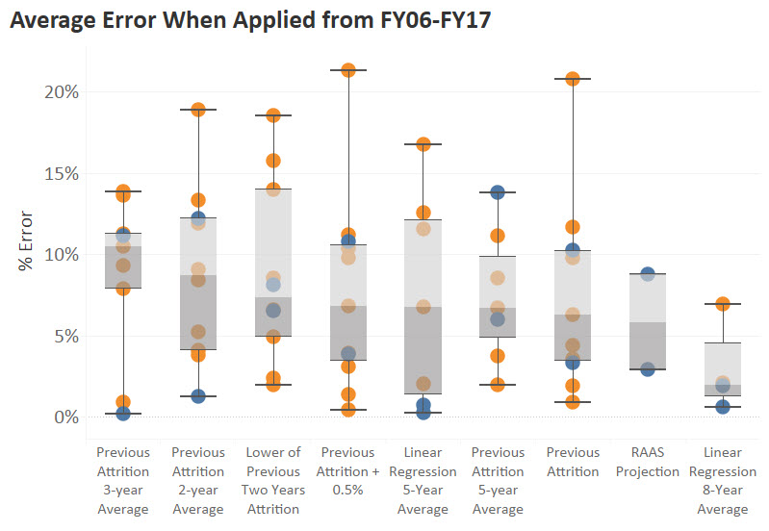
Error Rates of Attrition Methods
*
*
*Due to frequent reorganizations, Linear Regression is not a method usable by most Business Units

Slide 11
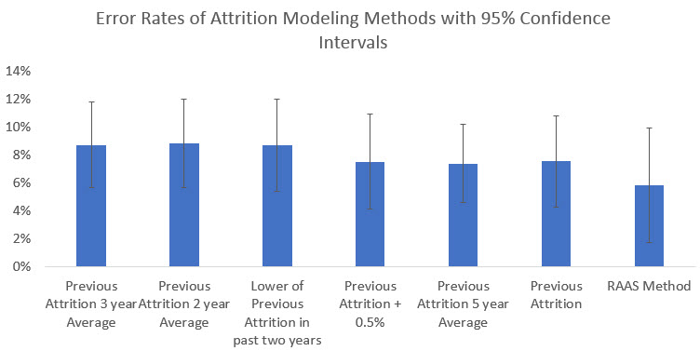
Result Validation

Slide 12
Concerns with the RAAS Model (Research, Applied Analytics, and Statistics)
Business Units expressed skepticism about the RAAS Model because:
Some Fiscal Years start on even pay periods
The model adds to the overall process
5-Year Predictions are inaccurate
The model does not account for frequent reorganizations
The model overestimates attrition
One-year plans should use one-year data, while five-year plans should use five-year data
The model only accounts for technical employees
The model is inaccurate

Slide 13
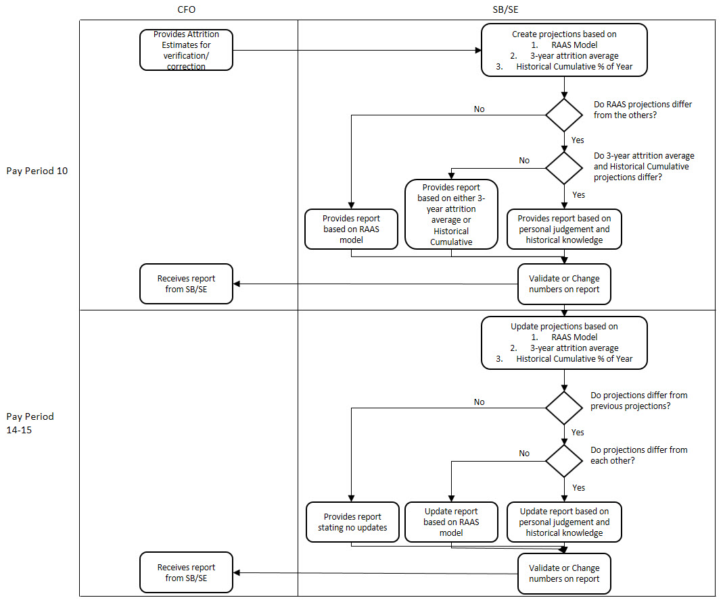
The Small Business/Self-Employed Business Unit Attrition Modeling Procedure

Slide 14
The Small Business/Self-Employed Business Unit Attrition Modeling Procedure
13

Slide 15
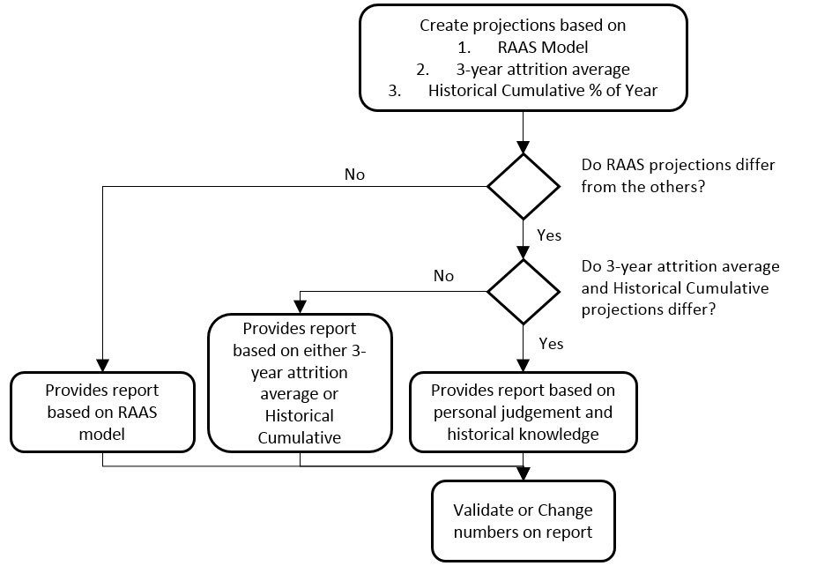
The Small Business/Self-Employed Business Unit Attrition Modeling Procedure

Slide 16
Findings from the Interviews
Methods are inconsistent among and within Business Units
Federal agencies are incentivized to underestimate attrition
The Business Units are more incentivized to underestimate attrition than the IRS CFO

Slide 17
The Recommendations
RAAS can modify their report by:
Only releasing 1-year projects unless specifically asked
Modifying their report to start with even or odd pay periods
Sending out a bi-annual data call for more information about upcoming reorganizations
Making clear that this model includes all employees
The CFO can modify their process by:
Requesting data from RAAS on behalf of the Business Units
Using the RAAS models as a “base” when sending out data calls for review
The Business Units can modify their process by:
Starting with the RAAS model
Switching to the % of Year Loss Factor method towards the end of the Fiscal Year

Slide 18
The Way Forward
The RAAS model’s error rate represents a 2.29% improvement over the average of the non-statistical methods
A 2.29% improvement in projections from FY06-17 would have resulted in:
The additional attrition of 107-138 individuals being correctly identified
The redistribution of $16-$21 million dollars/year earlier in the year for unfunded requirements
The variability in the error rates and the potential benefit means more study is warranted.
The IRS plans to implement these suggestions.

