Slide 1


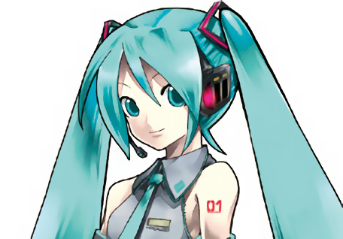
a small image
↓2x Upscaling
Lanczos3 (GIMP)
waifu2x

Slide 2
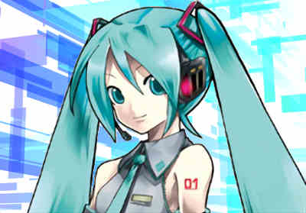


a noisy image (Compression Artifact)
↓2x Upscale
↓Noise Reduction
Selective Blur (GIMP)
waifu2x

Slide 3
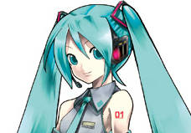


a small noisy image
Your image viewer
waifu2x

Slide 4

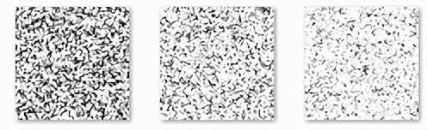

a screentone (manga texture)
waifu2x
↓0.5x

