Slide 1
Corporate Finance
Naga Dumpala

Slide 2
Intrinsic value of a security
Market value of a security can be undervalued/overvalued – to be determined by deriving intrinsic value, which can be known by valuation of a company
Enterprise Value using DCF(Discounted cash flow)
NPV = DCF value – upfront investment
Enterprise value = DCF value + discounted Terminal value
Terminal Value (TV)= FCF_{last} × (1 + g) ÷ (r – g) [g-10 year risk free rate, r-wacc)
Enterprise value / number of shares = intrinsic value
FCF = NOPAT + Dep – Capex – change in Net working capital
======================================================================
Estimating future cash flows and then discounting them with discount rate(WACC).
5 years average of cash flows taken for estimation
WACC = (E/V x Re) + ((D/V x Rd) x (1 – T))
E/V - percentage of capital that is equity D/V - percentage of capital that is debt
T - Tax rate
Rd Cost of debt – interest rate
Re Cost of equity – determined by using CAPM model

Slide 3
CAPM
Re = Rf + beta(ERP)
Re – cost of equity(expected return)
Rf - Risk free rate(yield of a government 10 year bond)
beta – levered(riskiness of a stock compared to market) – sourced from Bloomberg or calculated using historical stock rate(for public firm)/public company comparables(for private firms)
ERP – Equity Risk premium(market return minus risk free rate) –sourced from Ibbotson’s.

Slide 4
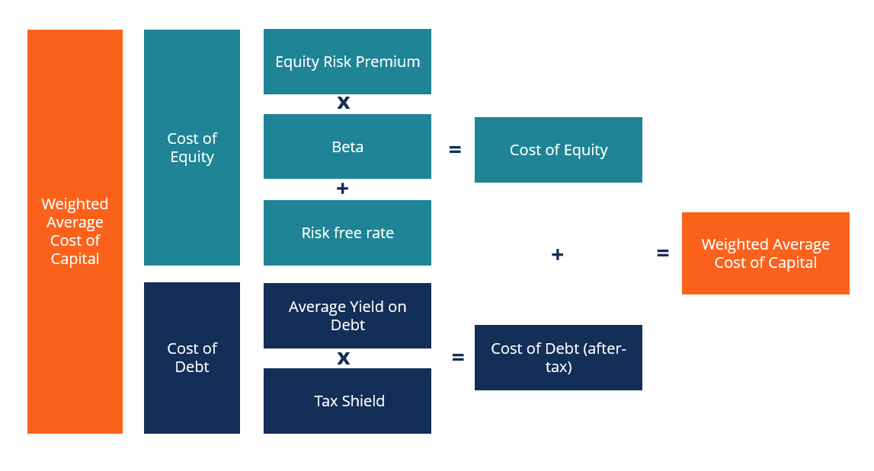
WACC

Slide 5
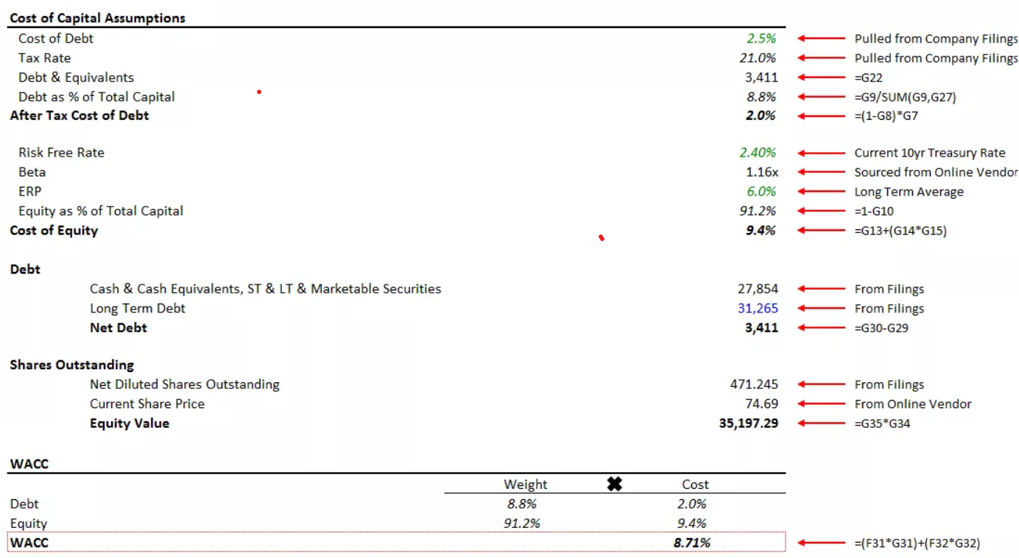
WACC

Slide 6
ROE
Return on Equity

