Slide 1
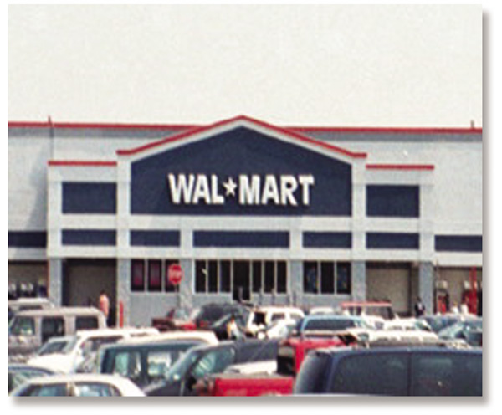
Chapter 1
An Introduction to Retailing
RETAIL
MANAGEMENT:
A STRATEGIC
APPROACH,
9th Edition
BERMAN EVANS

Slide 2
Chapter Objectives
To define retailing, consider it from different perspectives, demonstrate its impact, and note its special characteristics
To introduce the concept of strategic planning and apply it
To show why the retailing concept is the foundation of a successful business, with an emphasis on the total retail experience, customer service, and relationship retailing
To indicate the focus and format of the text

Slide 3
Retailing
Retailing encompasses the business activities involved in selling goods and services to consumers for their personal, family, or household use. It includes every sale to the final consumer.

Slide 4
Issues in Retailing
How can we best serve our customers while earning a fair profit?
How can we stand out in a highly competitive environment where consumers have too many choices?
How can we grow our business, while retaining a core of loyal customers?

Slide 5
The Philosophy
Retailers can best address these questions by fully understanding and applying the basic principles of retailing, as well as the elements in a well-structured, systematic, and focused retail strategy.

Slide 6

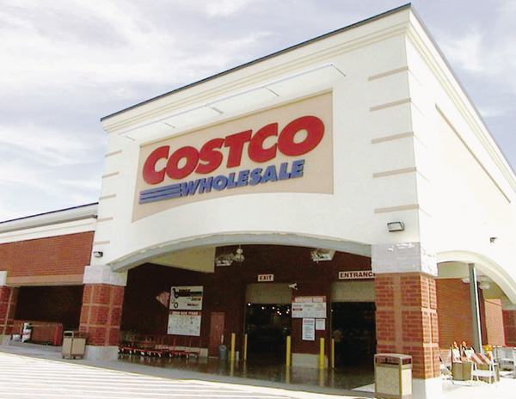
Figure 1.1 Boom Times for Costco

Slide 7
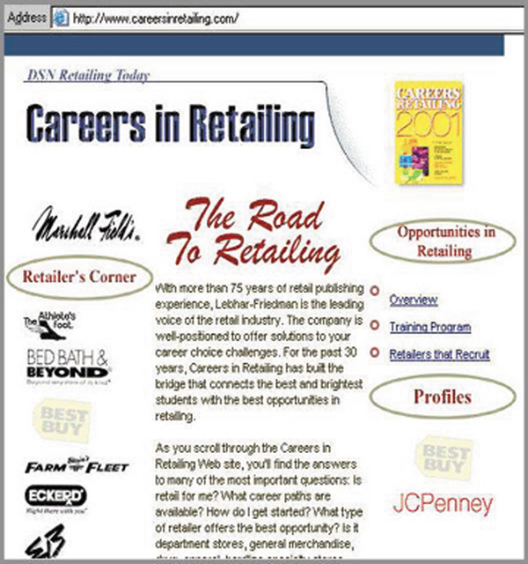
Figure 1.2 Career Pathways to Success

Slide 8
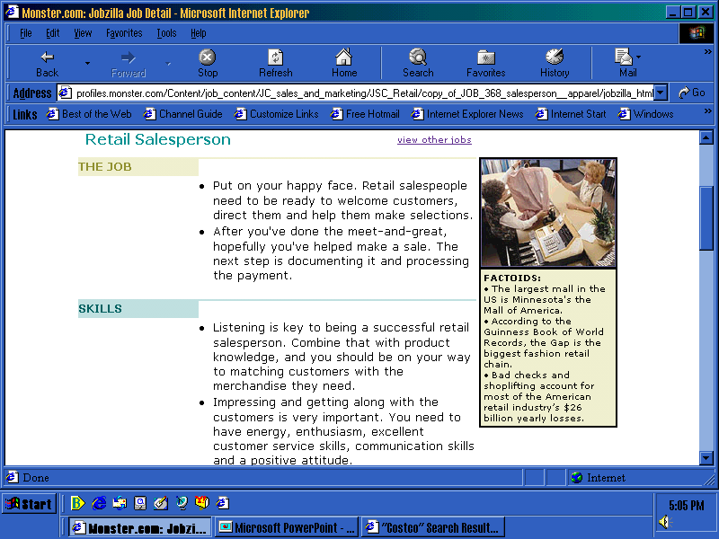
Career Pathways to Success

Slide 9
An Ideal Candidate for Retailing Career
Be a people person
Be flexible
Be decisive
Have analytical skills
Have stamina

Slide 10
Table 1.1 The 10 Largest Retailers in the U.S., 2001
Rank | Company | $ Sales (million) | # of stores | # of employees
1 | Wal-Mart | 219,812 | 4,414 | 1,383,000
2 | Home Depot | 53,553 | 1,348 | 256,300
3 | Kroger | 50,098 | 3,534 | 288,000
4 | Sears | 41,078 | 2,960 | 310,000
5 | Target | 39,362 | 1,381 | 223,500
6 | Albertson’s | 37,931 | 2,400 | 220,000
7 | Kmart | 37,028 | 2,150 | 240,525
8 | Costco | 34,797 | 369 | 64,500
9 | Safeway | 34,301 | 1,773 | 193,000
10 | J.C. Penney | 32,004 | 3,770 | 270,000

Slide 11
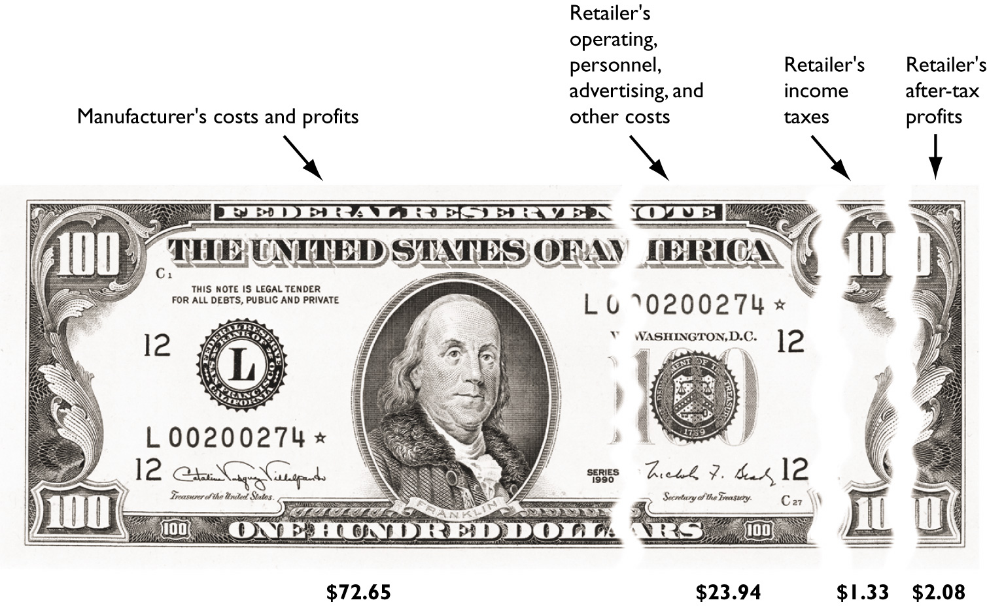
Figure 1.3 The High Costs and Low Profits of Retailing

Slide 12
Figure 1.4 A Typical Channel of Distribution
Retailer
Manufacturer
Wholesaler
Final
Consumer

Slide 13
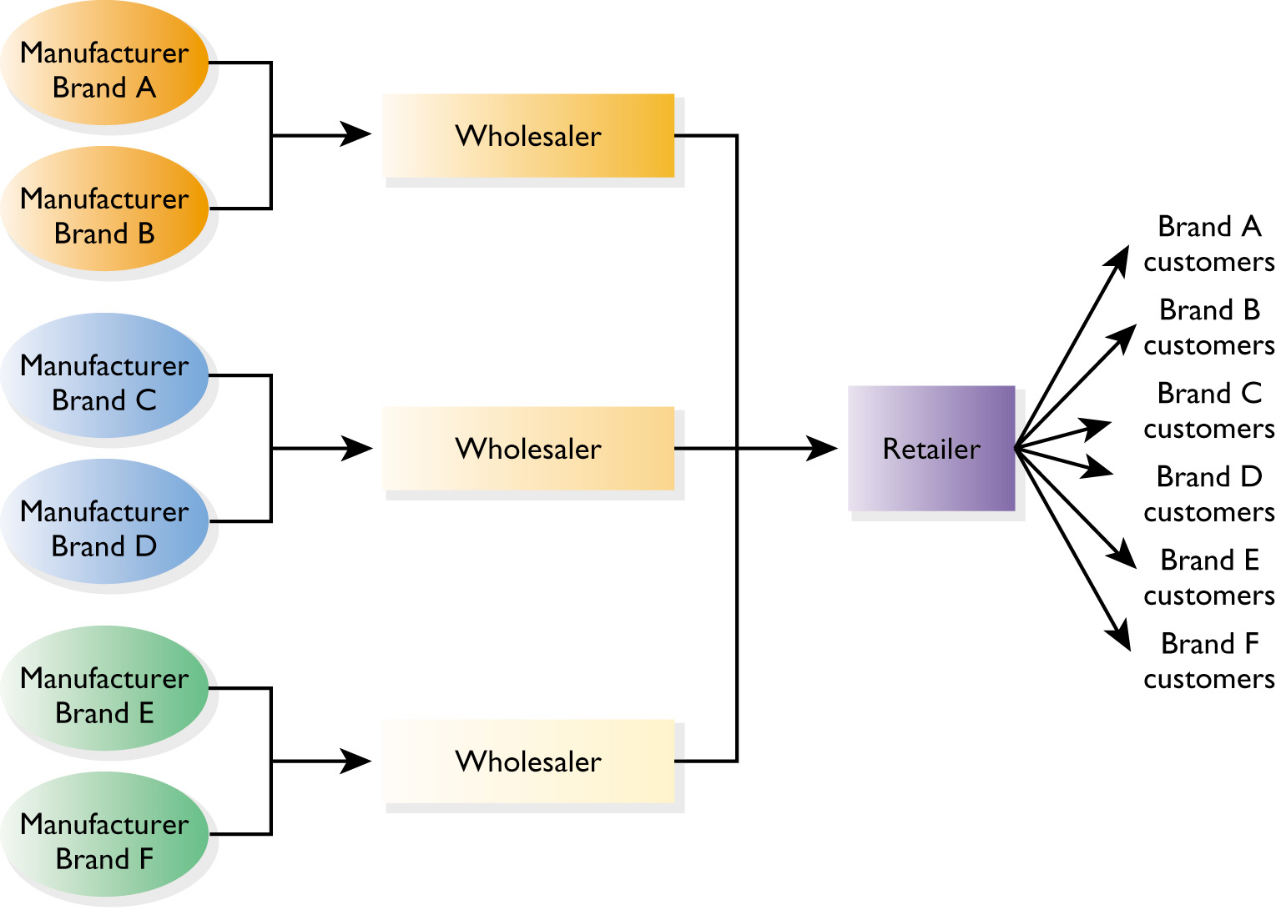
Figure 1.5 The Retailer’s Role in the Sorting Process

Slide 14
Multi-Channel Retailing
A retailer sells to consumers through multiple retail formats
  Web sites
  Physical stores

Slide 15
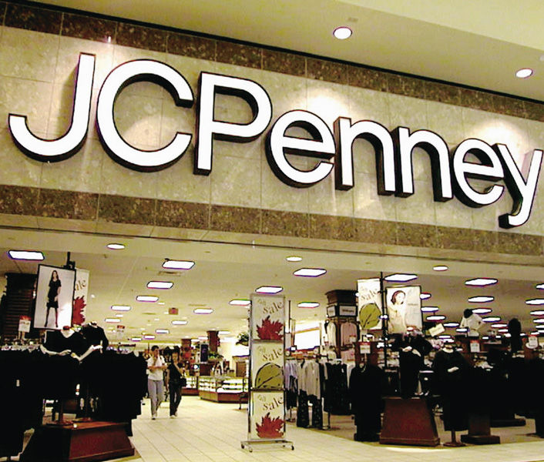
Figure 1.6 J.C. Penney and
Multi-Channel Retailing

Slide 16
Relationship Management Among Retailers and Suppliers
Disagreements may occur:
  control over channel
  profit allocation
  number of competing retailers
  product displays
  promotional support
  payment terms
  operating flexibility

Slide 17
Distribution Types
Exclusive: suppliers make agreements with one or few retailers that designate the latter as the only ones in a specified geographic area to carry certain brands or products
Intensive: suppliers sell through as many retailers as possible
Selective: suppliers sell through a moderate number of retailers

Slide 18
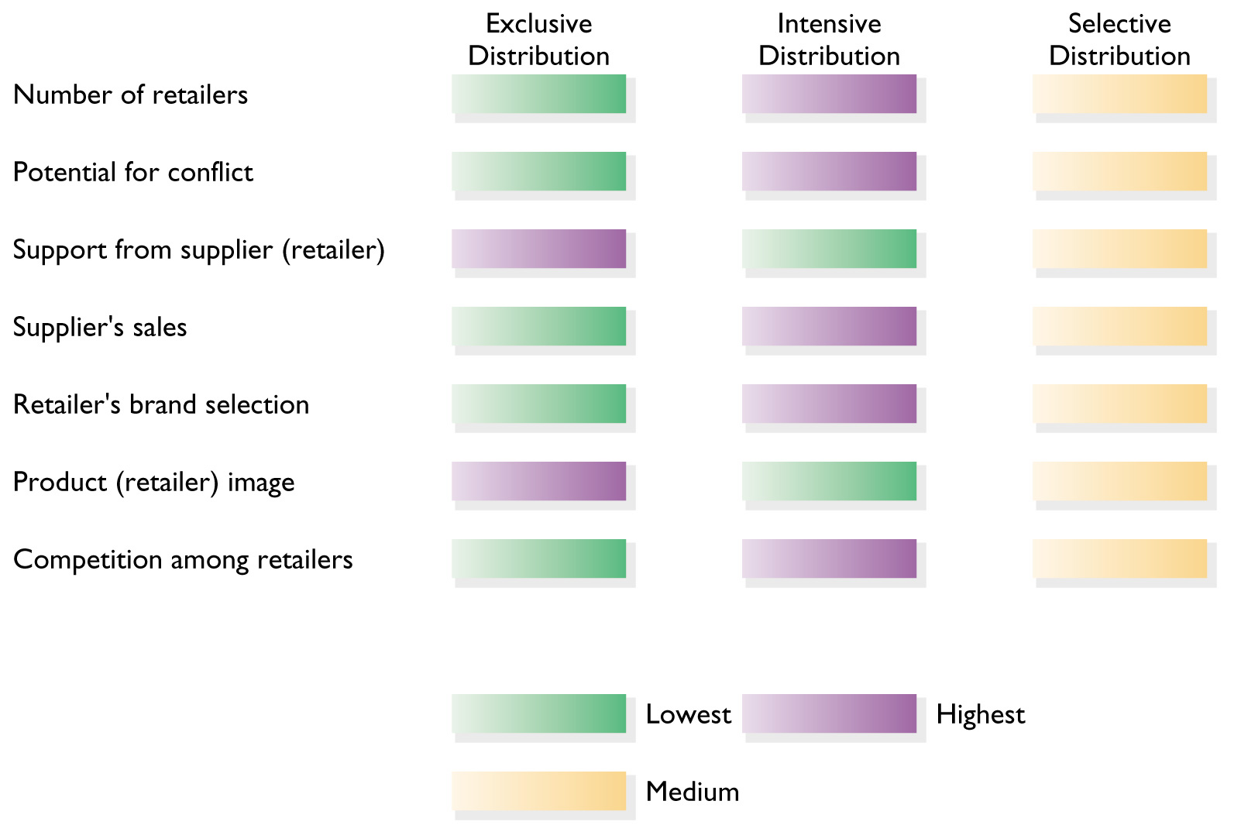
Figure 1.7 Comparing Distribution Types

Slide 19
Figure 1.8 Special Characteristics Affecting Retailers
Small
Average
Sale
Impulse
Purchase
Retailer’s
Strategy
Popularity
of
Stores

Slide 20
Retail Strategy
An overall plan for guiding a retail firm
Influences the firm’s business activities
Influences firm’s response to market forces

Slide 21
Six Steps in Strategic Planning
1. Define the type of business
2. Set long-run and short-run objectives
3. Determine the customer market
4. Devise an overall, long-run plan
5. Implement an integrated strategy
6. Evaluate and correct

Slide 22
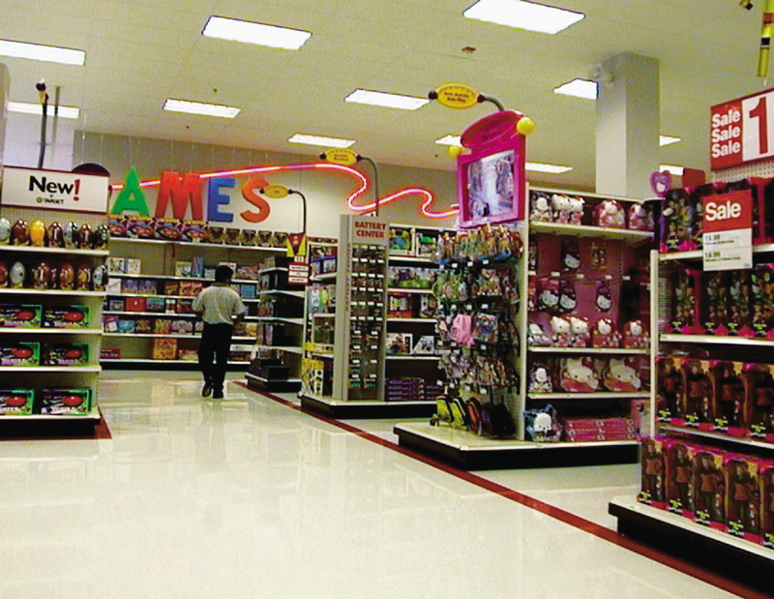
Figure 1.9 “Pay Less + Export More” at Target

Slide 23
Aspects of Target’s Strategy
Growth-oriented objectives
Appeal to a prime market
Distinctive company image
Focus
Strong customer service
Multiple points of contact
Employee relations
Innovation
Commitment to technology
Community involvement
Constantly monitoring performance

Slide 24
Figure 1.10 Applying the Retail Concept
Customer Orientation
Coordinated Effort
Retailing
Concept
Retail
Strategy
Value driven
Goal Orientation

Slide 25
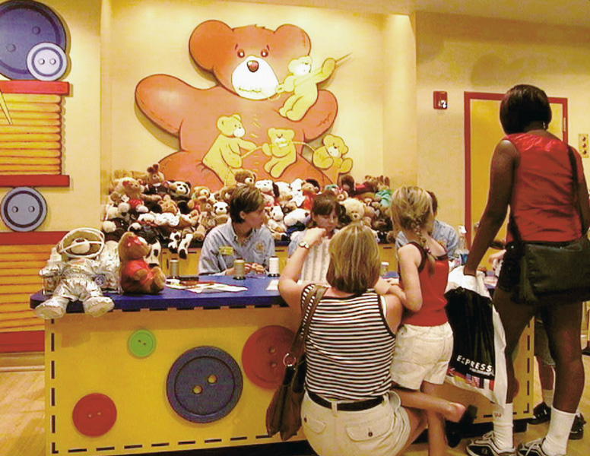
Figure 1.11 Eliminating
Shopper Boredom

Slide 26
Customer Service
Activities undertaken by a retailer in conjunction with the basic goods and services it sells.
  Store hours
  Parking
  Shopper-friendliness
  Credit acceptance
  Salespeople

Slide 27
Figure 1.12 A Customer
Respect Checklist
Do we trust our customers?
Do we stand behind what we sell?
Is keeping commitments to customers important to our company?
Do we value customer time?
Do we communicate with customers respectfully?
Do we treat all customers with respect?
Do we thank customers for their business?
Do we respect employees?

Slide 28
Relationship Retailing
Seek to establish and maintain long-term bonds with customers, rather than act as if each sales transaction is a completely new encounter
  Concentrate on the total retail experience
  Monitor satisfaction
  Stay in touch with customers

Slide 29
Effective Relationship Retailing
Use a win-win approach
  It is harder to get new customers than to keep existing ones happy
Develop a customer database
  Ongoing customer contact is improved with information on people’s attributes and shopping behavior

Slide 30
Approaches to the Study of Retailing
Institutional
Functional
Strategic

Slide 31
Parts of Retail Management: A Strategic Approach
Building relationships and strategic planning
Retailing institutions
Consumer behavior and information gathering
Elements of retailing strategy
Integrating, analyzing, and improving retail strategy

