Slide 1
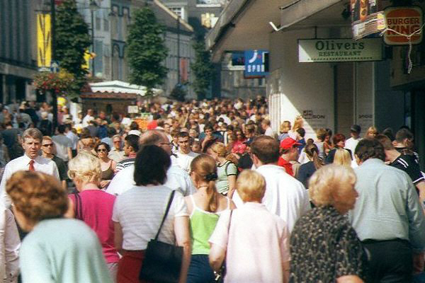
Chapter 2
Building and Sustaining Relationships in Retailing
RETAIL
MANAGEMENT:
A STRATEGIC
APPROACH,
9th Edition
BERMAN EVANS

Slide 2
Chapter Objectives
To explain what “value” really means and highlight its pivotal role in retailers’ building and sustaining relationships
To describe how both customer relationships and channel relationships may be nurtured in today’s highly competitive marketplace

Slide 3
Chapter Objectives_2
To examine the differences in relationship building between goods and services retailers
To discuss the impact of technology on relationships in retailing
To consider the interplay between retailers’ ethical performance and relationships in retailing

Slide 4
What is Value?
The bottom line:
  Consumers will demand more for less from the shopping experience
  They will spend less time shopping
  They will split the commodity-shopping trip from the value-added shopping trip

Slide 5
What is Value?
Channel Perspective:
Value is a series of activities and processes - the value chain - that provides a certain value for the consumer
Customer Perspective
Value is the perception that the shopper has of the value chain
It is the view of all the benefits from a purchase versus the price paid.

Slide 6
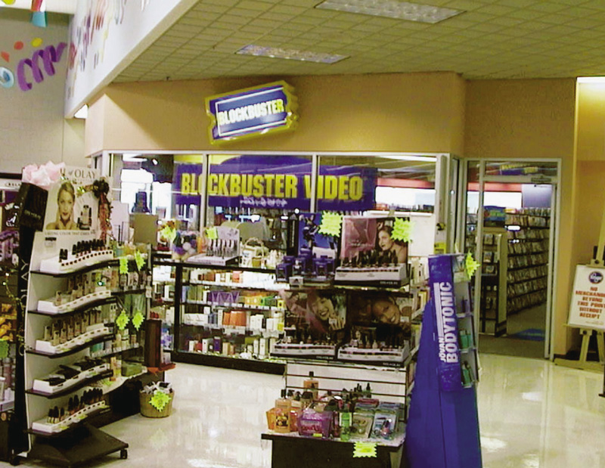
Figure 2.1 Kroger Providing Extra Value for Customers

Slide 7
Retail Value Chain
Represents the total bundle of benefits offered to consumers through a channel of distribution
  Store location and parking, retailer ambience, customer service, brands/products carried, product quality, retailer’s in-stock position, shipping, prices, image, and other elements

Slide 8
3 Aspects of Value-Oriented Retail Strategy
Expected
Augmented
Potential

Slide 9
Potential Pitfalls to Avoid in Planning a Value-Oriented Retail Strategy
Planning value with just a price perspective
Providing value-enhanced services that customers do not want or will not pay extra for
Competing in the wrong value/price segment
Believing augmented elements alone create value
Paying lip service to customer service

Slide 10
Figure 2.2 A Value-Oriented Retailing Checklist
Is value defined from a consumer perspective?
Does the retailer have a clear value/ price point?
Is the retailer’s value position competitively defensible?
Are channel partners capable of delivering value-enhancing services?
Does the retailer distinguish between expected and augmented value chain elements?
Has the retailer identified meaningful potential value chain elements?
Is the retailer’s value-oriented approach aimed at a distinct market segment?
Is the retailer’s value-oriented approach consistent?
Is the retailer’s value-oriented approach effectively communicated to the target market?
Can the target market clearly identify the retailer’s positioning strategy?
Does the retailer’s positioning strategy consider trade-offs in sales versus profits?
Does the retailer set customer satisfaction goals?
Does the retailer periodically measure customer satisfaction levels?
Is the retailer careful to avoid the pitfalls in value-oriented retailing?
Is the retailer always looking out for new opportunities that will create customer value?

Slide 11
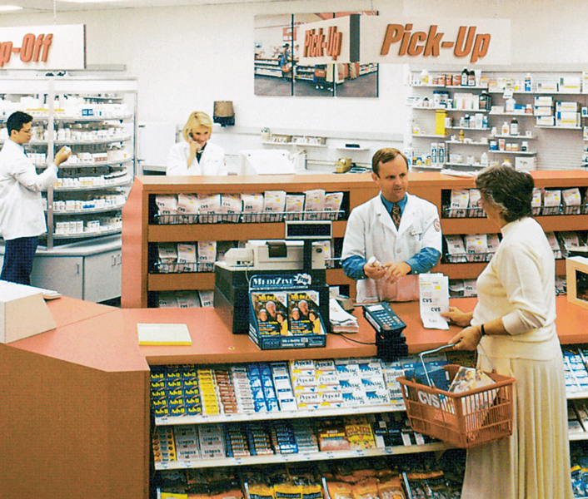
Figure 2.3 Places to Bring the Care Back to Health Care

Slide 12
Customer Service
Expected customer service is the service level that customers want to receive from any retailer such as basic employee courtesy
Augmented customer service includes the activities that enhance the shopping experience and give retailers a competitive advantage

Slide 13
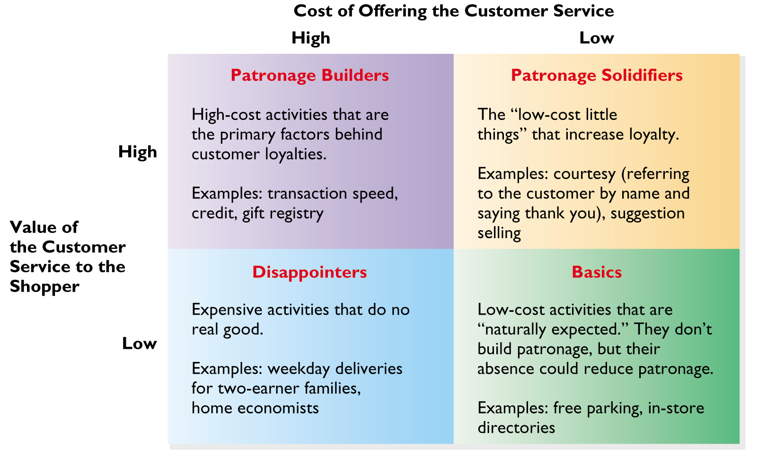
Figure 2.4 Classifying Customer Services

Slide 14
Fundamental Decisions
What customer services are expected and what customer services are augmented for a particular retailer?
What level of customer service is proper to complement a firm’s image?
Should there be a choice of customer services?

Slide 15
Fundamental Decisions_2
Should customer services be free?
How can a retailer measure the benefits of providing customer services against their costs?
How can customer services be terminated?

Slide 16
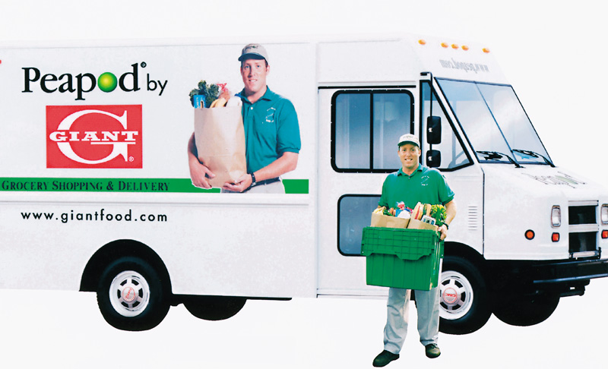
Figure 2.5 Augmented Services: Going Above and Beyond

Slide 17
Table 2.1 Typical Customer Services
Credit
Delivery
Alterations/ Installations
Packaging/ gift wrapping
Complaints/ Return handling
Gift certificates
Trade-ins
Trial purchases
Special sales
Extended store hours
Mail and phone orders

Slide 18
Table 2.1 Miscellaneous Customer Services
Bridal registry
Interior designers
Personal shoppers
Ticket outlets
Parking
Water fountains
Pay phones
Baby strollers
Restrooms
Restaurants
Baby-sitting
Fitting rooms
Beauty salons
Fur storage
Shopping bags
Information

Slide 19

Figure 2.6 Turning Around Weak Customer Service
Focus on
Customer Concerns
Empower Front-Line
Employees
Show That You Are
Listening
Express Sincere
Understanding
Apologize and Rectify
the Situation

Slide 20
Principles of Category Management
Retailers listen more to customers
Profitability is improved because inventory matches demand more closely
By being better focused, each department is more desirable for shoppers
Retail buyers are given more responsibilities and accountability for category results
Retailers and suppliers must share data and be more computerized
Retailers and suppliers must plan together

Slide 21
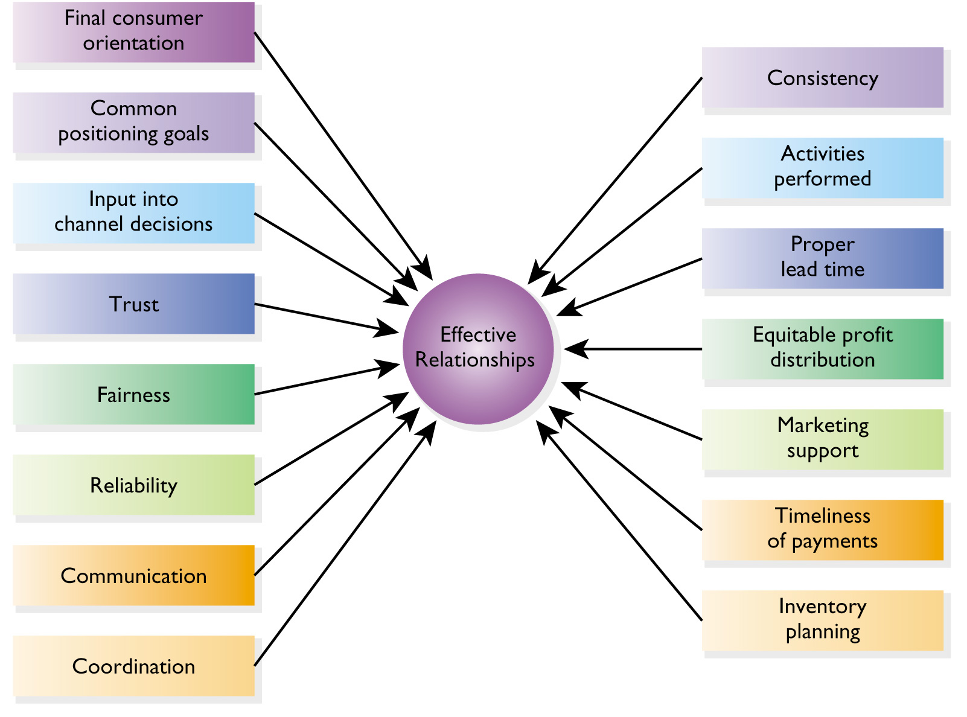
Figure 2.7 Elements Contributing to Effective Channel Relationships

Slide 22
3 Kinds of Service Retailing
Rented goods services
Owned goods services
Nongoods services

Slide 23
Four Characteristics of
Services Retailing
Intangibility
Inseparability
Perishability
Variability

Slide 24
Figure 2.8a Characteristics of
Service Retailing
Intangibility
No patent protection possible
Difficult to display/communicate service benefits
Service prices difficult to set
Quality judgment is subjective
Some services involve performances/experiences

Slide 25
Figure 2.8b Characteristics of
Service Retailing
Inseparability
Consumer may be involved in service production
Centralized mass production difficult
Consumer loyalty may rest with employees

Slide 26
Figure 2.8c Characteristics of
Service Retailing
Perishability
Services cannot be inventoried
Effects of seasonality can be severe
Planning employee schedules can be complex

Slide 27
Figure 2.8d Characteristics of
Service Retailing
Variability
Standardization and quality control hard to achieve
Services may be delivered in locations
beyond control of management
Customers may perceive variability
even when it does not actually occur

Slide 28
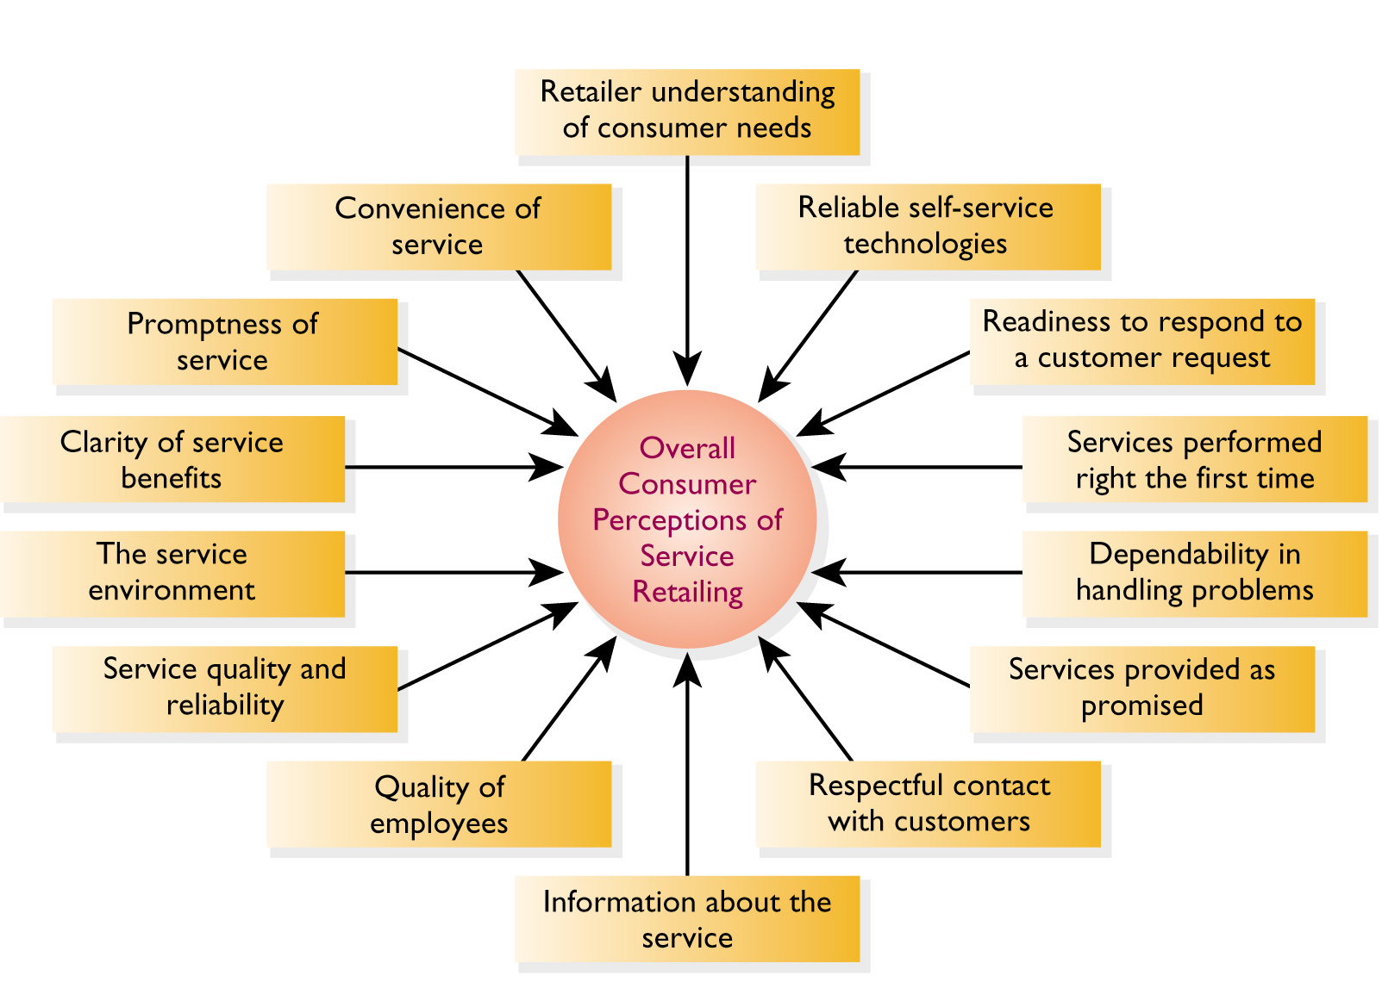
Figure 2.9 Selected Factors Affecting Consumer Perceptions of Service Retailing

Slide 29
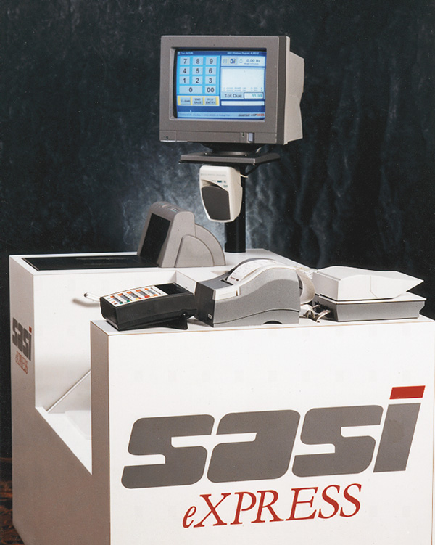
Figure 2.10 A Self-Checkout Station

Slide 30
Consumer Advantages to
Self-Checkout
Shorter lines
Increased speed
Privacy

Slide 31
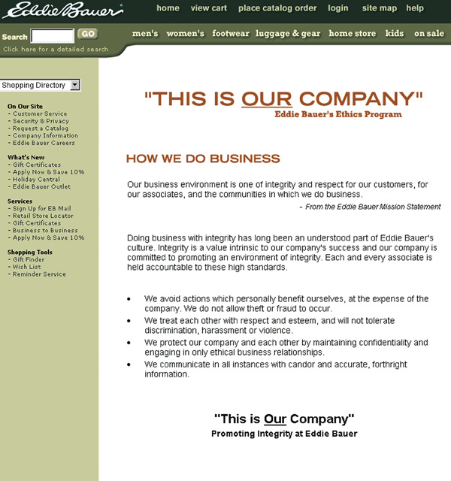
Figure 2.11 Eddie Bauer: Strong Ethical Sensibilities

Slide 32
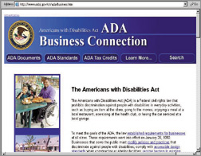
Figure 2.12 Understanding the Americans with Disabilities Act

Slide 33
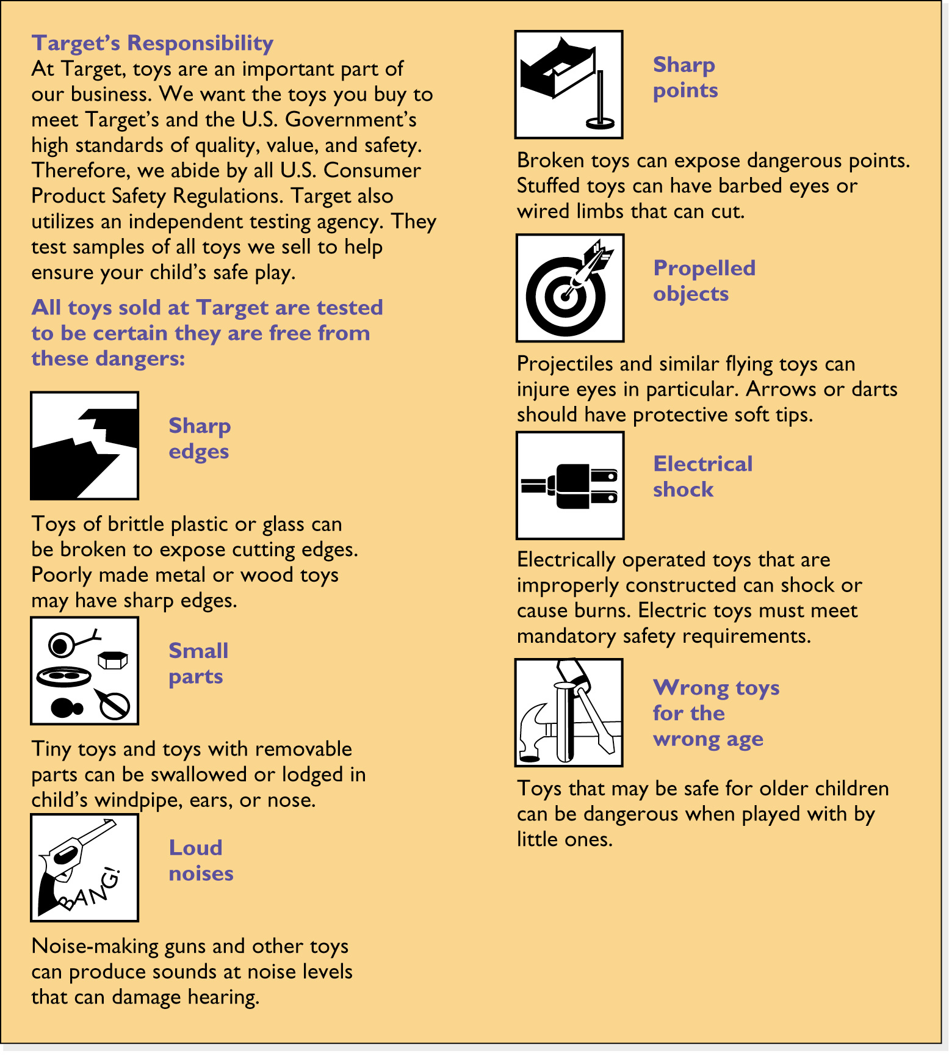
Figure 2.13 Voluntary
Product Testing at Target Stores

Slide 34
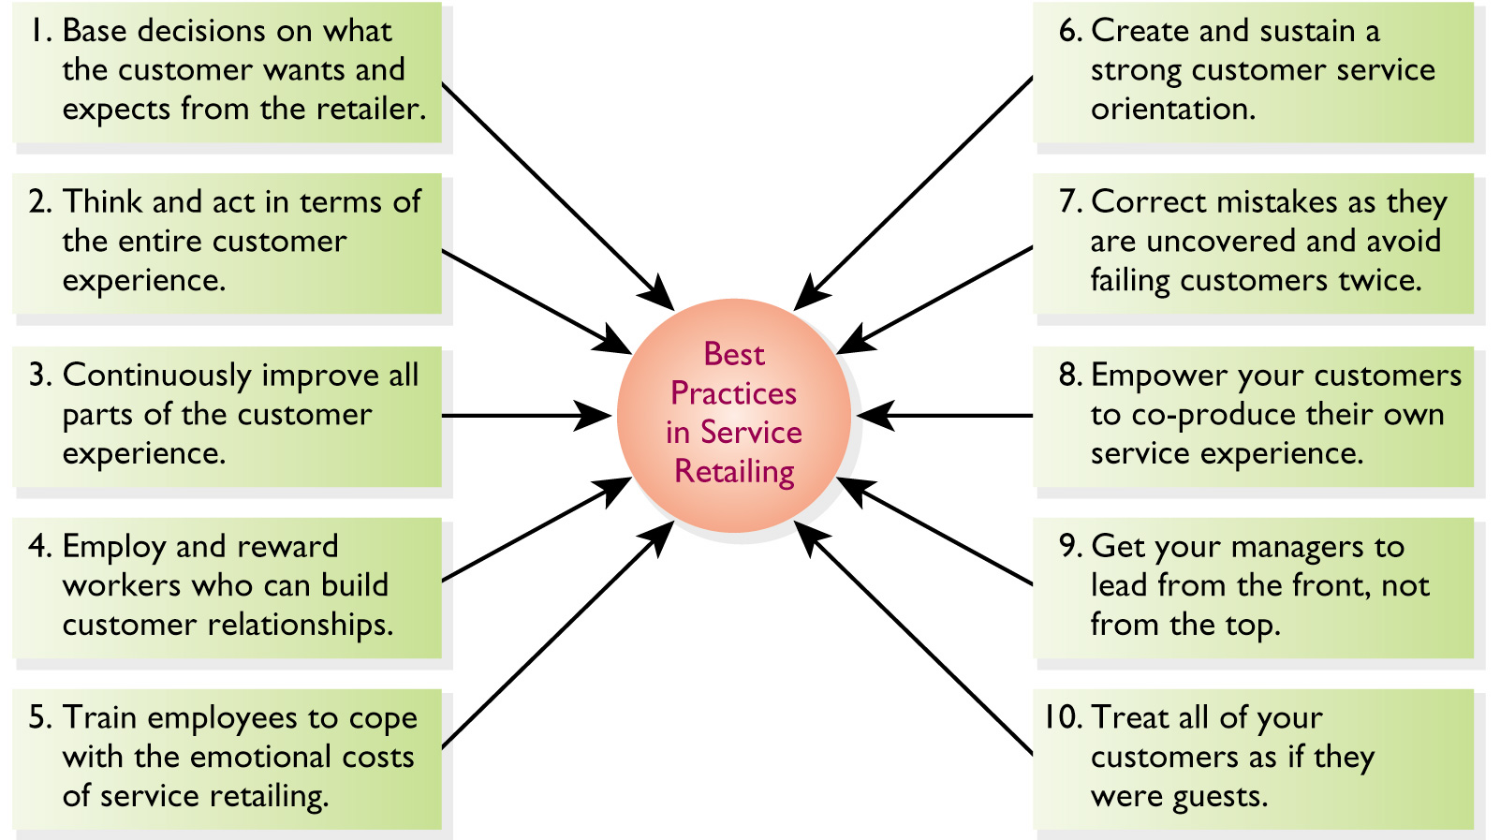
Figure A2.1 Lessons in
Service Retailing

