Slide 1
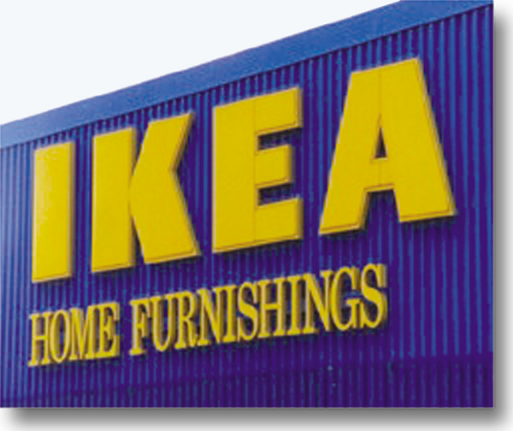
Chapter 5
Retail Institutions by Store-Based Strategy Mix
RETAIL
MANAGEMENT:
A STRATEGIC
APPROACH,
9th Edition
BERMAN EVANS

Slide 2
Chapter Objectives
To describe the wheel of retailing, scrambled merchandising, and the retail life cycle, and show how they can help explain the performance of retail strategy mixes
To discuss some ways in which retail strategy mixes are evolving

Slide 3
Chapter Objectives_2
To examine a wide variety of food-oriented retailers involved with store-based strategy mixes
To study a wide range of general merchandise retailers involved with store-based strategy mixes

Slide 4
Retailer Strategy Mix
A strategy mix is the firm’s particular combination of:
  store location,
  operating procedures,
  goods/services offered,
  pricing tactics,
  store atmosphere,
  customer services, and
  promotional methods

Slide 5
Earning Destination Retailer Status
Be price oriented and cost efficient
Be upscale
Be convenient
Offer a dominant assortment
Offer superior customer service
Be innovative or exclusive

Slide 6
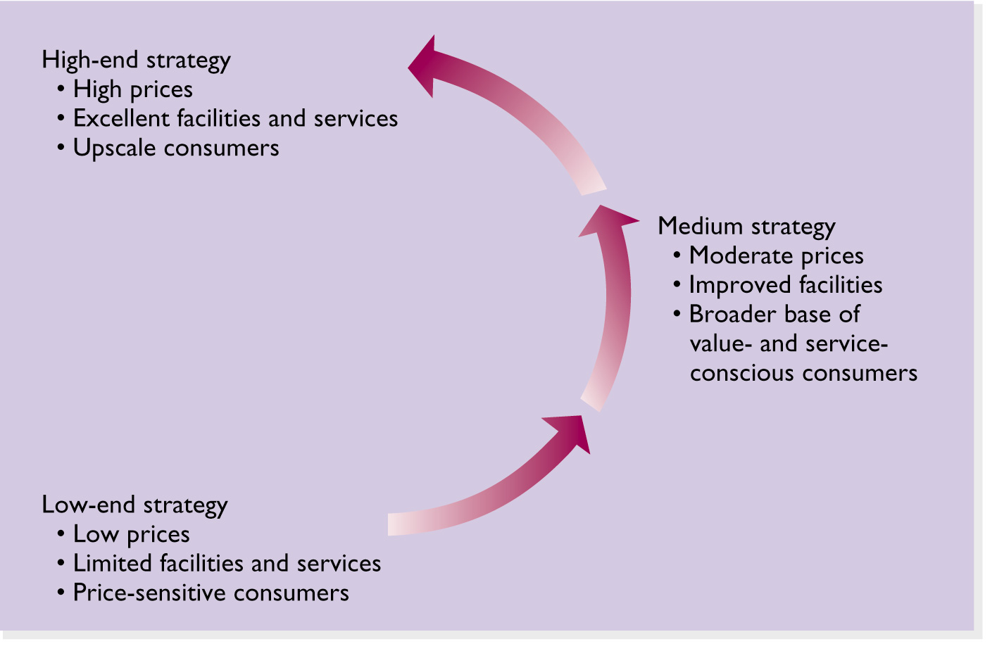
Figure 5.1 The Wheel of Retailing

Slide 7
Three Basic Strategic Positions
Low end
Medium
High end

Slide 8
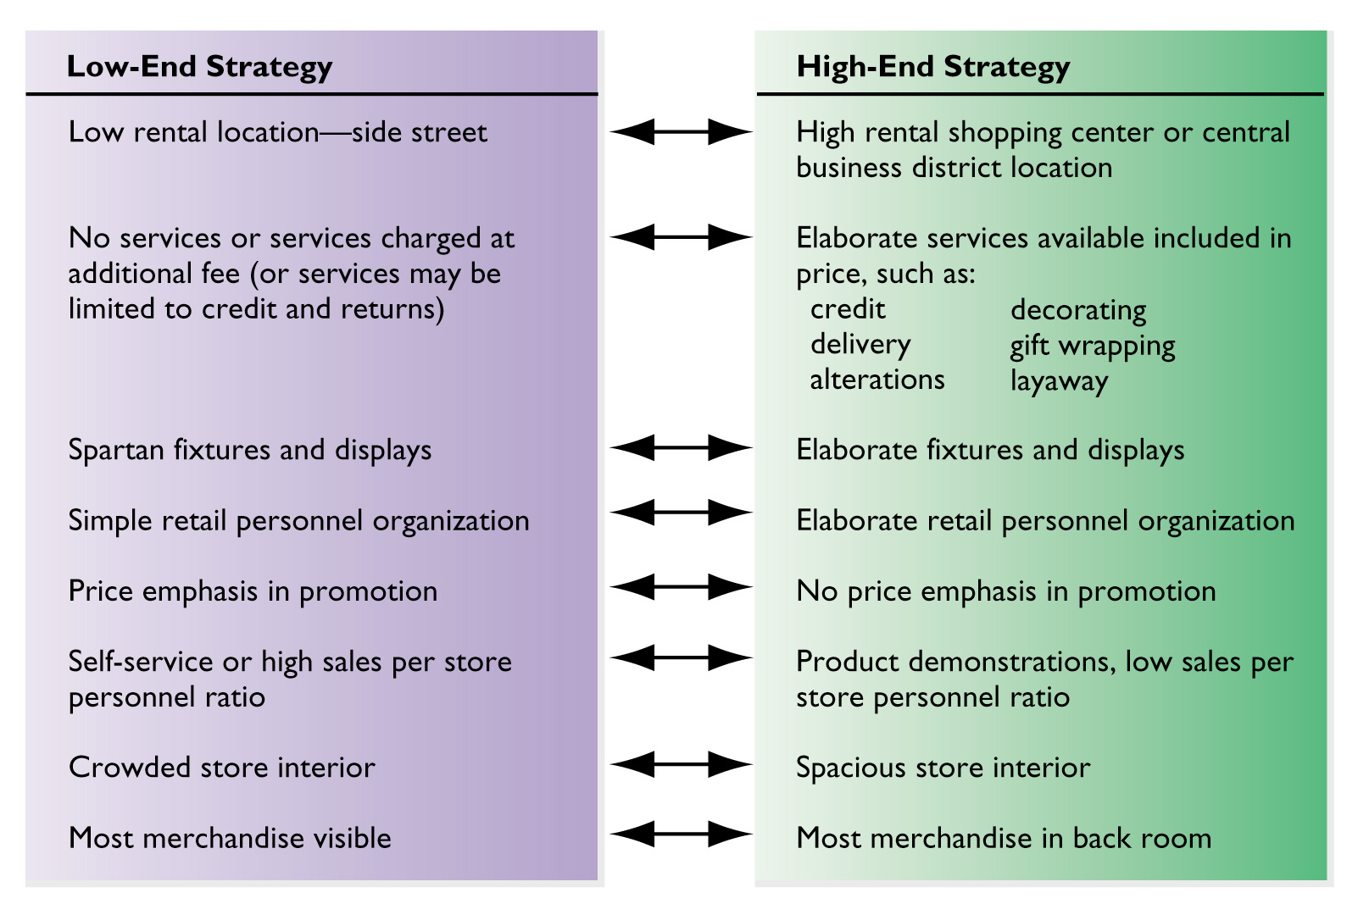
Figure 5.2 Retail
Strategy Alternatives

Slide 9
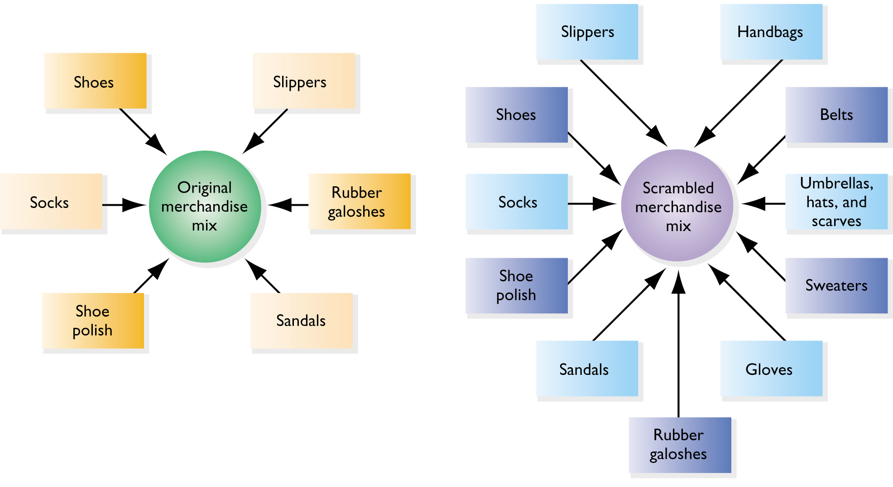
Figure 5.3 Scrambled Merchandising by a Shoe Store

Slide 10
Retail Life Cycle
Retail institutions pass through identifiable life stages
  introduction
  growth
  maturity
  decline

Slide 11
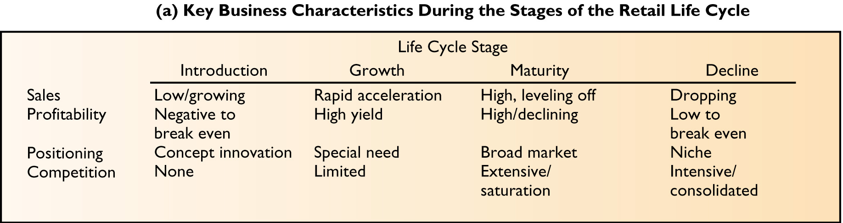
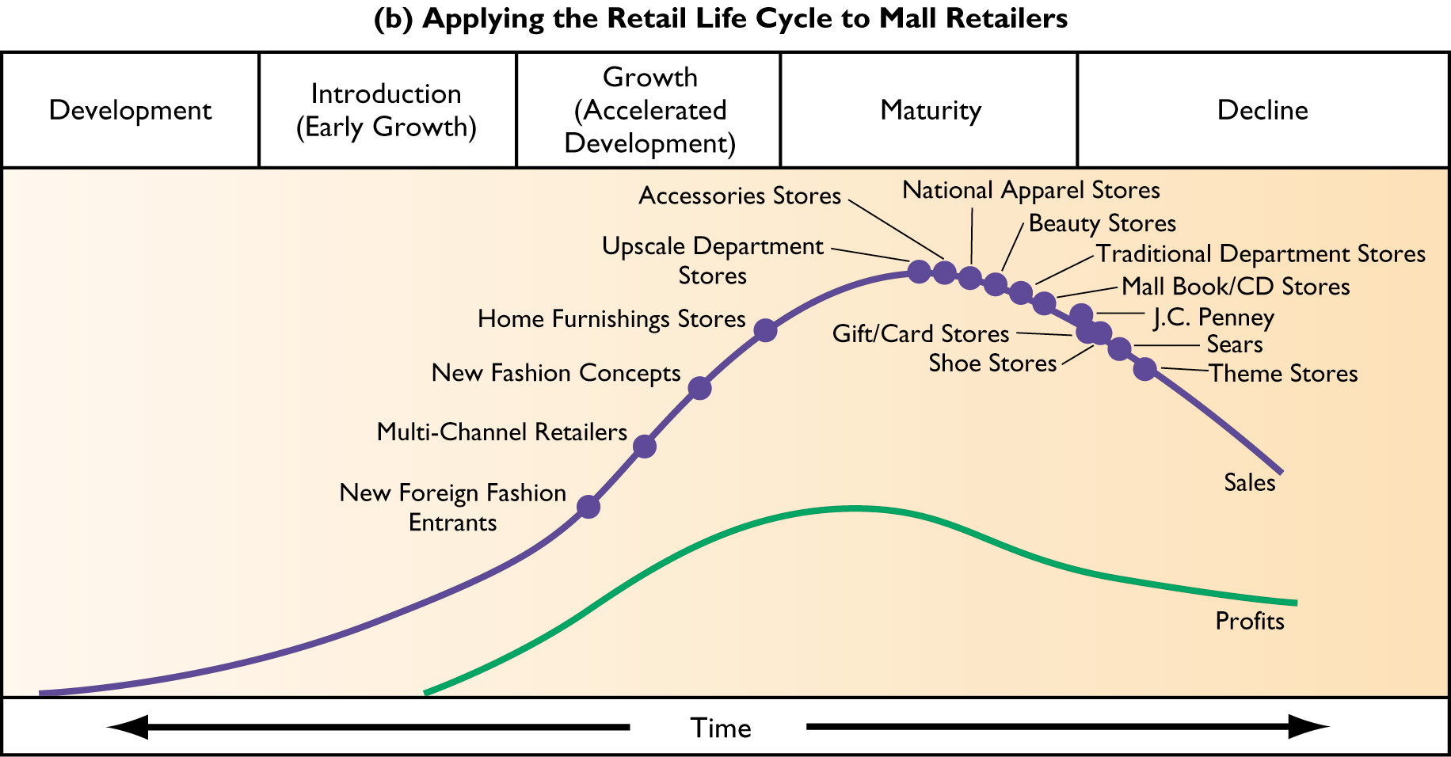
Figure 5.4 Retail Life Cycle

Slide 12
How Retail Institutions are Evolving
Mergers, Diversification, Downsizing
Cost-Containment and Value-Driven Retailing

Slide 13
Mergers, Diversification, and Downsizing
Mergers: combination of separately owned firms (e.g., Sears and Lands’ End)
Diversification: retailers become active in businesses outside their normal operations (e.g., Limited Brands)
Downsizing: unprofitable stores are closed or divisions are sold off (e.g., Kmart)

Slide 14
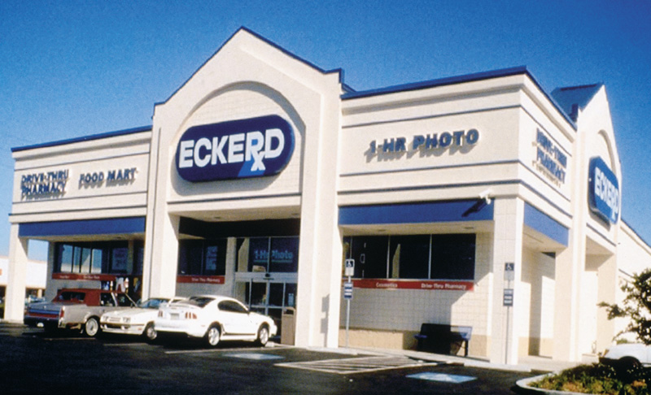
Figure 5.5 J.C. Penney’s Eckerd

Slide 15
Methods for Cost Containment
Standardizing procedures, store layouts, store size, and product offerings
Using secondary locations
Placing stores in smaller communities
Using inexpensive construction materials
Using plainer fixtures and displays
Buying refurbished equipment
Joining cooperative buying and advertising
Creatively financing inventories

Slide 16
Table 5.1 Store-Based Retail Strategy Mixes
Food Oriented
Convenience store
Conventional supermarket
Food-based superstore
Combination store
Box (limited-line) store
Warehouse store
General Merchandise
Specialty store
Traditional department
Full-line discount store
Variety store
Off-price chain
Factory outlet
Membership club
Flea market

Slide 17
Convenience Store Strategy Mix
Location:
Neighborhood
Prices:
Average to
Above average
Merchandise:
Medium width
and low depth
of assortment;
average quality
Atmosphere and
Services:
Average
Promotion:
Moderate

Slide 18
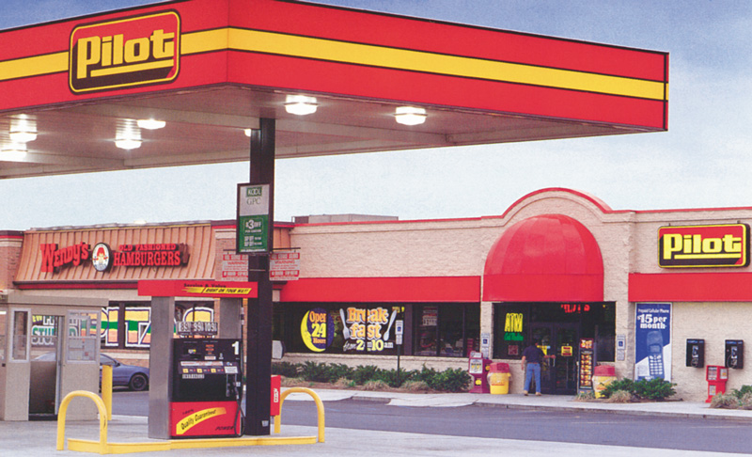
Figure 5.6 Wendy’s and Pilot

Slide 19
Conventional Supermarket Strategy Mix
Location:
Neighborhood
Prices:
Competitive
Merchandise:
Extensive width
and depth
of assortment;
average quality;
manufacturer,
private, and generic brands
Atmosphere and
Services:
Average
Promotion:
Heavy use of
newspapers, flyers,
and coupons

Slide 20
Food-Based Superstore
Strategy Mix
Location:
Community shopping
center or isolated site
Prices:
Competitive
Merchandise:
Full assortment plus health
and beauty aids and
general merchandise
Atmosphere and
Services:
Average
Promotion:
Heavy use of
newspapers, flyers

Slide 21
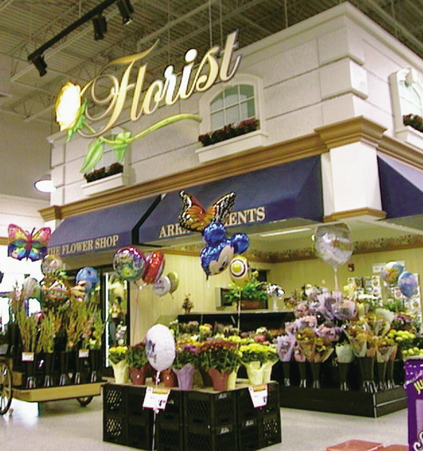
Figure 5.7 Supermarkets Have
Come a Long Way

Slide 22
Combination Store
Strategy Mix
Location:
Community shopping center
or isolated site
Prices:
Competitive
Merchandise:
Full assortment plus health
and beauty aids and
general merchandise
Atmosphere and
Services:
Average
Promotion:
Heavy use of
newspapers, flyers

Slide 23
Box Store Strategy Mix
Location:
Neighborhood
Prices:
Very low
Merchandise:
Low width and depth of
assortment; few
perishables; few national
brands
Atmosphere and
Services:
Low
Promotion:
Little or none

Slide 24
Warehouse Store Strategy Mix
Location:
Secondary site, often in
industrial area
Prices:
Very low
Merchandise:
Moderate width and
low depth of
assortment; emphasis on
manufacturer brands
bought at discount
Atmosphere and
Services:
Low
Promotion:
Little or none

Slide 25
Specialty Store Strategy Mix
Location:
Business district or
shopping center
Prices:
Competitive to
Above average
Merchandise:
Very narrow width and
extensive depth of
assortment; average to
good quality
Atmosphere and
Services:
Average to excellent
Promotion:
Heavy use of displays
Extensive sales force

Slide 26
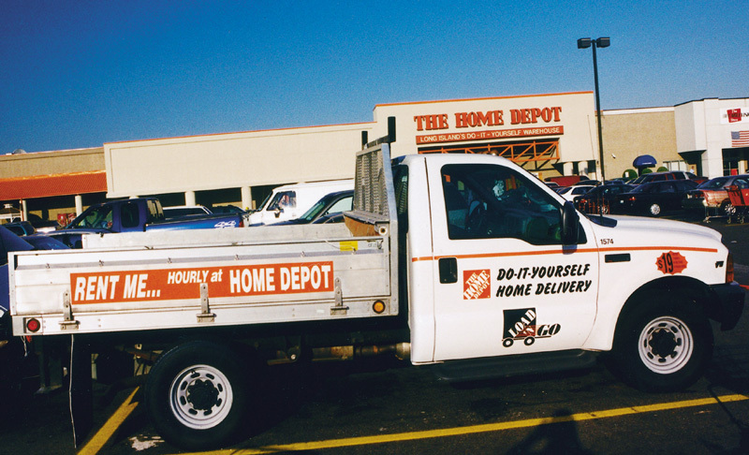
Figure 5.8 Home Depot

Slide 27
Traditional Department Store Strategy Mix
Location:
Business district, shopping
center or isolated store
Prices:
Average to
Above average
Merchandise:
Extensive width and
depth of
assortment; average to
good quality
Atmosphere and
Services:
Good to excellent
Promotion:
Heavy ad and catalog
use; direct mail;
personal selling

Slide 28
Full-line Discount Store Strategy Mix
Location:
Business district, shopping
center or isolated store
Prices:
Competitive
Merchandise:
Extensive width and
depth of
assortment; average to
good quality
Atmosphere/ Services:
Slightly below
average to average
Promotion:
Heavy on newspapers;
price-oriented; selling

Slide 29
Variety Store Strategy Mix
Location:
Business district, shopping
center or isolated store
Prices:
Average
Merchandise:
Good width and
some depth of
assortment;
below-average
to average quality
Atmosphere/ Services:
Below average
Promotion:
Use of newspapers

Slide 30
Off-Price Chain Strategy Mix
Location:
Business district, shopping
center or isolated store
Prices:
Low
Merchandise:
Moderate width and
poor depth of
assortment;
average to good quality;
low continuity
Atmosphere/ Services:
Below average
Promotion:
Use of newspapers;
brands not advertised;
limited selling

Slide 31
Factory Outlet Strategy Mix
Location:
Out of the way site
or discount mall
Prices:
Very Low
Merchandise:
Moderate width and
poor depth of
assortment;
low continuity
Atmosphere/ Services:
Very low
Promotion:
Little

Slide 32
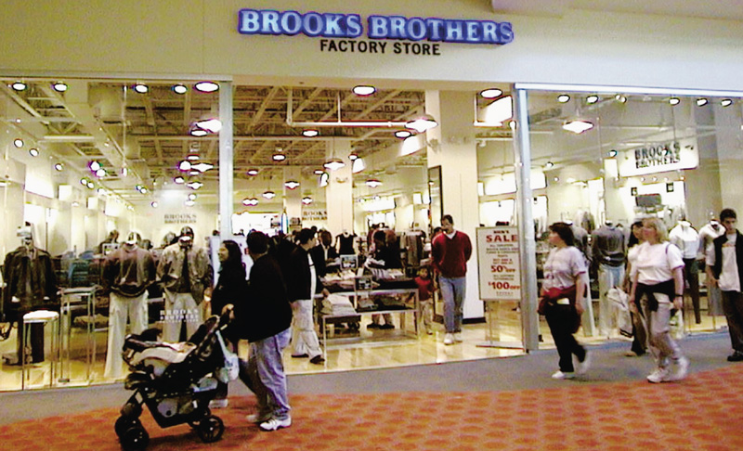
Figure 5.9 Brooks Brothers:
Realizing the Power of the Factory Outlet

Slide 33
Membership Club Strategy Mix
Location:
Isolated store or
secondary site
Prices:
Very Low
Merchandise:
Moderate width and
poor depth of
assortment;
low continuity
Atmosphere/ Services:
Very low
Promotion:
Little;
some direct mail

Slide 34
Flea Market Strategy Mix
Location:
Isolated store
Prices:
Very Low
Merchandise:
Extensive width and
poor depth of
assortment;
low continuity;
variable quality
Atmosphere/ Services:
Very low
Promotion:
Limited

