Slide 1
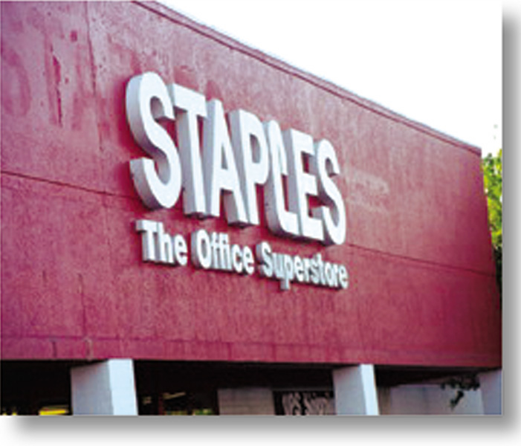
Chapter 7
Identifying and Understanding Consumers
RETAIL
MANAGEMENT:
A STRATEGIC
APPROACH,
9th Edition
BERMAN EVANS

Slide 2
Chapter Objectives
To discuss why it is important for a retailer to properly identify, understand, and appeal to its customers
To enumerate and describe a number of consumer demographics, lifestyle factors, and needs and desires – and to explain how these concepts can be applied to retailing

Slide 3
Chapter Objectives _2
To examine consumer attitudes toward shopping and consumer shopping behavior, including the consumer decision process and its stages
To look at retailer actions based on target market planning
To note some of the environmental factors that affect consumer shopping

Slide 4
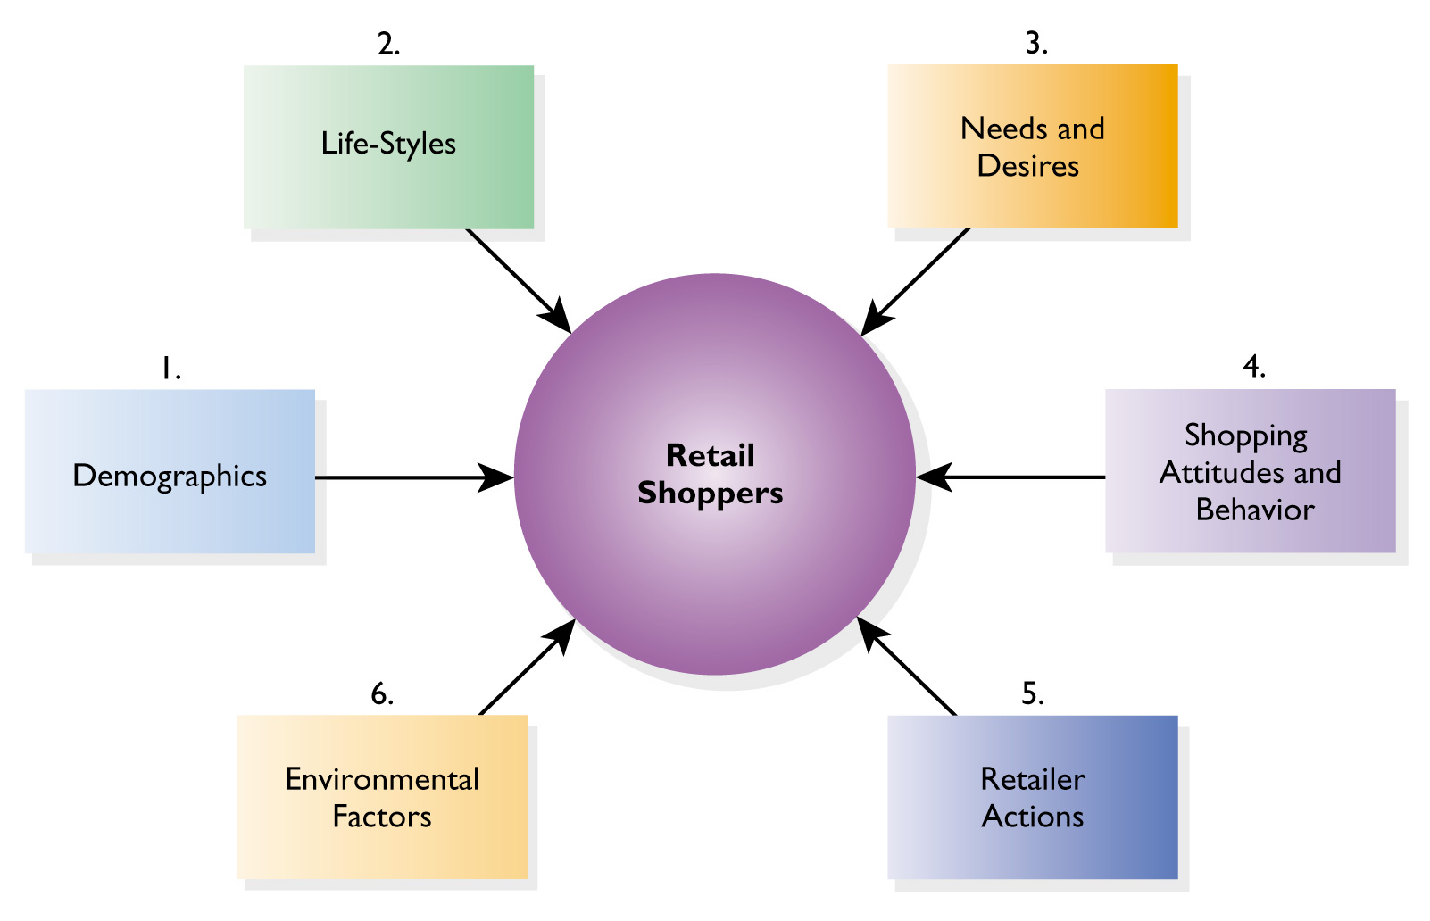
Figure 7.1 What Makes Retail Shoppers Tick

Slide 5
Demographics and Lifestyles
Demographics
  consumer data that is objective, quantifiable, easily identifiable, measurable
Lifestyles
  ways in which consumers and families live and spend time and spend money

Slide 6
Helpful Facts for Understanding U.S. Demographics
Typical household has an annual income of $45,000
Top 1/4 of households earn $75,000 or more
Lowest 1/6 of households earn under $15,000
High incomes lead to high discretionary income

Slide 7

Helpful Facts_2
There are 5 million more females than males
Three-fifths of females age 16 and older are in the labor force
Most U.S. employment is in services
25% of all U.S. adults age 25 and older have at least graduated from a four-year college

Slide 8
Understanding Consumer Lifestyles: Social Factors
Culture
Reference
Groups
Lifestyle
Social
Class
Time
Utilization
Household
Life
Cycle
Family
Life
Cycle

Slide 9
Understanding Consumer Lifestyles: Psychological Factors
Personality
Attitudes
Lifestyle
Perceived
Risk
Class
Consciousness
Purchase
Importance

Slide 10
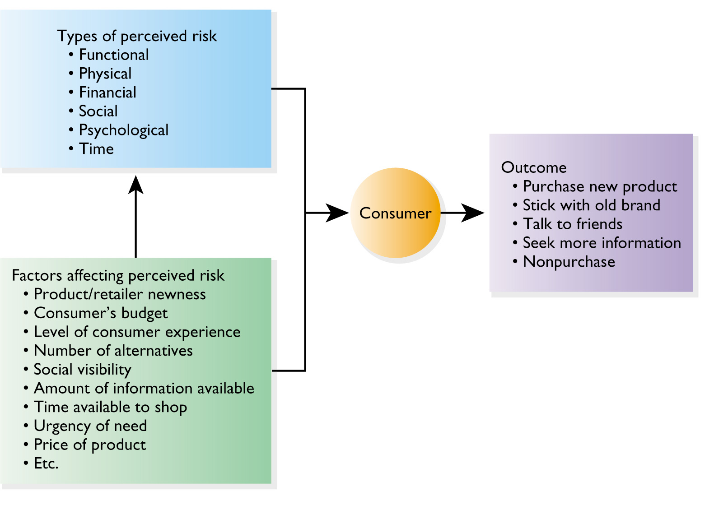
Figure 7.2 The Impact of Perceived Risk on Consumers

Slide 11
Illustrations
Gender Roles
Consumer Sophistication and Confidence
Poverty of Time
Component Lifestyles

Slide 12
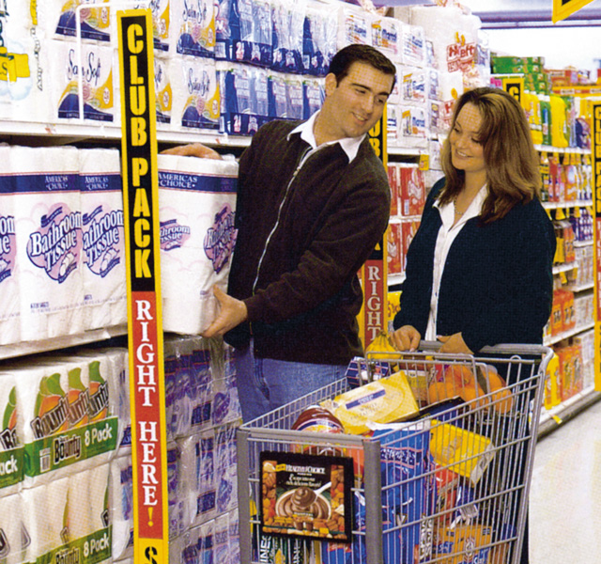
Figure 7.3 Blurring Gender Roles

Slide 13
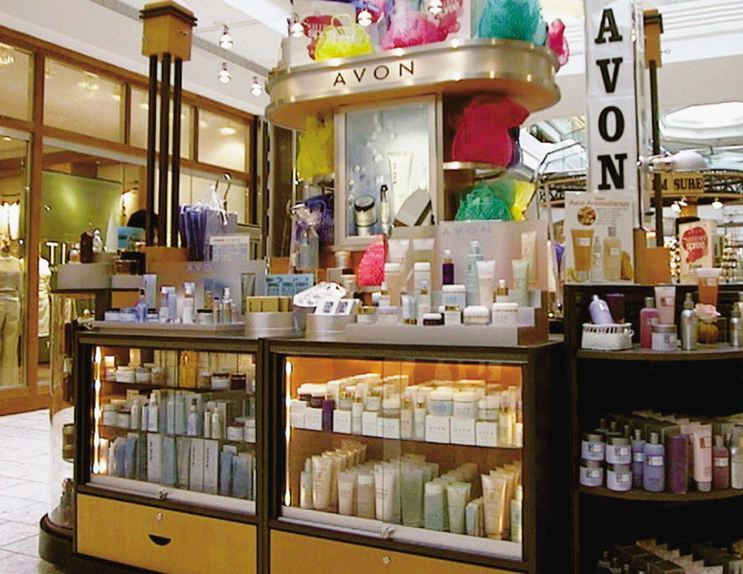
Figure 7.4 Avon:
Addressing the Poverty of Time

Slide 14
3 Special Market Segments
In-Home Shoppers
Online Shoppers
Outshoppers

Slide 15

In-Home Shoppers
Shopping is discretionary, not necessary
Convenience is important
Active, affluent, well-educated
Self-confident, younger, adventuresome
Time scarcity is not a motivator

Slide 16

Online Shoppers
Use of Web for decision- making process as well as buying process
Convenience is important
Above average incomes, well-educated
Time scarcity is a motivator

Slide 17

Out- Shoppers
Out-of-hometown shopping
Male, young, members of a large family, and new to the community
Income and education vary
They like to travel, enjoy fine food, are active, and read out-of-town newspapers

Slide 18
Attitudes Towards Shopping
Shopping Enjoyment
Attitudes toward Shopping Time
Shifting Feelings About Retailing
Why People Buy or Not on a Shopping Trip
Attitudes by Market Segment
Attitudes toward Private Brands

Slide 19
Top Reasons for Leaving an Apparel Store Without Buying
Cannot find an appealing style
Cannot find the right size
Nothing fits
No sales help is available
Cannot get in and out of the store easily
Prices are too high
In-store experience is stressful
Cannot find a good value

Slide 20
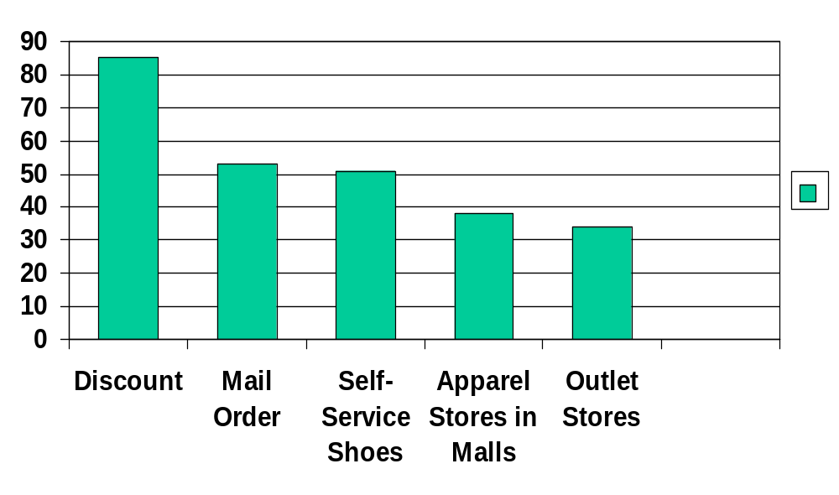
Table 7.3 Where America Shops: Household Purchases

Slide 21
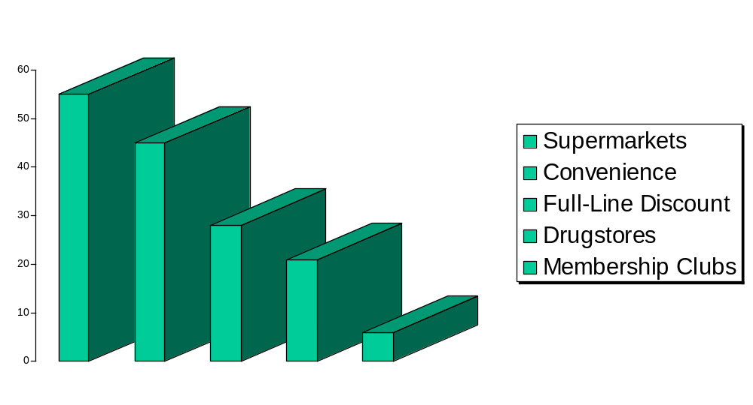
Table 7.3 Where America Shops: Weekly Purchases

Slide 22
Cross-Shopping
Shopping for a product category at more than one retail format during the year
Visiting multiple retailers on one shopping trip

Slide 23
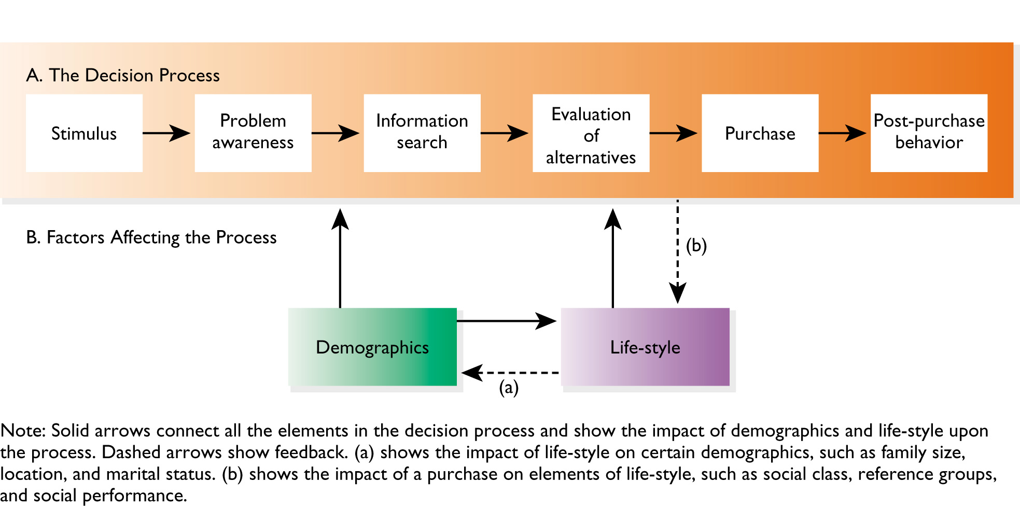
Figure 7.5 The Consumer Decision Process

Slide 24
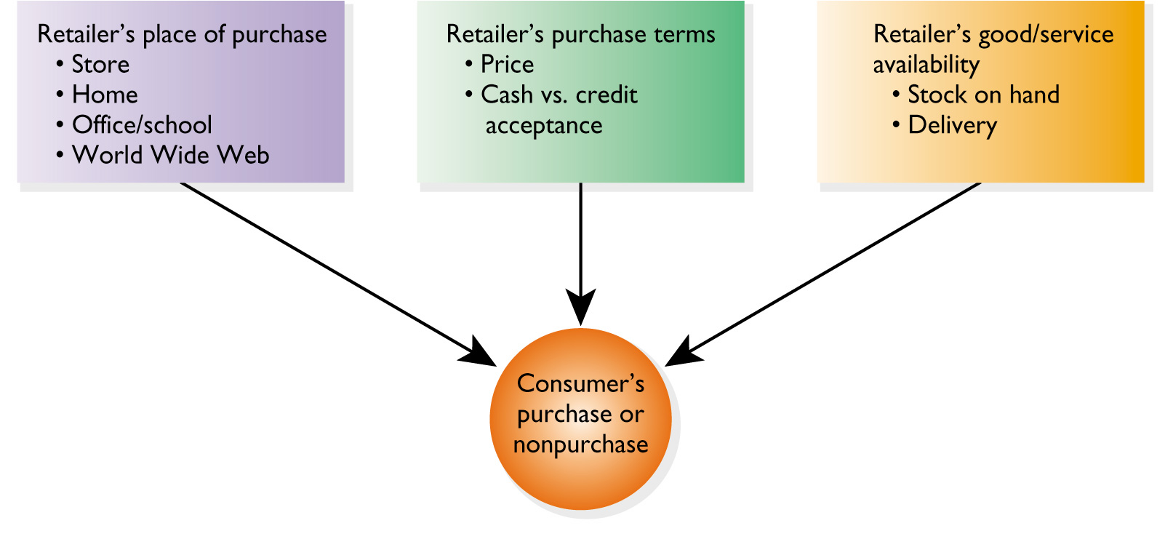
Figure 7.6 Key Factors in the Purchase Act

Slide 25

Types of Consumer Decisions
Extended
Limited
Routine
High
RISK & TIME
Low

Slide 26
Types of Impulse Shopping
Completely unplanned
Partially unplanned
Unplanned substitution

Slide 27
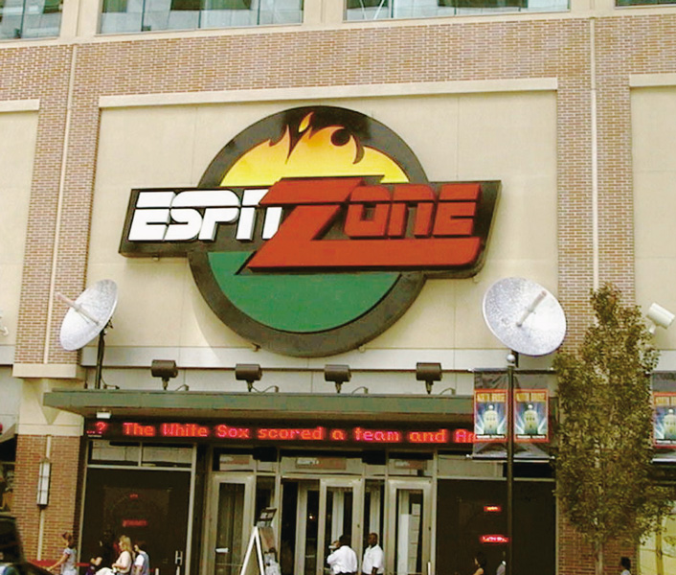
Figure 7.7 ESPNZone

Slide 28
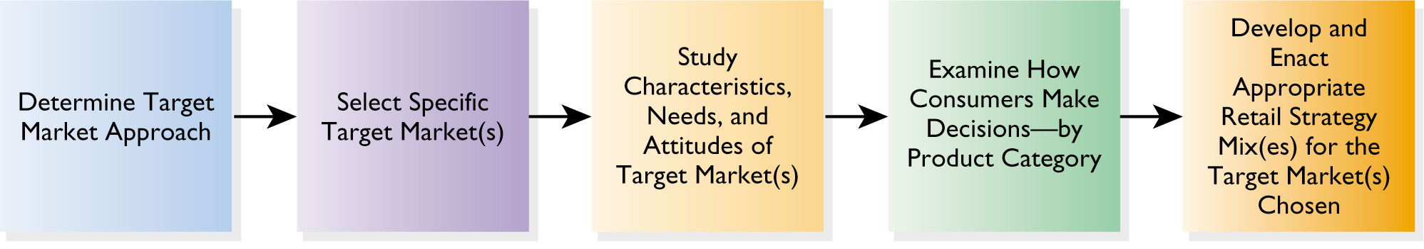
Figure 7.8 Devise a Marketing Strategy

Slide 29
Possible Retailer Approaches
Mass Marketing
  Kohl’s Department Stores
Concentrated Marketing
  Zutopia
Differentiated Marketing
  Foot Locker

Slide 30
Environmental Factors and Consumers
State of the Economy
Rate of Inflation
Infrastructure for Shopping
Price Wars
Emergence of New Retail Formats
People Working at Home
Regulations on Shopping
Changing Social Values and Norms

