Slide 1
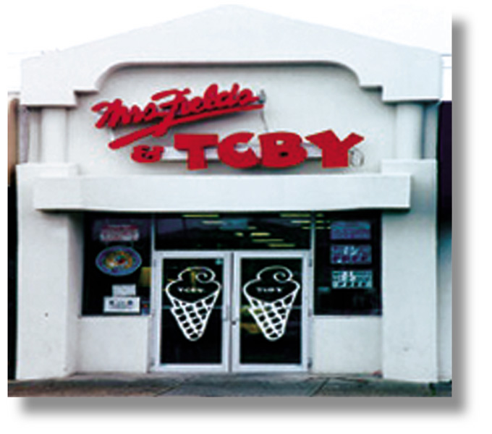
Chapter 8
Information Gathering and Processing in Retailing
RETAIL
MANAGEMENT:
A STRATEGIC
APPROACH,
9th Edition
BERMAN EVANS

Slide 2
Chapter Objectives
To discuss how information flows in a retail distribution channel
To show why retailers should avoid strategies based on inadequate information
To look at the retail information system, its components, and recent advances
To describe the marketing research process

Slide 3
Figure 8.1 How Information Flows in a Retail Distribution Channel
Information
and the
Supplier
Information
and the
Consumer
Information
and the
Retailer

Slide 4
Suppliers Need To Know
From the Retailer
Estimates of category sales
Inventory turnover rates
Feedback on competitors
Level of customer returns
From the Customer
Attitudes toward styles and models
Extent of brand loyalty
Willingness to pay a premium for superior quality

Slide 5
Retailers Need To Know
From the Supplier
Advance notice of new models and model changes
Training materials
Sales forecasts
Justifications for price changes
From the Customer
Why people shop there
What they like and dislike
Where else people shop

Slide 6
Consumers Need To Know
From the Supplier
Assembly and operating instructions
Extent of warranty coverage
Where to send a complaint
From the Retailer
Where specific merchandise is stocked in the store
Methods of payment acceptable
Rain check and other policies

Slide 7

Retail Information System (RIS)
Anticipates the information needs of retail managers
Collects, organizes, and stores relevant data on a continuous basis
Directs the flow of information to the proper decision makers

Slide 8
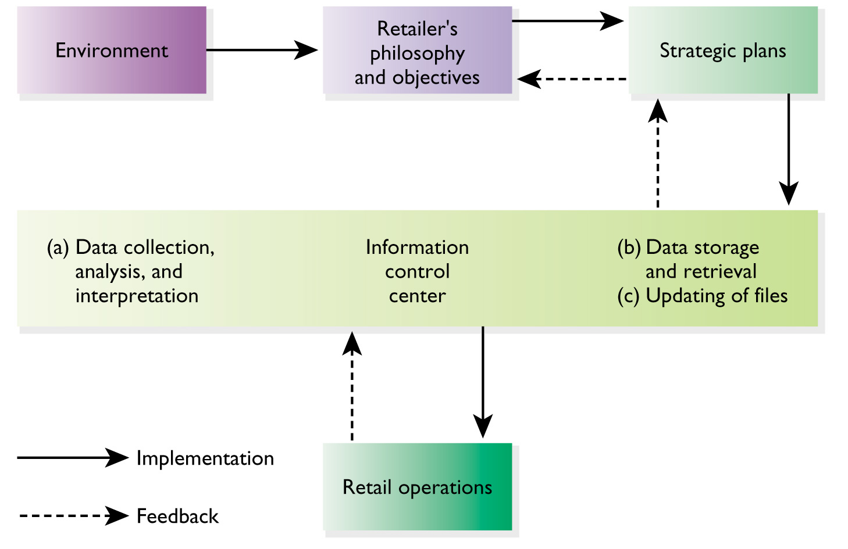
Figure 8.2 A Retail Information System

Slide 9
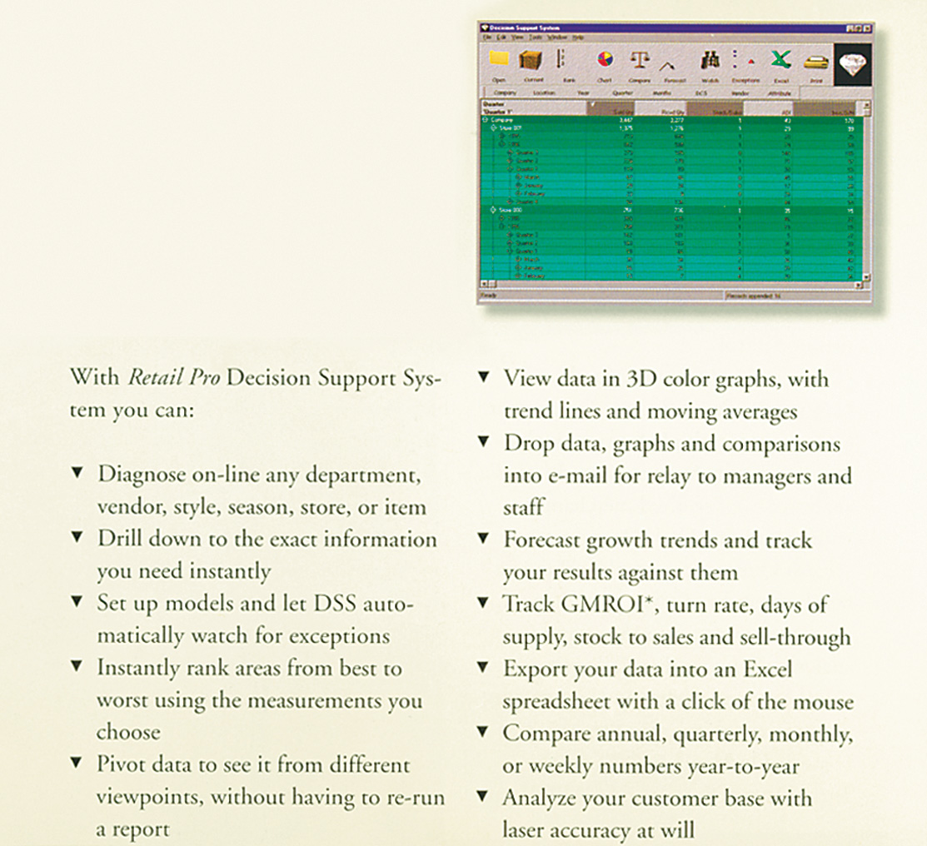
Figure 8.3 Retail Pro Management Information Software

Slide 10
Database Management
A major element in an RIS
System gathers, integrates, applies, and stores information in related subject areas
Used for
  Frequent shopper programs
  Customer analysis
  Promotion evaluation
  Inventory planning
  Trading area analysis

Slide 11
Five Steps to Approaching Database Management
Plan the particular database and its components and determine information needs
Acquire the necessary information
Retain the information in a usable and accessible format
Update the database regularly to reflect changing demographics, recent purchases, etc.
Analyze the database to determine strengths and weaknesses

Slide 12
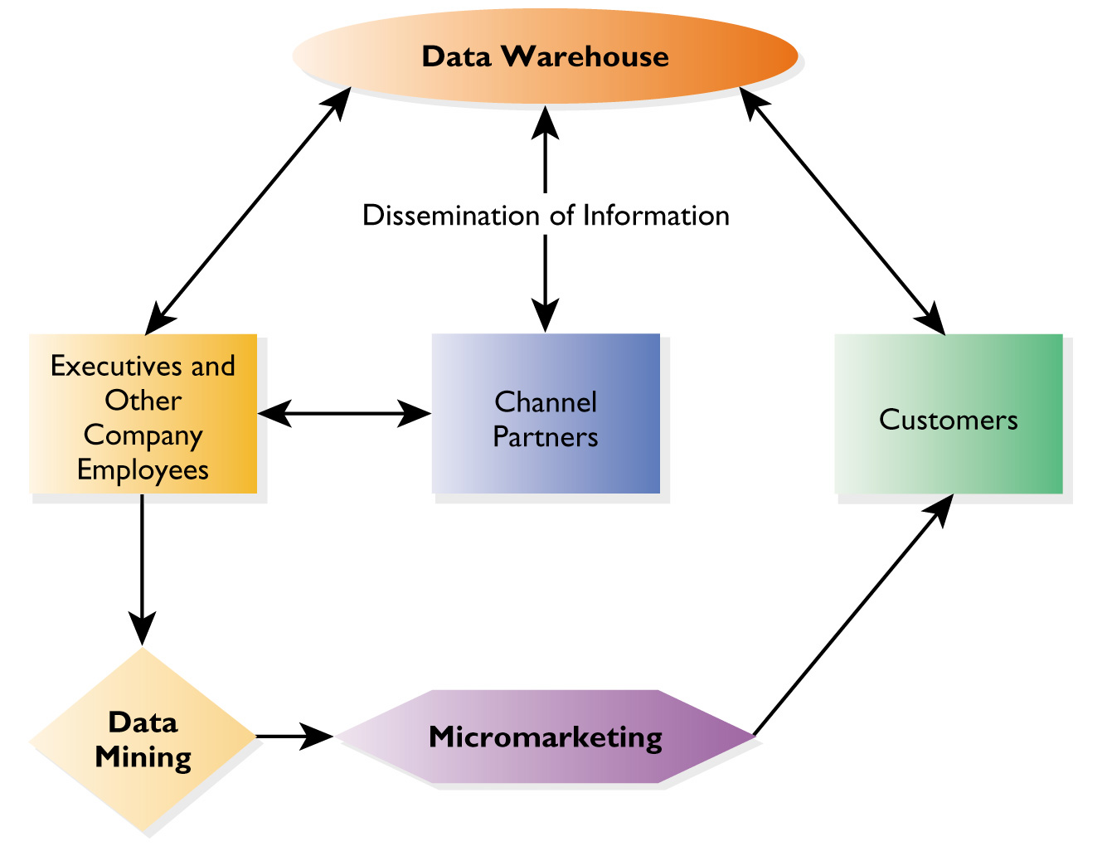
Figure 8.4 Retail Database Management in Action

Slide 13
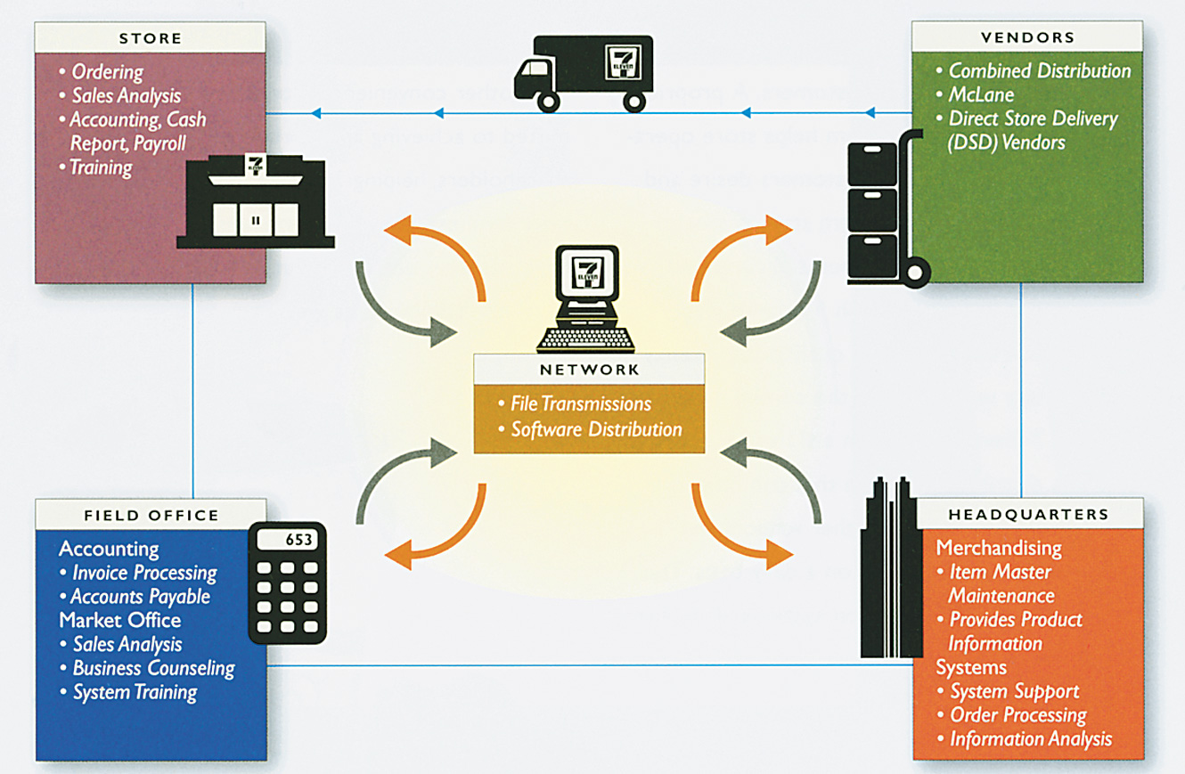
Figure 8.5 Data Warehousing

Slide 14
Components of a Data Warehouse
Physical storage location for data – the warehouse
Software to copy original databases and transfer them to warehouse
Interactive software to allow processing of inquiries
A directory for the categories of information kept in the warehouse

Slide 15
Data Mining and Micromarketing
Data mining is the in-depth analysis of information to gain specific insights about customers, product categories, vendors, and so forth
Micromarketing is an application of data mining, whereby retailers use differentiated marketing and develop focused retail strategy mixes for specific customer segments

Slide 16
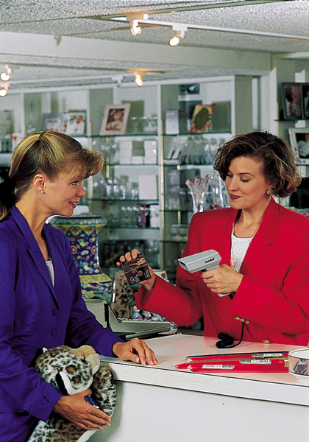
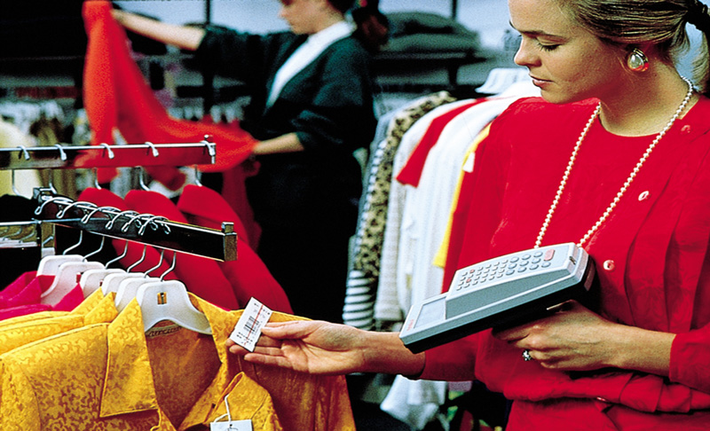
Figure 8.6 Applying UPC Technology to Gain Better Information

Slide 17
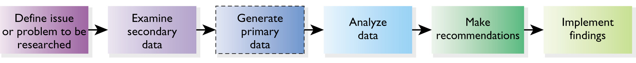
Figure 8.7 The Marketing Research Process

Slide 18
Marketing
Research in
Retailing
The collection and analysis of information relating to specific issues or problems facing a retailer

Slide 19
Secondary Data
Advantages
Inexpensive
Fast
Several sources and perspectives
Generally credible
Provides background information
Disadvantages
May not suit current study
May be incomplete
May be dated
May not be accurate or credible
May suffer from poor data collection techniques

Slide 20
Secondary Data Sources
Internal
Sales reports
Billing reports
Inventory records
Performance reports
External
Databases
  ABI/Inform, Business Periodicals Index, etc.
Government
  U.S. Census of Retail Trade
  Statistical Abstract of the U.S.
  Public records

Slide 21
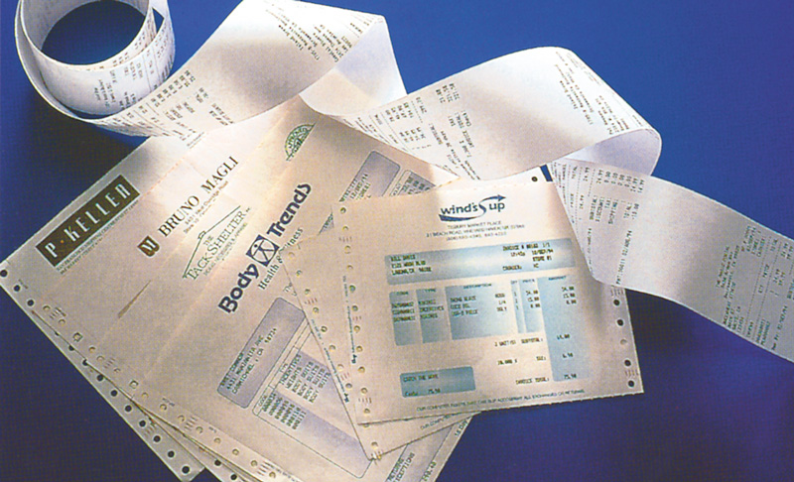
Figure 8.8 Internal Secondary Data

Slide 22
Primary Data
Advantages
Collected for specific purpose
Current
Relevant
Known and controlled source
Disadvantages
May be more expensive
Tends to be more time consuming
Information may not be acquirable
Limited perspectives

Slide 23
Primary Decisions
In-house or outsource?
Sampling method?
  Probability
  Nonprobability
Data collection method?
  Survey
  Observation
  Experiment
  Simulation

Slide 24
Survey Methods
In-person
Over the telephone
By mail
Online
Disguised
Non-disguised

Slide 25
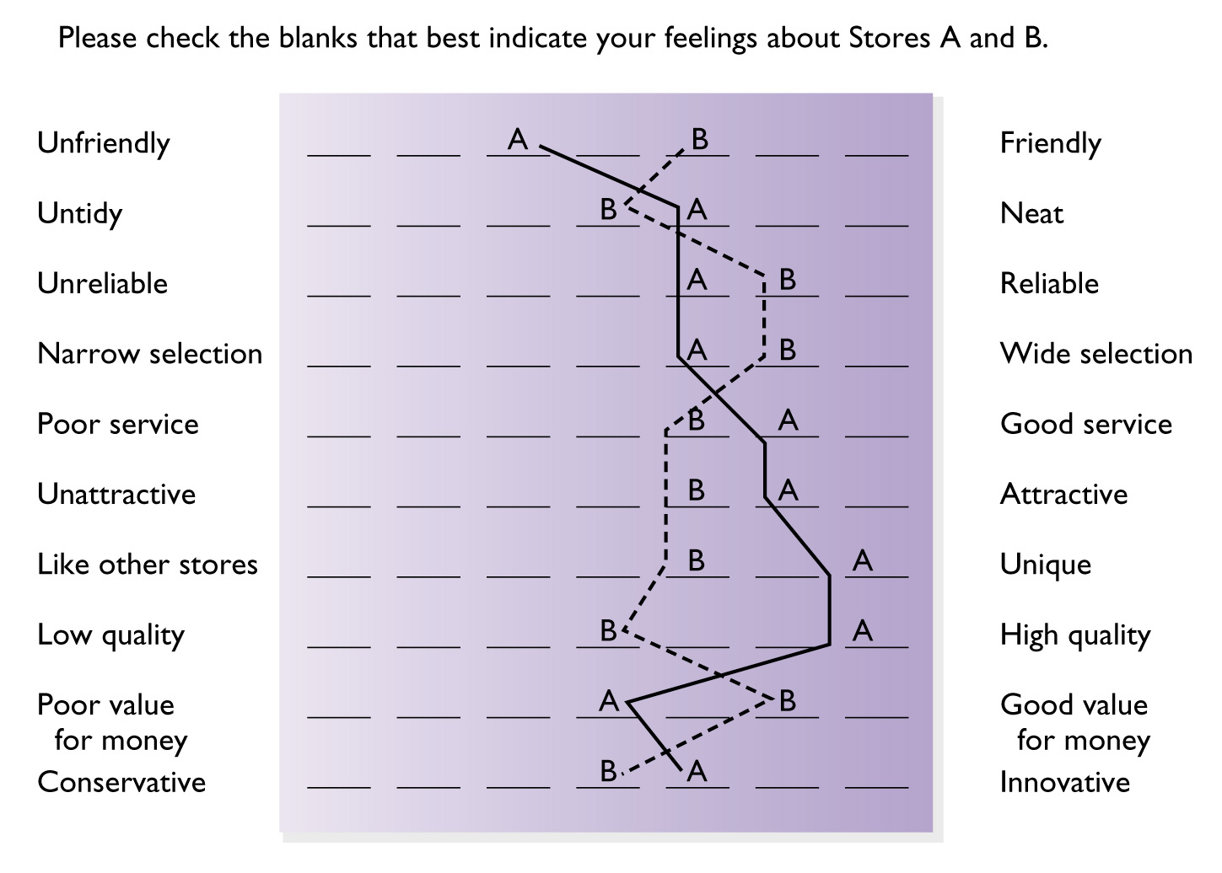
Figure 8.9 A Semantic Differential for Two Furniture Stores

Slide 26
Mystery Shoppers
Retailers hire people to pose as customers and observe operations from sales presentations to how well displays are maintained to service calls

Slide 27
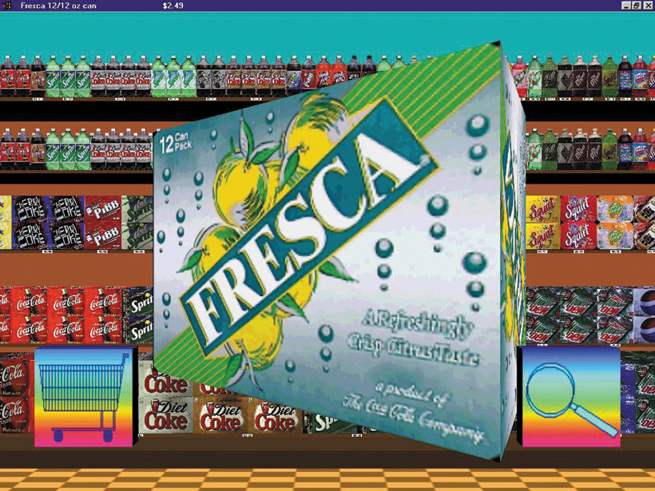
Figure 8.10 Visionary Shopper

Slide 28
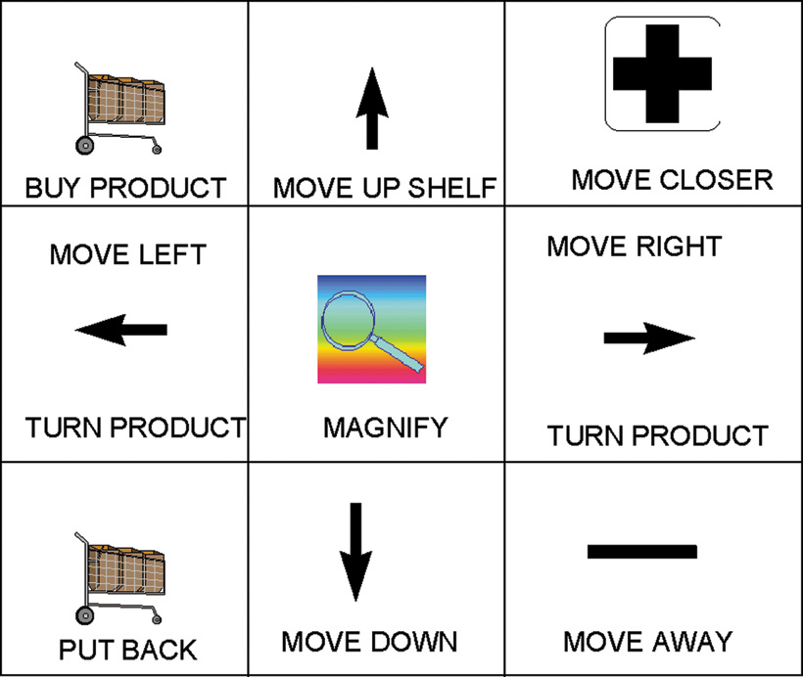
Figure 8.10b Visionary Shopper

