Slide 1
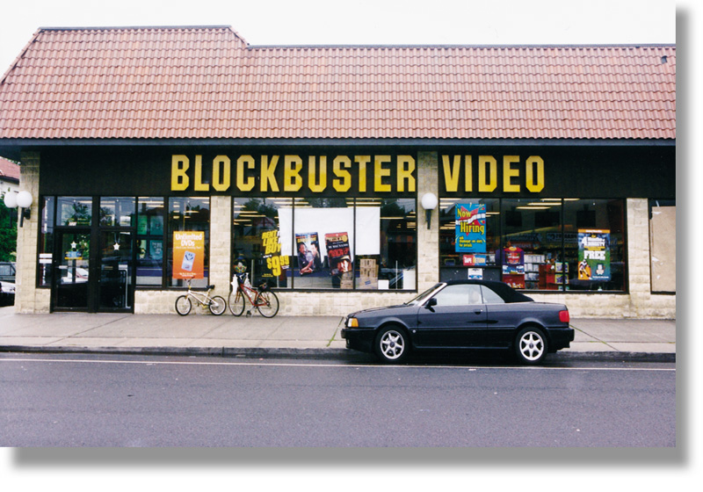
Chapter 9
Trading-Area Analysis
RETAIL
MANAGEMENT:
A STRATEGIC
APPROACH,
9th Edition
BERMAN EVANS

Slide 2
Chapter Objectives
To demonstrate the importance of store location for a retailer and outline the process for choosing a store location
To discuss the concept of a trading area and its related components
To show how trading areas may be delineated for existing and new stores

Slide 3
Chapter Objectives_2
To examine three major factors in trading-area analysis
  Population characteristics
  Economic base characteristics
  Competition and level of saturation

Slide 4
Location, Location, Location
Criteria to consider include
  population size and traits
  competition
  transportation access
  parking availability
  nature of nearby stores
  property costs
  length of agreement
  legal restrictions

Slide 5

Figure 9.1 Importance of
Location to Esprit

Slide 6
Choosing a Store Location
Step 1: Evaluate alternate geographic (trading)
areas in terms of residents and existing retailers
Step 2: Determine whether to locate as an
isolated store or in a planned shopping center
Step 3: Select the location type
Step 4: Analyze alternate sites contained in the
specific retail location type

Slide 7
Trading-Area Analysis
A trading area is a geographic area containing the customers of a particular firm or group of firms for specific goods or services

Slide 8
Benefits of Trading Area Analysis
Discovery of consumer demographics and socioeconomic characteristics
Opportunity to determine focus of promotional activities
Opportunity to view media coverage patterns
Assessment of effects of trading area overlap
Ascertain whether chain’s competitors will open nearby
Discovery of ideal number of outlets, geographic weaknesses
Review of other issues, such as transportation

Slide 9
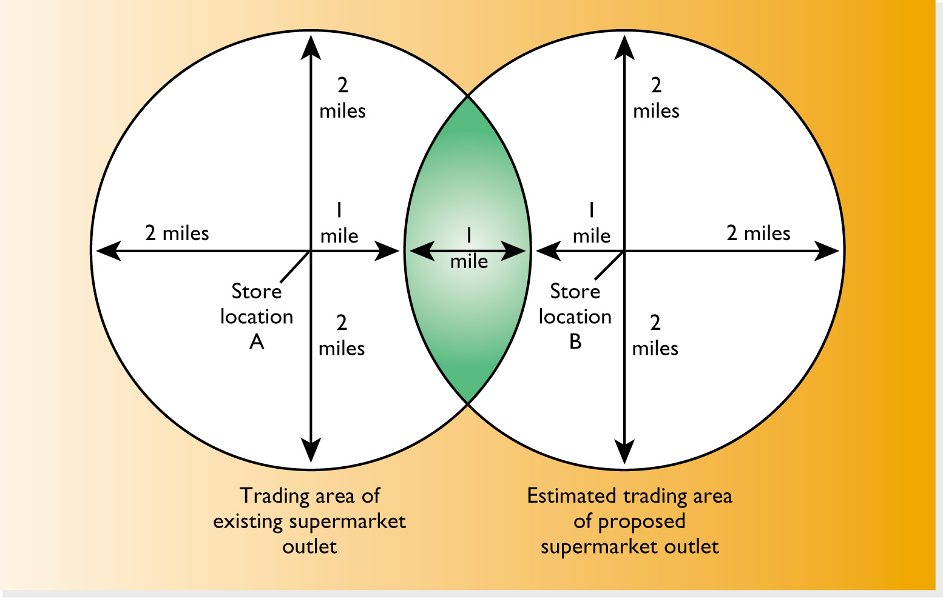
Figure 9.2 The Trading Areas of Current and Proposed Outlets

Slide 10
GIS Software
Geographic Information Systems
  digitized mapping with key locational data to graphically depict trading-area characteristics such as
    population demographics
    data on customer purchases
    listings of current, proposed, and competitor locations

Slide 11

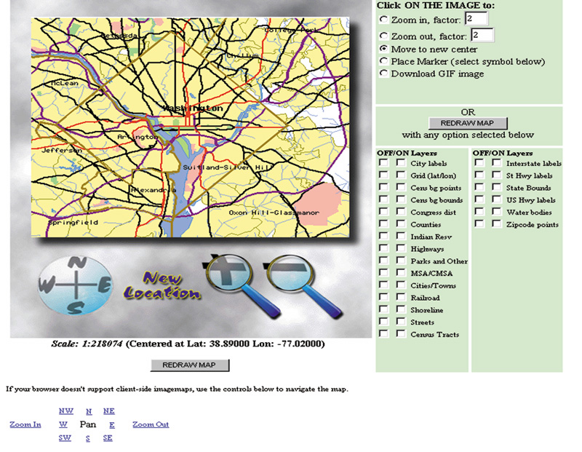
Figure 9.3a
The TIGER Map Service

Slide 12
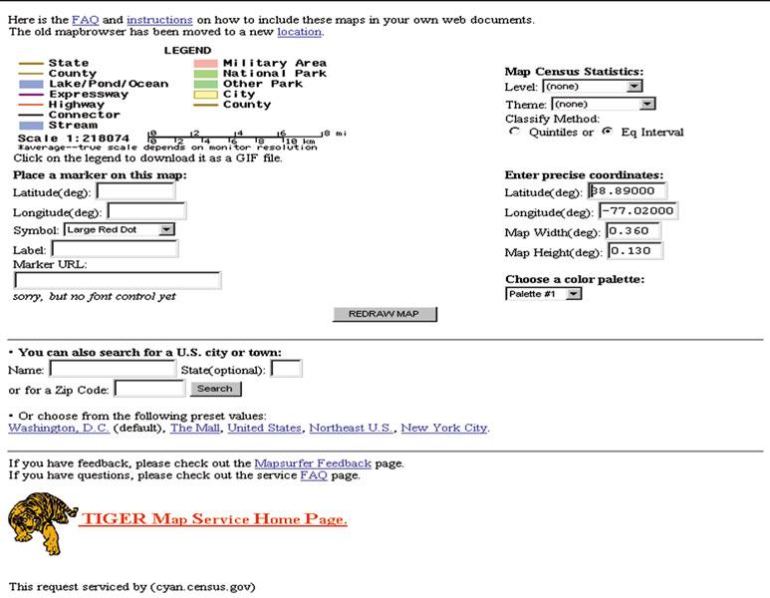
Figure 9.3b
The TIGER Map Service

Slide 13
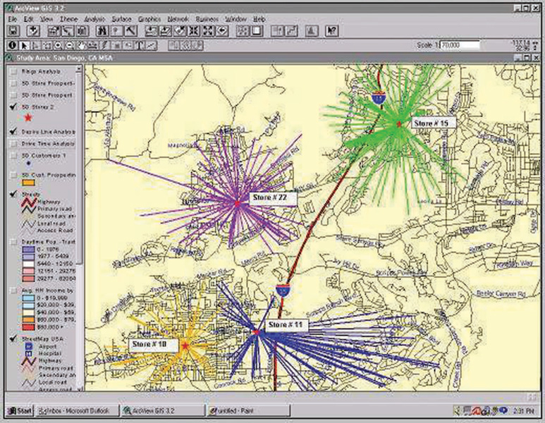
Figure 9.4
GIS Software in Action - A

Slide 14
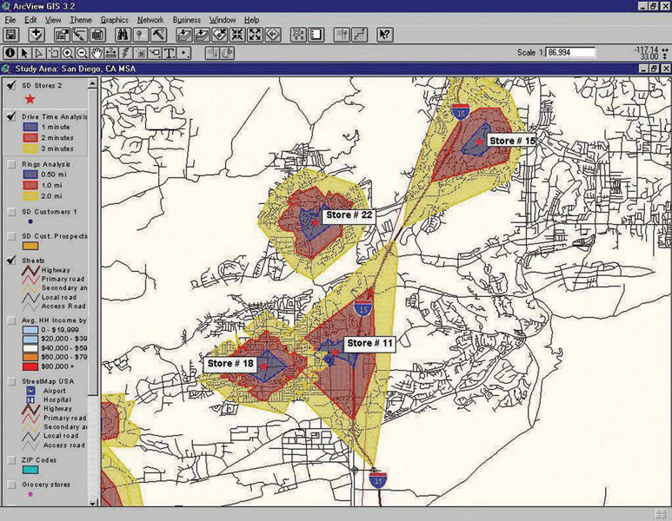
Figure 9.4
GIS Software in Action - B

Slide 15
Private Firms Offering
Mapping Software
Claritas
ESRI
GDT
GeoVue
Mapinfo
SRC

Slide 16
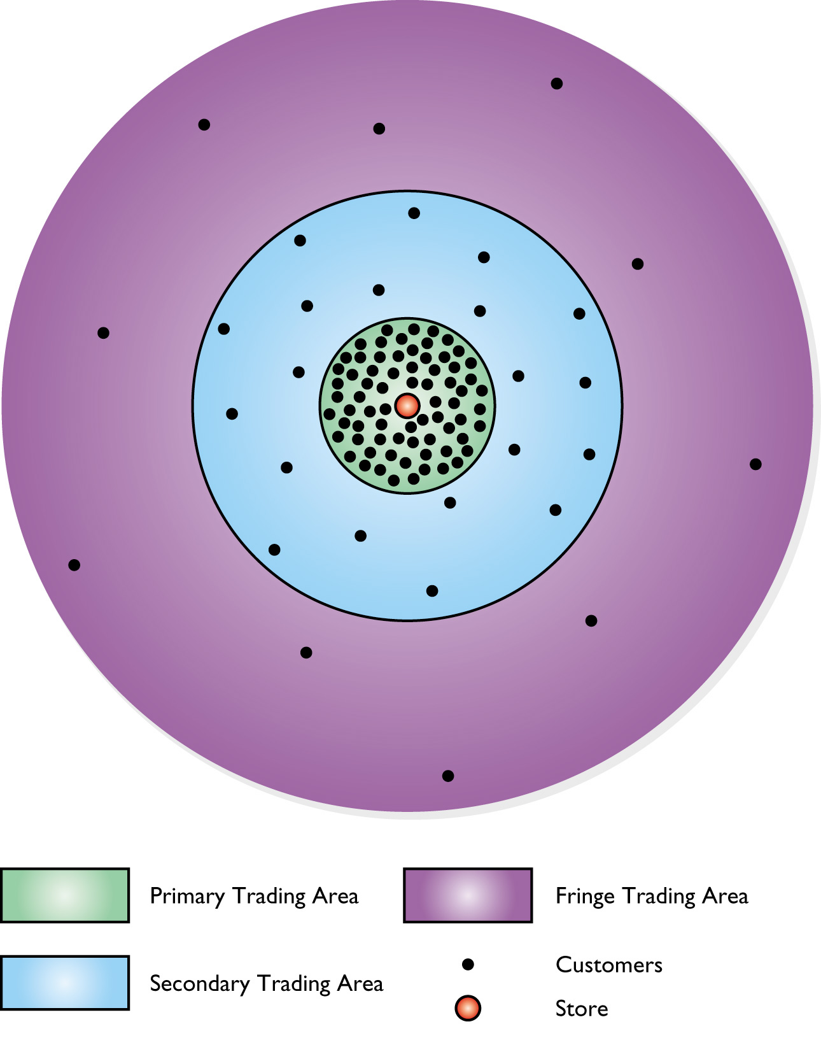
Figure 9.5 The Segments of a Trading Area

Slide 17
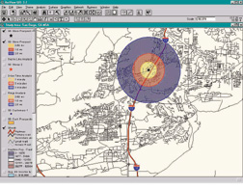
Figure 9.6 Delineating Trading-Area Segments

Slide 18
The Size and Shape of
Trading Areas
Primary trading area - 50-80% of a store’s customers
Secondary trading area - 15-25% of a store’s customers
Fringe trading area - all remaining customers

Slide 19
Destinations versus Parasites
Destination stores have a better assortment, better promotion, and/or better image
It generates a trading area much larger than that of its competitors
Dunkin’ Donuts: “It’s worth the trip!”
Parasite stores do not create their own traffic and have no real trading area of their own
These stores depend on people who are drawn to area for other reasons

Slide 20
Trading Areas and Store Type
Largest
TRADING
AREAS
Smallest
Department stores
Supermarkets
Apparel stores
Gift stores
Convenience stores

Slide 21

Figure 9.7 Carrefour Shanghai

Slide 22
The Trading Area of a New Store
Different tools must be used when an area must be evaluated in terms of opportunities rather than current patronage and traffic patterns
  Trend analysis
  Consumer surveys
  Computerized trading area analysis models

Slide 23
Computerized Trading-Area Analysis Models
Analog Model
Regression Model
Gravity Model

Slide 24
Reilly’s Law
Reilly’s law of retail gravitation, a traditional means of trading-area delineation, establishes a point of indifference between two cities or communities, so the trading area of each can be determined

Slide 25
Limitations of Reilly’s Law
Distance is only measured by major thoroughfares; some people will travel shorter distances along cross streets
Travel time does not reflect distance traveled. Many people are more concerned with time traveled than with distance
Actual distance may not correspond with perceptions of distance

Slide 26
Huff’s Law
Huff’s law of shopper attraction delineates trading areas on the basis of product assortment (of the items desired by the consumer) carried at various shopping locations, travel times from the shopper’s home to alternative locations, and the sensitivity of the kind of shopping to travel time.

Slide 27
Table 9.1 Chief Factors to Consider in Evaluating Retail Trading Areas
Population Size and Characteristics
Total size and density
Age distribution
Average educational level
Percentage of residents owning homes
Total disposable income
Per capita disposable income
Occupation distribution
Trends

Slide 28
Table 9.1 Chief Factors to Consider in Evaluating Retail Trading Areas
Availability of Labor
Management
Management trainee
Clerical

Slide 29
Table 9.1 Chief Factors to Consider in Evaluating Retail Trading Areas
Closeness to Sources of Supply
Delivery costs
Timeliness
Number of manufacturers
Number of wholesalers
Availability of product lines
Reliability of product lines

Slide 30
Table 9.1 Chief Factors to Consider in Evaluating Retail Trading Areas
Economic Base
Dominant industry
Extent of diversification
Growth projections
Freedom from economic and seasonal fluctuations
Availability of credit and financial facilities

Slide 31
Table 9.1 Chief Factors to Consider in Evaluating Retail Trading Areas
Competitive Situation
Number and size of existing competition
Evaluation of competitor strengths and weaknesses
Short-run and long-run outlook
Level of saturation

Slide 32
Table 9.1 Chief Factors to Consider in Evaluating Retail Trading Areas
Availability of Store Locations
Number and type of store locations
Access to transportation
Owning versus leasing opportunities
Zoning restrictions
Costs

Slide 33
Table 9.1 Chief Factors to Consider in Evaluating Retail Trading Areas
Regulations
Taxes
Licensing
Operations
Minimum wages
Zoning

Slide 34
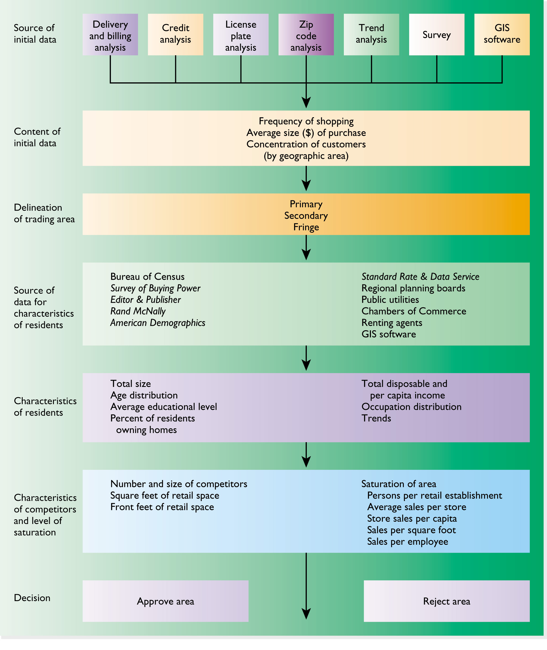
Figure 9.8 Analyzing Retail Trading Areas

Slide 35
Elements in Trading-Area Selection
Population
Characteristics
Economic Base
Characteristics
Nature and Saturation
of Competition

Slide 36
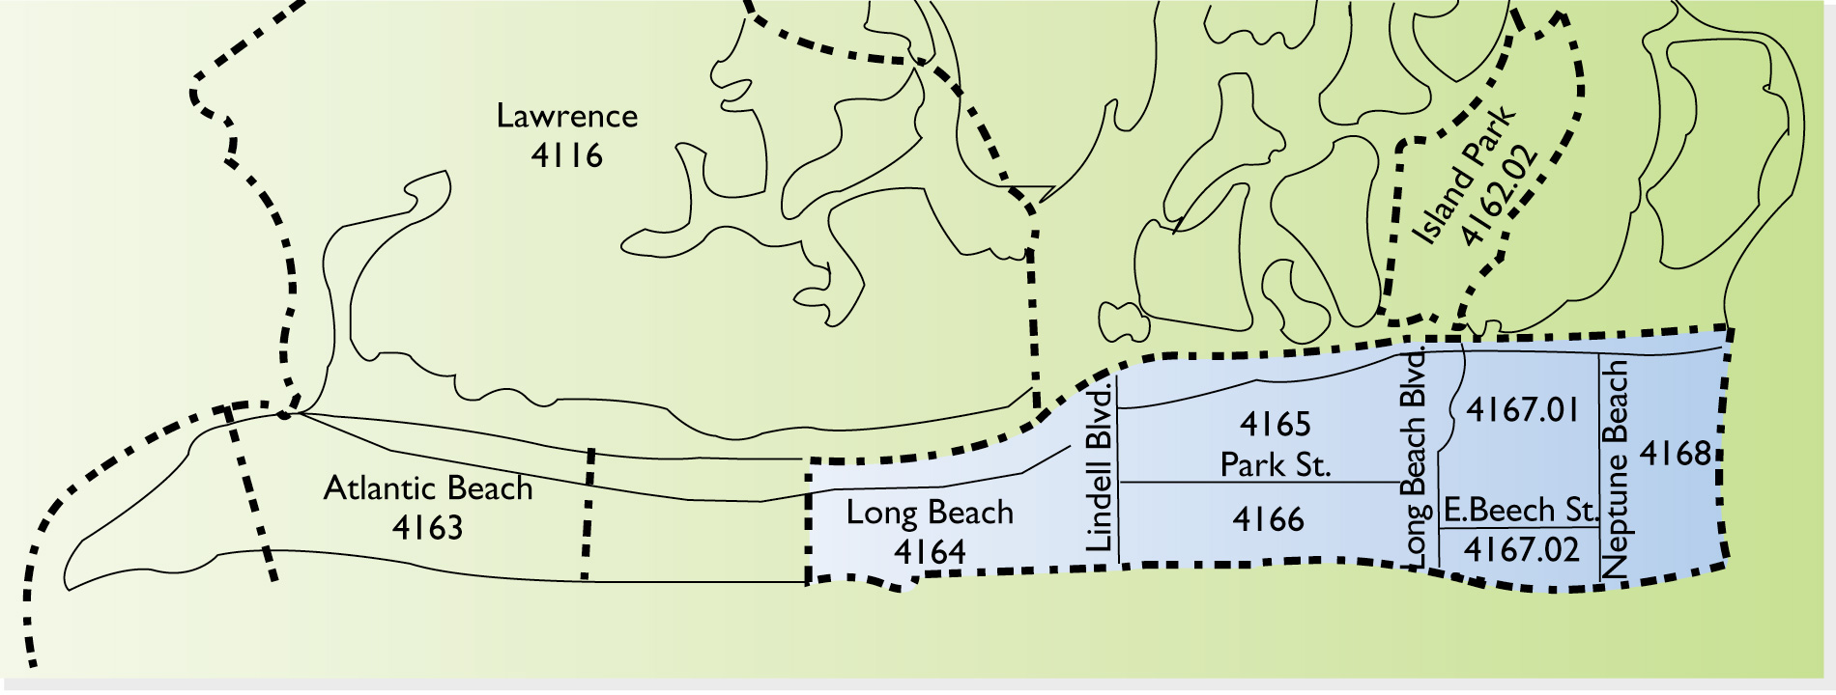
Figure 9.9 The Census Tracts of
Long Beach, NY

Slide 37
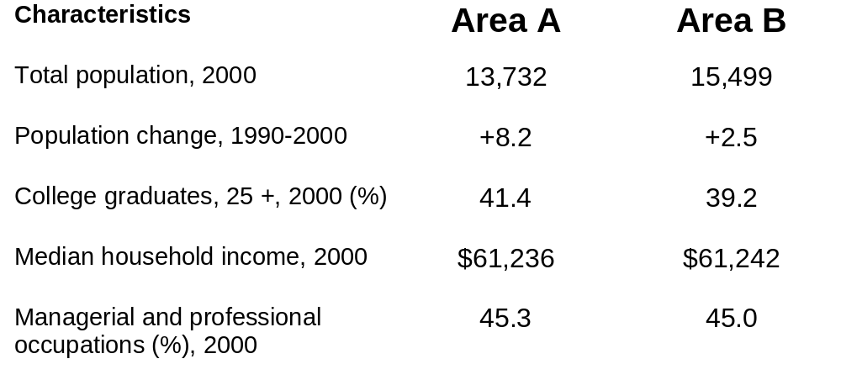
Table 9.3 Selected Population Statistics for Trading Areas A and B

