Slide 1
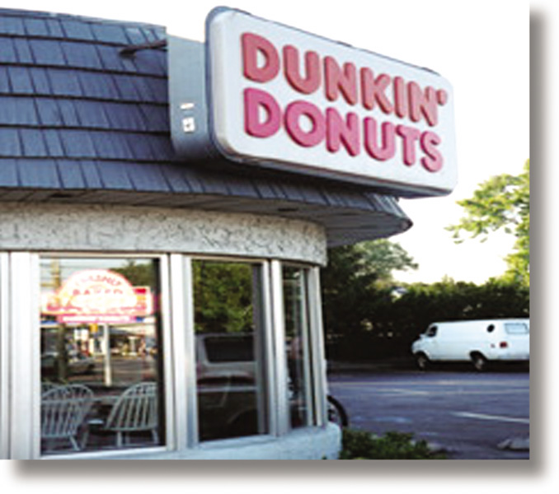
Chapter 10
Site Selection
RETAIL
MANAGEMENT:
A STRATEGIC
APPROACH,
9th Edition
BERMAN EVANS

Slide 2
Chapter Objectives
To thoroughly examine the types of locations available to a retailer: isolated store, unplanned business district, and planned shopping center
To note the decisions necessary in choosing a general retail location
To describe the concept of one-hundred percent location

Slide 3
Chapter Objectives_2
To discuss several criteria for evaluating general retail locations and the specific sites within them
To contrast alternative terms of occupancy

Slide 4
Overview
Step 1: investigate alternative trading areas (Chapter 9)
Step 2: determine what type of location is desirable
Step 3: select the general location
Step 4: evaluate alternative specific store sites
Chapter 10 discusses steps 2-4

Slide 5
3 Types of Locations
Isolated
Store
Planned
Shopping
Center
Unplanned
Business
District

Slide 6
Isolated Stores
Advantages
  No competition
  Low rental costs
  Flexibility
  Good for convenience stores
  Better visibility
  Adaptable facilities
  Easy parking
Disadvantages
  Difficulty attracting customers
  Travel distance
  Lack of variety for customers
  High advertising expenses
  No cost sharing
  Restrictive zoning laws

Slide 7
Isolated Stores
Advantages
  No competition
  Low rental costs
  Flexibility
  Good for convenience stores
  Better visibility
  Adaptable facilities
  Easy parking
Disadvantages
  Difficulty attracting customers
  Travel distance
  Lack of variety for customers
  High advertising expenses
  No cost sharing
  Restrictive zoning laws

Slide 8
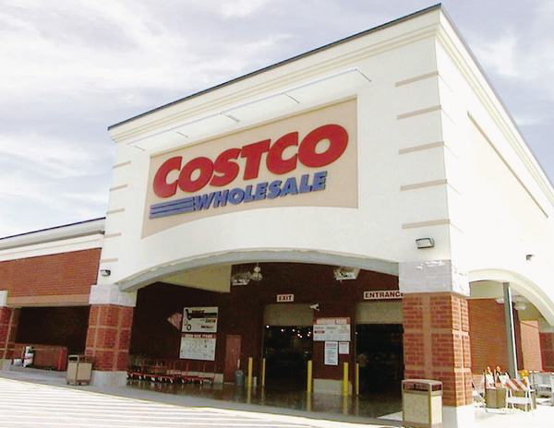
Isolated Stores
Large-store formats
  Wal-Mart
  Costco
Convenience stores
  7-Eleven

Slide 9

Figure 10.1 Site Selection and McDonald’s

Slide 10
Unplanned Business Districts
Secondary
Business
District
Central Business
District
Neighborhood
Business
District
String
District

Slide 11

Figure 10.2 Revitalized Central Business District

Slide 12
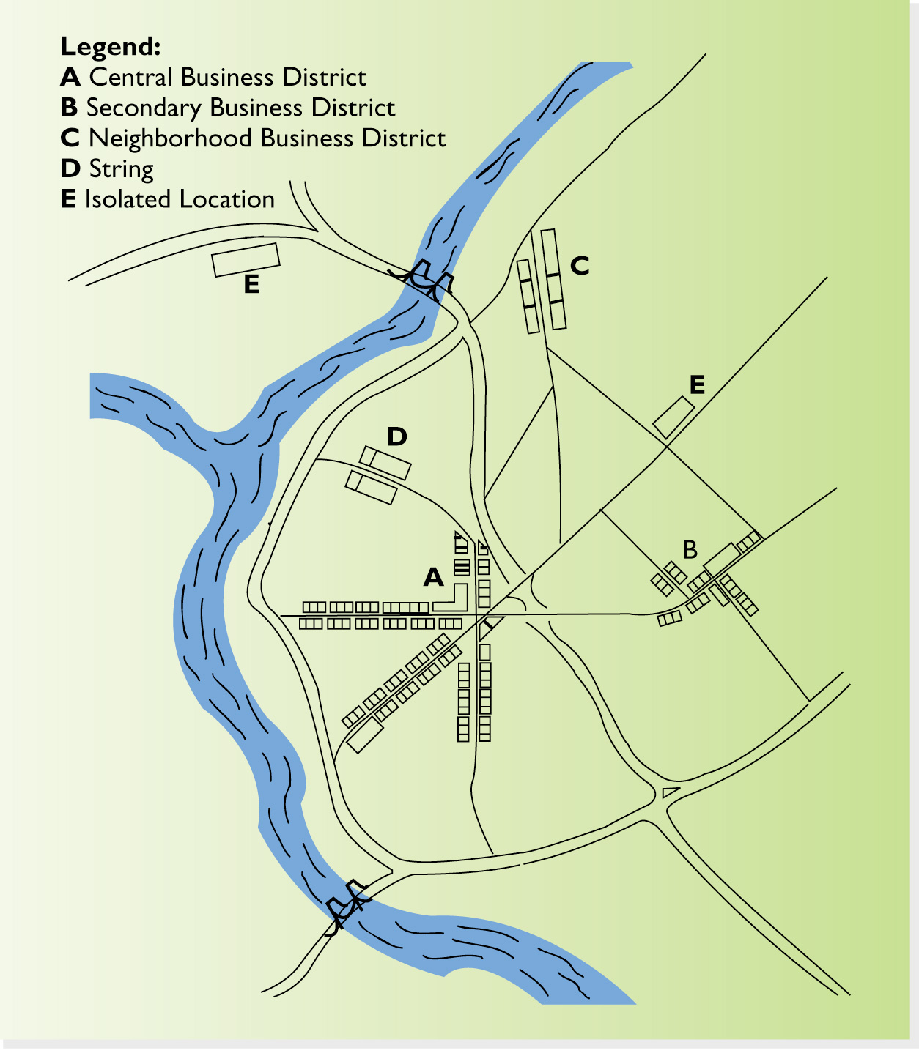
Figure 10.3 Unplanned Business Districts and Isolated Locations

Slide 13
Planned Shopping Centers
Advantages
Well-rounded assortments
Strong suburban population
One-stop, family shopping
Cost sharing
Transportation access
Pedestrian traffic
Disadvantages
Limited flexibility
Higher rent
Restrictions on offerings
Competitive environment
Requirements for association memberships
Too many malls
Domination by anchor stores

Slide 14

Renovations to Sustain Growth
The Florida Mall, Orlando, Florida
King of Prussia, Pennsylvania
Park Place, Tucson, Arizona
Roosevelt Field, Long Island, New York
University Towne Center, San Diego, California

Slide 15

Figure 10.4 Roosevelt Field

Slide 16
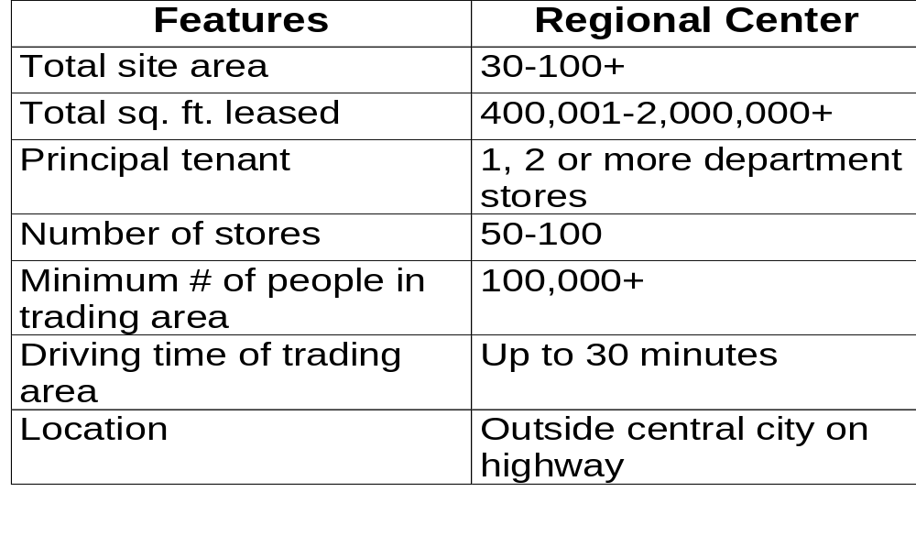
Table 10.1 A
Characteristics of Centers

Slide 17

Figure 10.5 Festival Walk:
Hong Kong Megamall

Slide 18
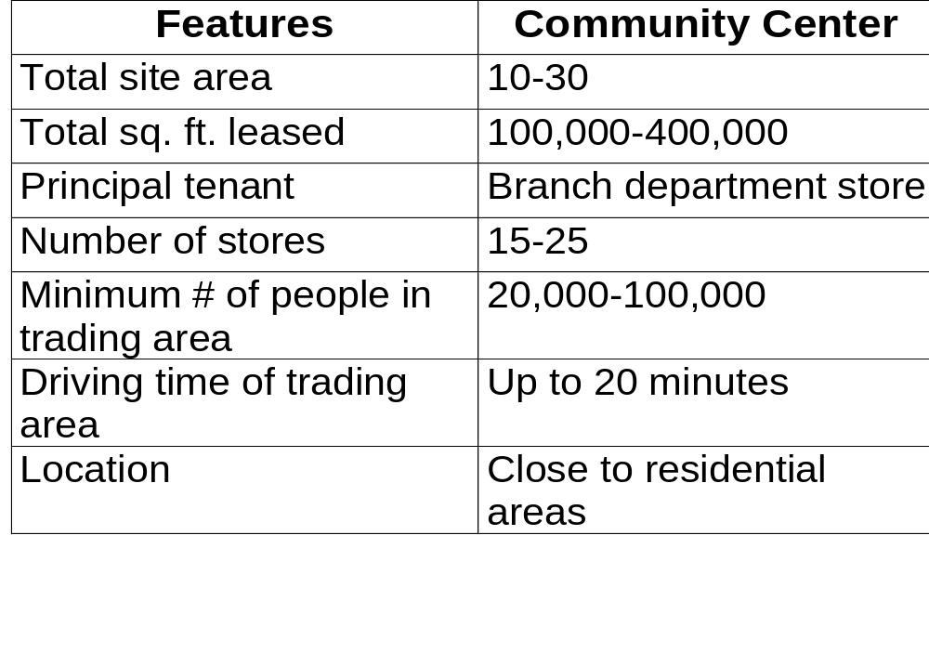
Table 10.1 B
Characteristics of Centers

Slide 19
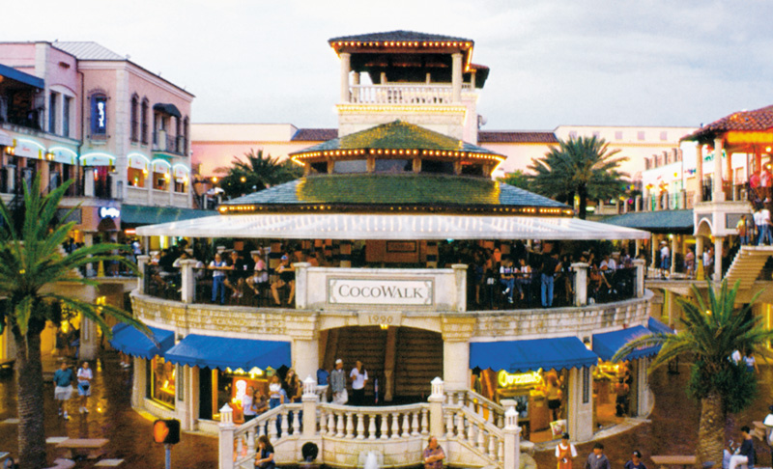
Figure 10.6 CocoWalk:
A Life-Style Center

Slide 20
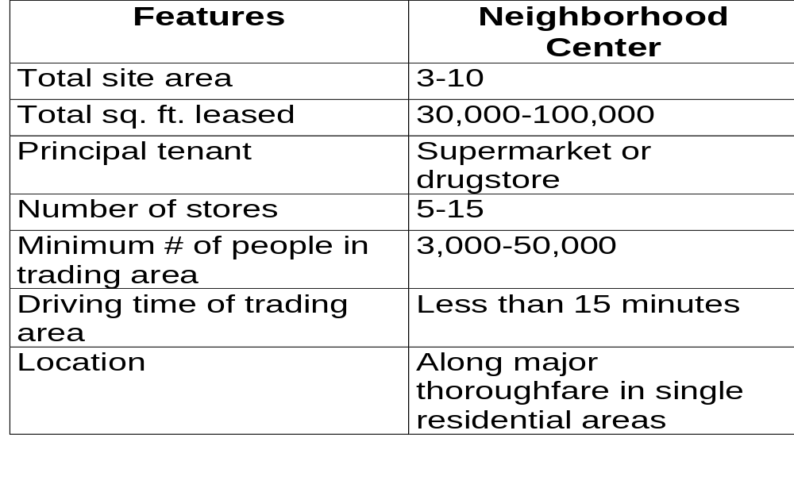
Table 10.1 C
Characteristics of Centers

Slide 21
Location and Site Evaluation
One-hundred
Percent
Location
The
optimum site
for a
particular store

Slide 22
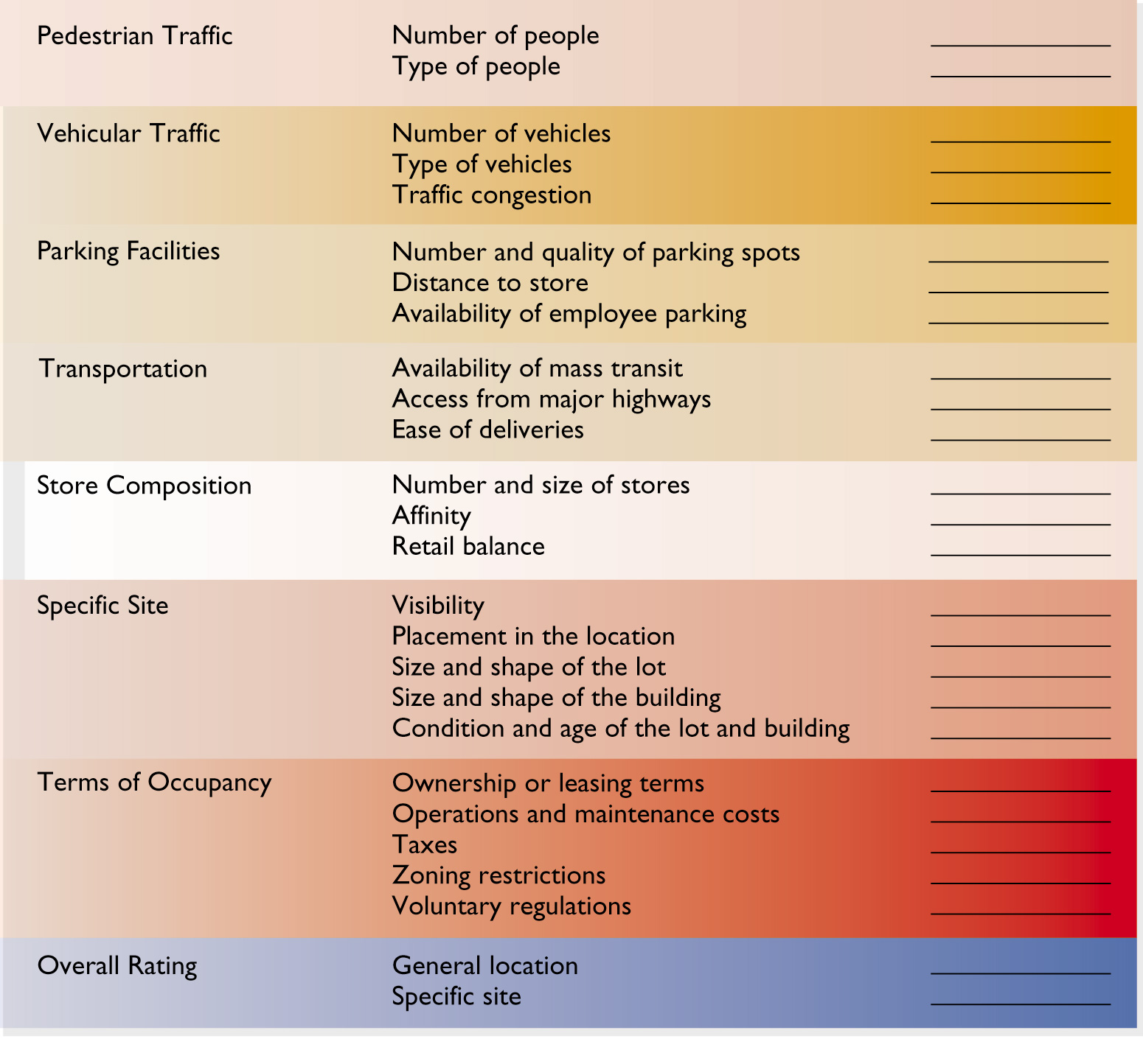
Figure 10.7
Location/ Site Evaluation Checklist

Slide 23
Pedestrian Traffic
The most crucial measures of a location’s and site’s value are the number and type of people passing by.
Proper pedestrian traffic count should include
  age and gender (exclude very young children)
  count by time of day
  pedestrian interviews
  spot analysis of shopping trips

Slide 24
Vehicular Traffic
Important for
  convenience stores
  outlets in regional shopping centers
  car washes
  suburban areas with limited pedestrian traffic

Slide 25
Parking Considerations
Number and quality of spots
Distance of spots from stores
Availability of employee parking
Price to charge customers for parking

Slide 26
How Many Parking Spaces?
Shopping centers = 4-5 spaces per 1000 square feet of gross floor space
Supermarkets = 10-15 spaces per 1000 square feet of gross floor space
Furniture stores = 3-4 spaces per 1000 square feet of gross floor space

Slide 27
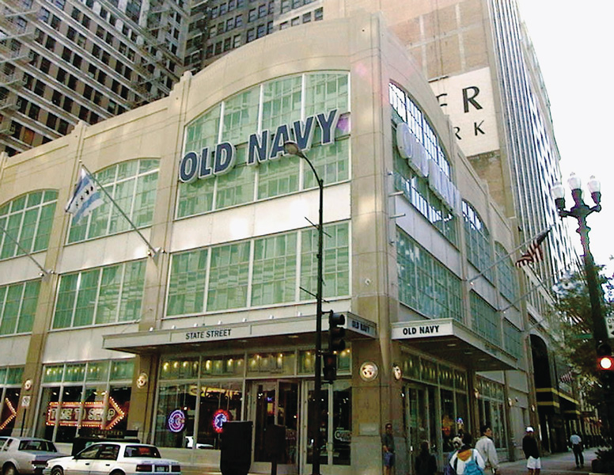
Figure 10.8
Corner Influence and Old Navy

Slide 28
Terms of Occupancy Considerations
Ownership versus Leasing
Type of Lease
Operations and Maintenance Costs
Taxes
Zoning Restrictions
Voluntary regulations

Slide 29
Types of Leases
Straight Lease
Maintenance-
increase
recoupment
lease
Percentage
Lease
Graduated
Lease
Net Lease

