Slide 1

Chapter 15
Implementing Merchandise Plans
RETAIL
MANAGEMENT:
A STRATEGIC
APPROACH,
9th Edition
BERMAN EVANS

Slide 2
Chapter Objectives
To describe the steps in the implementation of merchandise plans: gathering information, selecting and interacting with merchandise sources, evaluation, negotiation, concluding purchases, receiving and stocking merchandise, reordering, and re-evaluation
To examine the prominent roles of logistics and inventory management in the implementation of merchandise plans

Slide 3
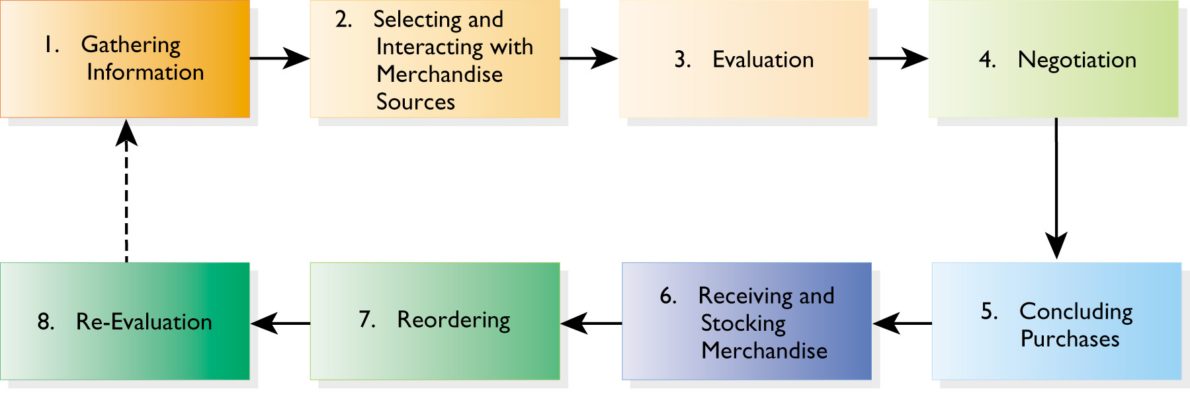
Figure 15.1 The Process for Implementing Merchandise Plans

Slide 4
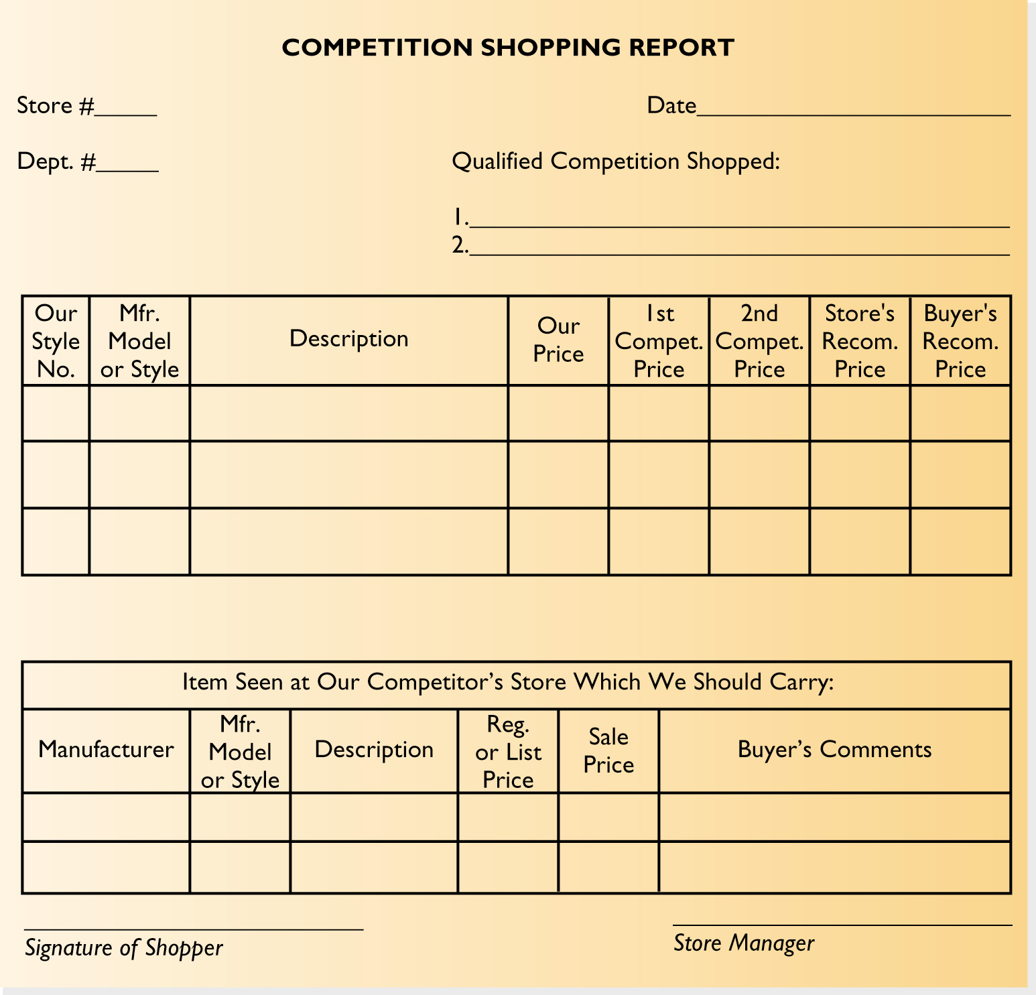
Figure 15.2
A Competition Shopping Report

Slide 5
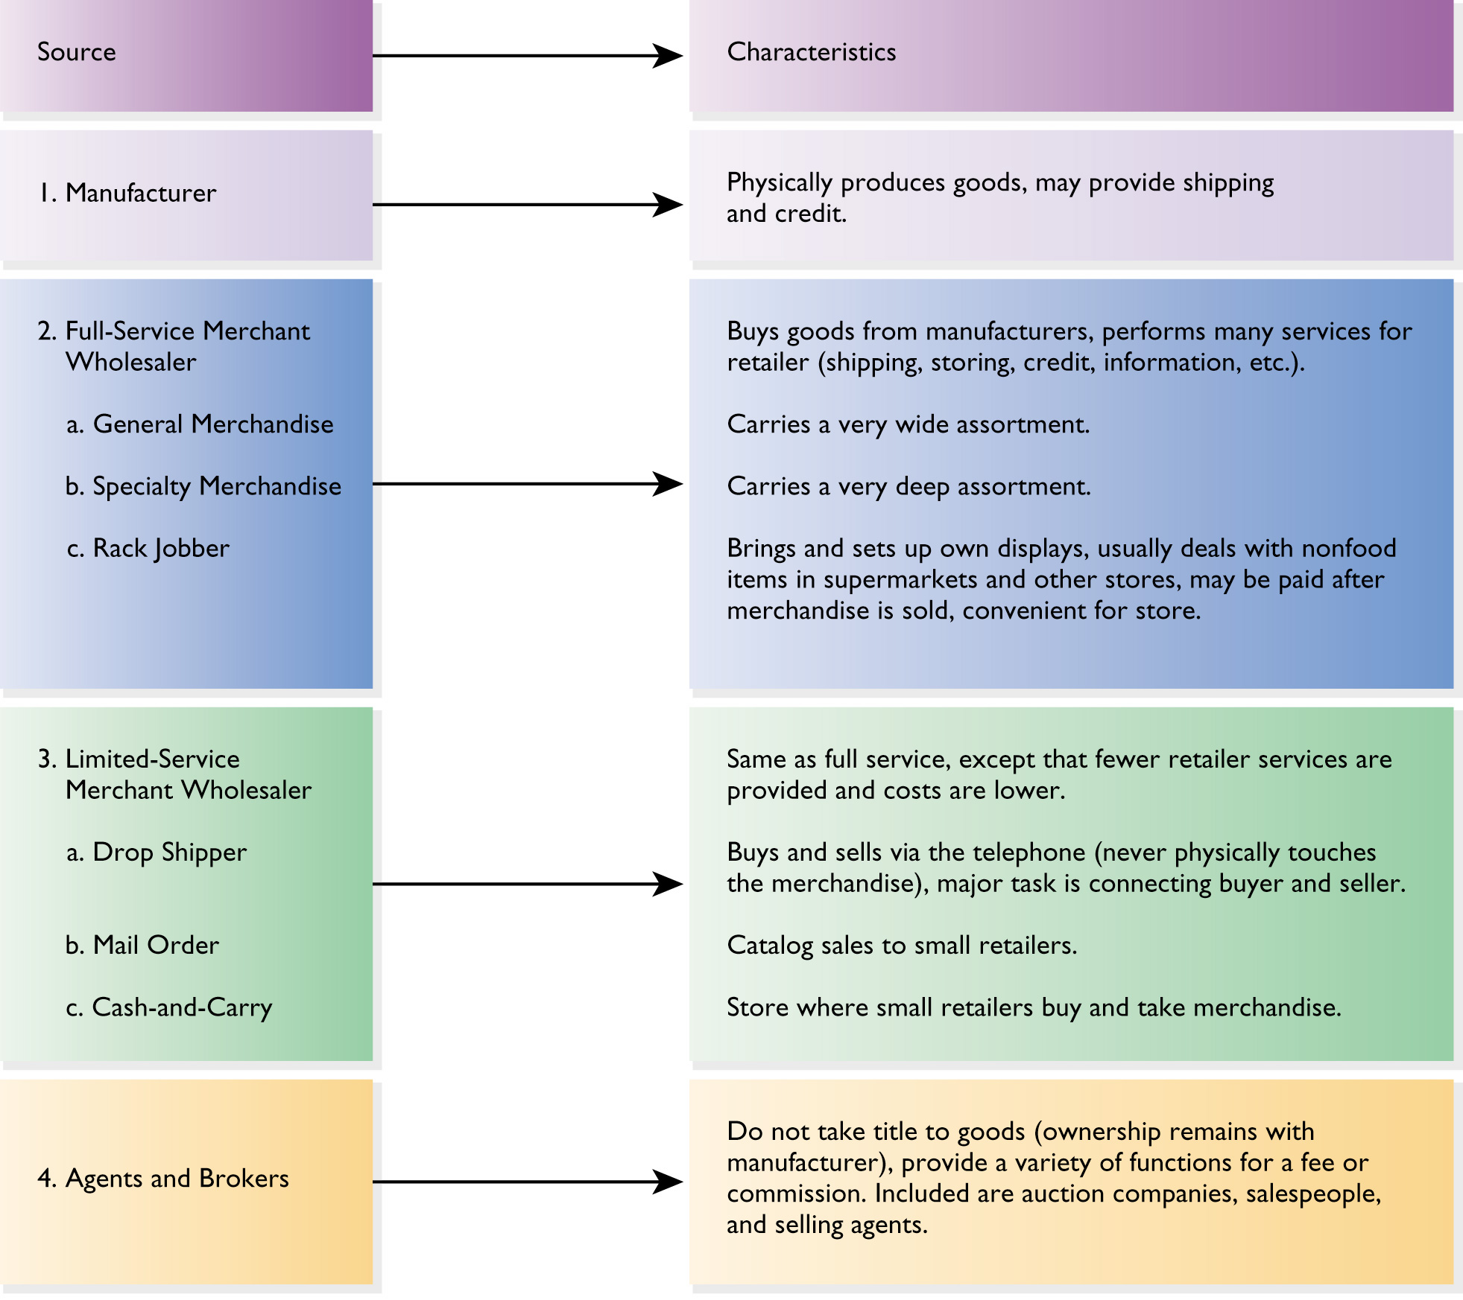
Figure 15.3
Outside
Sources of
Supply

Slide 6
Selecting Merchandise Sources
Company-owned
Outside, regularly used supplier
Outside, new supplier

Slide 7
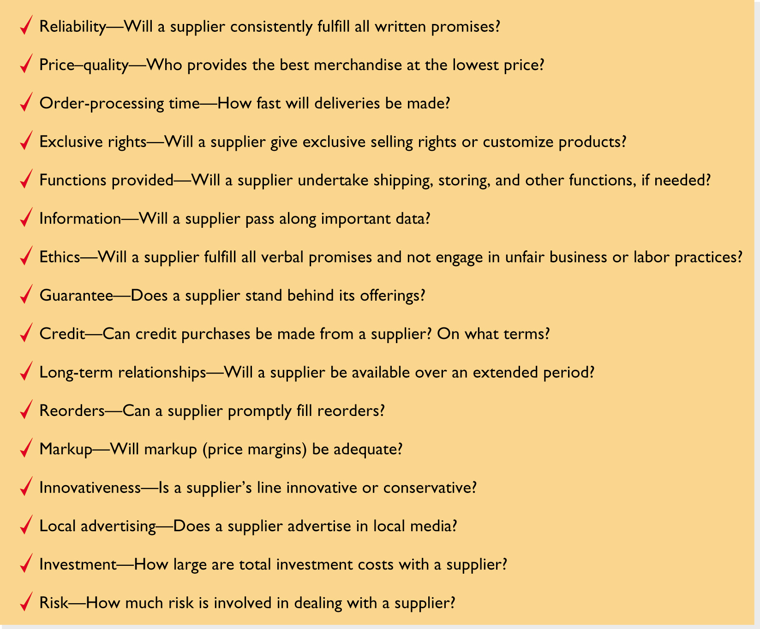
Figure 15.4
A Checklist of
Points to Review in
Choosing Vendors

Slide 8
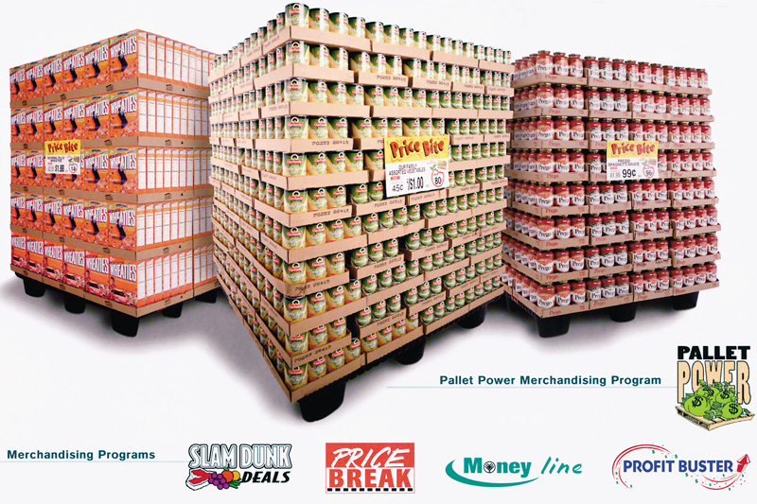
Figure 15.5 A Collaborative Supplier-Retailer Program

Slide 9
Negotiating the Purchase
Opportunistic buying
Slotting allowances

Slide 10
Concluding Purchases
The retailer takes title immediately on purchase
The retailer assumes ownership after titles are loaded onto the mode of transportation
The retailer takes title when a shipment is received
The retailer does not take title until the end of a billing cycle, when the supplier is paid
The retailer accepts merchandise on consignment and does not own the items. The supplier is paid after merchandise is sold

Slide 11
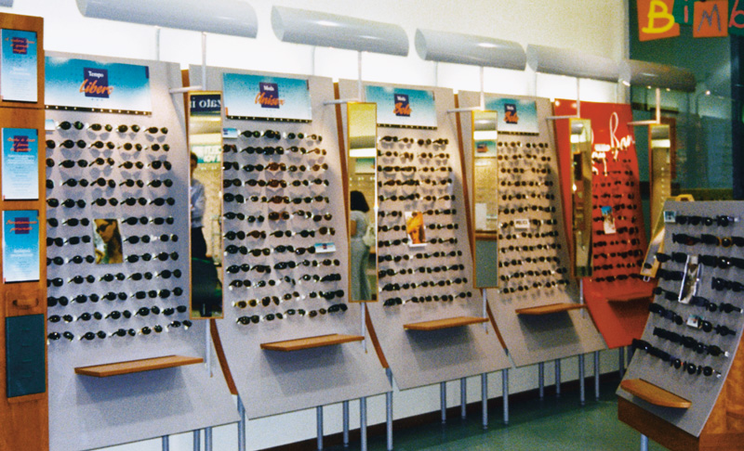
Figure 15.6 Receiving and Stocking Merchandise at Category Killer Stores

Slide 12

Figure 15.7 The Monarch 1130 Series Labeler

Slide 13
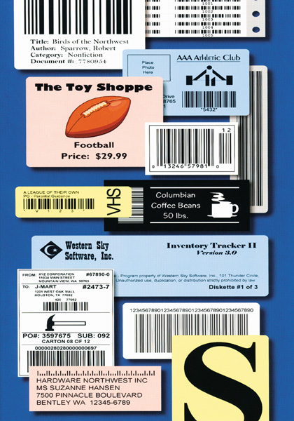
Figure 15.8 Bar Tender for Windows

Slide 14
Reordering Merchandise
Four critical factors:
  Order and delivery time
  Inventory turnover
  Financial outlays
  Inventory versus ordering costs

Slide 15
Logistics
Logistics is the total process of planning, implementing, and coordinating the physical movement of merchandise from manufacturer (wholesaler) to retailer to customer in the most timely, effective, and cost-efficient manner possible

Slide 16
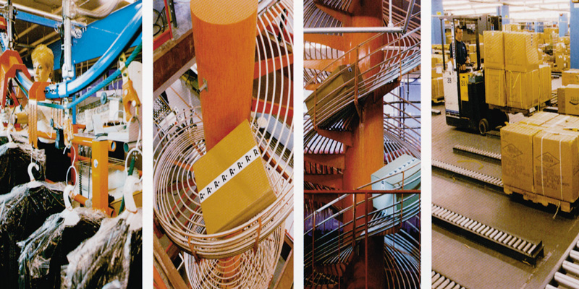
Figure 15.9 The Sophisticated Logistics System of Reitmans

Slide 17
Performance Goals
Relate costs incurred to specific logistics activities
Place and receive orders as easily, accurately, and satisfactorily as possible
Minimize the time between ordering and receiving merchandise
Coordinate shipments from various suppliers
Have enough merchandise on hand to satisfy customer demand, without having so much inventory that heavy markdowns will be necessary

Slide 18
Performance Goals_2
Place merchandise on the sales floor efficiently
Process customer orders efficiently and in a manner satisfactory to customers
Work collaboratively and communicate regularly with other supply chain members
Handle returns effectively and minimize damaged products
Monitor logistics’ performance
Have backup plans in case of breakdowns in the system

Slide 19

Supply Chain Management
The supply chain is the logistics aspect of a value delivery chain
  Parties involved
    Manufacturers
    Wholesalers
    Third-party specialists
    Retailer

Slide 20
Order Processing and Fulfillment
Quick Response Inventory Planning (QR)
Floor-ready merchandise
Efficient Consumer Response (ECR)

Slide 21
Transportation and Warehousing
How often will merchandise be shipped to the retailer?
How will small order quantities be handled?
What shipper will be used?
What transportation form will be used? Are multiple forms required?
What are the special considerations for perishables and expensive merchandise?
How often will special shipping arrangements be necessary?
How are shipping terms negotiated with suppliers?
What delivery options will be available for the retailer’s customers?

Slide 22
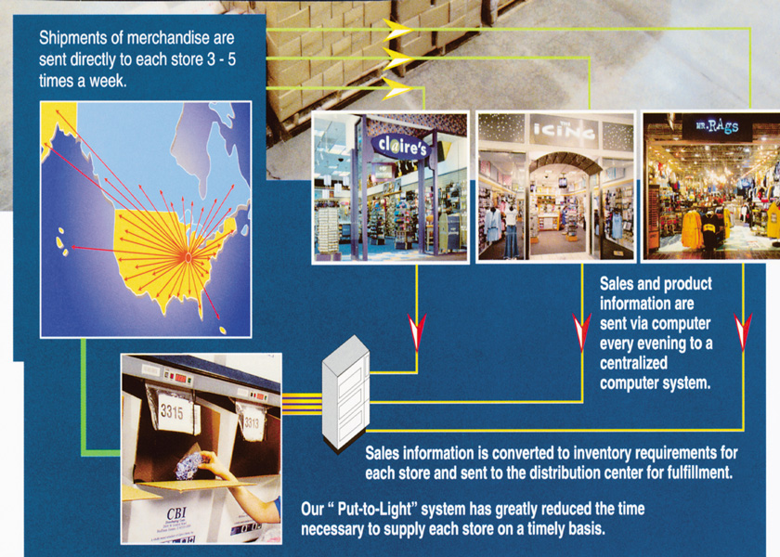
Figure 15.10 Claire’s Aggressive
Use of Central Warehousing

Slide 23
Problems Balancing Inventory Levels
The retailer wants to be appealing and never lose a sale by being out of stock; it does not want to be “stuck” with excess merchandise
What fad merchandise and how much should be carried?
Customer demand is never completely predictable
Shelf space allocation should be linked to current revenues

Slide 24
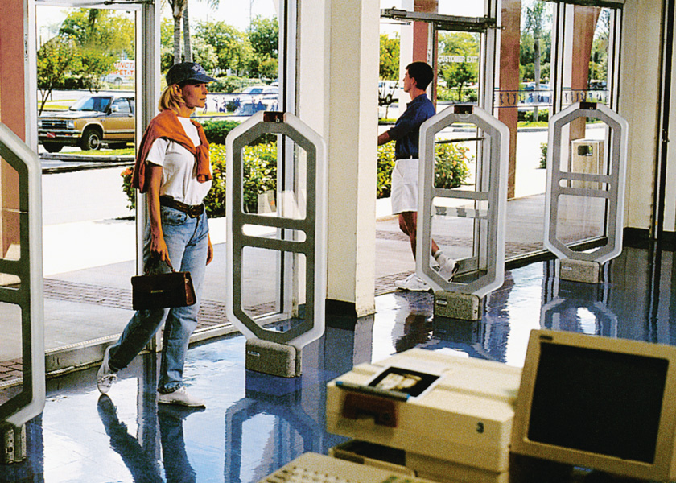
Figure 15.11 Sensormatic:
The Leader in Store Security Systems

Slide 25
Figure 15.12 Ways Retailers Can Deter Employee and Shopper Theft
Employee Theft
  Use honesty tests as employee screen-in devices
  Lock up trash to prevent merchandise from being thrown out and then retrieved
  Verify through cameras and undercover personnel whether all sales are rung up
  Centrally control all exterior doors to monitor opening/ closing
  Divide responsibilities – have one employee record sales and another make deposits
  Give rewards for spotting thefts
  Have training programs
  Vigorously investigate all known losses and fire offenders immediately

Slide 26
Figure 15.12 Ways Retailers Can Deter Employee and Shopper Theft
Shopper Theft While Store is Open
  Use uniformed guards
  Set up cameras and mirrors to increase visibility – especially in low-traffic areas
  Use electronic article surveillance for high-value and theft-prone goods
  Develop comprehensive employee training programs
  Offer employee bonuses based on an overall reduction in shortages
  Inspect all packages brought into store
  Use self-locking showcases for high-value items such as jewelry
  Attach expensive clothing together
  Alternate the direction of hangers on clothing near doors
  Limit the number of entrances and exits to the store, and the dollar value and quantity of merchandise displayed near exits
  Prosecute all individuals charged with theft

Slide 27
Figure 15.12 Ways Retailers Can Deter Employee and Shopper Theft
Employee/ Shopper Theft While Store is Closed
  Conduct a thorough building check at night to make sure no one is left in store
  Lock all exits, even fire exits
  Utilize ultrasonic/infrared detectors, burglar alarm traps, or guards with dogs
  Place valuables in a safe
  Install shatterproof glass and/or iron gates on windows and doors to prevent break-ins
  Make sure exterior lighting is adequate
  Periodically test burglar alarms

Slide 28
Reverse Logistics
All merchandise flows from the retailer back through the supply channel
Reverse Logistics Decisions
  Under what conditions are customer returns accepted by the retailer and by the manufacturer?
  What is the customer refund policy? Is there a fee for returning an opened package?
  What party is responsible for shipping a returned product to the manufacturer?
  What customer documentation is needed to prove the date of purchase and the price paid?
  How are customer repairs handled?
  To what extent are employees empowered to process customer returns?

Slide 29
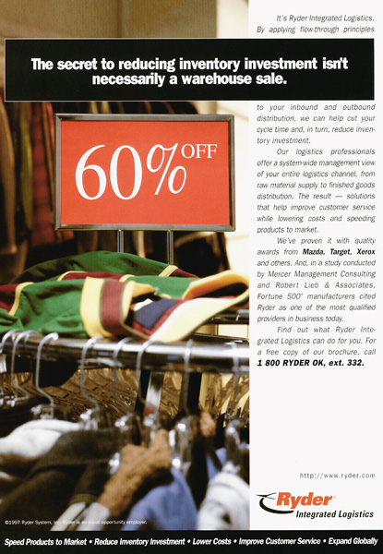
Figure 15.13 Ryder: A Solution for Reducing the Investment in Inventory

Slide 30
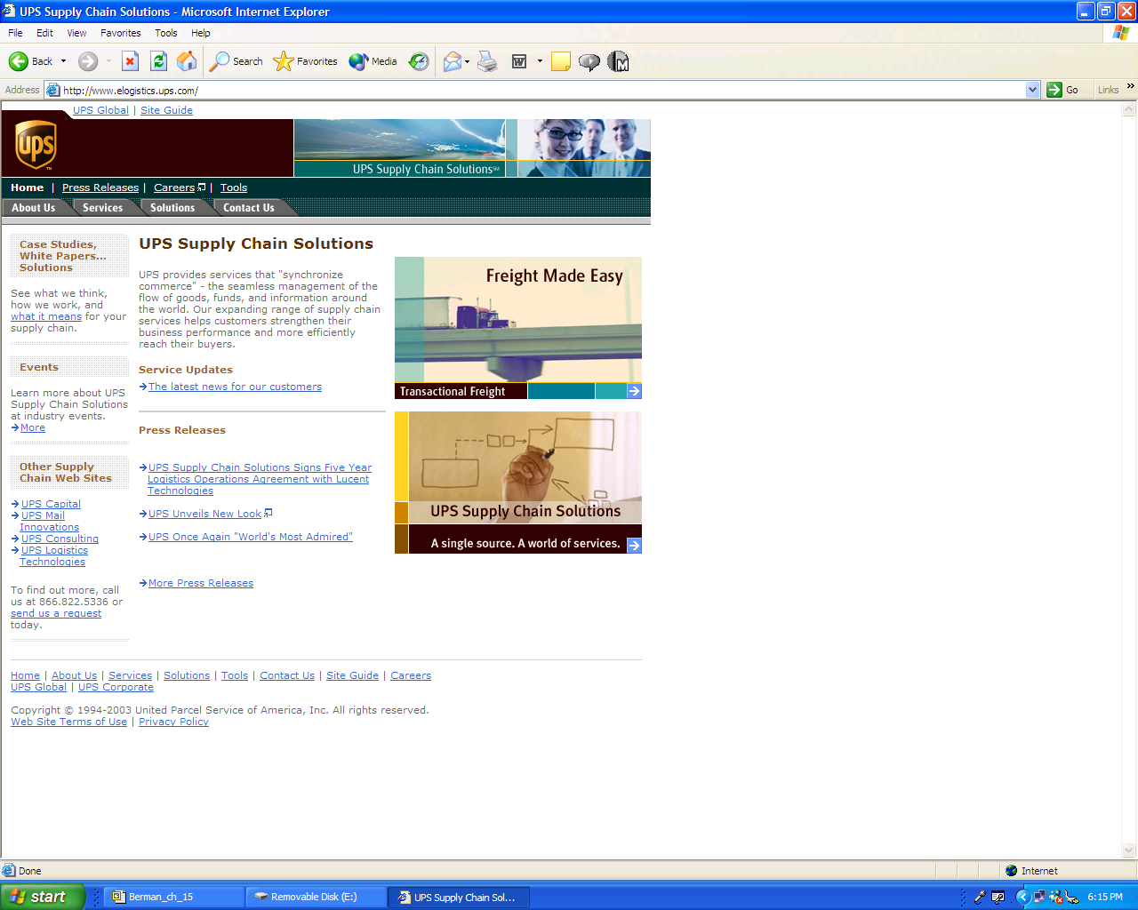
UPS E-Logistics

