Slide 1
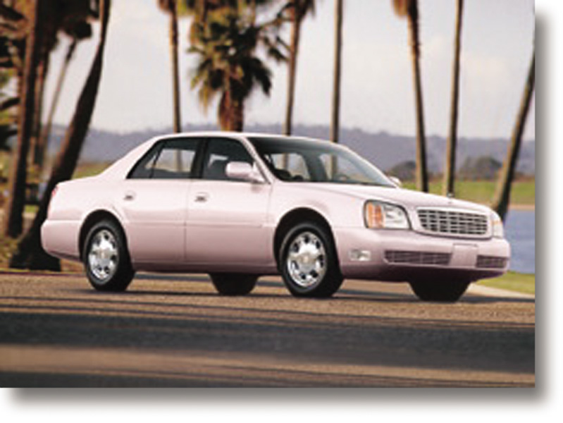
Chapter 19
Promotional Strategy
RETAIL
MANAGEMENT:
A STRATEGIC
APPROACH,
9th Edition
BERMAN EVANS

Slide 2
Chapter Objectives
To explore the scope of retail promotion
To study the elements of retail promotion: advertising, public relations, personal selling, and sales promotion
To discuss the strategic aspects of retail promotion: objectives, budgeting, the mix of forms, implementing the mix, and reviewing and revising the plan

Slide 3
Elements of the Promotional Mix
Advertising
Public Relations
Personal Selling
Sales Promotion

Slide 4
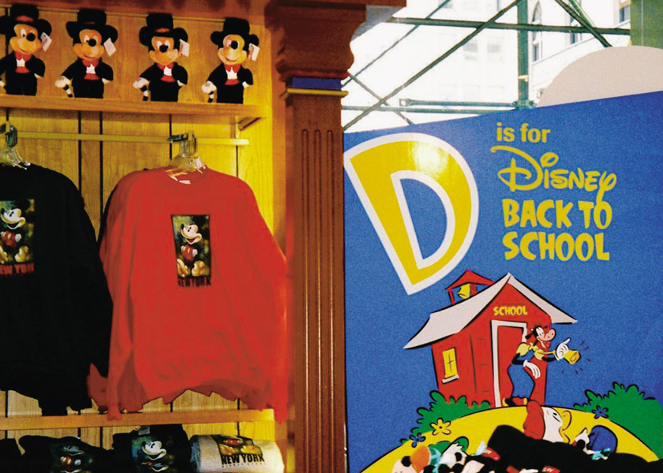
Figure 19.1 Communicating Through the Retail Promotion Mix

Slide 5

Advertising
Paid, nonpersonal communication transmitted through out-of-store mass media by an identified sponsor
Key aspects
  Paid form
  Nonpersonal presentation
  Out-of-store mass media
  Identified sponsor

Slide 6
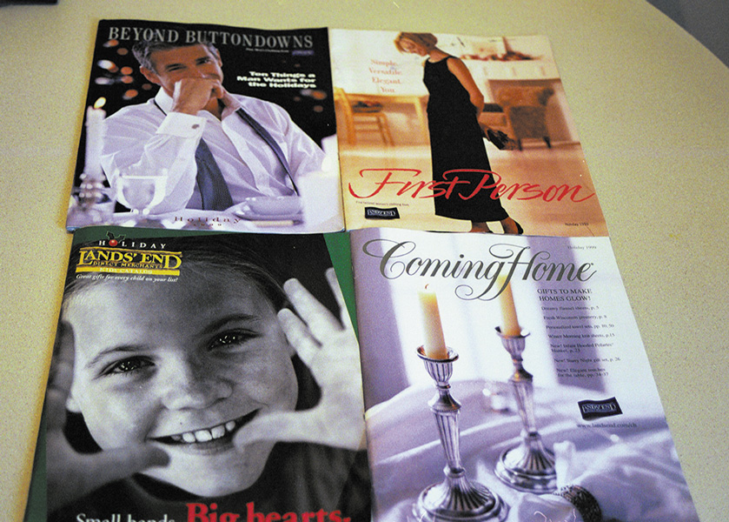
Figure 19.2 Lands’ End’s Dominant Business : Mail-Order Retailing

Slide 7
Table 19.1 Selected U.S. Advertising-to-Sales Ratios by Type of Retailer
Type of Retailer | Advertising $ as a % of Sales Dollars | Advertising $ as % of Margin
Apparel and accessories stores | 6.6 | 16.7
Auto and home supply stores | 1.0 | 2.3
Department stores | 3.6 | 10.3
Drug and proprietary stores | 0.8 | 3.2
Eating places | 3.6 | 16.1
Family clothing stores | 2.5 | 8.3
Furniture stores | 4.6 | 13.8
Grocery stores | 1.2 | 4.9
Hobby, toy, and game shops | 1.2 | 3.8
Hotels and motels | 1.8 | 8.1
Lumber and building materials | 0.5 | 1.7

Slide 8
Advertising Objectives for Retailers
Lifting short-term sales
Increasing customer traffic
Developing and/or reinforcing a retail image
Informing customers about goods and services and/or company attributes
Easing the job for sales personnel
Developing demand for private brands

Slide 9
Advertising
Advantages
Attracts a large audience
Gains pass along readership (for print)
Low cost per contact
Many alternatives available
Control over message content; message can be standardized
Message study possible
Editorial content surrounds ad
Self-service operations possible
Disadvantages
Standardized messages lack flexibility
Some media require large investments
Geographic flexibility limited
Some media require long lead time
Some media have high throwaway rate
Some media limit the ability to provide detailed information

Slide 10
Table 19.2a Advertising Media Comparison Chart
Medium | Market Coverage | Particular Suitability
Daily Papers | Single community or entire metro area; local editions may be available | All larger retailers
Weekly Papers | Single community usually; may be a metro area | Retailers with a strictly local market
Shopper Papers | Most households in one community; chain shoppers can cover a metro area | Neighborhood retailers and service businesses
Phone Directories | Geographic area or occupational field served by the directory | All types of goods and service-oriented retailers
Direct Mail | Controlled by the retailer | New and expanding firms, those using coupons or special offers, mail order

Slide 11
Table 19.2b Advertising Media Comparison Chart
Medium | Market Coverage | Particular Suitability
Radio | Definable market area surrounding the station | Retailers focusing on identifiable segments
TV | Definable market area surrounding the station | Retailers of goods and services with wide appeal
World Wide Web | Global | All types of goods and service-oriented retailers
Transit | Urban or metro community served by transit system | Retailers near transit routes, especially those appealing to commuters
Outdoor | Entire metro area or single neighborhood | Amusement and tourist-oriented retailers, well-known firms

Slide 12
Table 19.2c Advertising Media Comparison Chart
Medium | Market Coverage | Particular Suitability
Local Magazines | Entire metro area or region, zoned editions sometimes available | Restaurants, entertainment-oriented firms, specialty shops, mail-order firms
Flyers/ Circulars | Single neighborhood | Restaurants, dry cleaners, service stations, and other neighborhood firms

Slide 13
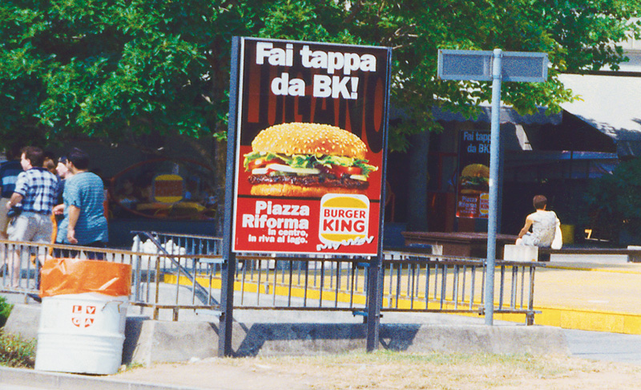
Figure 19.3 Billboard Advertising for Pedestrians and Motorists

Slide 14
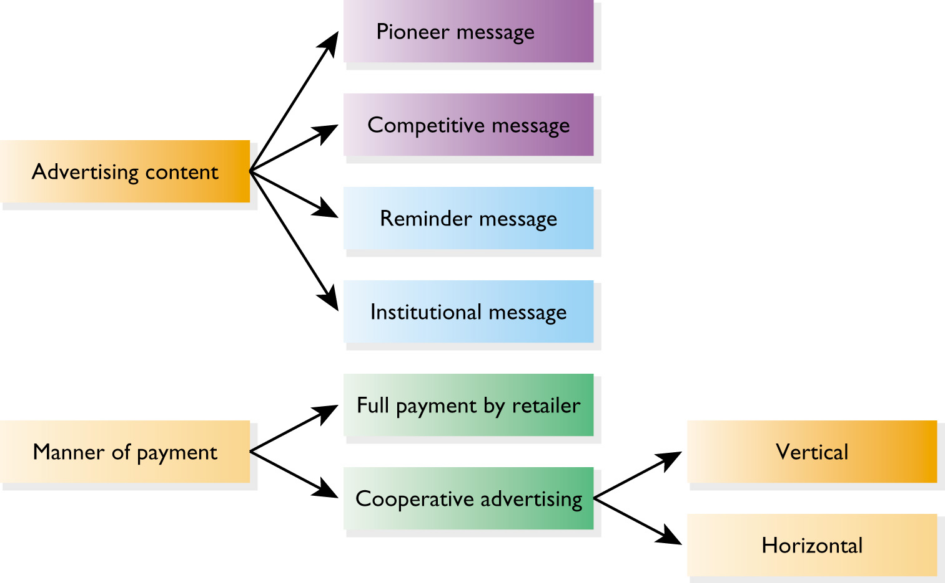
Figure 19.4 Types of Advertising

Slide 15
Planning a Cooperative Strategy
What ads qualify, in terms of merchandise and special requirements?
What percentage of advertising is paid by each party?
When can ads be run? In what media?
Are there special provisions regarding message content?
What documentation is required for reimbursement?
How does each party benefit?
Do cooperative ads obscure the image of individual retailers?

Slide 16
Public Relations
Public Relations - Any communication that fosters a favorable image for the retailer among its publics
  Nonpersonal or personal
  Paid or nonpaid
  Sponsor-controlled or not
Publicity – Any nonpersonal form of public relations whereby messages are transmitted through mass media, the time or space provided by the media is not paid for, and there is no identified commercial sponsor

Slide 17
Public Relations Objectives for Retailers
Increase awareness of the retailer and its strategy mix
Maintain or improve the company image
Show the retailer as a contributor to the public’s quality of life
Demonstrate innovativeness
Present a favorable message in a highly believable manner
Minimize total promotion costs

Slide 18
Public Relations
Advantages
Image can be presented or enhanced
More credible source
No costs for message’s time or space
Mass audience addressed
Carryover effects possible
People pay more attention than to clearly identified ads
Disadvantages
Some retailers do not believe in spending on image-related communication
Little control over publicity message
More suitable for short run
Costs for PR staff, planning activities, and events

Slide 19
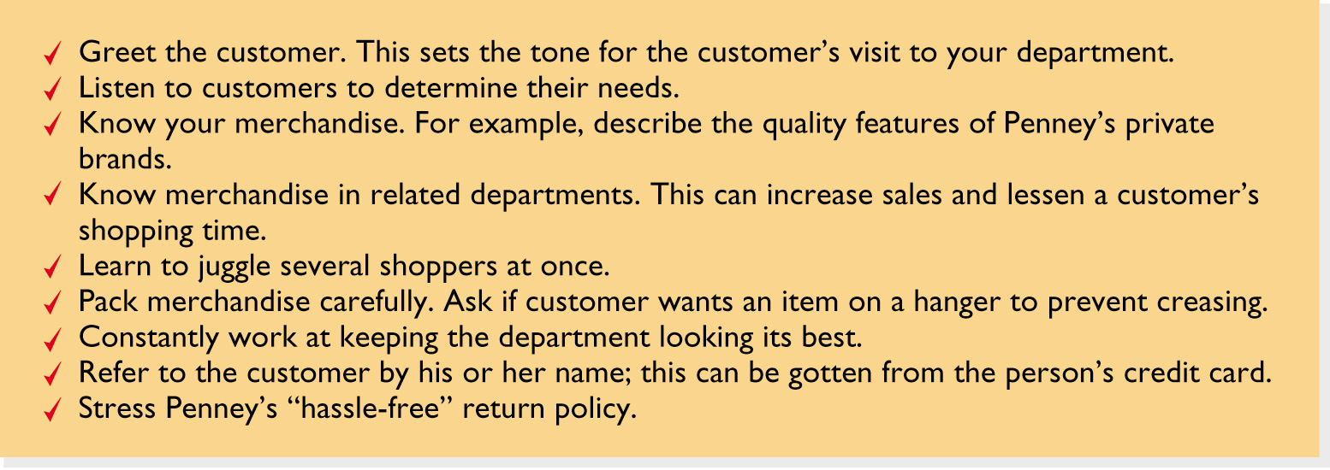
Figure 19.5 J.C. Penney’s
Tips for Sales Associates

Slide 20
Personal Selling
Oral communication with one or more prospective customers for the purpose of making a sale

Slide 21
Personal Selling Objectives for Retailers
Persuade customers to buy
Stimulate sales of impulse items or products related to customers’ basic purchases
Complete customer transactions
Feed back information to company decision makers
Provide proper levels of customer service
Improve and maintain customer satisfaction
Create awareness of items also marketed through the Web, mail, and telemarketing

Slide 22
Personal Selling
Advantages
Message can be adapted
Many ways to meet customer needs
High attention span
Less waste
Better response
Immediate feedback
Disadvantages
Limited number of customers handled at one time
High costs
Doesn’t get customer in store
Self-service discouraged
Negative attitudes toward salespeople (aggressive, unhelpful)

Slide 23
Types of Sales Positions
Order-taker
Order-getter

Slide 24
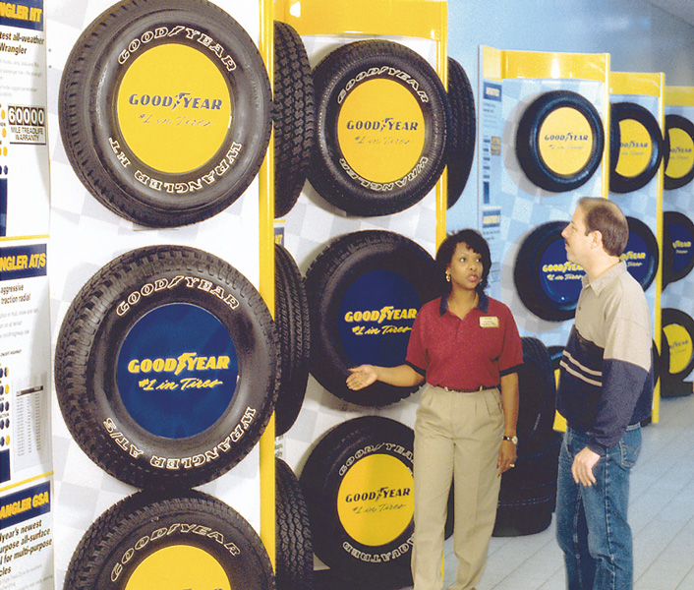
Figure 19.6 Personal Selling: When Self-Service Isn’t Appropriate

Slide 25
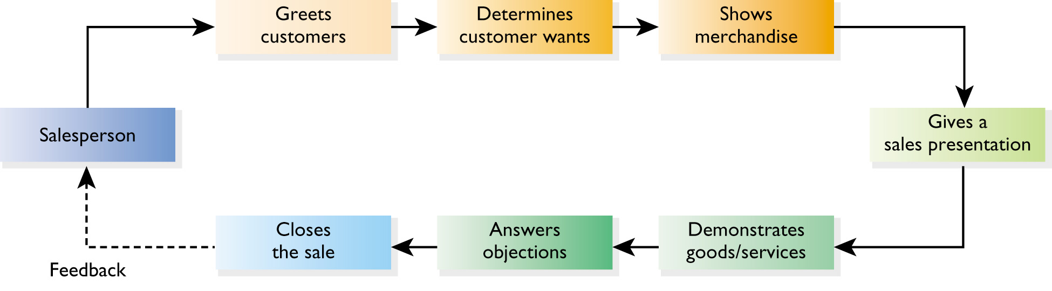
Figure 19.7 Typical Personal Selling Functions

Slide 26
Sales Promotion
Encompasses the paid communication activities other than advertising, public relations, and personal selling that stimulate consumer purchases and dealer effectiveness

Slide 27
Types of Sales Promotions
Displays
Contests
Sweepstakes
Coupons
Frequent shopper programs
Prizes
Samples
Demonstrations
Referral gifts
Other limited-time selling efforts

Slide 28
Sales Promotions Objectives for Retailers
Increasing short-term sales volume
Maintaining customer loyalty
Emphasizing novelty
Complementing other promotion tools

Slide 29
Sales Promotions
Advantages
Eye-catching appeal
Distinctive themes and tools
Additional value for customer
Draws customer traffic
Maintains customer loyalty
Increases impulse purchases
Fun for customers
Disadvantages
Difficult to terminate
Possible damage to retailer’s image
More stress on frivolous selling points
Short-term effects only
Used as a supplement

Slide 30
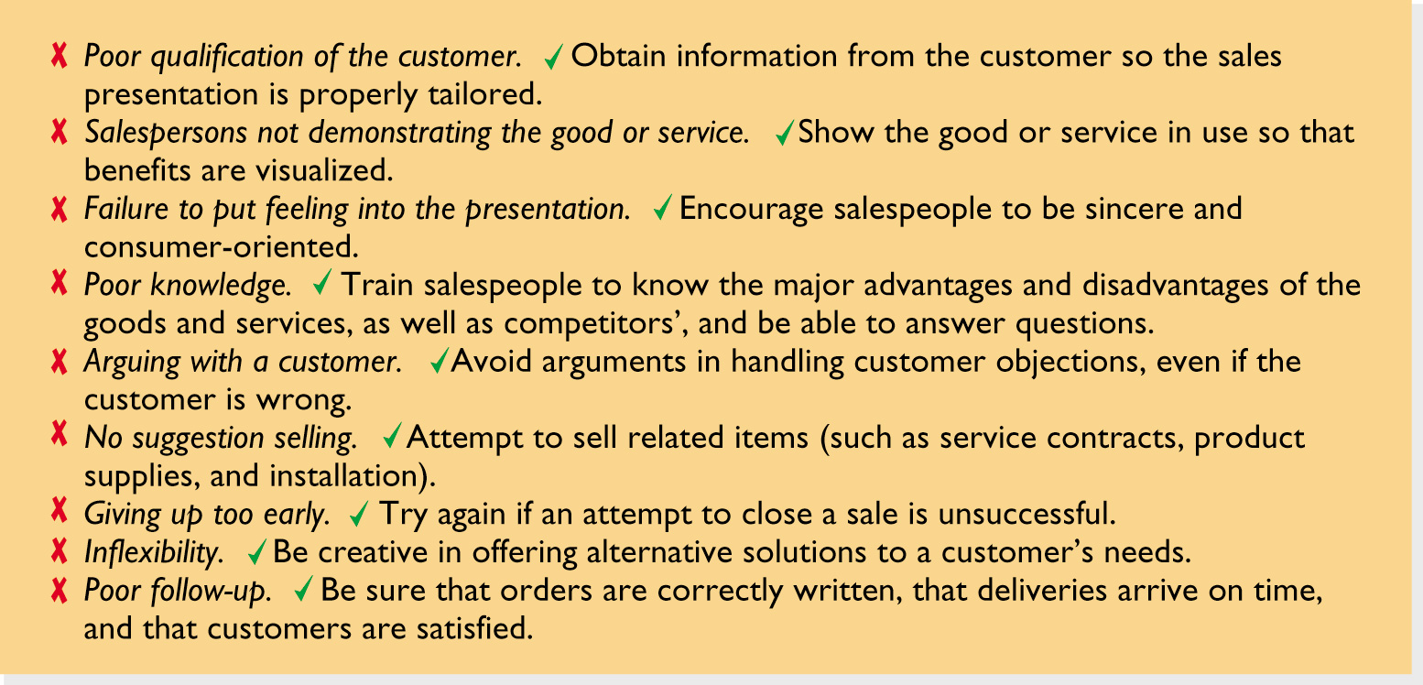
Figure 19.8 Selected Reasons Why Retail Sales Are Lost

Slide 31
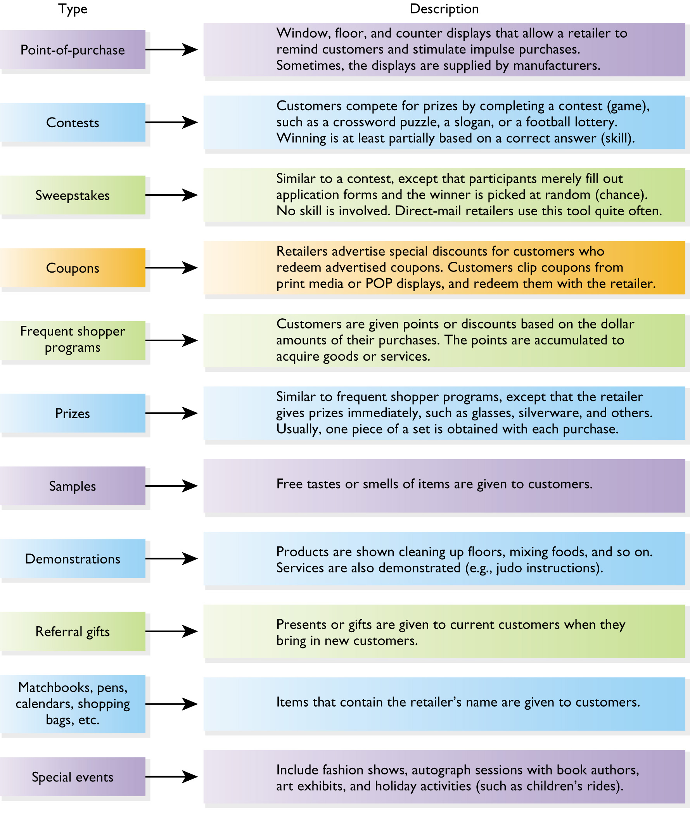
Figure 19.9
Types of
Sales
Promotions

Slide 32
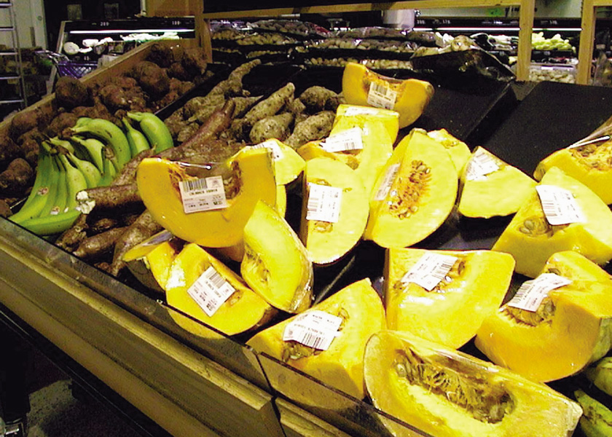
Figure 19.10 Using
Point-of-Purchase Displays

Slide 33
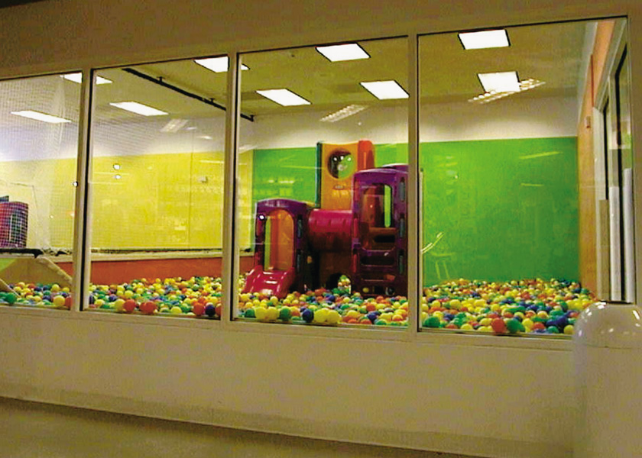
Figure 19.12 The Ikea Playroom

Slide 34
Advantages of Coupons
Manufacturers may pay to advertise and redeem them
99% of consumers redeem coupons at least once during the year
They contribute to the consumer’s perception of getting a good value
Coupon redemption can serve as a measure of advertising effectiveness

Slide 35
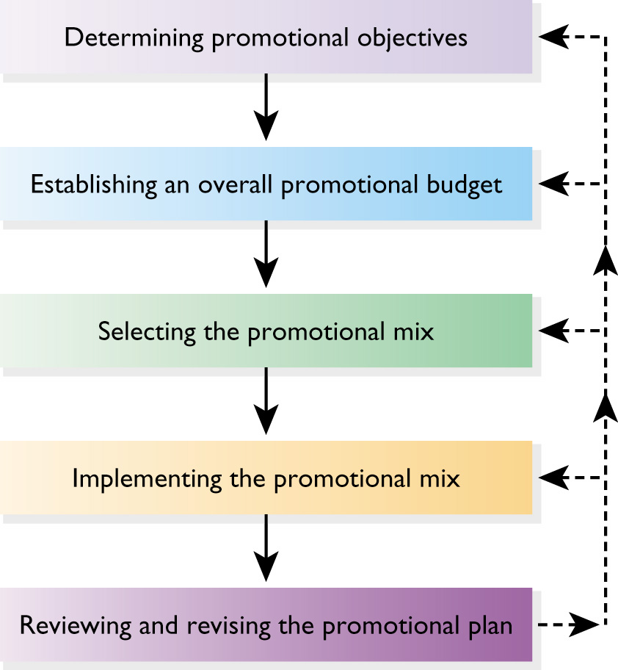
Figure 19.11 Planning a Retail Promotional Strategy

Slide 36
Promotional Objectives
Increase sales
Stimulate impulse and reminder buying
Raise customer traffic
Get leads for sales personnel
Present and reinforce the retailer image
Inform customers about goods and services
Popularize new stores and Web sites
Capitalize on manufacturer support
Enhance customer relations
Maintain customer loyalty
Have consumers pass along positive information to friends and others

Slide 37
Procedures for Setting a Promotional Budget
All-you-can-afford method
Incremental method
Competitive parity method
Percentage-of-sales method
Objective-and-task method

Slide 38
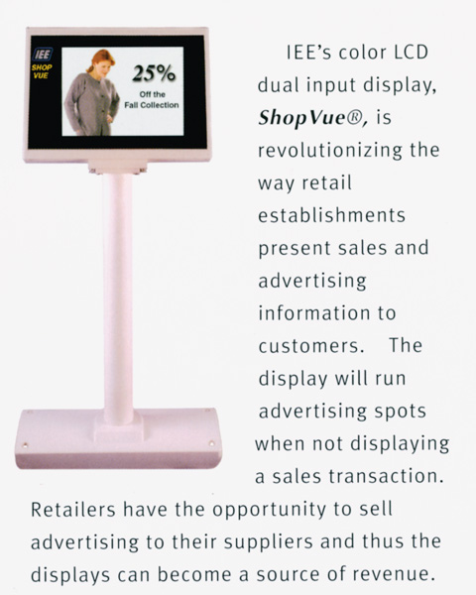
Figure 19.13 Hi-Tech, In-Store Promotion

Slide 39
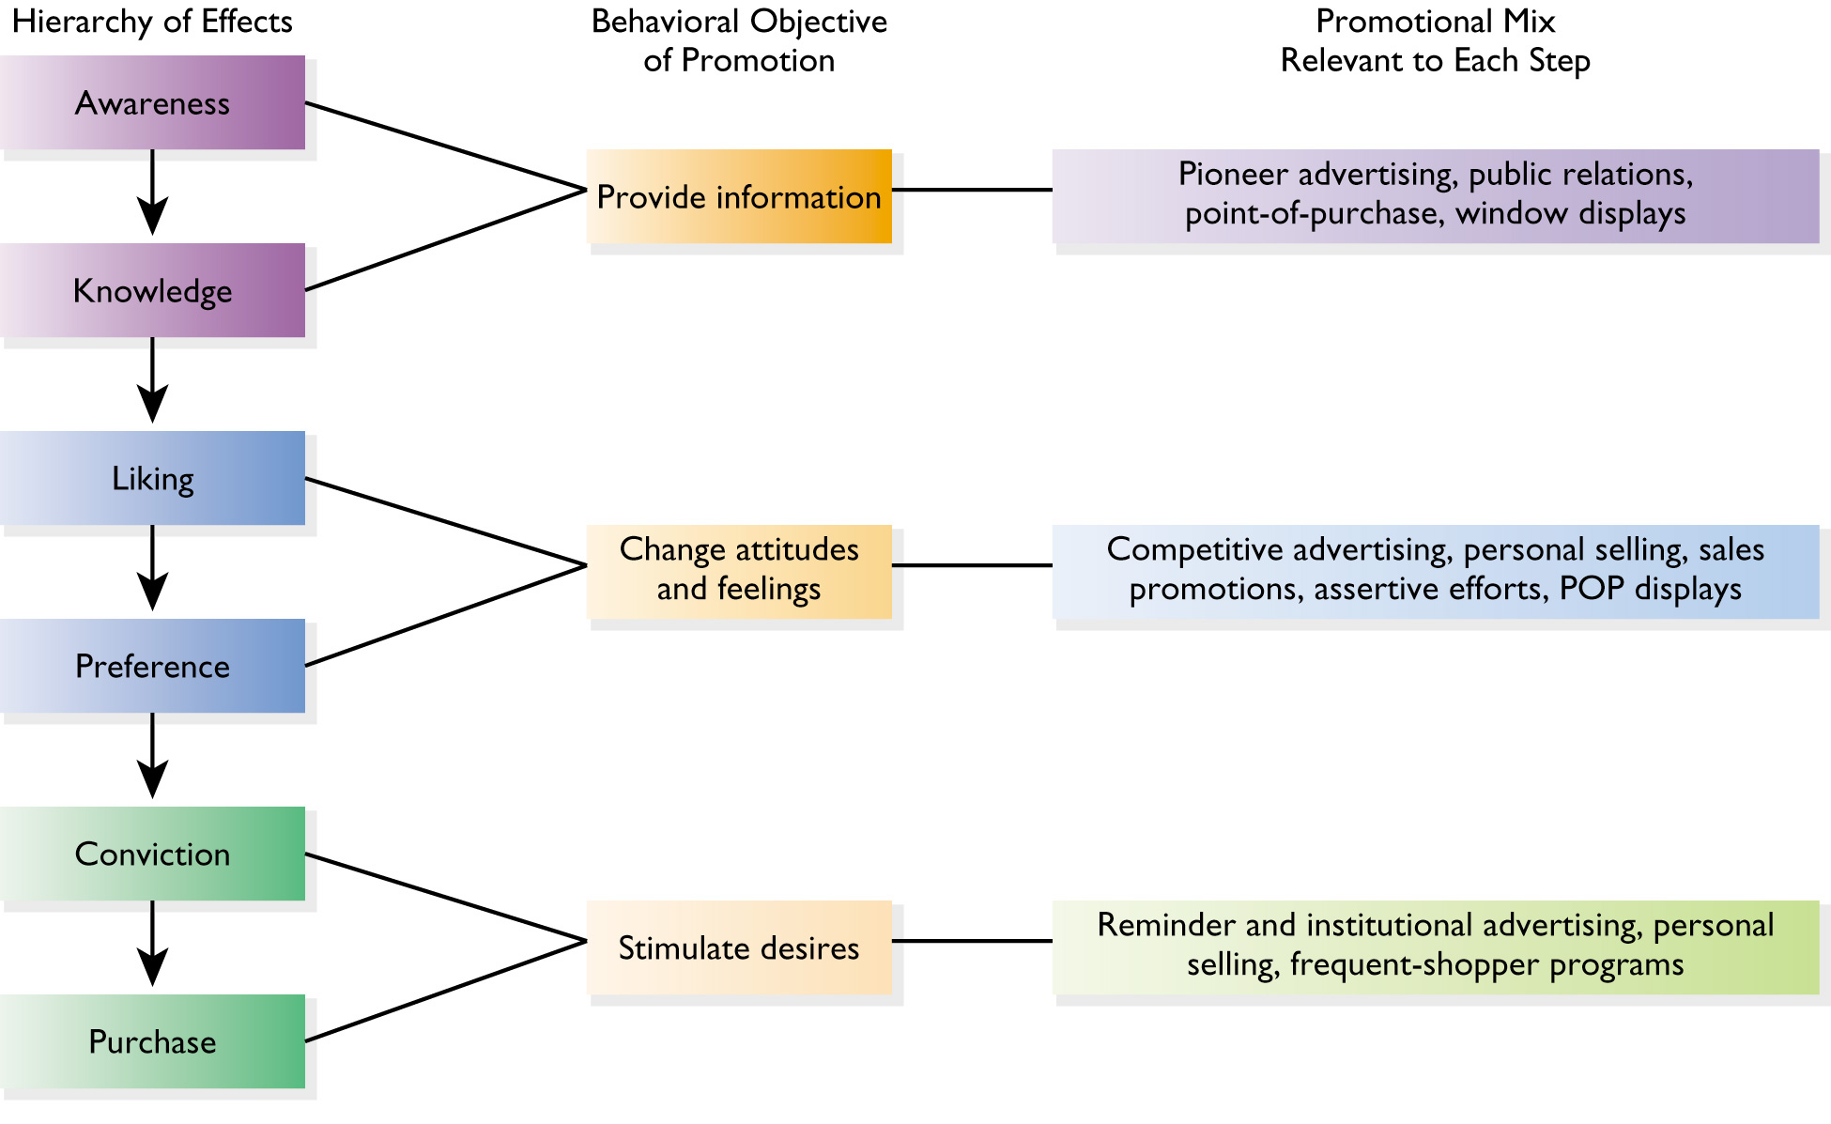
Figure 19.14 Promotion and the Hierarchy of Effects

Slide 40
Implementation Decisions
Media
Timing
Content
Makeup of Sales Force
Sales Promotion Tools
Responsibility for Coordination

