Slide 1
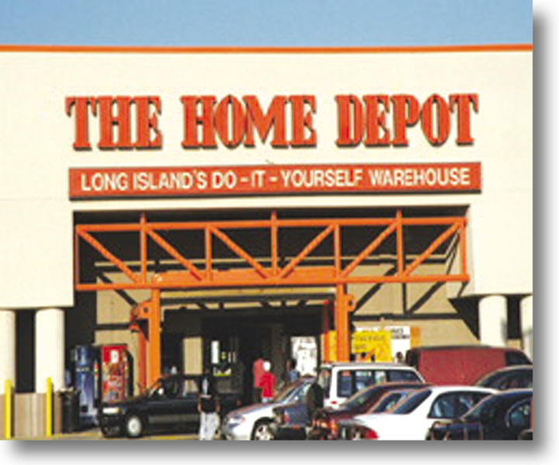
Chapter 20
Integrating and Controlling the Retail Strategy
RETAIL
MANAGEMENT:
A STRATEGIC
APPROACH,
9th Edition
BERMAN EVANS

Slide 2
Chapter Objectives
To demonstrate the importance of integrating a retail strategy
To examine four key factors in the development and enactment of an integrated retail strategy: planning procedures and opportunity analysis, defining productivity, performance measures, and scenario analysis
To show how industry and company data can be used in strategy planning and analysis (benchmarking and gap analysis)
To show the value of a retail audit

Slide 3
Planning Procedures
Outline the firm’s overall direction and goals
Combine top-down plans and bottom-up or horizontal plans
Enact specific plans, including checkpoints and dates

Slide 4
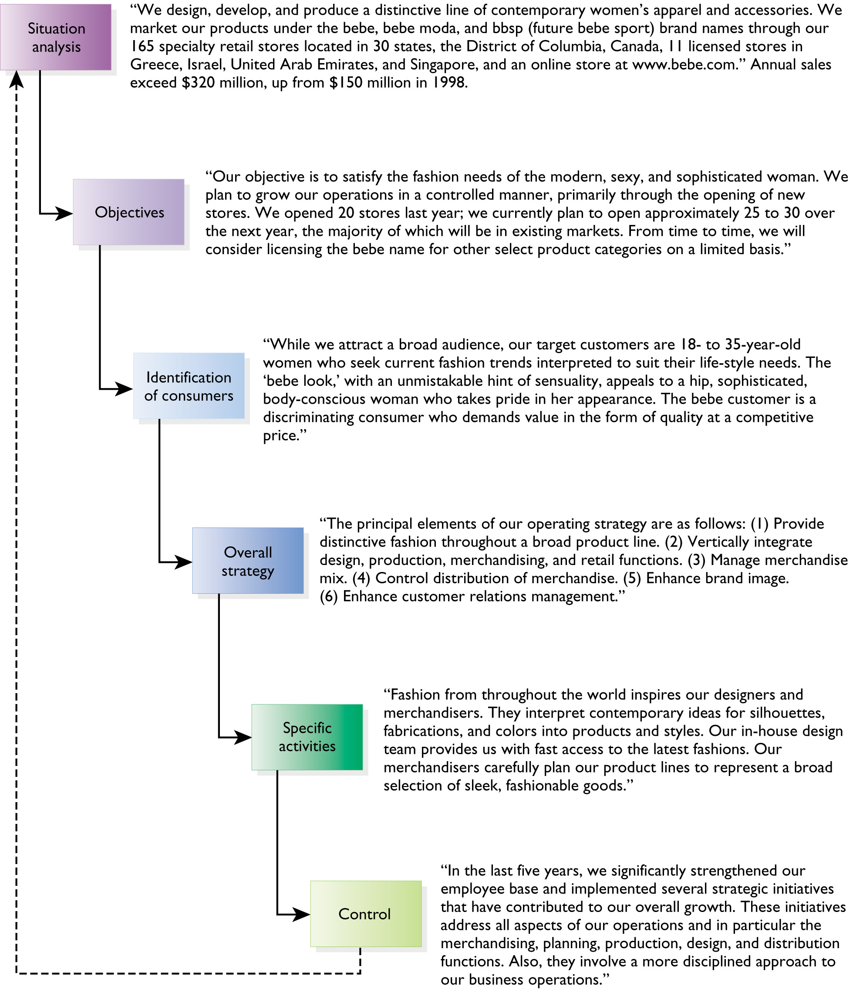
Figure 20.1 The Integrated
Strategy of bebe

Slide 5

Performance Measures
Total sales
Average sales per store
Sales by goods/ service category
Sales per square foot
Gross margins
Gross margin return on investment
Operating income
Inventory turnover
Markdown percentages
Employee turnover
Financial ratios
Profitability

Slide 6
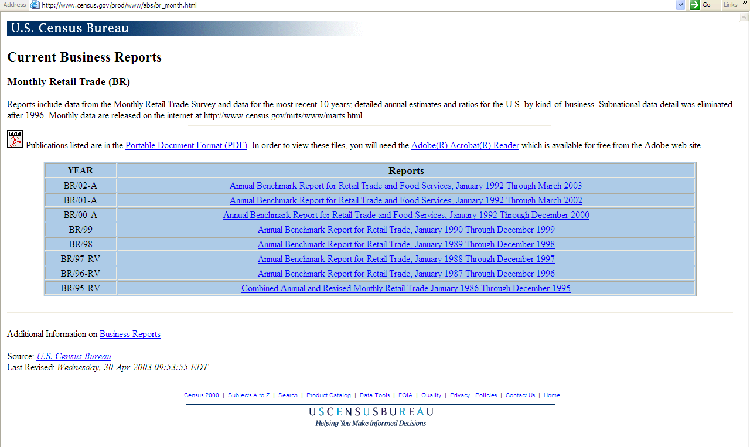
Benchmark Report

Slide 7
American Customer
Satisfaction Index (ACSI)
Are customer satisfaction and evaluations of quality improving or declining in the United States?
Are they improving or declining for particular sectors of industry and for specific companies?

Slide 8
Table 20.3a Benchmarking Through the ACSI
Department/ Discount Stores | 4th Qtr 1995 Index Score | 4th Qtr 1998 Index Score | 4th Qtr 2001 Index Score
Target | 76 | 74 | 75
Nordstrom | 83 | 79 | 77
Sears | 75 | 74 | 76
Wal-Mart | 81 | 75 | 75
J.C. Penney | 77 | 75 | 75
May | 75 | 72 | 75
Dillard’s | 74 | 71 | 75
Target (department stores) | 76 | 74 | 74
Kmart | 72 | 71 | 74
Federated | 71 | 67 | 69

Slide 9
Table 20.3b Benchmarking Through the ACSI
Supermarkets | 4th Qtr 1995 Index Score | 4th Qtr 1998 Index Score | 4th Qtr 2001 Index Score
Publix | 82 | 79 | 81
Supervalu | 77 | 77 | 76
Kroger | 76 | 73 | 75
Safeway | 73 | 71 | 75
Albertson’s | 77 | 70 | 72
Winn-Dixie | 75 | 74 | 72

Slide 10
Table 20.3c Benchmarking Through the ACSI
Hotels | 4th Qtr 1995 Index Score | 4th Qtr 1998 Index Score | 4th Qtr 2001 Index Score
Marriott | 77 | 77 | 76
Hilton | 75 | 74 | 76
Hyatt | 77 | 73 | 75
Holiday Inn | 69 | 68 | 69
Ramada Inn | 70 | 67 | 67

Slide 11
Table 20.3d Benchmarking Through the ACSI
Restaurant/ Fast-Food Firms | 4th Qtr 1995 Index Score | 4th Qtr 1998 Index Score | 4th Qtr 2001 Index Score
Domino’s | 70 | 70 | 73
Wendy’s | 73 | 73 | 72
Pizza Hut | 66 | 71 | 71
Little Caesar’s | 69 | 71 | 70
Taco Bell | 66 | 64 | 66
Burger King | 65 | 64 | 65
KFC | 68 | 64 | 63
McDonald’s | 63 | 61 | 62

Slide 12
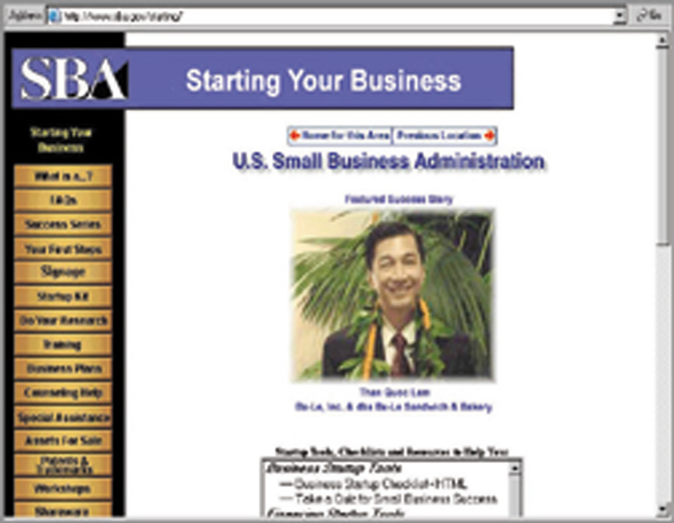
Figure 20.2 Opportunity Analysis with the SBA

Slide 13
Measurement Tool for
Service Retailing
Reliability
Responsiveness
Assurance
Empathy
Tangibles

Slide 14
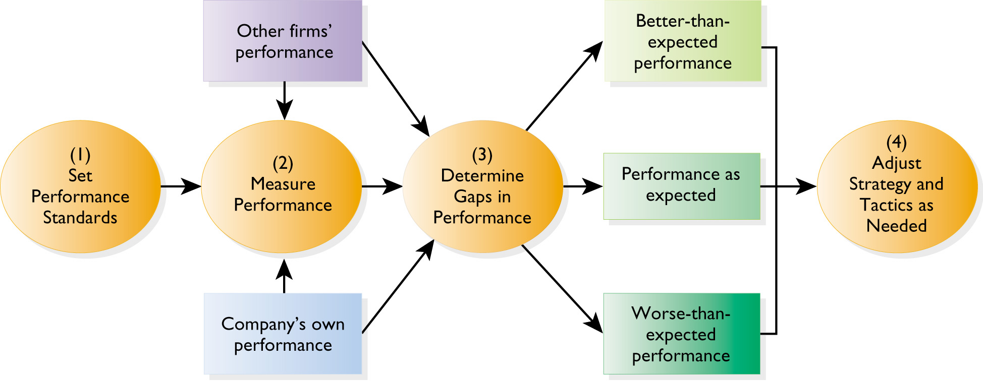
Figure 20.3 Utilizing Gap Analysis

Slide 15
Minimizing Gaps
Customer insight
Customer profiling
Customer life-cycle
Extended business model
Relationship program planning and design
Implementation

Slide 16
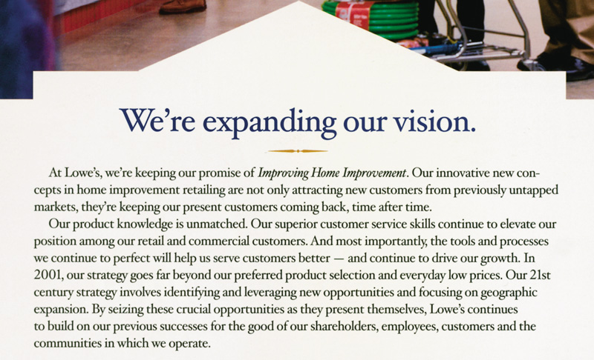
Figure 20.4 Lowe’s Home Improvement

Slide 17
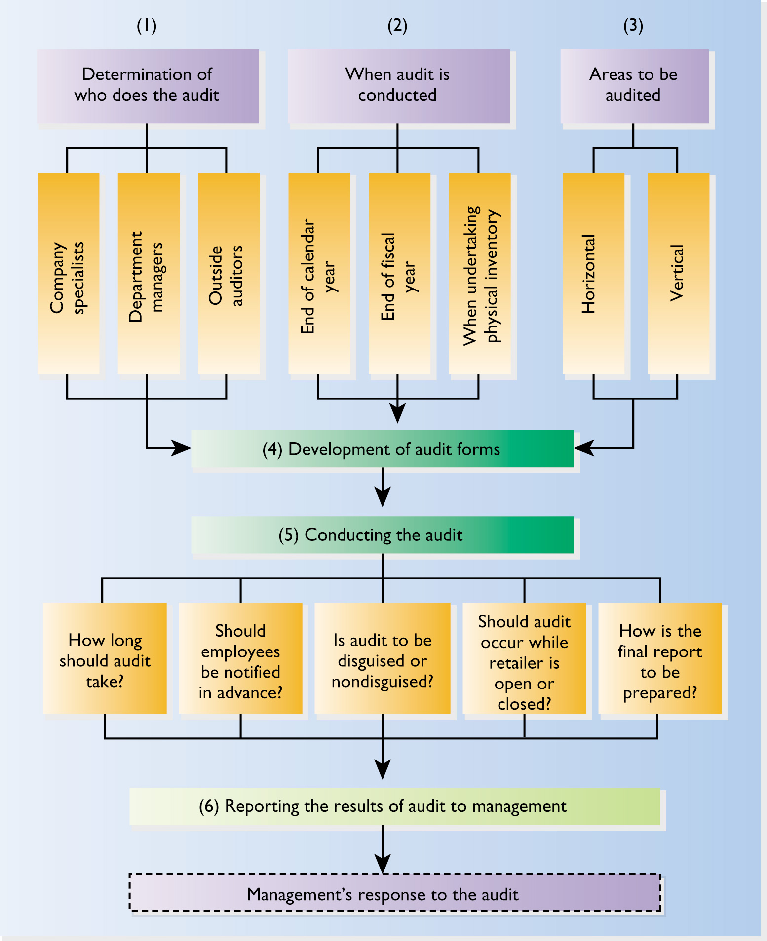
Figure 20.5 The
Retail
Audit Process

Slide 18
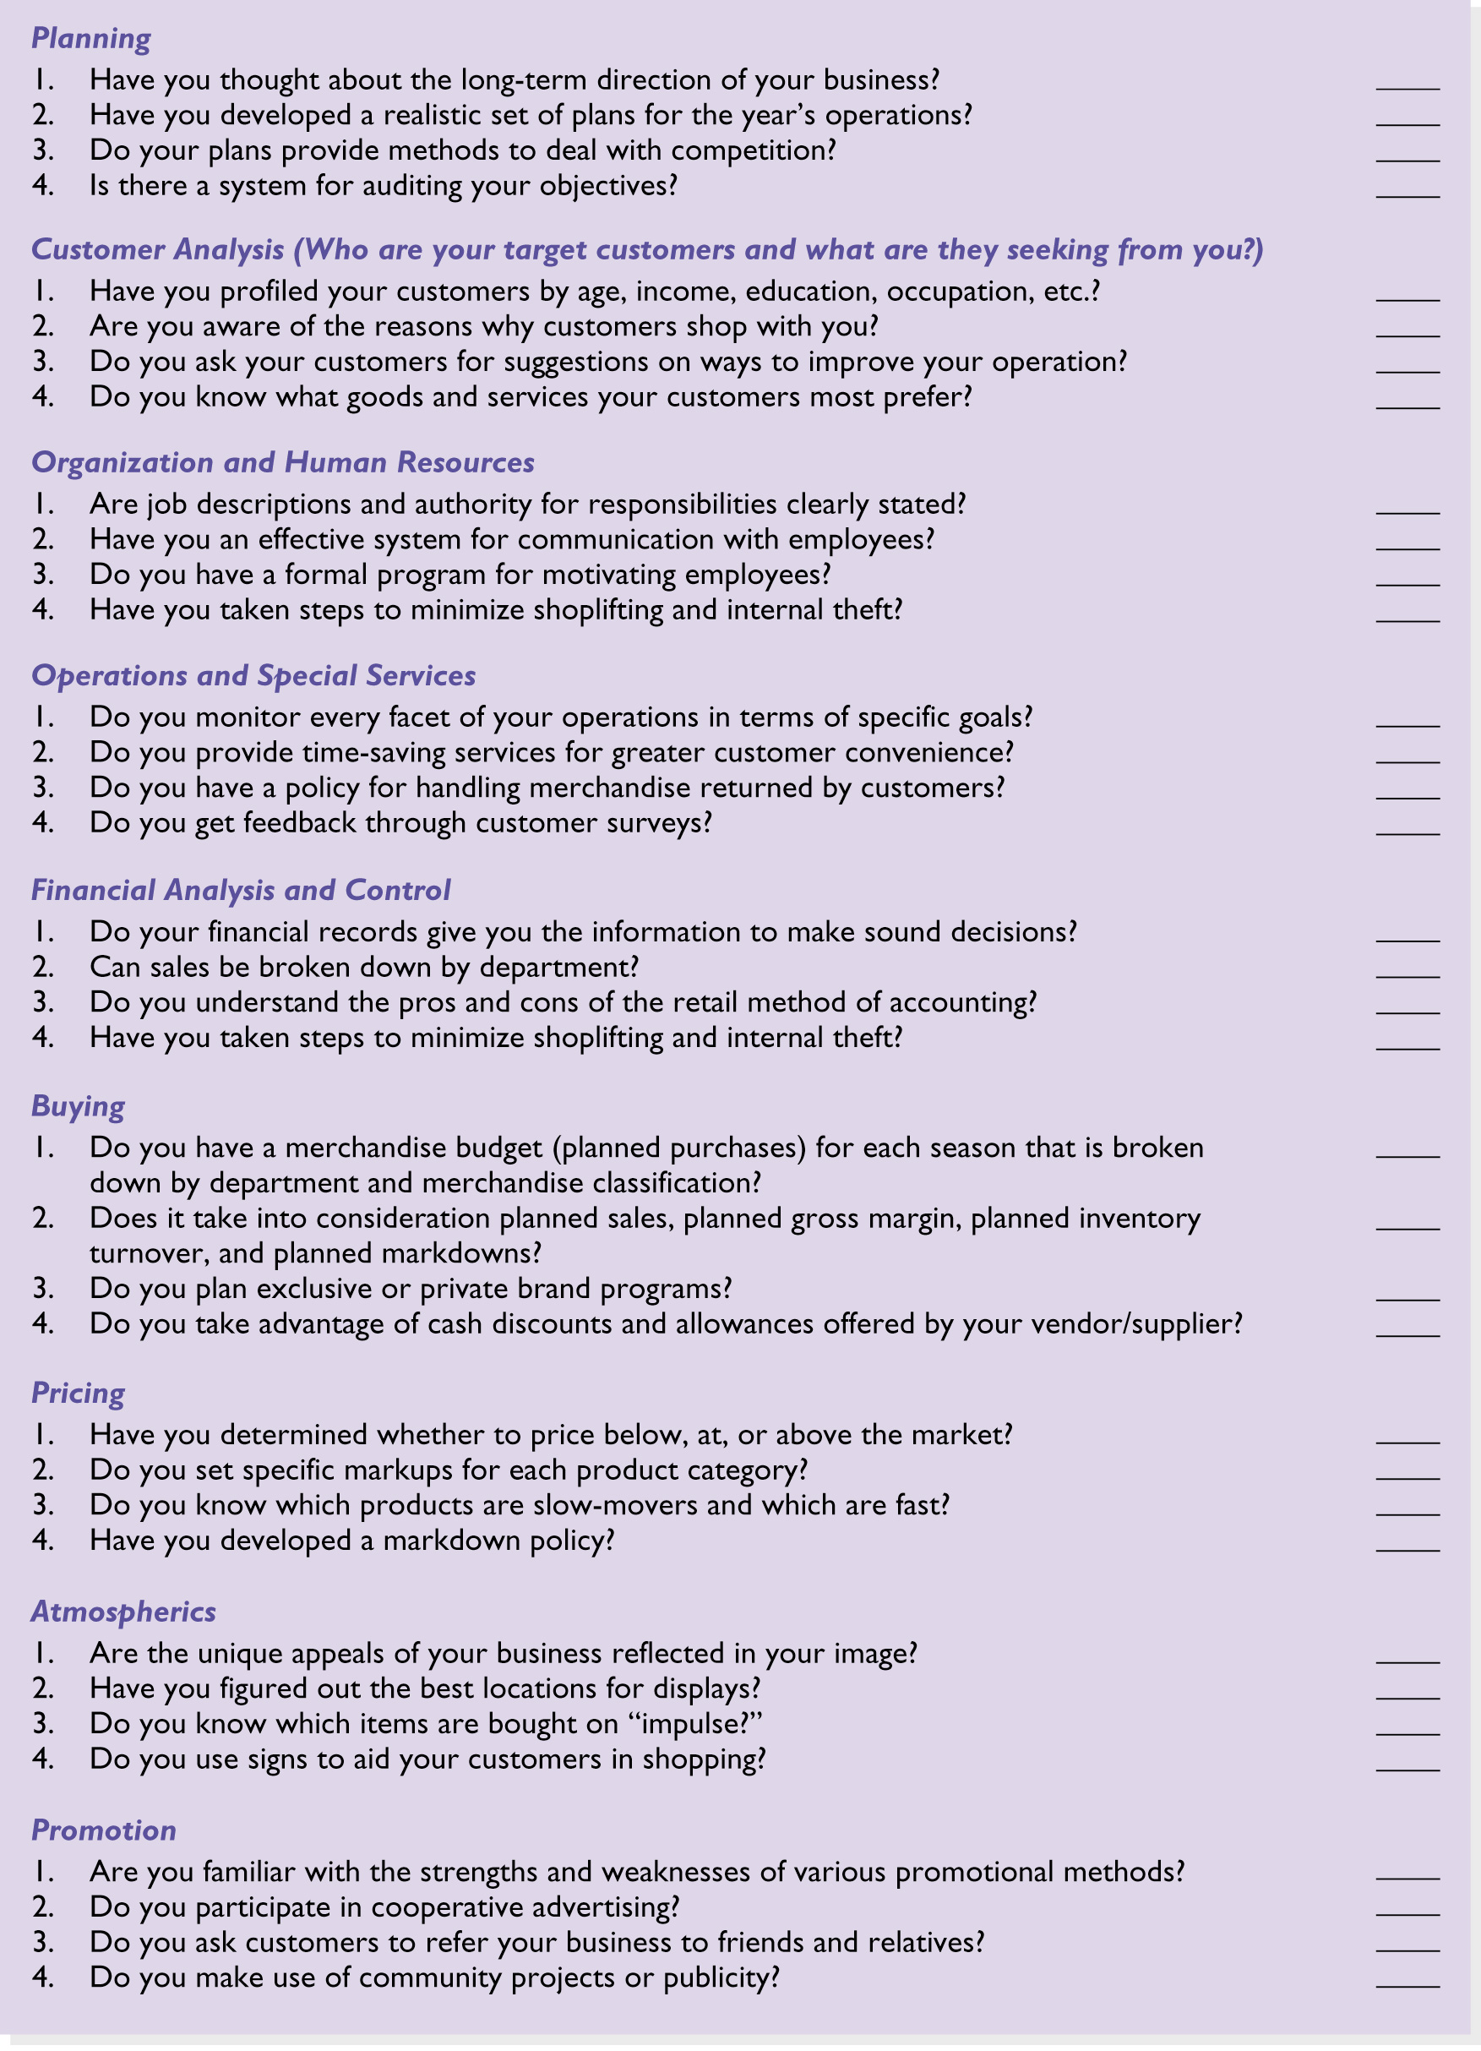
Figure 20.6 Management Audit
Form for Small Retailers

Slide 19
Obstacles for Doing a Retail Audit
An audit may be costly
It may be quite time consuming
Performance measures may be inaccurate
Employees may feel threatened and not cooperate as much as desired
Incorrect data may be collected
Management may not be responsive to the findings

Slide 20
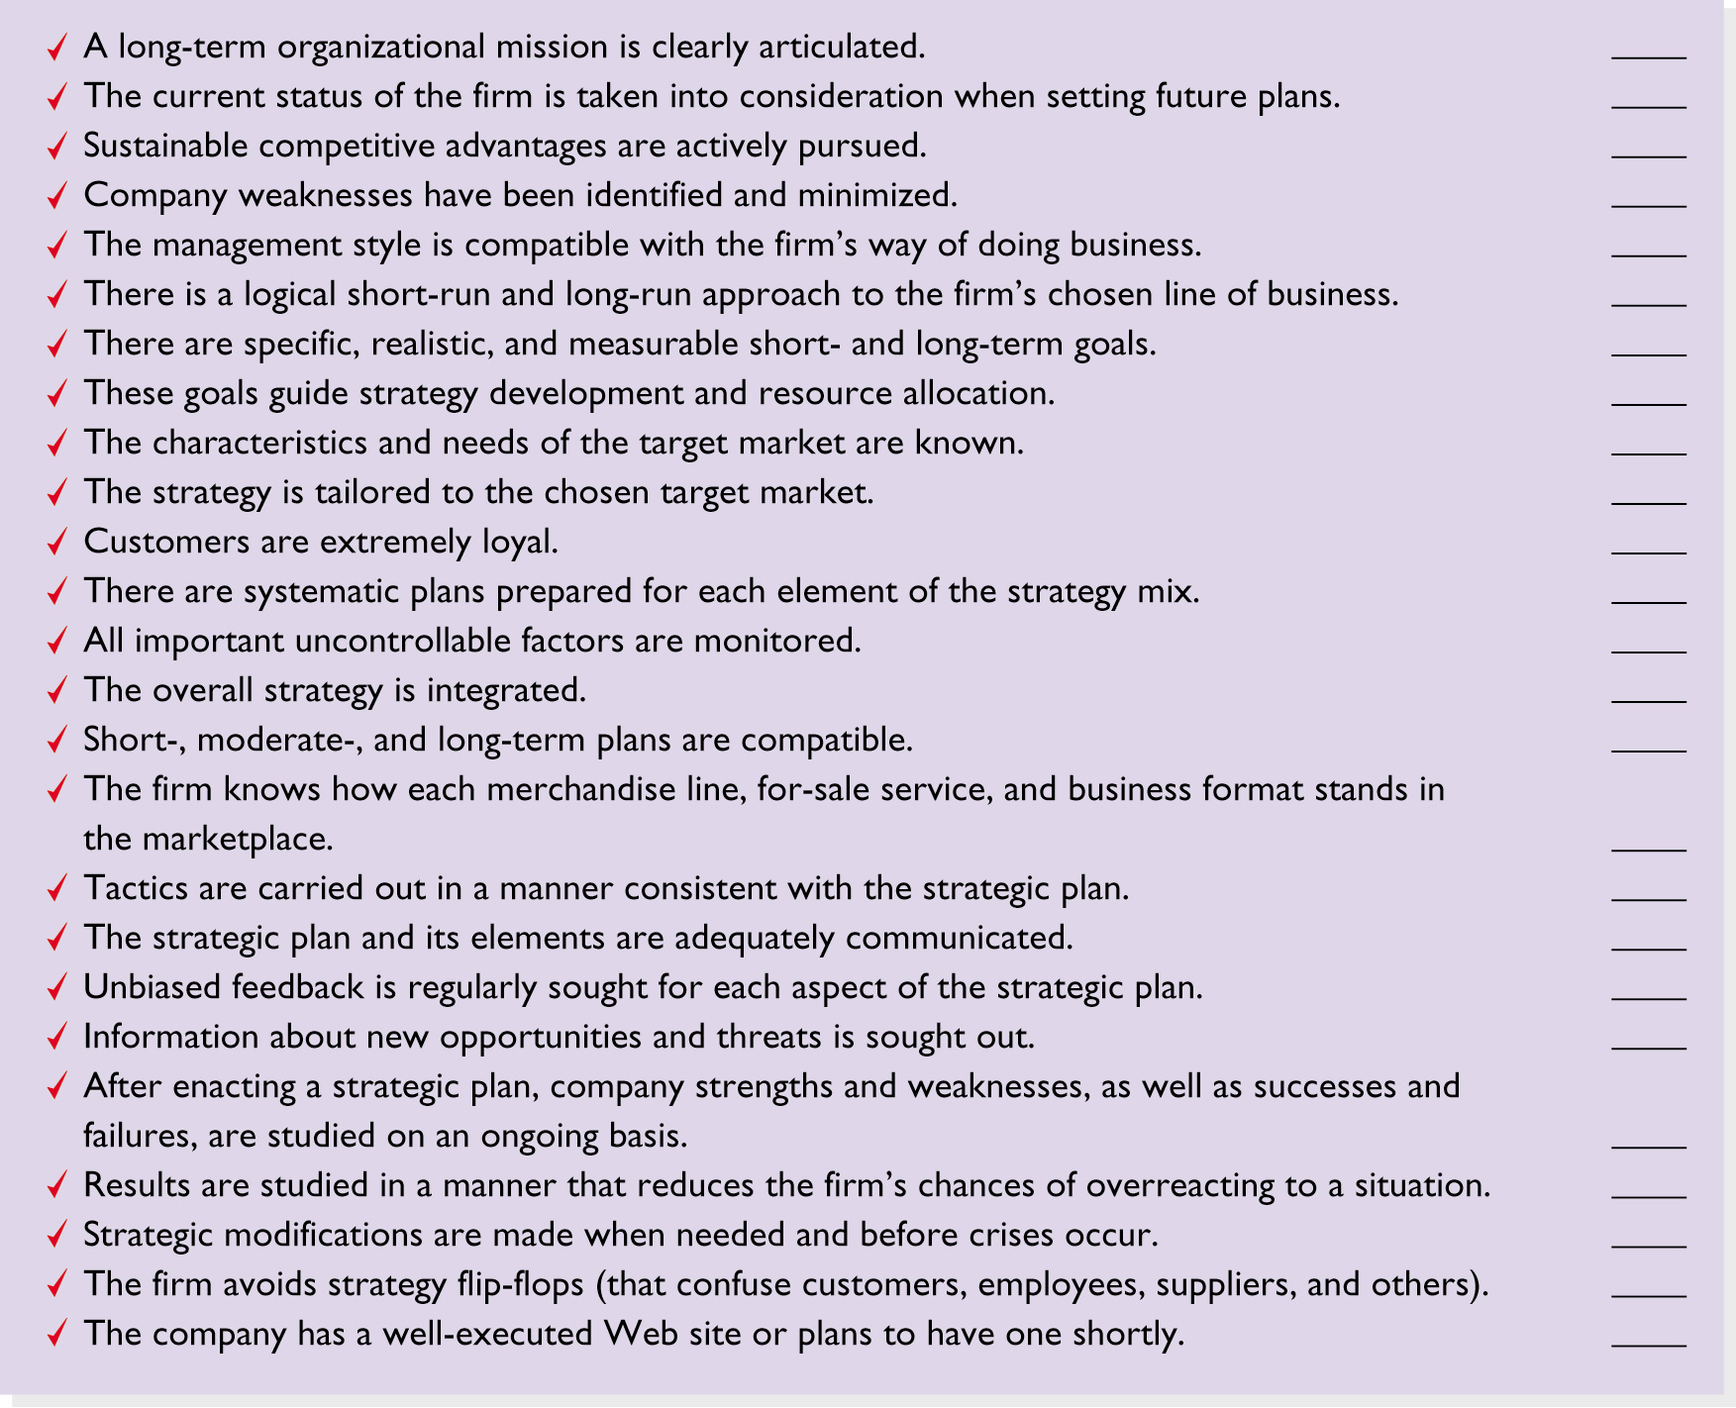
Figure 20.7
A Retailing
Effectiveness Checklist

