Slide 1

CHICAGO TAXI POWER BI PROJECT
Chicago Taxi Demand &
Financial Analysis
Turning 267,884 validated trip records into operational intelligence for
staffing, fleet staging, payments, and market oversight.
SOS ALPHA SQUAD 4
Final Presentation | Power BI Business Intelligence Project

Slide 2




01 THE BUSINESS PROBLEM
A Transportation Network Nobody Could Fully See
267,889 raw trip records existed , but no one could answer basic operational questions from them
THE GAP
No visibility into demand timing
Peaks by hour, day, and shift were invisible in raw rows.
Chicago taxi planners and fleet operators had thousands of trip logs, but the data lived as flat rows not answers. Nobody could easily see when demand rises, where trips concentrate, how riders pay, or which companies lead the market.
No view of high-traffic zones
Pickup and drop-off hot spots weren’t mapped to operations.
In a market increasingly squeezed by rideshare competition, that blind spot means idle vehicles at the wrong times, understaffed shifts during real demand peaks, and no consistent benchmark for operator performance.
Payment & tipping trends unclear
Cash vs. card behavior across fare levels wasn’t compared.
OUR OBJECTIVE
No way to benchmark operators
Give taxi trip planners and operators one clear, interactive view of when demand rises, where trips move, how riders pay, and which companies lead.
267K trips couldn’t be rolled up by company or fleet.
SOS ALPHA SQUAD 4 | CHICAGO TAXI POWER BI PROJECT
02

Slide 3


02 WHAT WE SET OUT TO ANSWER
Six Business Questions Shaped Every Dashboard
Each Power BI page was built to answer one operational question decision makers ask
BUSINESS QUESTION
BUSINESS QUESTION
BUSINESS QUESTION
How active and valuable is the taxi network overall?
When is demand highest, and how does speed move?
Which areas attract the most pickups and drop-offs?
Fleet Performance Summary
Time of Day & Congestion
Origin–Destination Flow
BUSINESS QUESTION
BUSINESS QUESTION
BUSINESS QUESTION
How do riders pay, and what tipping shows up?
Which companies lead, and how do they compare?
How does one operator perform in depth?
Payment & Tipping Habits
Company & Fleet Comparison
Company Detail Drill-through
SOS ALPHA SQUAD 4 | CHICAGO TAXI POWER BI PROJECT
03

Slide 4




03 GETTING THE DATA READY
From Raw Logs To A Trusted Dataset
Every number on the dashboards traces back to a documented cleaning decision
267,889
267,884
5
20 days
imported rows
retained trips
error rows removed
covered (12–31 Dec 2023)
EXCLUDE
KEEP
REVIEW
GROUP
Five imported error payloads weren’t taxi trips removed, with the decision documented.
Trips with missing area names still count in totals and revenue, just not in named-location charts.
Unusual duration, fare, distance and speed values are reviewed only where they could affect a result (100 MPH implausible-speed threshold).
Busy periods grouped as 06–09 and 16–19. Fares bucketed from below $10 to $50+, plus Unknown.
SOS ALPHA SQUAD 4 | CHICAGO TAXI POWER BI PROJECT
04

Slide 5

04 STRUCTURING THE DATA
A Star Schema Keeps Every Comparison Reliable
One fact table at the grain of a single trip, surrounded by five reusable dimensions
DimDate
DimTime
One row per calendar day
Hour & shift bucket
FACT TABLE
DimPayment
FactTaxiTrips
DimCompany
Payment method type
Taxi operator / company
One row per trip · 267,884 records
active · Pickup
inactive · Dropoff (USERELATIONSHIP)
DimCommunityArea
Chicago community areas — serves both Pickup and Dropoff roles
Pickup is the active relationship; Dropoff is activated only inside destination measures via USERELATIONSHIP() — so one Community Area dimension safely serves two roles without ambiguous filtering.
SOS ALPHA SQUAD 4 | CHICAGO TAXI POWER BI PROJECT
05

Slide 6
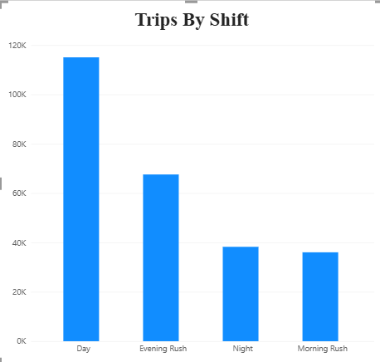
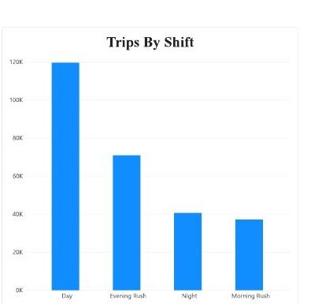
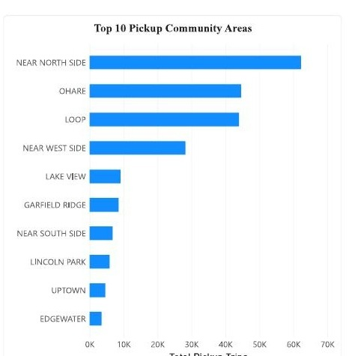
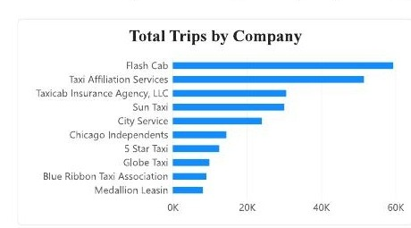
06 WHAT THE DATA REVEALS
Three Findings, Three Actions For Decision Makers
Complementary insights spanning operations, geography, and market structure
OPERATIONS
TRAVEL
MARKET
Demand Is Sharply Time-Bound
Near North Side Is A Two-Way Hub
One Operator Dominates The Field
The Day shift alone carries ~120K of 268K trips — nearly 45% of activity, more than triple the Night shift.
Near North Side ranks #1 for both pickups and drop-offs, ahead of O’Hare and the Loop for reasons like high touristic activity.
Flash Cab leads with ~59K trips and 22.16% market share — nearly double its closest competitor.
RECOMMENDATION
RECOMMENDATION
RECOMMENDATION
Prioritize vehicle & driver availability during Day and Evening Rush windows.
Create dedicated staging areas near Near North Side, the Loop, and O’Hare with strong curb access.
Use Flash Cab’s operating metrics as the fleet-performance benchmark for smaller operators.
CUSTOMERS & PAYMENTS — Credit card is the top payment method (~100K trips) with average card tips of 22.97%; cash tips are under-recorded, so treat cash-trip totals as a floor, not a ceiling.
SOS ALPHA SQUAD 4 | CHICAGO TAXI POWER BI PROJECT
07

Slide 7



07 PRESENTATION RECAP
From Raw Records To Business Decisions
How the four pieces of this project connect into one complete analysis
01
02
03
04
DATA PREPARATION
DATA MODEL
DASHBOARD ANALYSIS
FINDINGS & ACTION
267,889 imported rows cleaned to 267,884 trusted trips; 5 non-trip errors removed and documented.
A star schema — FactTaxiTrips plus Date, Time, Payment, Company and Community Area dimensions.
Five linked Power BI pages answer six business questions on demand, geography, payments, and companies.
Time, geography and market insights translate directly into staffing, staging, and benchmarking decisions.
We cleaned and validated the taxi records, modeled them for reliable comparisons, built dashboards that answer real business questions, and turned the results into concrete recommendations.
SOS ALPHA SQUAD 4 | CHICAGO TAXI POWER BI PROJECT
08

Slide 8
Thank You!
SOS ALPHA SQUAD 4
CHICAGO TAXI POWER BI PROJECT

