Slide 1
Songs Analysis Using Power BI
TASK-3

Slide 2

INTRODUCTION
Welcome to the presentation on Unlocking Insights: An In-Depth Analysis of Songs Using PowerBI. This presentation will delve into the analysis of songs using PowerBI, providing valuable insights into music data. Join us in this exploration of the fascinating world of music analytics.
PROBLEM STATEMENT
This project aims to conduct a comprehensive analysis of YouTube songs data using Power BI. The goal is to utilize Power BI to create insightful visualizations and reports that provide a
deeper understanding of YouTube songs' performance, popularity, and user engagement. The analysis aims to uncover trends, preferences, and
patterns in the data and optimizing YouTube song content.

Slide 3

DATASET DESCRIPTION:
video_id: Unique identifier for each YouTube video.
channelTitle: Title of the YouTube channel publishing the song.
title: Title of the YouTube song video.
description: Description provided for the YouTube song video.
tags: Tags associated with the YouTube song video.
publishedAt: Date and time when the YouTube song video was published.
viewCount: Number of views received by the YouTube song video.
likeCount: Number of likes received by the YouTube song video.
favoriteCount: Number of times the YouTube song video, marked as a favorite.
commentCount: Number of comments posted on the YouTube song video.
duration: Duration of the YouTube song video.
definition: Video definition or quality (e.g., HD, SD).
caption: Availability of captions for the YouTube song video.

Slide 4

UNDERSTANDING MUSIC DATA
An overview of the diverse data available in the music industry, including song attributes, lyrics, and listening patterns. Gain insights into the potential of music data for analysis and decision- making.

Slide 5

POWER BI: THE ULTIMATE TOOL
Discover the capabilities of PowerBI for
analyzing and visualizing music data. Explore how PowerBI enables in-depth exploration and insights extraction from music-related datasets.

Slide 6
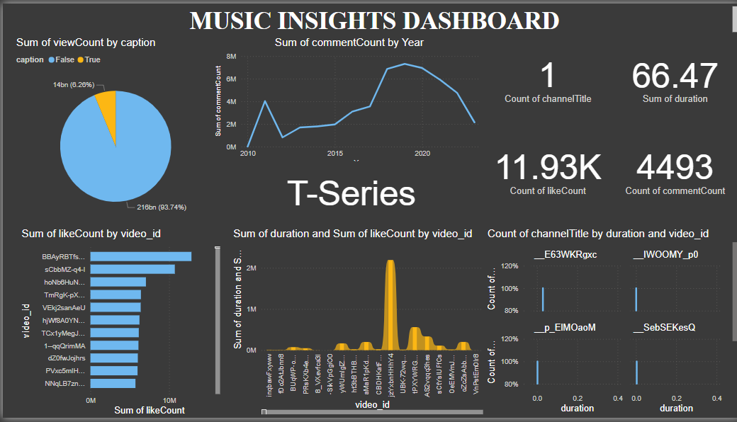
DASHBOARD

Slide 7

1. Data Cleaning and Preparation:
Remove Duplicate Rows
Handle Missing Values
Handle Outliers
Convert Data Types
Normalize or Standardize Data
Encoding Categorical Variables

Slide 8

2. Exploratory Data Analysis (EDA)
Exploratory Data Analysis (EDA) is crucial for understanding the characteristics of your dataset. Here’s a detailed approach to performing EDA on an Excel dataset, specifically focusing on view counts, like counts, and comments of YouTube song videos.
Exploring Patterns and Distributions
Summary Statistics
Frequency Distribution
Visualize Distributions
Identifying Trends in Popularity and Engagement
Time Series Analysis
Correlation Analysis
Scatter Plots

Slide 9
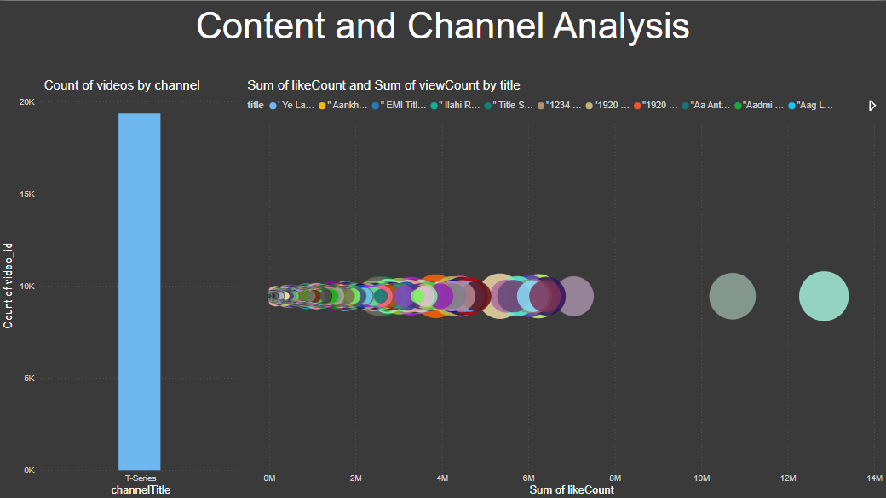
3. Content and Channel Analysis:
Distribution of Videos Across Different Channels
To analyze the distribution of videos across different channels, you can utilize Excel and Power BI. Use excel functions and Power bi tools. These methods help you understand the distribution and volume of videos across various channels, aiding in channel performance analysis.
Identifying Popular Tags and
Their Correlation with View Counts
To identify popular tags and their correlation
with view counts, use Excel methods ,functions and
Power BI tools such as charts and graphs .

Slide 10

4. Temporal Trends:
To explore temporal trends in YouTube song video metrics, analyze how metrics like view counts, like counts, and comments vary over time using Excel and Power BI. In Excel, create time series plots by selecting your date and metric columns and inserting line charts to visualize trends over time. Use pivot tables to aggregate metrics by different time periods (e.g., days, months, years) to identify patterns. This analysis helps in understanding seasonal trends, optimal publishing times, and the impact of timing on video performance.

Slide 11

5. User Engagement Insights:
To gain insights into user engagement with YouTube song videos, investigate the relationships between likes, comments, and views using correlation analysis and scatter plots in Excel and Power BI. Identify patterns by calculating correlation coefficients and visualizing the data to see how likes and comments correlate with views. Further, analyze factors influencing engagement, such as video length, tags, and publishing times, by creating pivot tables and regression models to determine their impact on likes, comments, and views. This analysis helps uncover key drivers of user engagement, informing content strategy for higher viewer interaction.

Slide 12




CHALLENGES AND OPPORTUNITIES
Discuss the and leveraging music data for and
in
. Explore ways
to overcome data-related obstacles and maximize the potential of music analytics.

Slide 13




FUTURE OF MUSIC ANALYTICS
Envision the future of potential impact on the Explore emerging
and its
.
and
that will shape the future of music data analysis.

Slide 14




CONCLUSION
In conclusion, the
into the and
opportunities for
of songs using oﬀers valuable
. The potential for
in music analytics is vast, presenting exciting and alike.

Slide 15
Thanks!

