Slide 1
A Java-Based Hotel Management Application
A Java-based Hotel Management System
Manages rooms, guests, and bookings
Uses DAO architecture and database connectivity
Console-based application with clean menu-driven flow

Slide 2
Project Overview
Build using Java, JDBC, DAO Architecture and MySQL/SQ Lite
Provides an efficient system to manage rooms , guests, and bookings
interactive console-based interface with smooth interface
Focused on Real World hotel operations and System Automation

Slide 3
Core Features
View available rooms
Book a room
Cancel a booking
View all bookings
Guest management via GuestDAO

Slide 4
System Architecture
Main: UI logic and interaction flow
Models: Room, Guest, Booking classes
DAO Layer: RoomDAO, GuestDAO, BookingDAO
Database Layer: DB connection handler

Slide 5
Technology Stack
Java 8+
JDBC for Database Connection
MySQL / SQLite Backend
OOP + DAO Design Pattern

Slide 6
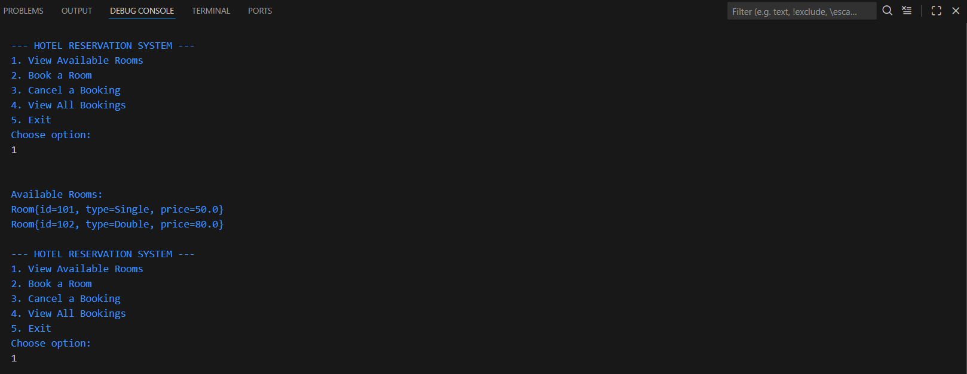
Project Output Screenshot
Add your output screenshot here

