Slide 1


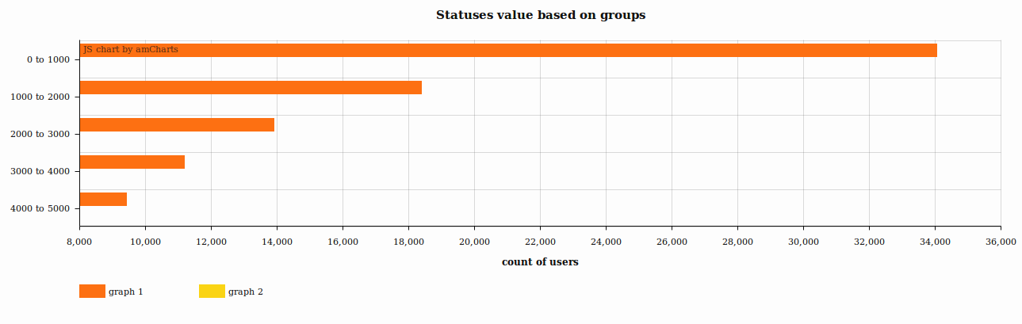
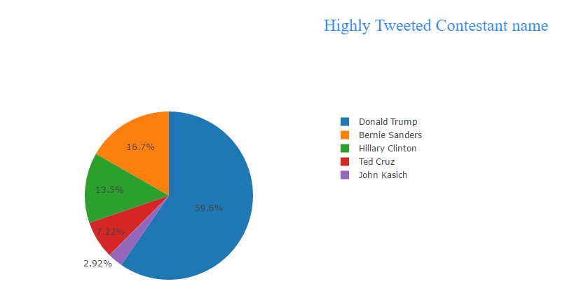
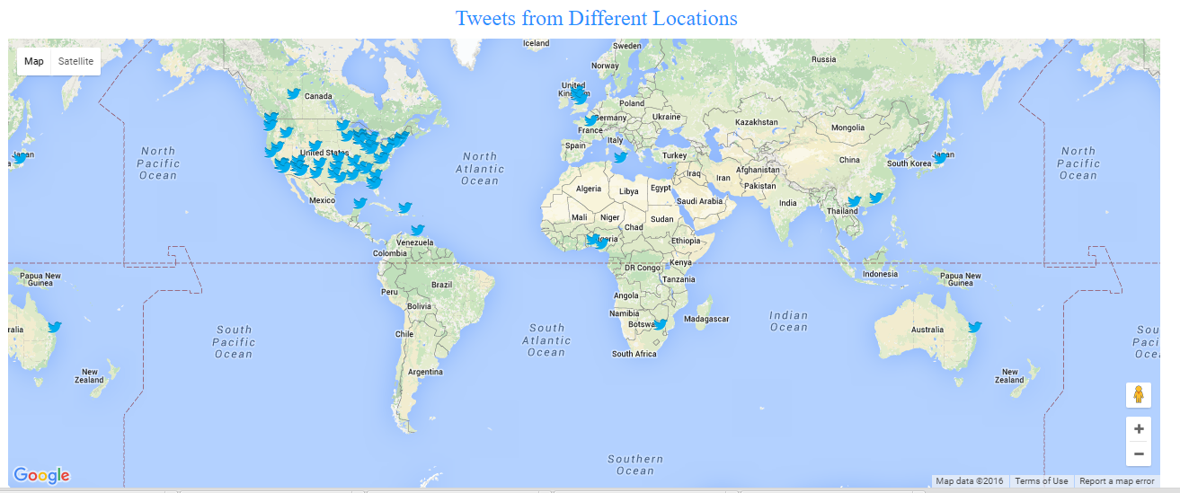
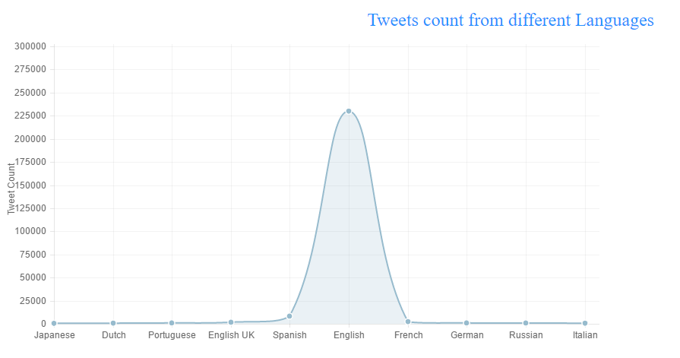
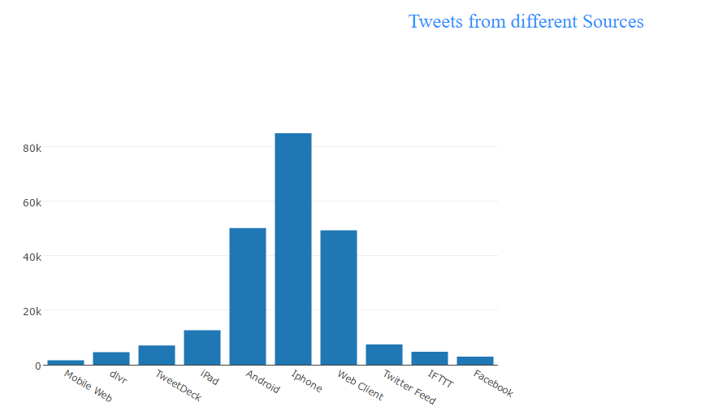
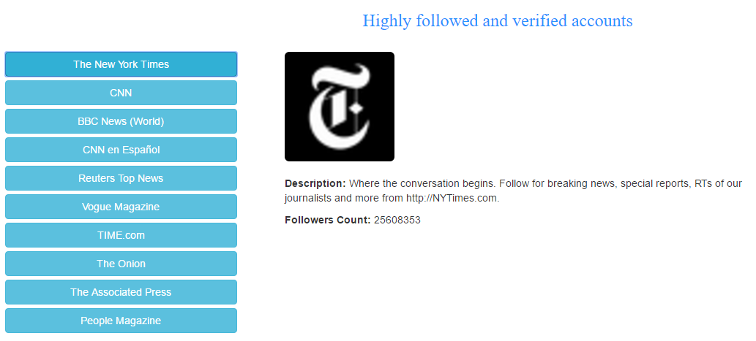
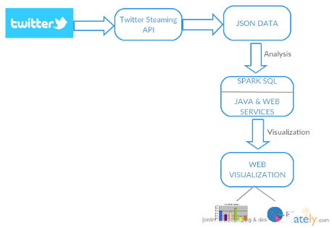
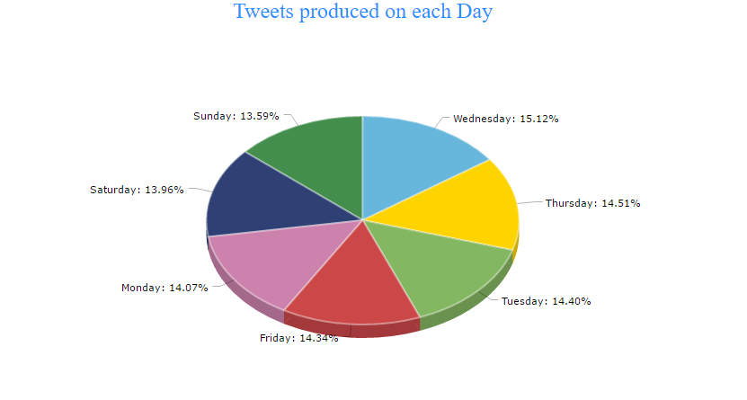
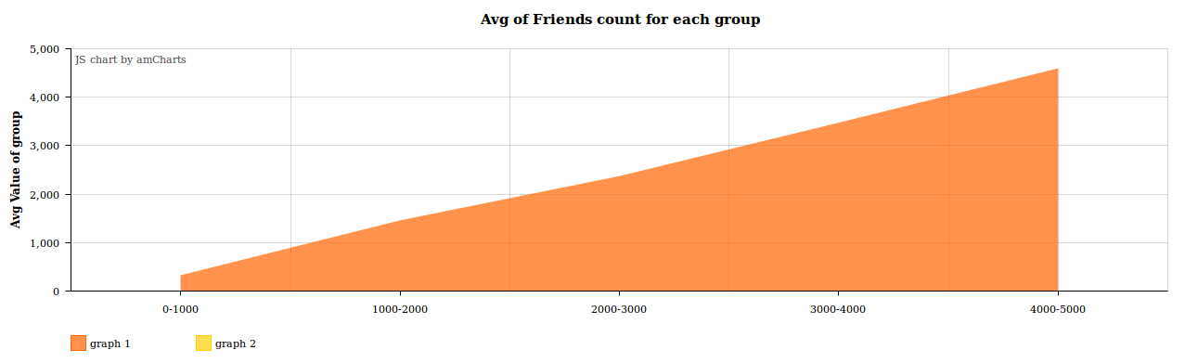
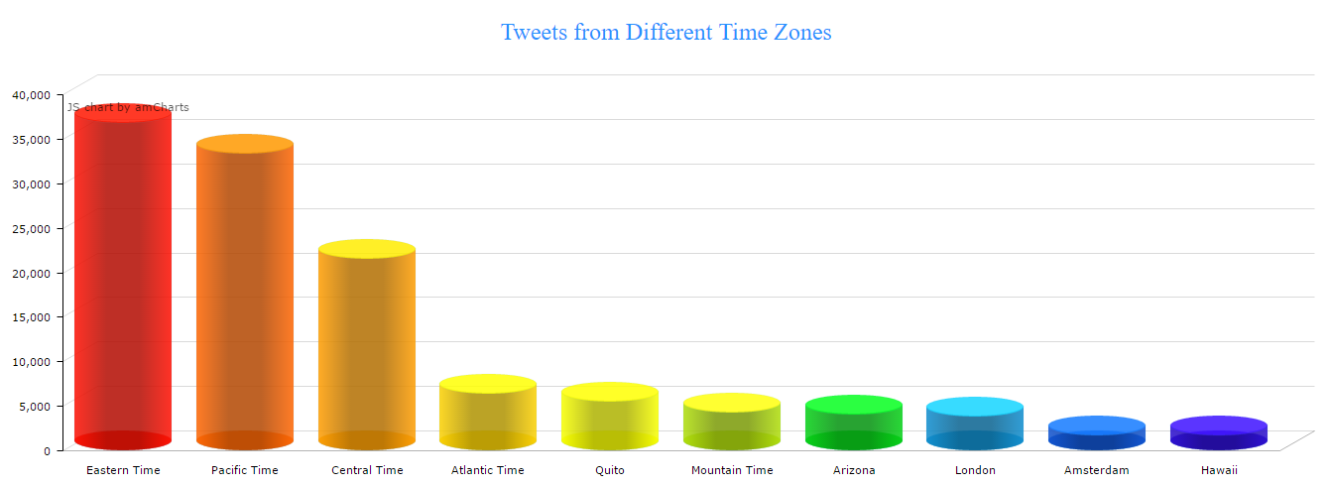
US Election Tweets Analysis Principles of big data Naga Krishna Vadlamudi. Sudheer Kumar Nagaruri, Lakshma Reddy Induri
Introduction
Users count based on statuses
Craze for Each Contestant
Tweets from different Locations
val Count1 = sqlContext.sql("SELECT count(user.statuses_count) from tweets WHERE user.statuses_count IS NOT NULL and
user.statuses_count between 0 and 1000")
val Count2 = sqlContext.sql("SELECT count(user.statuses_count) from tweets WHERE user.statuses_count IS NOT NULL and
user.statuses_count between 1000 and 2000")
val Count3 = sqlContext.sql("SELECT count(user.statuses_count) from tweets WHERE user.statuses_count IS NOT NULL and
user.statuses_count between 2000 and 3000")
val Count4 = sqlContext.sql("SELECT count(user.statuses_count) from tweets WHERE user.statuses_count IS NOT NULL and
user.statuses_count between 3000 and 4000")
SELECT count(*) total, sum(case when lower(text) like '%trump%' or text like '%donald%'
then 1 else 0 end) Trump, sum(case when lower(text) like '%sanders%' or lower(text) like
'%bernie%'then 1 else 0 end) Sanders, sum(case when lower(text) like '%hillary%' or text
like '%clinton%' then 1 else 0 end) Clinton, sum(case when lower(text) like '%ted%' or text
like '%cruz%' then 1 else 0 end) Cruz, sum(case when lower(text) like '%john%' or text like
'%kasich%' then 1 else 0 end) John from tweets
SELECT user.time_zone, count(*) AS count from tweets where
user.time_zone is not null GROUP BY user.time_zone ORDER BY
count DESC limit 10
Technologies and Tools Used
Tweets per Language
Tweets from different Sources
Highly followed accounts
Environment: Ubuntu
Tools: IntelliJ, Web storm, Spark 1.6.1
Java Rest API for backend services
Angular JS, HTML, CSS
Plotly.js, Am charts, Charts.js and
Google Maps for visualization
SELECT user.lang, count(*) as lang_user_count from tweets WHERE
user.lang IS NOT NULL GROUP BY user.lang ORDER BY lang_user_count DESC
LIMIT 10
SELECT source, count(source) as c from tweets group by source
order by c desc limit 10
SELECT distinct user.name,user.followers_count as c,
user.profile_image_url, user.description FROM tweets where
user.verified = true ORDER BY c desc limit 25
Architecture
Tweets count for each day of the week
Avg count of friends for each group
Tweets form different time zones
SELECT substr(user.created_at, 1, 3) as day, count(*) as count from
tweets where user.created_at is not null group by substr(user.created_at, 1, 3) order by count DESC
val Count1 = sqlContext.sql("SELECT avg(user.friends_count) from tweets WHERE user.friends_count
IS NOT NULL and user.friends_count between 0 and 1000")
val Count2 = sqlContext.sql("SELECT avg(user.friends_count) from tweets WHERE user.friends_count
IS NOT NULL and user.friends_count between 1000 and 2000")
val Count3 = sqlContext.sql("SELECT avg(user.friends_count) from tweets WHERE user.friends_count
IS NOT NULL and user.friends_count between 2000 and 3000")
SELECT user.time_zone, count(*) AS count from tweets where
user.time_zone is not null GROUP BY user.time_zone ORDER BY
count DESC limit 10

