Slide 1

Resume Classification
Team :Group-5
Mentors :Karthik Muskla
Dhanyapriya Somasundaran
Date :30/03/2023
Team Members:
Ms. Kavana E
Ms. Nagalakshmi M
Ms. Bhavana PM
Mrs. Rajyalakshmi Vyasabhagavan
Surarapu Hemalatha
Shubham Santhosh Bhalerao
Ms. Nirpal Pratiksha Sharad
Mr. M Kishore Arvind

Slide 2
Business Objective:
The document classification solution should significantly reduce the manual human effort in the HRM. It Should achieve a higher level of accuracy and automation with minimal human intervention.
Abstract :A resume is a brief summary of your skills and experience. Companies recruiters and HR teams have a tough time scanning thousands of qualified resumes. Spending too many labour hours segregating candidates resume’s manually is a waste of a company’s time, money, and productivity. Recruiter’s therefore, use resume classification in order to streamline the resume and applicant screening process. NLP technology allows recruiters to electronically gather, store, and organize large quantities of resumes. Once acquired, the resume data can be easily searched through and analysed

Slide 3
AIM:
The aim of the project is achieved by performing the various data analytical methods and using the Machine Learning Models and Natural Language Processing which will help in classifying of the resume and building the resume Classification Model.

Slide 4
DATA EXTRACTION:
The Given data is in the form of .docx, .doc and .pdf format
We Convert these formats into .csv using python

Slide 5
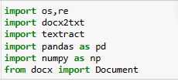
Importing Necessary Libraries:

Slide 6
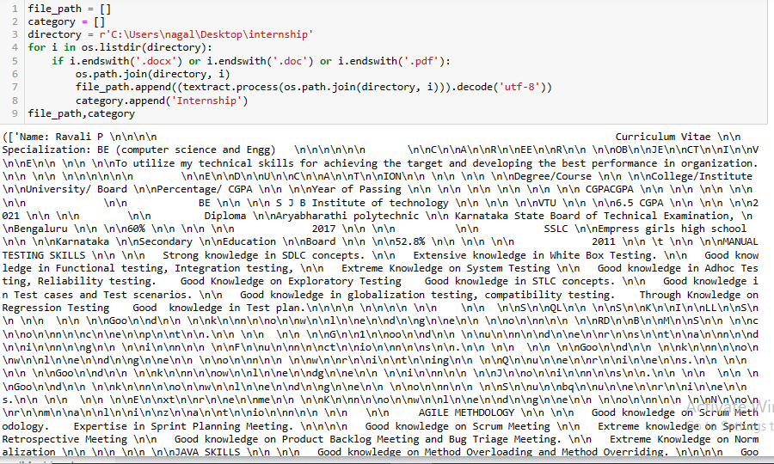
Internship resume docx file

Slide 7
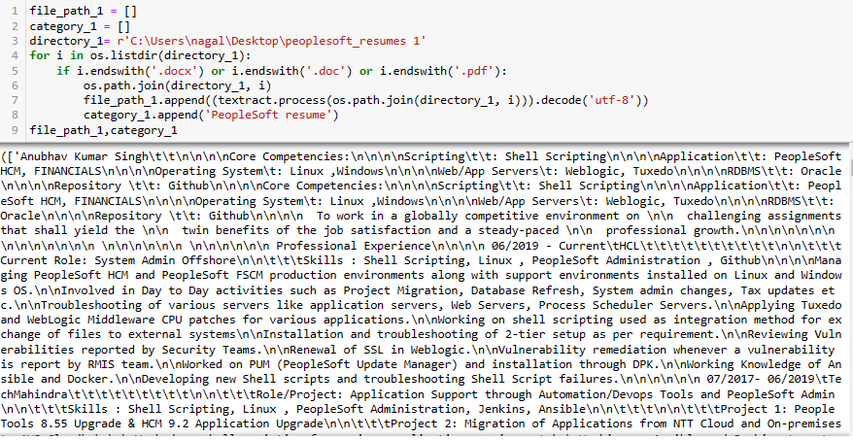
Peoplesoft resume docx file:

Slide 8
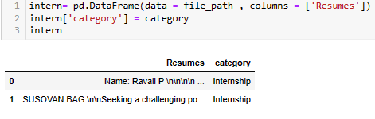
Now , creating data frame for Internship resume

Slide 9

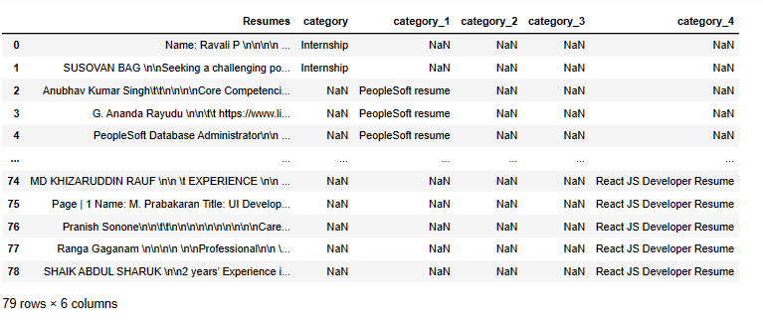
let's append all the dataframes into React JS dataframe

Slide 10
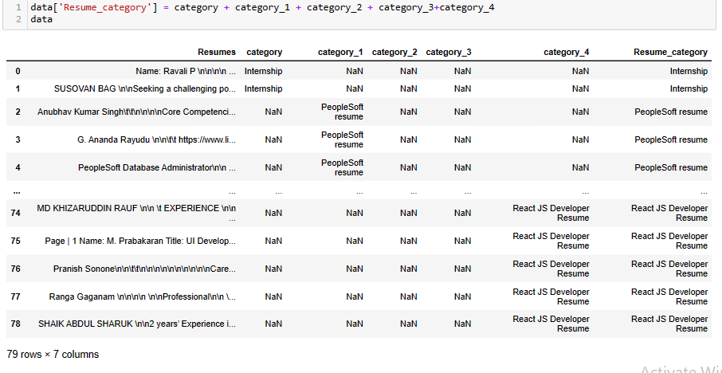
Take all categories of resume into a single column named "Resume_category"

Slide 11
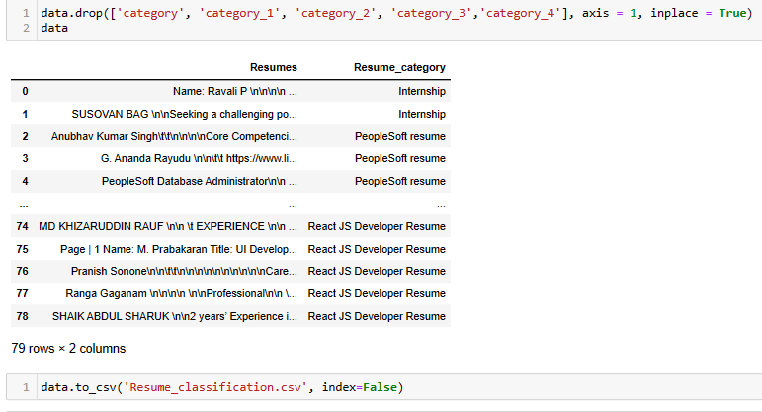
Now drop the category, category_1 , category_2 and category_3 columns from data frame and So now our data frame is in working condition and convert it in CSV format for resume classification and save it as a csv file

Slide 12
Exploratory Data Analysis (EDA) and
Feature Engineering

Slide 13
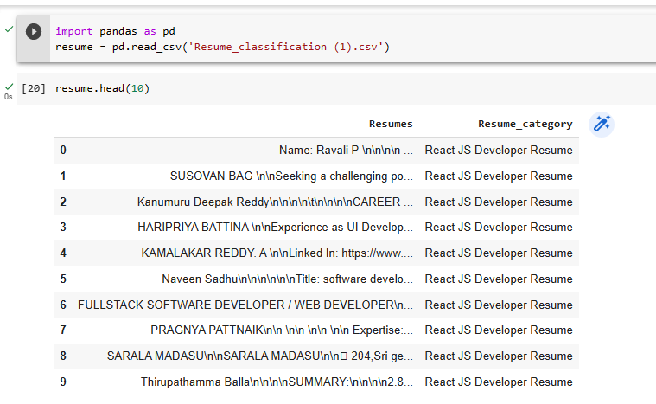
Data set details

Slide 14
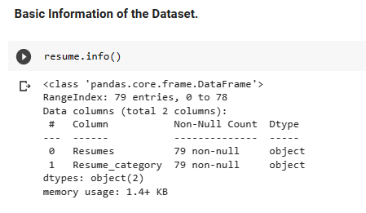
Data set details:
i) Information :
This dataset contains the information of various types of resumes.

Slide 15
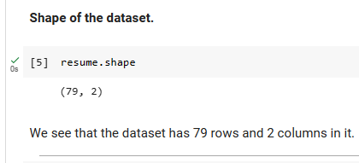
ii) Shape of the dataset:
This dataset has 79 rows and 2 columns in it.

Slide 16
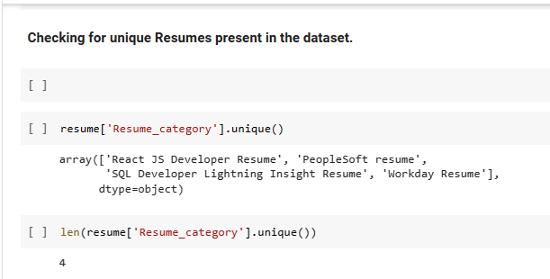
T
iii) Checking for Unique Values
There are 4 different categories of resume in our dataset.They are:
i) React JS Developer Resume.
ii)PeopleSoft Resume
iii)SQL Developer Lightning Insight Resume
iv)Work day Resume.

Slide 17
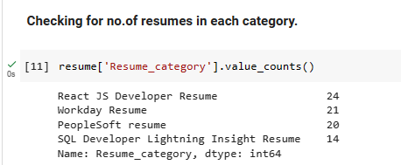
Exploratory Data Analysis (EDA)
1) Count of Resumes in each category
After doing EDA,We have found that React JS Developer Resume is the most frequent resume found in the dataset.
It comprises approximately 30% of the entire dataset.

Slide 18
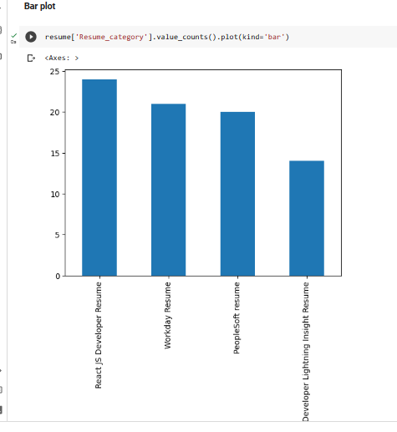
EDA
2. Visualization
i) Bar Graph
From the above Bar Graph , we conclude that React JS Developer Resumes are highest in the
given dataset.

Slide 19
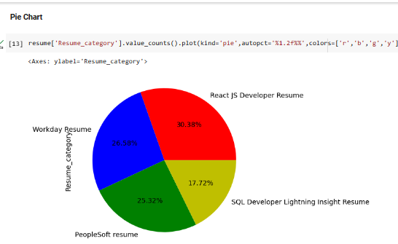
ii) Pie Chart
From the Pie chart representation,it is evident that React JS Developer Resume comprises of around 30.38% of the dataset, followed by Work Day Resume comprising of 26.58% of the dataset,followed by PeopleSoft Resumes comprising around 25.32% of the dataset,and the last one SQL Developer Lightning Insight Resume of 17.72% of the dataset.

Slide 20
SWEETVIZ VISUALIZATION
SweetViz Library is an open-source Python library that
generates beautiful, high-density visualizations to kickstart
EDA with just two lines of code.
-> Output is a fully self-contained HTML application.
The system is built around quickly visualizing target values and comparing datasets. Its goal is to help quick analysis of target characteristics, training vs testing data, and other such data characterization tasks.

Slide 21
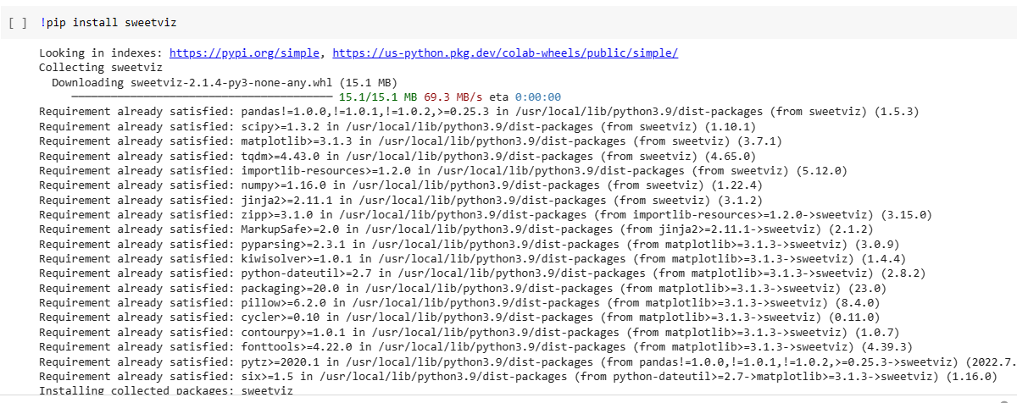
SWEETVIZ VISUALIZATION
In order to implement sweetviz visualization in our jupyter notebook, we
need to explicitely import the libraries using pipeline method.

Slide 22
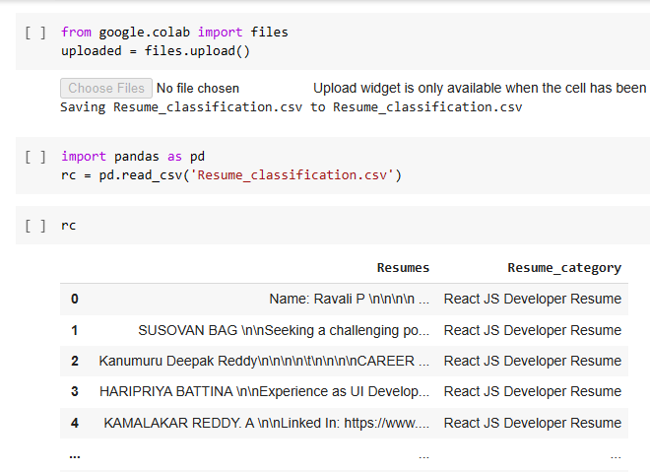
Loading the dataset

Slide 23
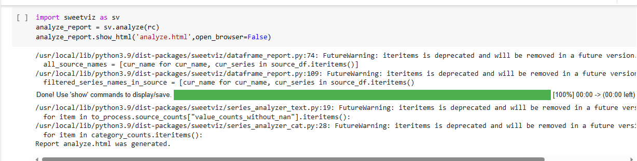
Importing Sweetviz library and analyzing the dataset.

Slide 24
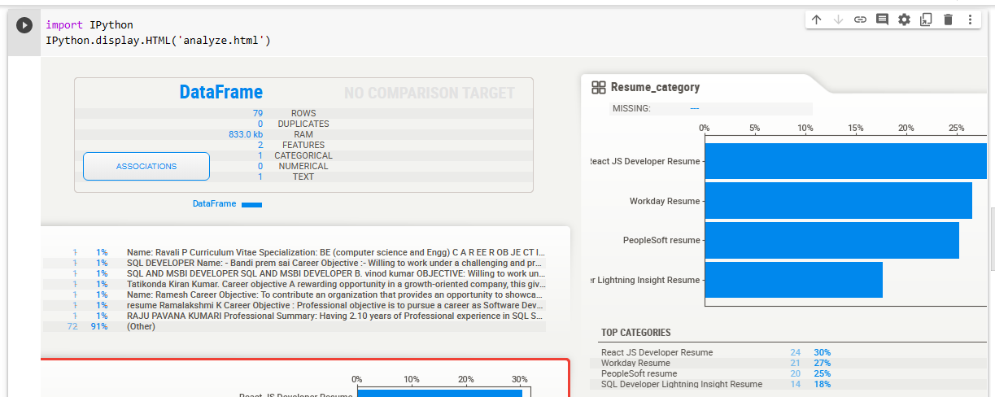
Importing IPython module and applying display and analyze methods for visualization.

Slide 25
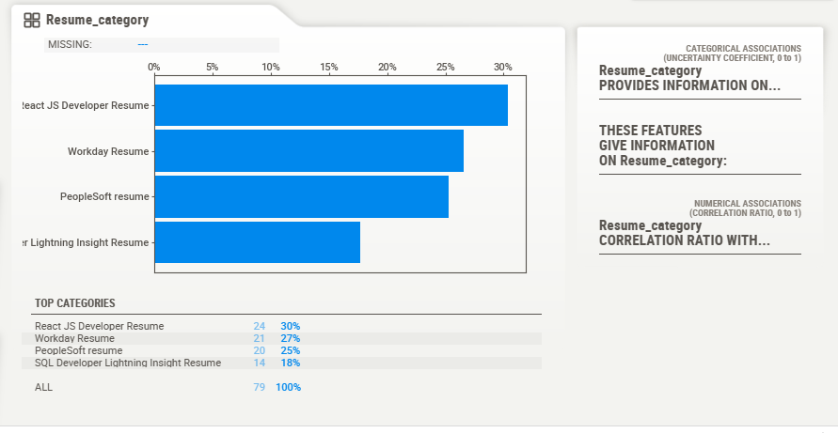

Slide 26
TEXT PREPROCESSING
Here the text preprocessing involves transforming text into a clean and consistent format that can then be fed into a model for further analysis and learning

Slide 27
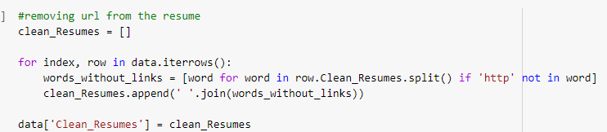
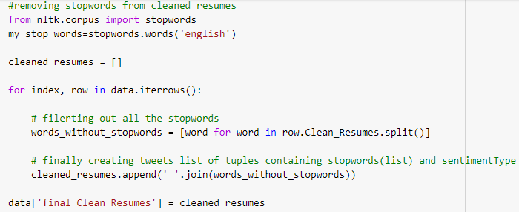
We try to remove URL and stop words from the text since they provide no meaningful informationURL and stop words of resumes to give more focus on important information URL and stop words of resumes to give more focus on important information

Slide 28
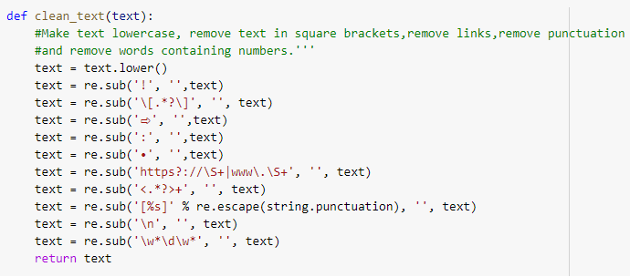
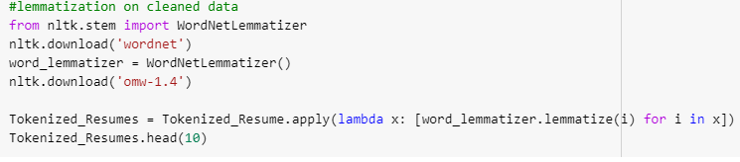
By removing the square brackets, link, punctuation and also we convert the data into lower case to maintain the uniformity of the data
And we apply lemmatization to convert the text format into the original format by converting the word to its root form which as meaning in the dictionary

Slide 29
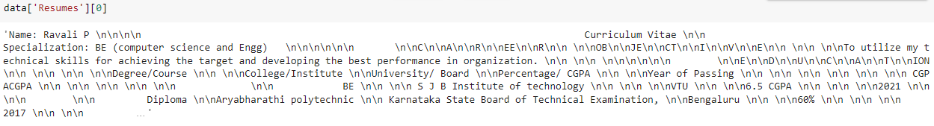
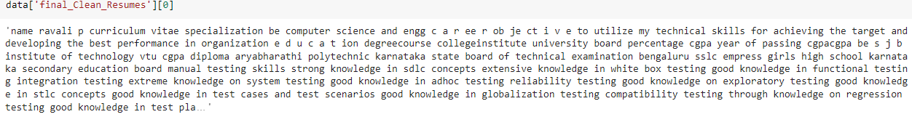
Now this the text before the text processing
Now this is the text after the text processing

Slide 30
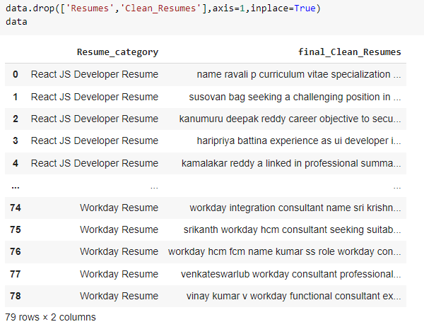
This will be the final data after text preprocessing and we can use this data for further analysis

Slide 31
Model Building

Slide 32
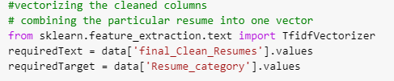
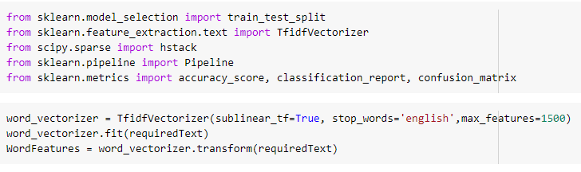
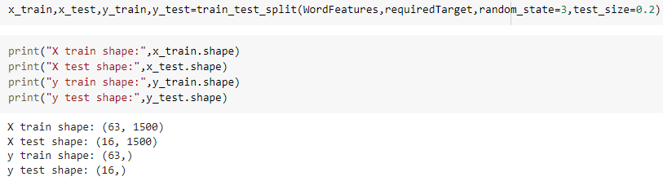
Before building the model we need to transform text to feature vectors that can be used as input to estimator by TfidVectorization
And we import necessary library for model building and dividing the data set into train and test for better accuracy of the model

Slide 33

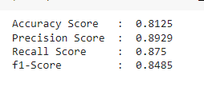


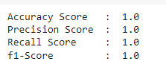

LOGISTIC REGRESSION Model Accuracy DECISION TREE
RANDOM FOREST

Slide 34

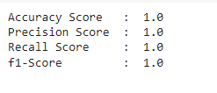

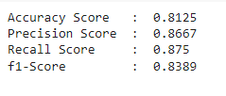
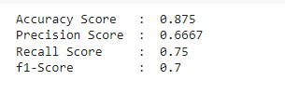

SVM - CLASSIFIER
MULTI NOMINAL NAVIE BAYES
ADA BOOST CLASSIFIER

Slide 35


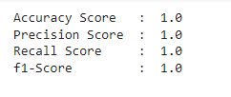



GRADIENT BOOST CLASSIFIER
XGB CLASSIFIER
LGBM CLASSIFIER

Slide 36
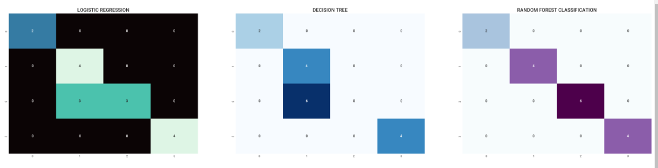
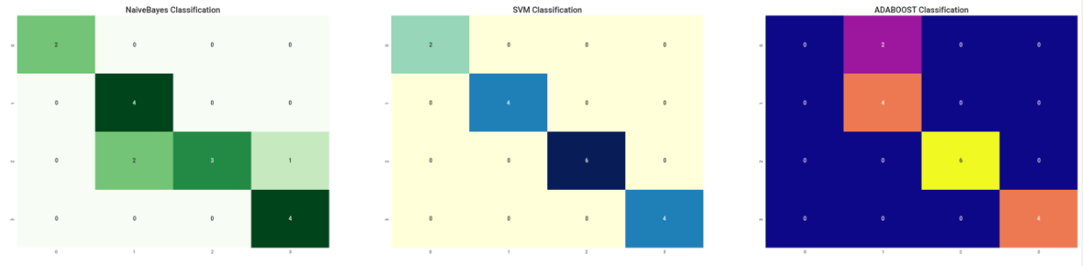
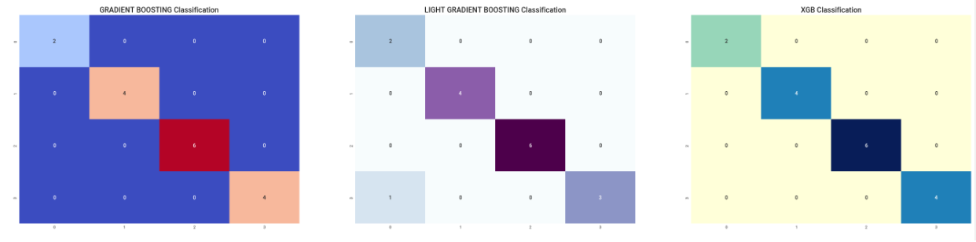
CONFUSION MATRIX OF ALL THE MODELS

Slide 37
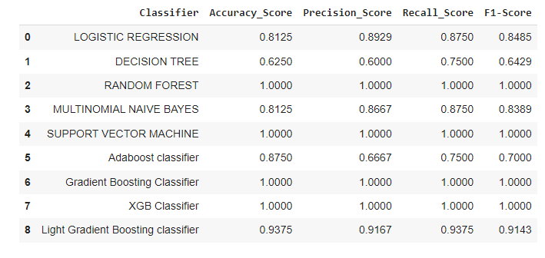
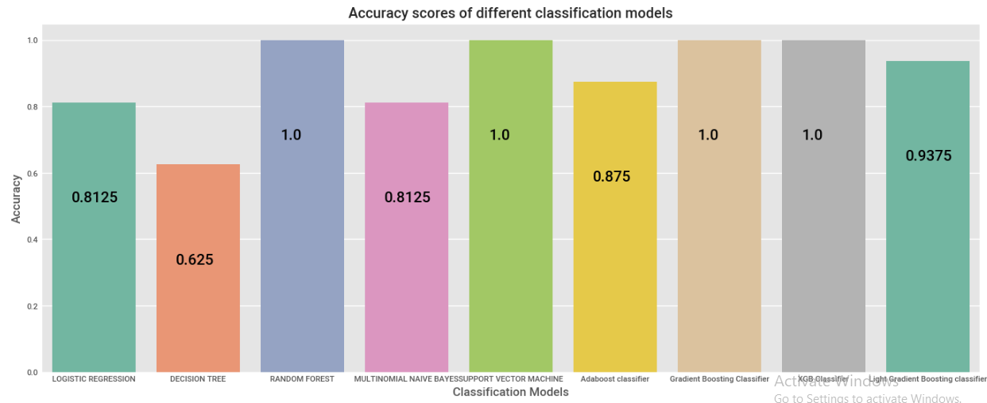
Now we consider accuracy score of all models in one data frame

Slide 38
DEPLOYMENT
We consider Light Gradient Boosting Classifier Algorithm for the model deployment and using Streamlit we deploy our model

Slide 39
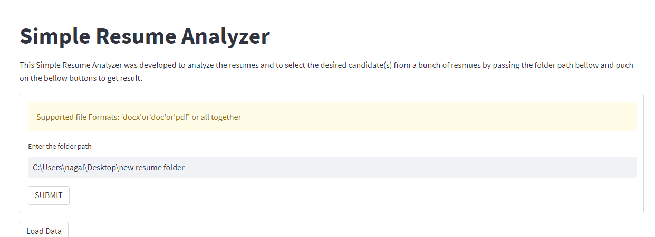
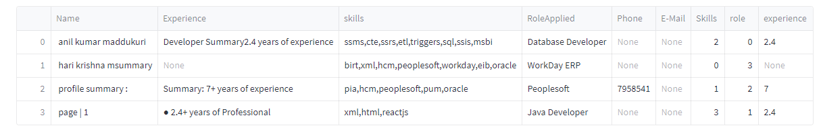
This the Web app for Simple Resume Analyzer using Streamlit.
Form the local drive we added the resume path in which we need find for which
Role they are applied for , from this we can extract name of the candidate
experience, skills, Role Applied for the particular resume

Slide 40
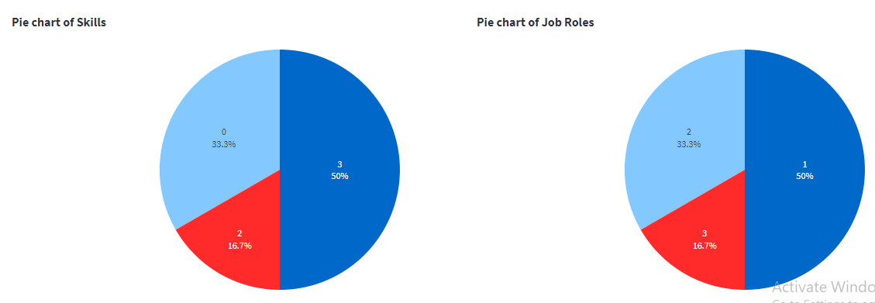
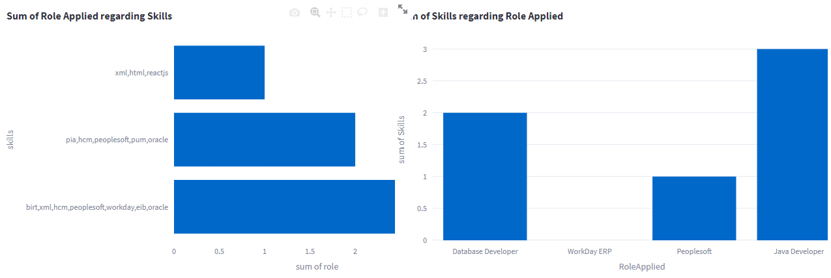
Visualization of the skills and role applied

Slide 41
Challenges faced?
How did you overcome?

Slide 42
Thank you

