Slide 1


TCS Stock Price Prediction
Group – 3
Mr. K Sampath Kumar Reddy
Mr. Prajwal s Gondi
Mr.Chinnam Rahul Sai Mr.Pavan Reddy
Mr. Sagar Betadur
Ms. Kavana E
Ms. Tejswini Khot
Ms. NagaLakshmi M
Ms. Bhavana PM

Slide 2
Business Problem:
In stock market it is difficult for the traders to make a decision for which company he/she should invest based on the future value of the stock.
Business objective:-
In today’s world companies and businesses are very keen to understand and analyze the market to lower their expenses and enhance profits.
With modern data analytics, we can identify purchasing and selling patterns by carefully analyzing the data to help the investors.
.

Slide 3

Why TCS?
Tata Consultancy Services is an IT services, consulting and business solutions organization that has been partnering with many of the world's largest businesses for the past 50 years. We believe innovation and collective knowledge can transform all our futures with greater purpose

Slide 4
PROJECT FLOW
Data collection
EDA(Exploratory data analysis
Data Visualizations
Transformations
Model Building & Evaluation
Deployment

Slide 5
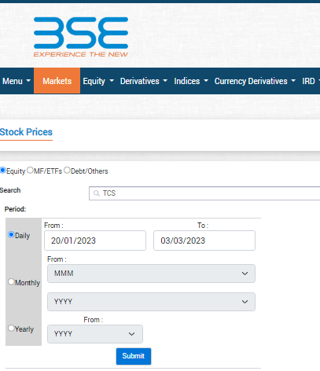
1. Data Collection
TCS
TATA CONSULTANCY SERVICES LTD.
extracted data from Bse.india
Stock price from
(Feb-2013 to Feb_2023)
Reference:
https://www.bseindia.com/markets/equity/EQReports/StockPrcHistori.aspx?expandable=7&scripcode=532540&flag=sp&Submit=G

Slide 6
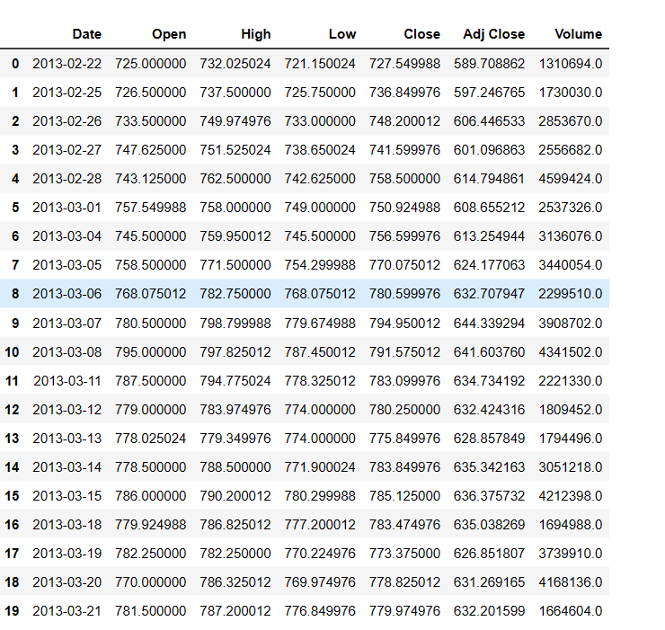
TCS DATASET

Slide 7
2. EDA
.
Data understanding
1. Open
The opening price is the price at which a security first trades when an exchange opens for the day.
2.High
The price at which stock as reached the highest amount of price.
3. Low
The price at which stock as reached the lowest amount of price.
4. Colse
The price at which a security last trades when an exchange ends for the day.
5. Adj Close
Adjusted closing price refers to the price of the stock after paying off the dividends.
6.Volume
Volume in the stock market means the total number of shares traded in a specified time frame

Slide 8
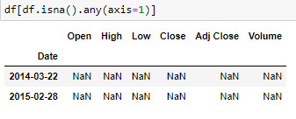


Data Cleaning
1. Check for missing values:
We have 2 missing values.so,dro them
2. Check for duplicates:
We don’t have any duplicate values in the data
3. Rename columns:
For better readability and understanding.
4. Remove irrelevant columns:
for better data analysis
5. Standardize data:
It helps to bring all the columns to the same scale

Slide 9
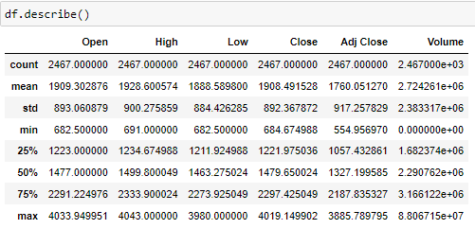
Describe :-
In the past Ten years the TCS stock price has moved from ₹ 684 to ₹ 4019
The stock price has increased 5.87X times
The average mean of the stock price is ₹ 1908

Slide 10
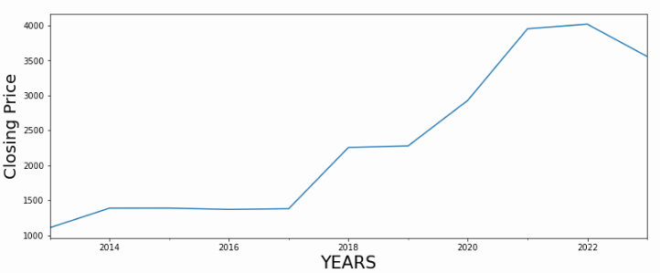
Insights from yearly data
The stock price has reached LOW (684) on 30-4-2013.
The stock price has reached HIGH (4019) on 31-1-2022
Percentage of increse ---- 587%
out of 10 years 8 years are profit and 2 years are loss
Average change in price per year is 252.68

Slide 11
Visualization:
Bar Chart
, Histogram
Boxplot
Line Plot

Slide 12
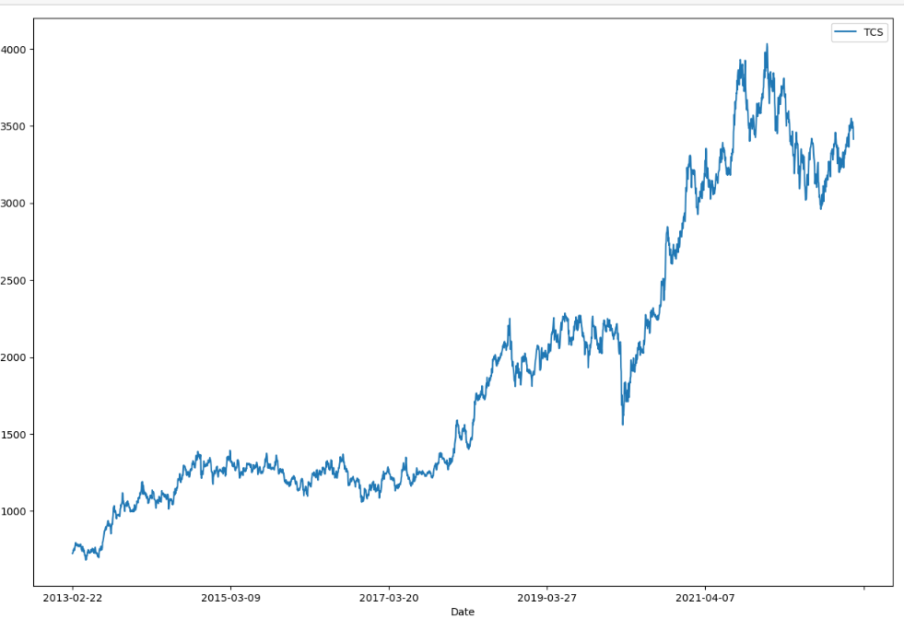
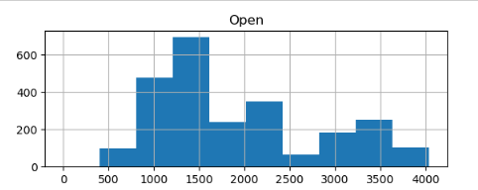
Opening Stock Prices Of TCS

Slide 13
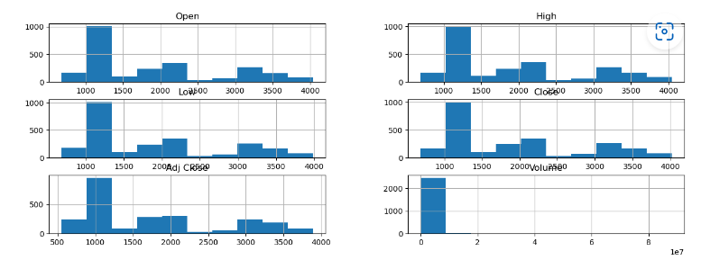
Hist Plot: - here also the histogram refers to the unimodal distribution which means their one distinct peak indicating the most frequent value in a histogram. - which means in one particular year their is drastic raise in the close stock price where all the investors get more profit during those period of frequency

Slide 14
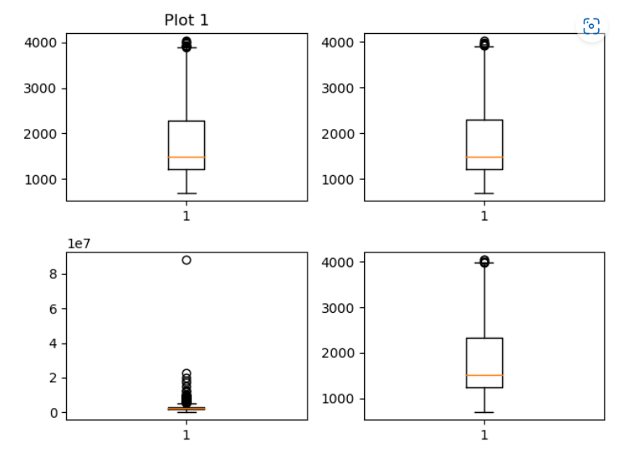
Box Plot: - A boxplot displays the prominent quartiles of the data along with the outliers. - Here these box plots shows that there is a outliers in our data

Slide 15
Line Plot: - this line plot is volume versus date this indicates that in the year between 2018 and 2019 their is a high purchase in stock

Slide 16
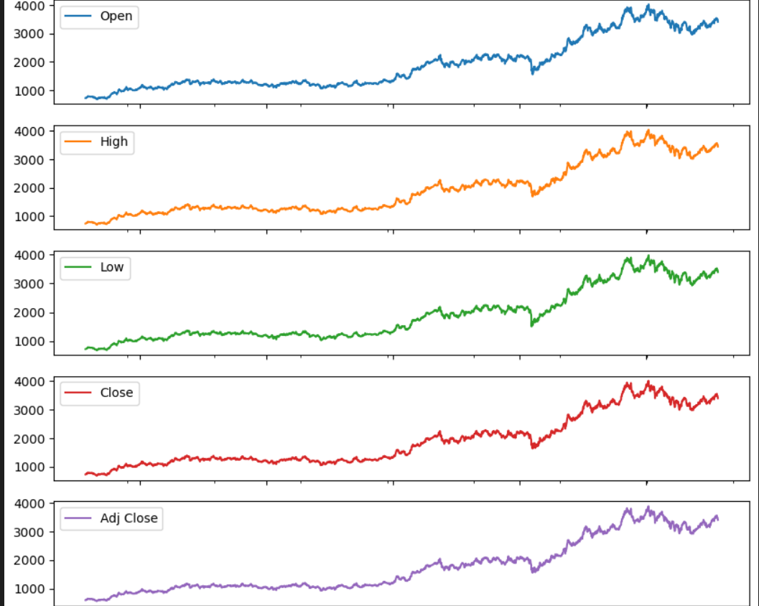
- here we analyze for every column here we found that the stock got increased in its price after 2018 and then we found their still more increase in the stock price after 2020

Slide 17
Calculate and Visualize: Correlations between variables, Heat Map.

Slide 18
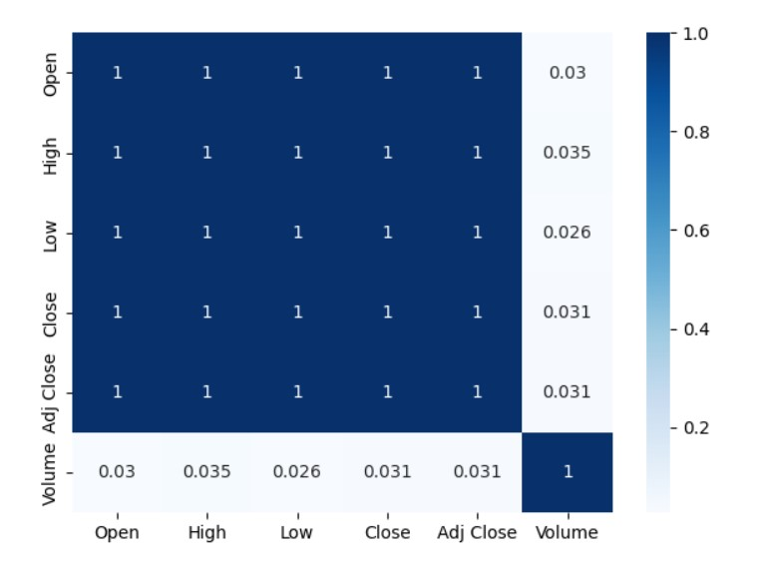
Heat Map: Since all the columns except volume column are showing high correlation between them. A correlation coefficient of 1 indicates a perfect positive correlation between the prices of two stocks, meaning the stocks always move in the same direction by the same amount.

Slide 19
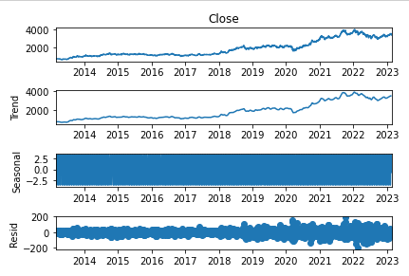
Components of time series data
Trend
Seasonal
Residual
- here we analyze for every column here we found that the stock got increased in its price after 2018 and then we found their still more increase in the stock price after 2020

Slide 20
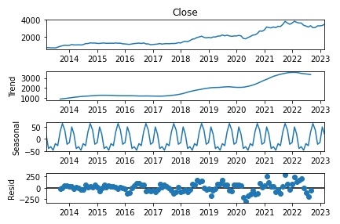
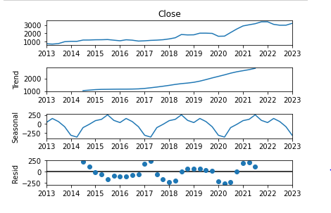
Quarterly data
Monthly Data
here we check the stock price for the month end of every year to check in which month the stock price will be more with the help of resampling

Slide 21
Checking the Stationary of data

Slide 22
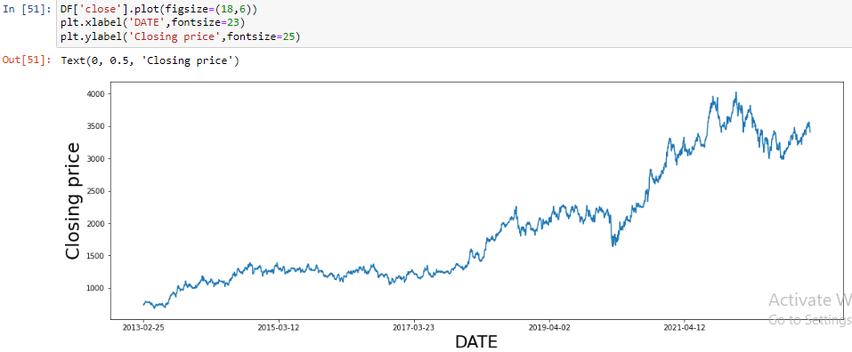
Visual test
The data is Non stationarity
Looking at the plot we can say there is up Trend in the market

Slide 23
Statistical test
ADF (Augmented Dickey Fuller) Test
KPSS (Kwiatkowski-Phillips-Schmidt-Shin) Test

Slide 24
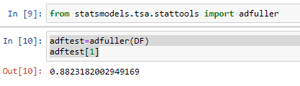
ADF (Augmented Dickey Fuller) Test
Null Hypothesis: data is non stationary
Alternate Hypothesis: data is stationary
If p-value <0.05 reject null hypothesis
As p value(0.8823) is higher then 0.05 the data is non stationarity

Slide 25
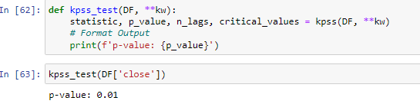
KPSS test
Null Hypothesis: data is stationary
Alternate Hypothesis: data is Non stationary
If p-value <0.05 reject null hypothesis
As p value(0.01) is higher then 0.05 the data is stationarity

Slide 26
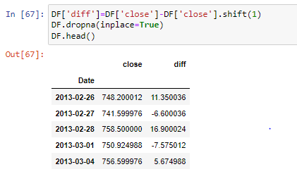
KPSS = stationary
ADF = not stationary
This means the Data has trend stationary
To make is series strict stationary we need to remove TREND
Differencing
We have done differencing useing lag 1 and removed the null values from the data

Slide 27
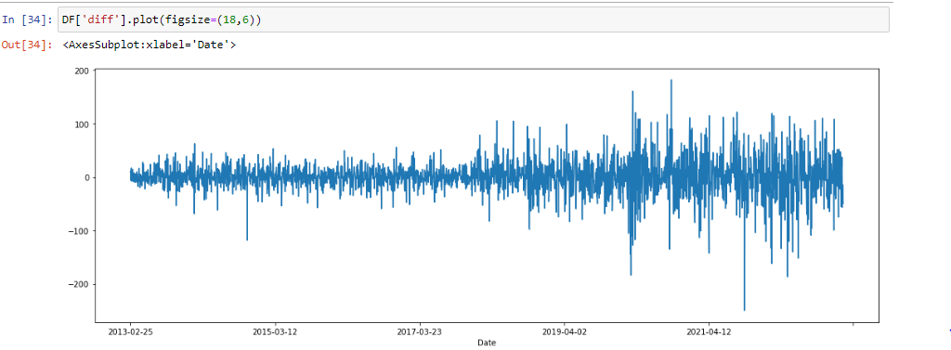
ORIGINAL DATA
DATA AFTER DIFFERENCING

Slide 28


ADF test after Differencing
KPSS test after Differencing
After both the tests we can conclude that the data is stationarity

Slide 29
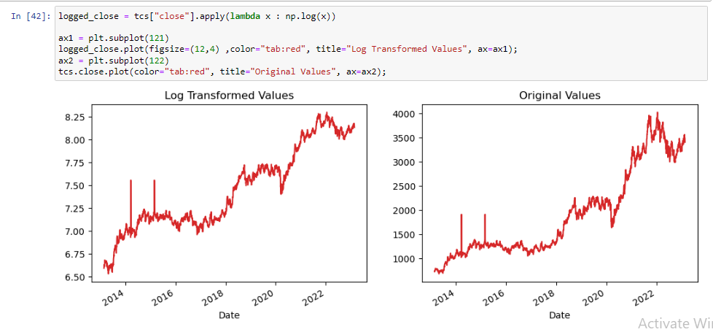
log transformation

Slide 30
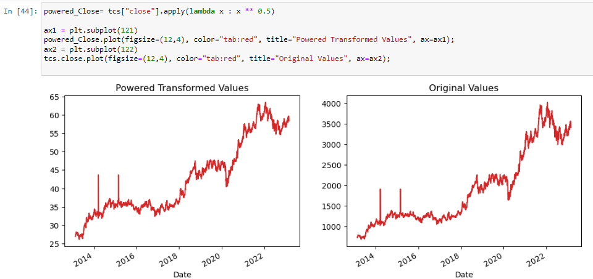
Sqr TRANSFORMATION

Slide 31
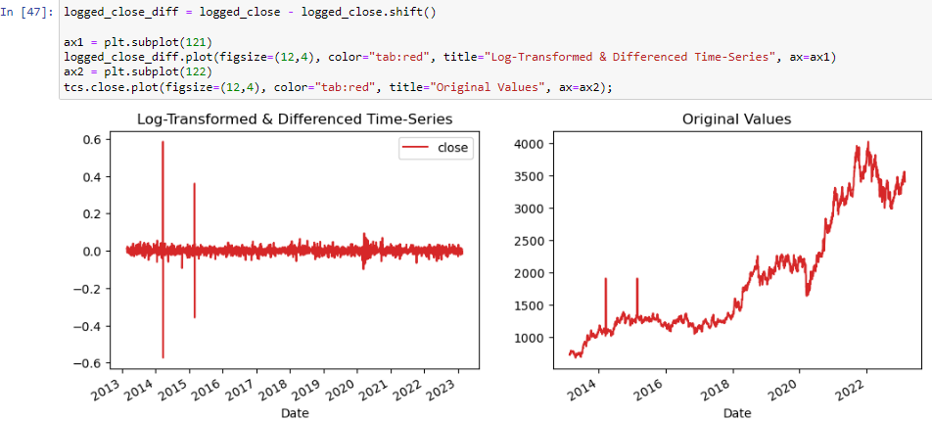
Differencing Log_close

Slide 32
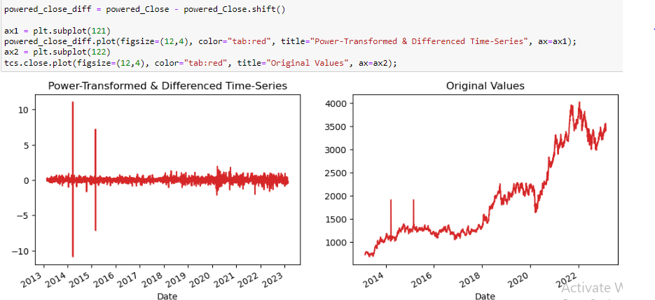
Differencing SQUAREROOT

Slide 33
Model Building

Slide 34
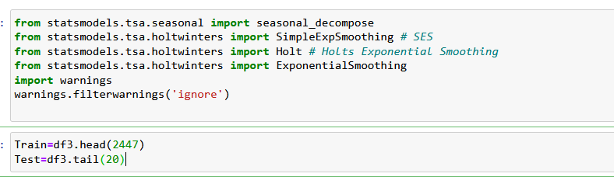
Importing necessary libraries and splitting the data to Train & Test

Slide 35
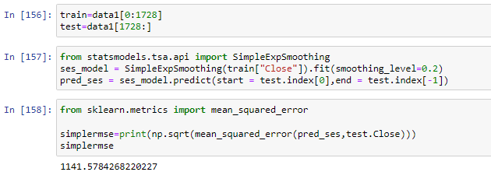
Simple
Exponential
Model
Simple Exponential Smoothing, is a time series forecasting method for univariate data without a trend or seasonality.
It requires a single parameter, called alpha (a), also called the smoothing factor or smoothing coefficient.
Forecasted values will be same for predicted days in SEM

Slide 36
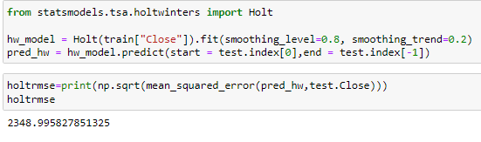
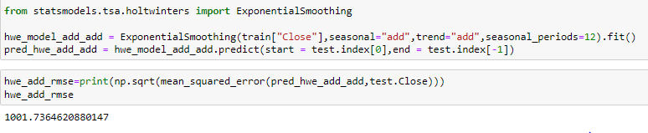
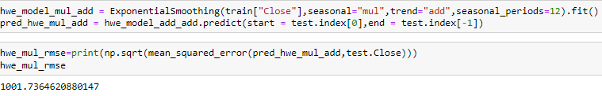
Holt's winter
method
additive trend and additive seasonality
additive trend and multiplicative seasonality

Slide 37
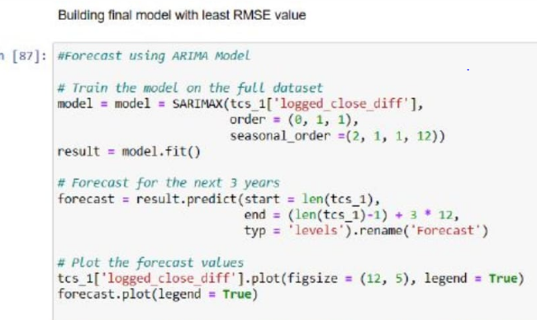
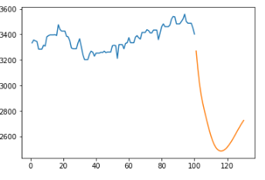
ARIMA
autoregressive integrated moving average

Slide 38
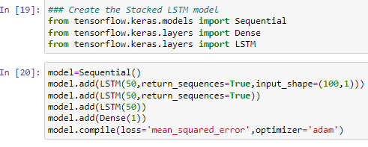
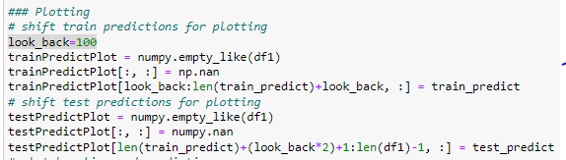
LSTM
Long short-term memory

Slide 39
deployment

Slide 40
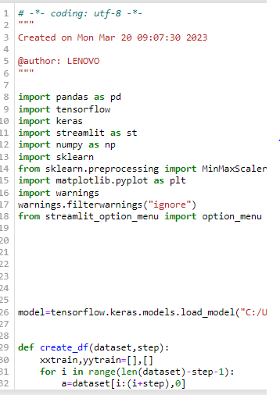
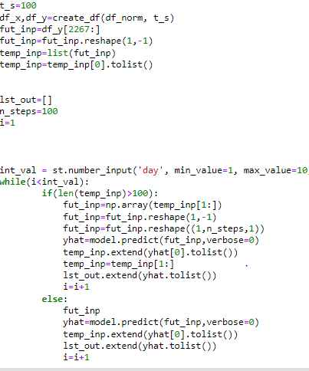

Slide 41
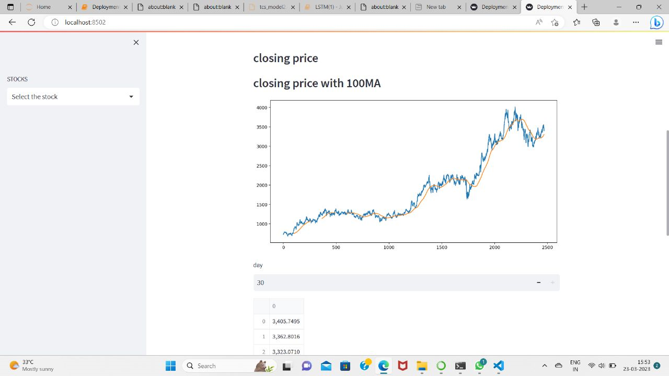

Slide 42
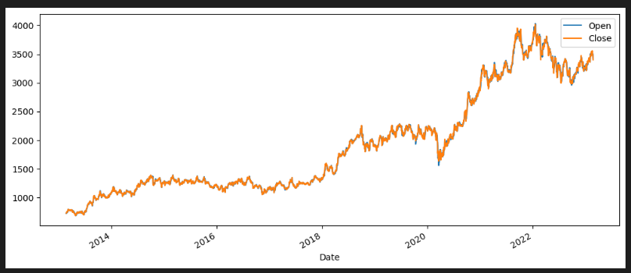
-The investors while investing in the stock were expecting that the open stock price should be low and the closing stock price should be high this typing of investing were interested for the people who are wiling to do INTRADAY trading - For the those who prefers the long term investments their were not worried about the open stock price although their need to purchase the stock in the low price - Here in this TCS dataset when we compare the opening and closing stock price we see their is almost similarity in them that is open and closing stock price were not have that much differences - This TCS stock is helpful for those investors who wants to invest for the long time to get the profit

Slide 43
Challenges faced
Lack of communication
conducted group meetings
Different versions of Python among team members
we build a ecosystem to overcome this
Skill gaps
everyone in the group has the same skill set. so, we trained each other
difficulty in choosing no. of epochs, neurons
we have used trail and error

Slide 44
Thank you

