Slide 1

Bank Analytics Project Project Code: P251 Bank Loan of Customers Group-5

Slide 2

Group – 05 Members
Divya Rathore
Supriya Umakanth Maurya
Ajay Gohel
Yamuna Kunta
Cheerla Nagamallika
Anuradha Avinash Isalkar
Aishwarya Sanjay Sukunde

Slide 3
Introduction
Bank loans play a significant role in the economy and financial system, providing both individuals and businesses with essential financial support. The importance of bank loans can be highlighted in several key aspects: Capital for Investment and Growth, Personal Finance and Purchases, Supporting Startups and Entrepreneurs, Building Credit History. Strengthening Banking System etc.

Slide 4


Goal
To prepare a report to assess the creditworthiness of potential borrowers and determine the risk associated with lending them funds. When individuals or businesses apply for a bank loan, the bank needs to evaluate their financial situation, repayment capacity and overall credit risk to make informed lending decisions.
Also to have a detailed study on financial condition of Bank And how we can further grow in the Market.
To have a Detailed Report on financial condition
Determine the risk in Fund Lending
Assess the creditworthiness of potential borrower
Goals
To find out Potential Growth in Market and make strategies

Slide 5

KPI’s
KPI 1
Year wise loan amount Stats
KPI 2
Grade and sub grade wise revol_bal
KPI 3
Total Payment for Verified Status Vs Total Payment for Non Verified Status.
KPI 4
State wise and last_credit_pull_d wise loan status
KPI 5
Home ownership Vs last payment date stats

Slide 6
KPI 1 Year-wise Loan Amount Stats
The average loan amount increased year by year. We've developed deep into the numbers, watching them rise and fall over the years. This tells us a story of financial trends and customer trust.

Slide 7
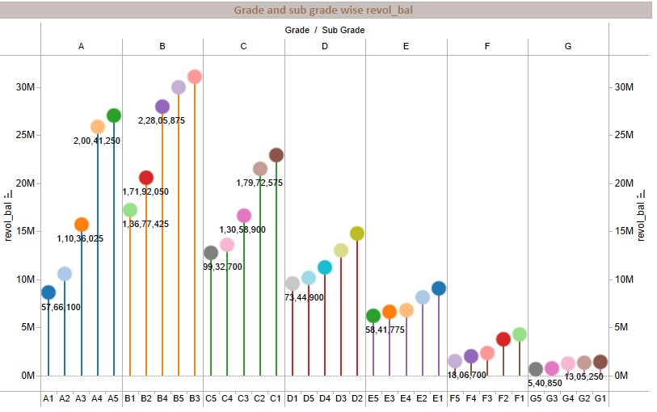
KPI 2 Grade and sub grade wise revol_bal
The highest loan amount was issued to customers with a grade of B, while the lowest loan amount was issued to customers with a grade of D.
The difference in payments received speaks volumes about the importance of verification.

Slide 8
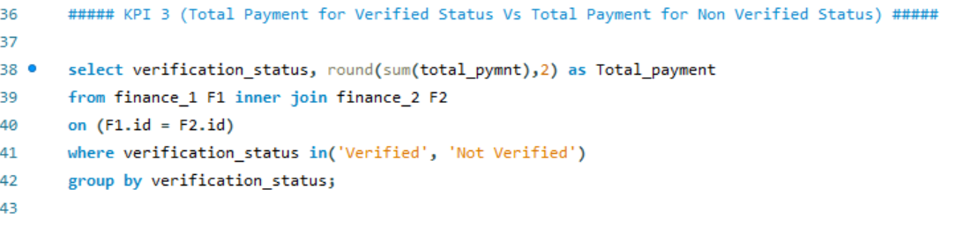
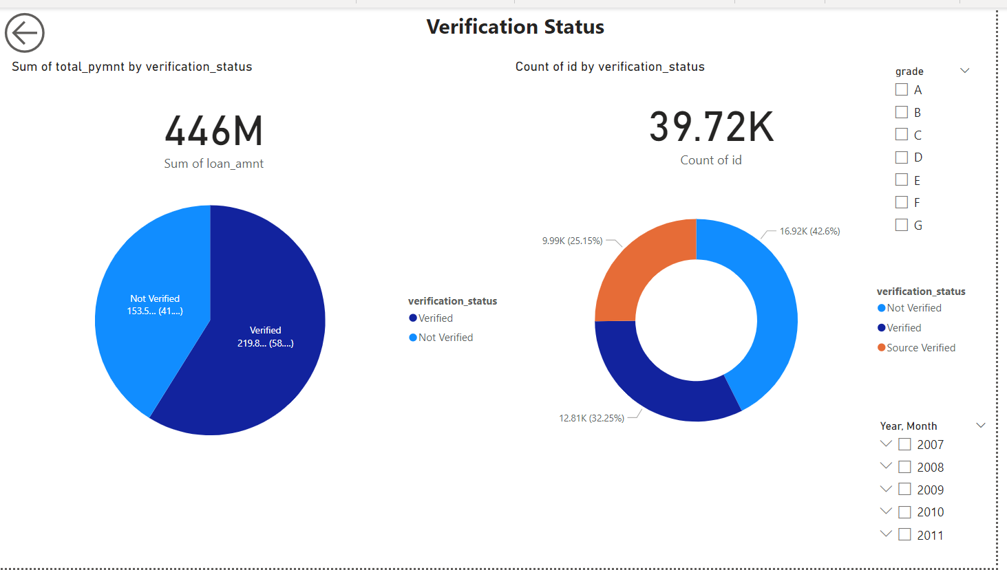
KPI 3: Total Payment for Verified Status Vs Total Payment for Non Verified Status
Customers with a verified status made more total payments than customers with a non-verified status. Regional insights help us tailor our services, while timing plays a vital role in loan outcomes.

Slide 9
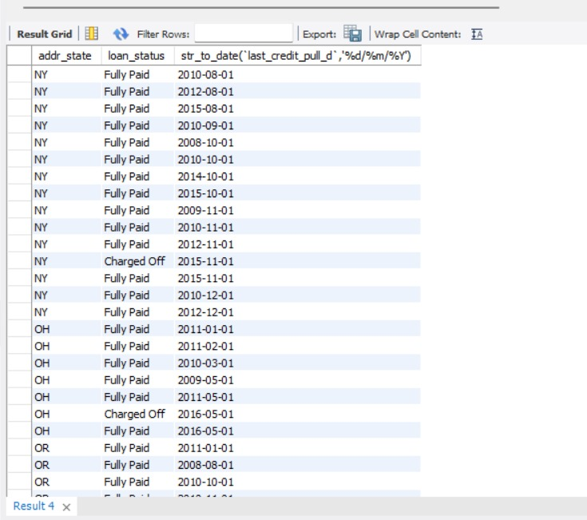
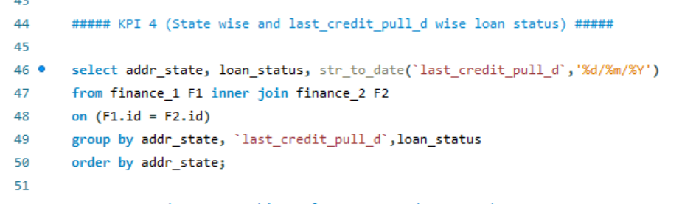
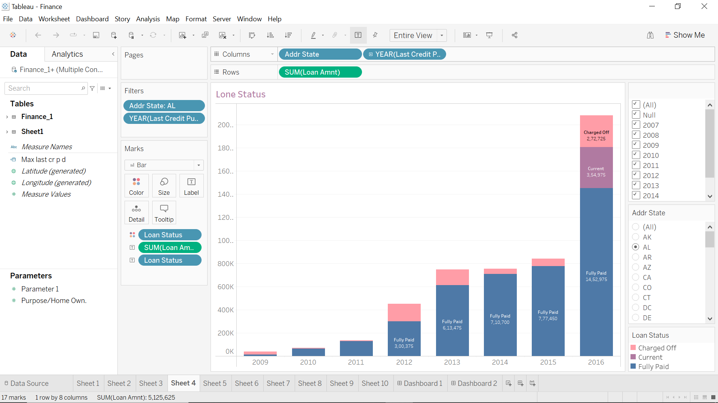
KPI 4: State-wise and Last_Credit_Pull_D wise Loan Status
The state with the highest number of approved loans was California, while the state with the lowest number of approved loans was Wyoming. Regional insights help us tailor our services, while timing plays a vital role in loan outcomes.

Slide 10
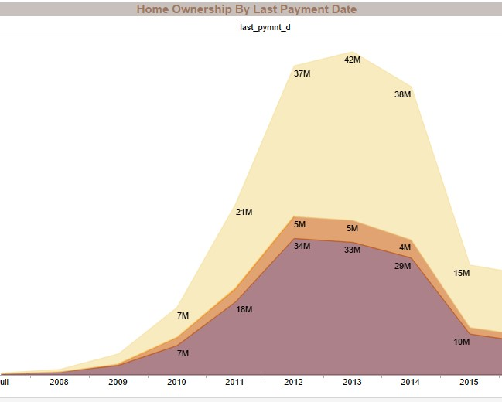
KPI 5 Home Ownership Vs. Last Payment Date Stats
Customers who owned their homes were more likely to make their last payment on time than customers who did not own their homes. the intersection of living situations and financial responsibility is revealing.

Slide 11
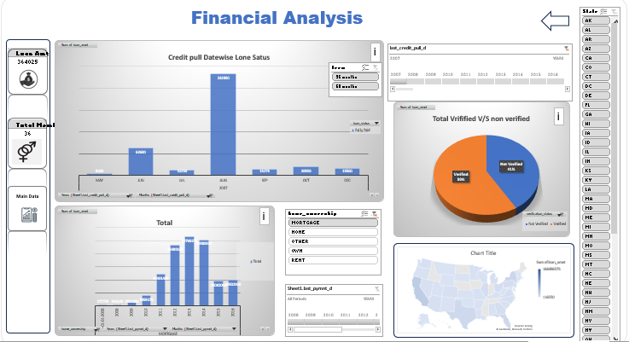
EXCEL DASHBOARD

Slide 12
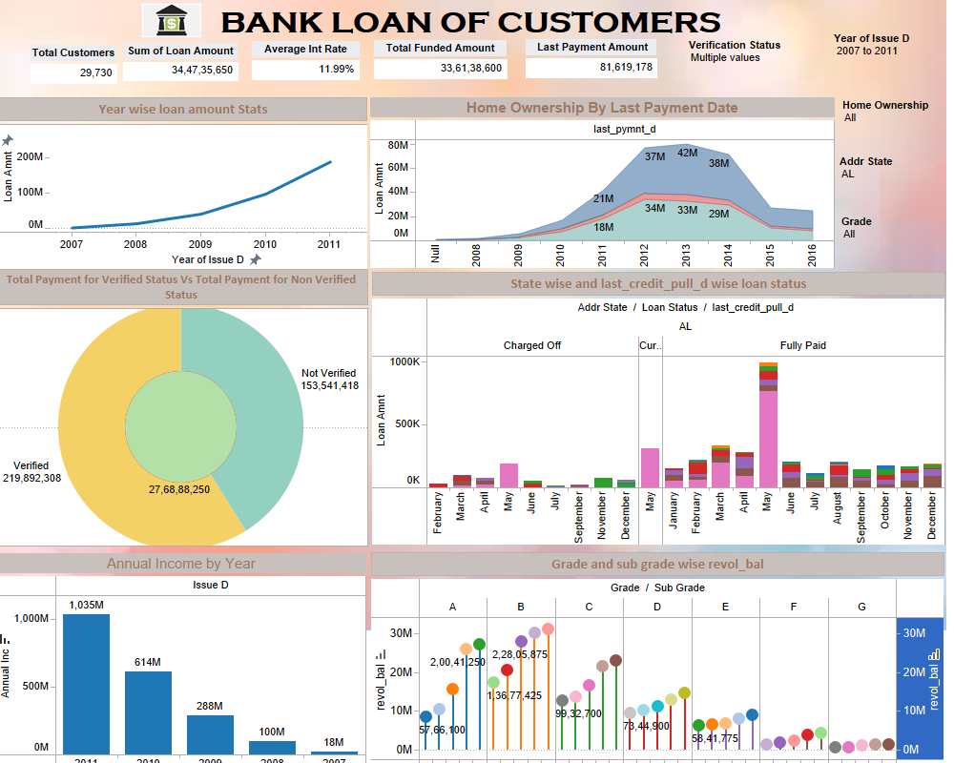
TABLEAU DASHBOARD

Slide 13
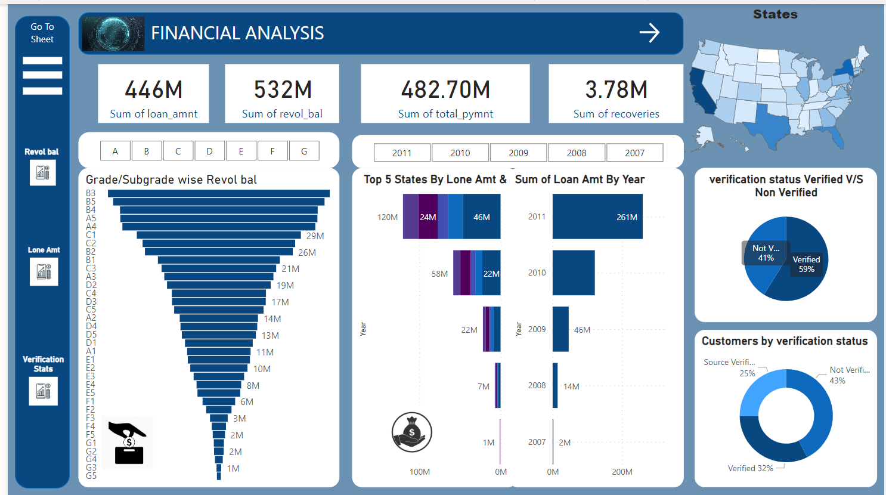
POWER BI DASHBOARD

Slide 14
Conclusion
On the basis of various techniques applied for the financial analysis of Bank loan we can arrive to the conclusion that the financial position and overall performance of bank is satisfactory and loan amount and the customers of bank has increased over the period of time and bank has maintaining the profitability position
This analysis will provide valuable information to a wide range of stakeholders, from banks and borrowers to investors, regulators, credit rating agencies, economists, and consumers.

Slide 15

DIVYA RATHORE
rathore.divyacool@gmail.com
SUPRIYA UMAKANT MAURYA
rangolimaurya56@gmail.com
AJAY GOHEL
ajaygohel587@gmail.com
YAMUNA KUNTA
yamunaraj.allepu@gmail.com
CHEERLA NAGAMALLIKA
mallikacnv@gmail.com
ANURADHA AVINASH ISALKAR
isalkaranuradha@gmail.com
AISHWARYA SANJAY SUKUNDE
aishwaryasukunde14@gmail.com
Thank you

