Slide 1
Answer Evaluation
Anvesh Mandadi - 34
Hiresh Jakkala Bhaskar - 17
Bharath Kumar Elaine - 12
Jaya Prakash Ravella - 42

Slide 2
PROJECT PURPOSE
To develop a web application that can evaluate user’s short answer using NLP
To check grammar and spelling errors while evaluating answers
To use BigHugeLabs’s Dictionary API to match the synonyms of the keywords with user’s answer
To use Google Cloud NLP API which will parse the answer and provide POS tag and dependency graph

Slide 3
TECHNOLOGIES USED
WebStorm for developing web application
Google Cloud NLP API for parsing the answer and to get dependency graph
Text Gears Grammar checker API to the grammar and spelling errors in the answer
BigHugeLab Dictionary API to get the synonyms for the keywords
MongoDB for storing user details for login and for storing question and answer keywords for each question
Facebook OAuth API for social login

Slide 4
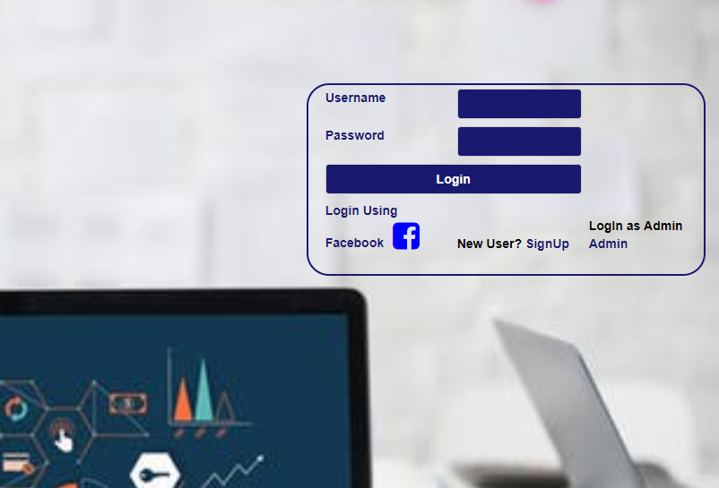
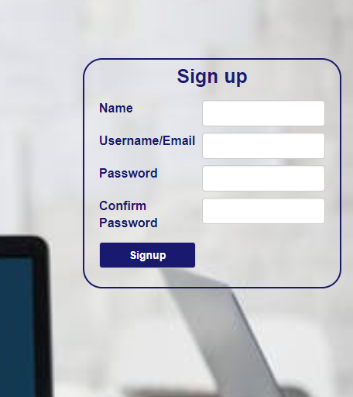
LOGIN AND REGISTER
New Users can register by giving the details in SignUp Form.
Once the User is Registered details will save in Mongo Database.
Registered User can able to login by using registered emailId.
User can login using Facebook login.

Slide 5
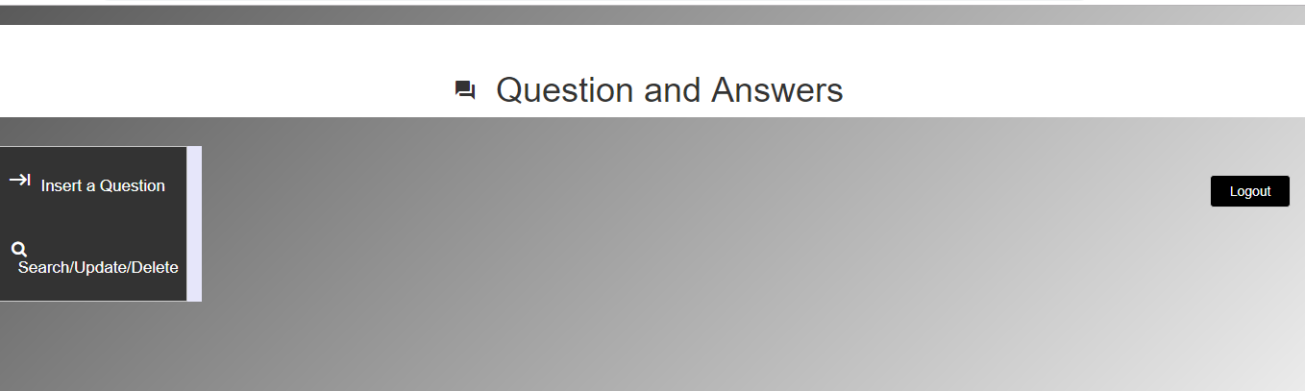
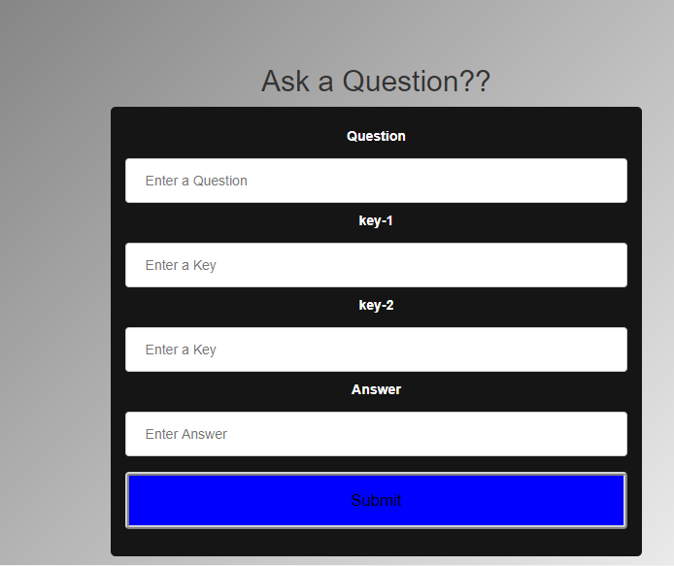
ADMIN PAGE
Once the Admin logged in with his Credentials admin can add,Update and delete Questions.
INSERTION:
To Insert the Question just click the Insert Question Tab on Admin Page
While Inserting the new Question we need to give Question,Answer and Two Keys for Evaluation
After completing the details give Submit then question details will save in Mongo Database

Slide 6
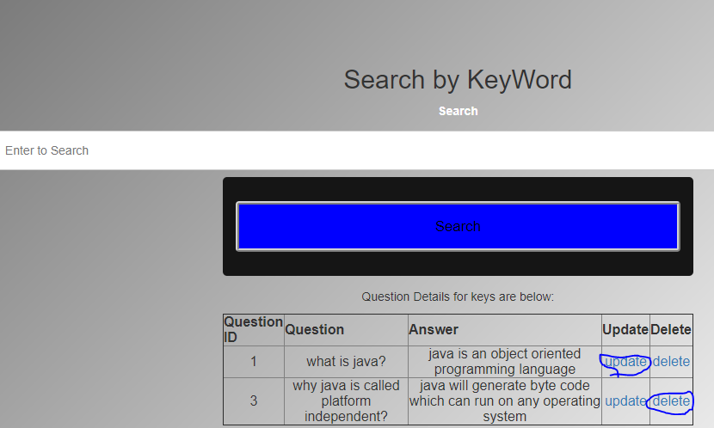
UPDATE:
Admin can Update the question with answer and the two keys for Evaluating
DELETE:
Admin can delete the question.

Slide 7
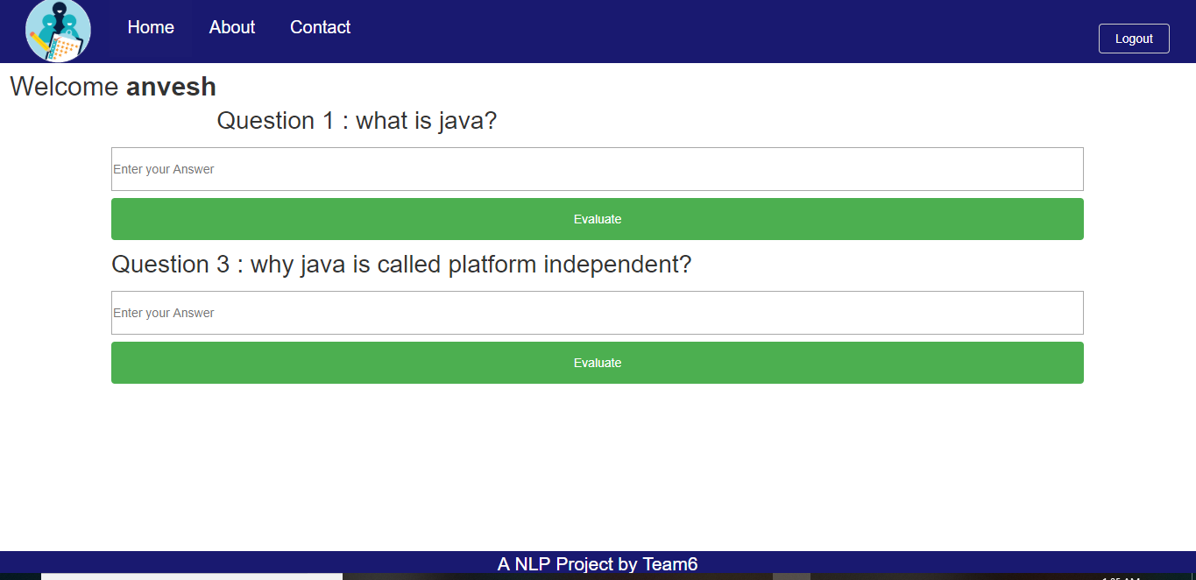
HOME PAGE
Once the user Logged in with his Credentials. Questions will be displayed on Home Page
Questions will add by admin in Admin Page
User can provide Answer to the question and press the Evaluate button then answer details will store in Mongo Database
And evaluation result will be shown in popup

Slide 8
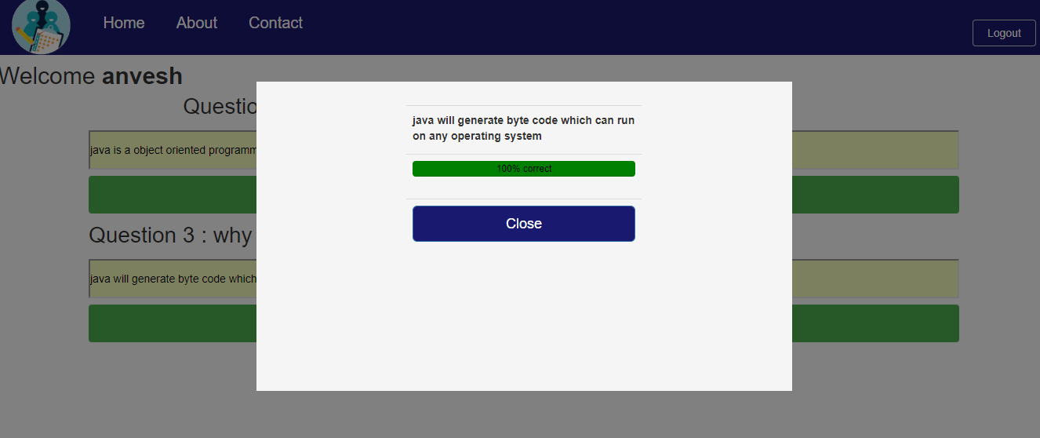
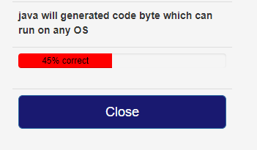
For example, consider
Keywords for the answer as “byte code” and “run on any operating system”
The system evaluated the answer and both the keywords are found so marks are given accordingly.
Using the dependency graph generated by NLP API we can checked correctness of the word’s relationship (like compound nouns)
Eg: byte code, black board
System should not evaluate “code byte” as correct

Slide 9
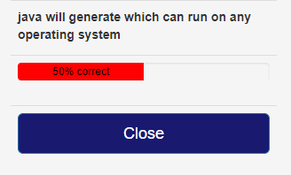
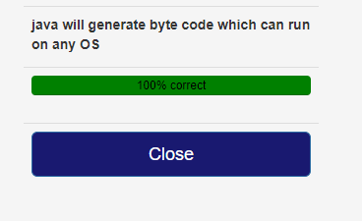
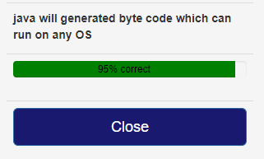
In the right side image, keyword byte code is missing in the answer and system deduced the marks accordingly
System will also handle abbreviations,
In the answer “Operating System ” is given as OS and system matched it and provided marks accordingly.
System will also check grammar and spelling errors in the user’s answer using TextGear’s grammar checker API

Slide 10
future Work
Implement more dependency check using Google NLP’s dependency graph to increase the accuracy of the system
Suggesting answers and grammar corrections to the user after evaluating the answer
Refer some online knowledge source like Wikipedia to get the updated latest answers(to avoid manually updating the keywords)
By maintaining the history of answers, we can notify the user about his knowledge on the subject over a period with visual representation
Demo Video is Available in below Url :
https://www.youtube.com/watch?v=H2Oc5GMNPa4&t=345s

Slide 11


