Slide 1
TECH MONSTERS - TEAM MEMBERS
Nagaparameswaran Jayaram
Raja Kolanghinathan
Rajesh Kannah Arunachalam
Ezhilan Manoharan
Nagarjuna Amara
ROLES PLAYED
UI:
Nagaparameswaran Jayaram
Rajesh Kannah Arunachalam
API:
Raja Kolanghinathan
Ezhilan Manoharan
DB:
Raja Kolanghinathan
Ezhilan Manoharan
QA:
Nagarjuna Amara

Slide 2

ARCHITECTURE DIAGRAM
UI
API Gateway
Service Layer
Repository Layer

Slide 3

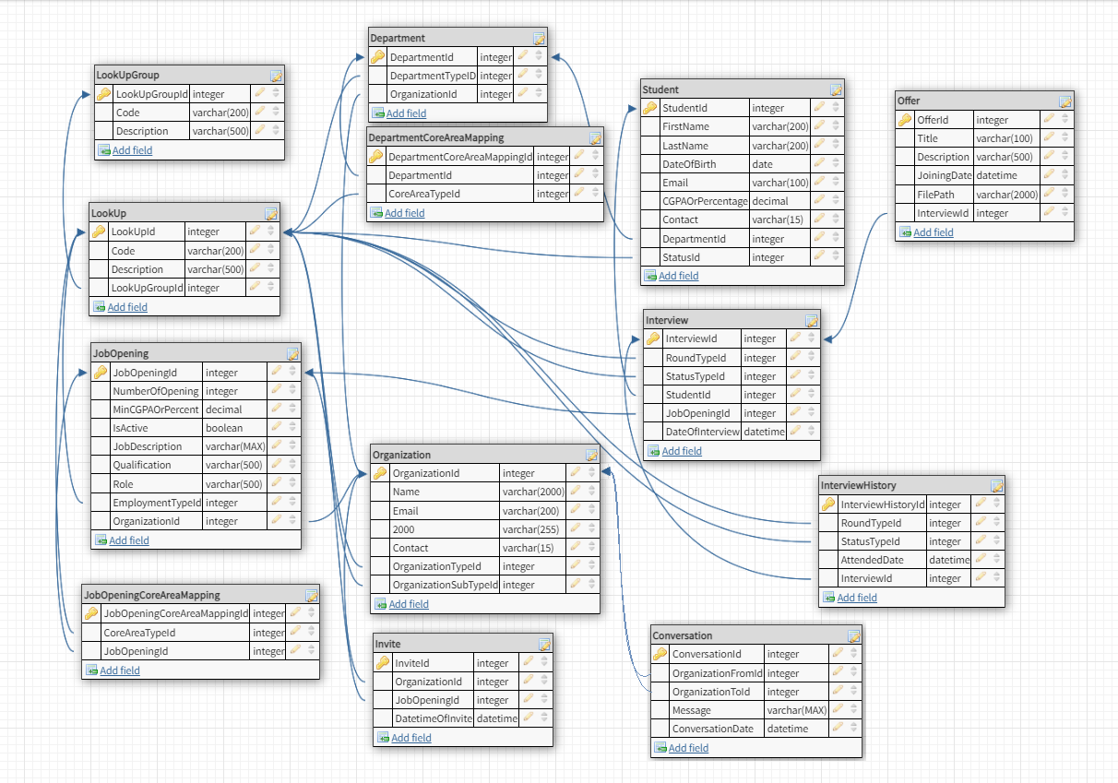
DB DESIGN

Slide 4
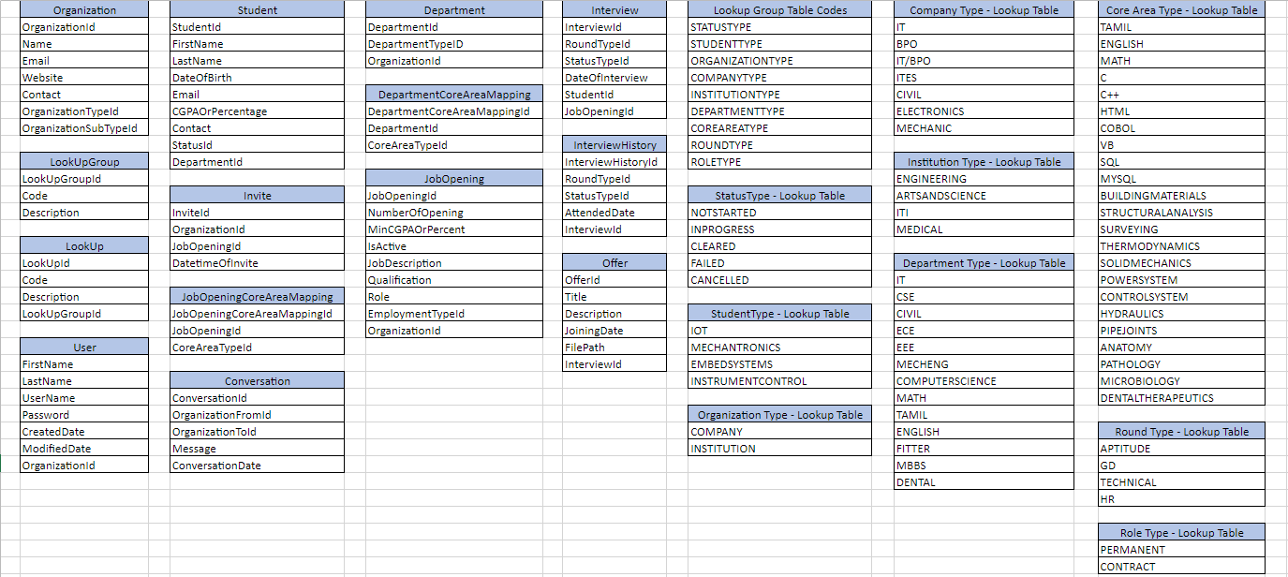
DB Tables & Lookup Values

