Slide 1
Cab Investment Case Study Analysis (2016–2018)
Data Glacier Internship – Week 3 Presentation
Presented by – Naga Pavithra Jajala

Slide 2
Objective & Use Case
Client (XYZ) wants to invest in either Pink or Yellow Cab.
Objective: Use data to analyze and recommend the better investment.
Time frame: Data spans from 2016 to 2018.
Goal: Compare profitability, customer metrics, and business trends.

Slide 3
Dataset Description
4 merged datasets: Cab data, City info, Customer data, and Transactions.
Final merged dataset: 30,000+ records with fields like Price, Cost, Profit, etc.
Cleaned for nulls, duplicates, and inconsistent formats.
Performed joins using Customer ID and Transaction ID.

Slide 4
Tools Used
Python & Jupyter Notebook
Libraries:
pandas, matplotlib, seaborn for analysis and visualization
numpy, datetime for data handling
Version Control: Git & GitHub

Slide 5
Exploratory Data Analysis
Checked for missing data with .info() and .isnull().
Converted date columns using pd.to_datetime().
Used .describe() to get summary stats on revenue, cost, and profit.

Slide 6
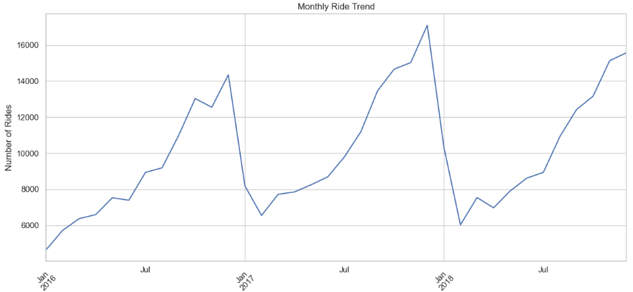
Visualizations
Monthly Ride Trends (2016–2018)
Ride volumes steadily increased from 2016 to 2018.
Seasonal peaks suggest higher usage in holidays and summers.
Shows overall business growth.

Slide 7
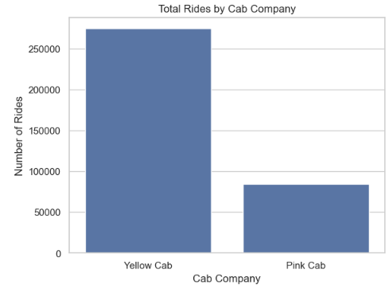
Visualizations
Fare Distribution
Yellow Cab had over 2.5x more rides than Pink Cab.
Indicates stronger market capture and demand.

Slide 8
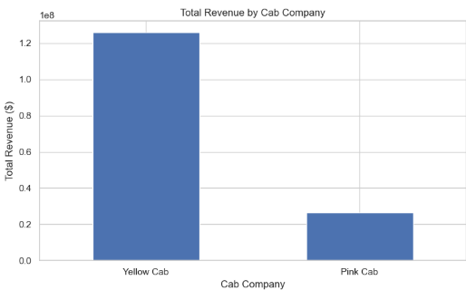
Visualizations
Total Revenue by Cab Company
Yellow Cab generated over $120M in revenue.
Clear evidence of higher service reach and financial strength.

Slide 9
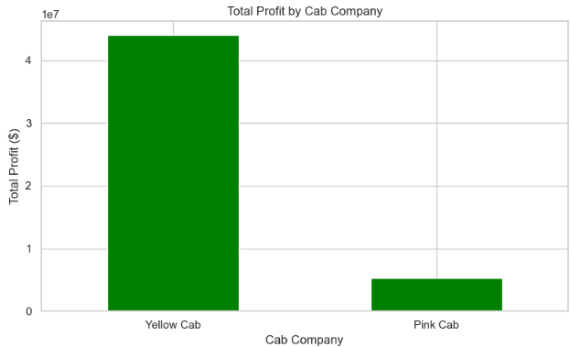
Visualizations
Total Profit by Cab Company
Yellow Cab profit crossed $40M, while Pink stayed under $10M.
Profitability directly supports investment recommendation.

Slide 10
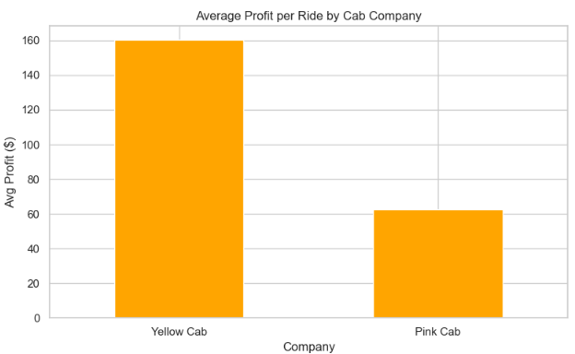
Visualizations
Average Profit per Ride
Yellow earns ~$160/ride, Pink earns ~$60/ride.
Yellow is more operationally efficient on a per-ride basis.

Slide 11
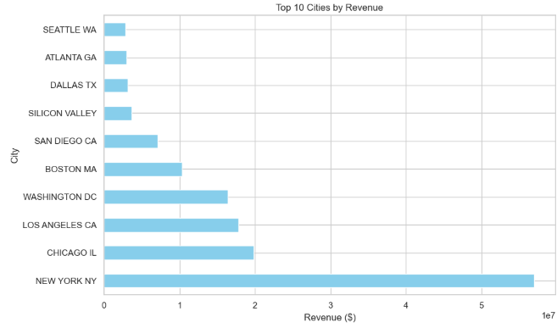
Visualizations
Top 10 Cities by Revenue
New York, Chicago, LA are top-performing cities.
Top 3 cities account for more than 60% of the total revenue.
Indicates city-wise market potential.

Slide 12
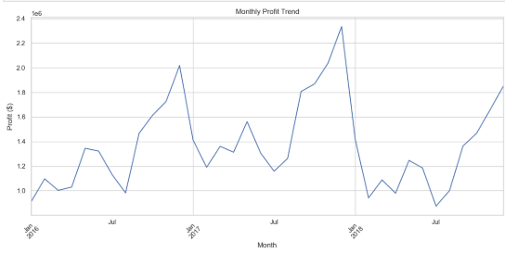
Visualizations
Monthly Profit Trend
Sharp increases seen during Q4s – likely holidays & travel demand.
Business profits remained positive & consistent across years.

Slide 13
Key Insights from Analysis
Yellow Cab leads in performance:
It provided ~270,000 rides, more than 2.5x Pink Cab, showing strong customer acquisition and demand.
Profit & revenue dominance:
Yellow Cab generated over $120M in revenue and $40M in profit, making it a financially stronger business.
Operational efficiency:
Yellow's average profit per ride is ~$160, nearly 3x higher than Pink Cab’s, indicating better cost control.
Three most important cities:
New York, Chicago, and LA collectively accounted for a significant portion of revenue, underscoring concentrated market influence.
Steady expansion:
Ride and profit patterns indicate annual business expansion with seasonal increases, reflecting customer loyalty and the maturity of the market.

Slide 14
Recommendation
Invest in Yellow Cab.
Based on ride volume, profitability, and market spread, Yellow is the stronger investment.
Reasons:
Higher customer base.
Better retention.
Higher average profit per trip.
Dominant in key metro cities.

Slide 15
Challenges & Solutions During Analysis
Dataset Merging Complexity
Challenge: Multiple datasets (Cab, Customer, Transaction, City) needed to be merged accurately using Customer ID and Transaction ID.
Solution: Used pandas.merge() with correct keys and validated merges using .info() and .shape to ensure integrity.
2. Missing & Duplicate Values
Challenge: Null entries in columns like Cost and Profit, along with a few duplicate records.
Solution: Applied .dropna() to remove incomplete rows and .drop_duplicates() to ensure no duplicate records skewed results.

Slide 16
Challenges & Solutions During Analysis(Cont.)
3. Data Type & Formatting Issues
Challenge: Date fields were in string format and couldn’t be grouped for time-series analysis.
Solution: Converted them using pd.to_datetime() to enable monthly ride and profit trend analysis.
4. Visual Scaling for Clarity
Challenge: Charts for Revenue and Profit had large numerical differences, making them hard to compare.
Solution: Used clean axes formatting and appropriate labels to make charts readable and visually aligned.

Slide 17
Thank You
Cab Investment Analysis (2016–2018) Presented by: Naga Pavithra Jajala Data Glacier Virtual Internship
Access full notebook:

