Slide 1
Programming language

Slide 2
Programming Language
To communicate with a person, we need a specific language, similarly to communicate with computers, programmers also need a language is called Programming language.
It is a set of instructions written in any specific language ( C, C++, Java, Python) to perform a specific task.

Slide 3
Types of programming language
Low-level programming language
High-level programming language
Middle-level programming language

Slide 4
Low-level programming language
Low-level language is machine-dependent (0s and 1s) programming language.
he processor runs low- level programs directly without the need of a compiler or interpreter, so the programs written in low-level language can be run very fast.

Slide 5
2. High-level programming language
High-level programming language (HLL) is designed for developing user-friendly software programs
This programming language requires a compiler or interpreter to translate the program into machine language (execute the program).
The main advantage of a high-level language is that it is easy to read, write, and maintain.
High-level programming language includes Python, Java, JavaScript, PHP, C#, C++, Objective C, Cobol, Perl, Pascal, LISP, FORTRAN, and Swift programming language.

Slide 6
A high-level language is further divided into three parts
Procedural Oriented programming language
Object-Oriented Programming language
Natural language

Slide 7
Procedural Oriented programming language
Procedural Oriented Programming (POP) language is derived from structured programming and based upon the procedure call concept.
The advantage of POP language is that it helps programmers to easily track the program flow
Example: C, FORTRAN, Basic, Pascal, etc.

Slide 8
Object-Oriented Programming language
Its based upon the objects. In this programming language, programs are divided into small parts called objects.
It is used to implement real-world entities like inheritance, polymorphism, abstraction, etc.
The main advantage of object-oriented programming is that OOP is faster and easier to execute, maintain, modify, as well as debug.
Example: C++, Java, Python, C#, etc.

Slide 9
Natural language
Natural language is a part of human languages such as English, Russian, German, and Japanese.
It is used by machines to understand, manipulate, and interpret human's language.
It is used by developers to perform tasks such as translation, automatic summarization

Slide 10
Python

Slide 11
What is Python?
Python is a widely used general-purpose, high level programming language. It was created by Guido van Rossum in 1991 and further developed by the Python Software Foundation.

Slide 12
What can Python do?
Python can be used on a server to create web applications.
Python can be used alongside software to create workflows.
Python can connect to database systems. It can also read and modify files.
Python can be used to handle big data and perform complex mathematics.
Python can be used for rapid prototyping, or for production-ready software development.

Slide 13
Why Python?
Python works on different platforms (Windows, Mac, Linux, Raspberry Pi, etc).
Python has a simple syntax similar to the English language.
Python has syntax that allows developers to write programs with fewer lines than some other programming languages.
Python runs on an interpreter system, meaning that code can be executed as soon as it is written. This means that prototyping can be very quick.
Python can be treated in a procedural way, an object-oriented way or a functional way.

Slide 14
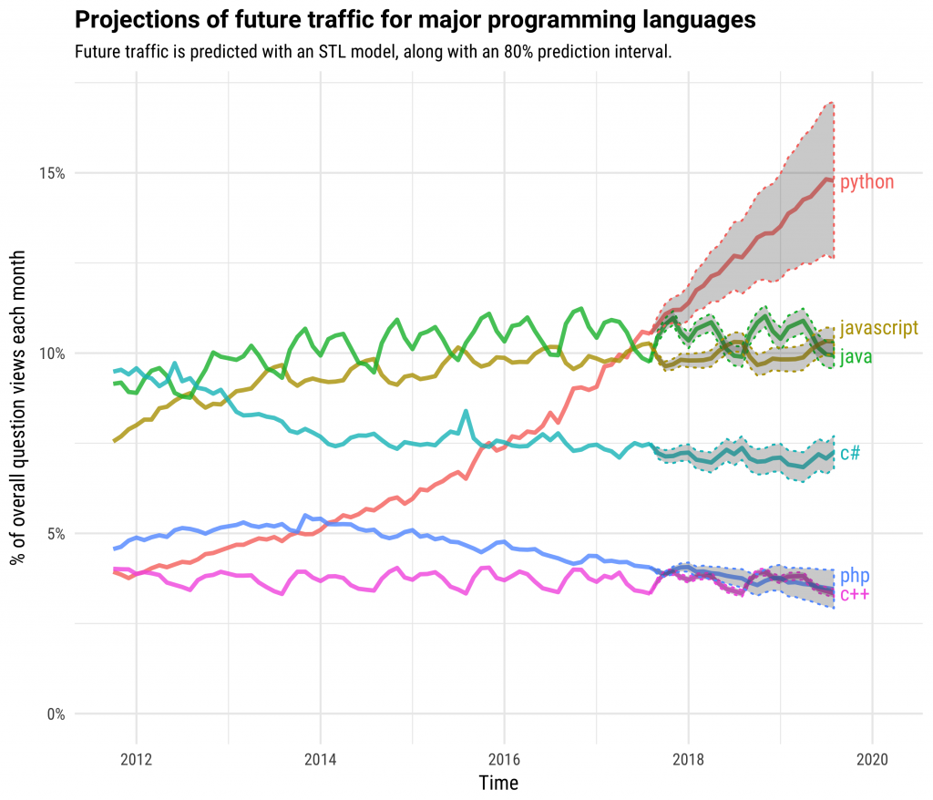
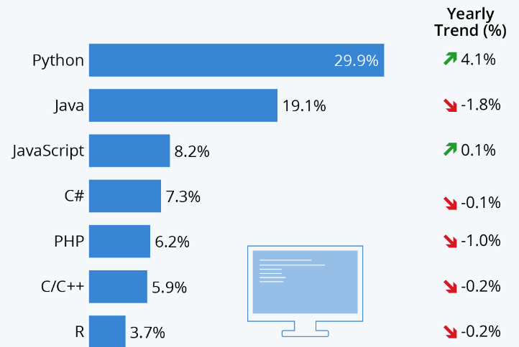

Slide 15
Good to know
The most recent major version of Python is Python 3, which we shall be using. However, Python 2, although not being updated with anything other than security updates
It is possible to write Python in an Integrated Development Environment, such as Thonny, Pycharm, Netbeans or Eclipse which are particularly useful when managing larger collections of Python files.

Slide 16
Data Types.
Boolean (eg: True, False)
Integer (eg: -4, 4, 0) both +VE & -VE.
Floating point (eg: 1.9) Decimals both +VE & -VE.
String (eg: “Hello World!!”) all alphanum char and special char

Slide 17
Data Structures in python
List
Tuple
Dictionary
Sets

Slide 18
Primitive Data Structures
Integers
Float
Strings
Boolean
Non-Primitive Data Structures
Arrays
Lists
Tuples
Dictionary
Sets
Files

Slide 19
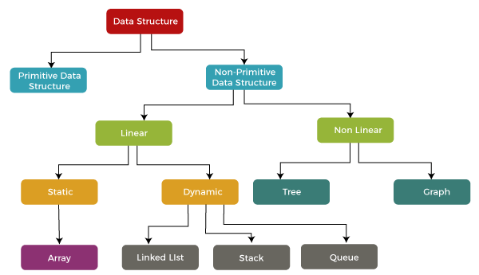

Slide 20
Primitive
Primitive data structure is a kind of data structure that stores the data of only one type.
Examples of primitive data structure are integer, character, float.
size depends on the type of the data structure.
Non-Primitive
Non-primitive data structure is a type of data structure that can store the data of more than one type.
Examples of non-primitive data structure are Array, Linked list, stack.
In case of non-primitive data structure, size is not fixed.

Slide 21
List
A list can be defined as a collection of values or items of different types.
Example: [ 12, ‘Hello’, 2.34, True]
What is nested list?
A list within another list is referred to as a nested list
Example: [ 12, [ 1, 2, 4 ], ‘Hello’, [2.34], True]

Slide 22
List Indexing
Positive indexing:
List1 = [ 1 , 2 , 4 , 6 , 45 ]
0 1 2 3 4
Negative indexing:
List1 = [ 1 , 2 , 4 , 6 , 45 ]
-5 -4 -3 -2 -1

Slide 23
List Slicing
Syntax: list_name[ start_index : end_index + 1]
Example:
List1 = [ 2 , 5 , 6 , 89 , 1 ]
print( List1[ 0 : 3 ])
print( List1[ -5: -2])
Output:
[ 2 , 5 , 6 ]
[ 2 , 5 , 6 ]

Slide 24
Functions
A function is a block of code that performs a specific task, which only runs when it is called.
You can pass data, known as parameters, into a function.
A function can return data as a result.

Slide 25
Function Syntax
def Function_Name (para1, para2… ):
Body
return
Function_Name(para1, para2… ) # call function
Function with Default parameter
def Function_Name (para1 = Default_Val, para2… ):
Body

Slide 26
Recursion A function call itself is called recursion.
def func(): <--
|
| (recursive call)
|
func() ----

Slide 27
Types of Operators in Python
Arithmetic Operators
Comparison Operators
Logical Operators
Bitwise Operators
Assignment Operators
Identity Operators and Membership Operators

Slide 28
Arithmetic Operators
Arithmetic Operators are used to perform basic mathematical operations like addition, subtraction, multiplication, and division.
+ Addition: adds two operands x + y
– Subtraction: subtracts two operands x – y
* Multiplication: multiplies two operands x * y
/ Division (float): divides the first operand by the second x / y
// Division (floor): divides the first operand by the second x // y
% Modulus: returns the remainder when the first operand is divided by the second x % y
** Power: Returns first raised to power second x ** y

Slide 29
Comparison Operators
Comparison of relational opertors compares the values. It either returns True or False according to the condition.
> Greater than: True if the left operand is greater than the right x > y
< Less than: True if the left operand is less than the right x < y
== Equal to: True if both operands are equal x == y
!= Not equal to – True if operands are not equal x != y
>= Greater than or equal to True if the left operand is greater than or equal to the right x >= y
<= Less than or equal to True if the left operand is less than or equal to the right x <= y

Slide 30
Logical Operators
Logical operators perform Logical AND, Logical OR, and Logical NOT operations. It is used to combine conditional statements.
and Logical AND: True if both the operands are true x and y
or Logical OR: True if either of the operands is true x or y
not Logical NOT: True if the operand is false not x

Slide 31
Bitwise Operators
Bitwise operators act on bits and perform bit-by-bit operations. These are used to operate on binary numbers.
& Bitwise AND x & y
| Bitwise OR x | y
~ Bitwise NOT ~x
^ Bitwise XOR x ^ y
>> Bitwise right shift x>>
<< Bitwise left shift x<<

Slide 32
Assignment Operators
Assignment operators are used to assign values to the variables.
= Assign the value of the right side of the expression to the left side operand x = y + z
+= Add AND: Add right-side operand with left-side operand and then assign to left operand a+=b a=a+b
-= Subtract AND: Subtract right operand from left operand and then assign to left operand a-=b a=a-b
*= Multiply AND: Multiply right operand with left operand and then assign to left operand a*=b a=a*b
/= Divide AND: Divide left operand with right operand and then assign to left operand a/=b a=a/b
%= Modulus AND: Takes modulus using left and right operands and assign the result to left operand a%=b a=a%b
//= Divide(floor) AND: Divide left operand with right operand and then assign the value(floor) to left operand a//=b a=a//b
**= Exponent AND: Calculate exponent(raise power) value using operands and assign value to left operand a**=b a=a**b
&= Performs Bitwise AND on operands and assign value to left operand a&=b a=a&b
|= Performs Bitwise OR on operands and assign value to left operand a|=b a=a|b
^= Performs Bitwise xOR on operands and assign value to left operand a^=b a=a^b
>>= Performs Bitwise right shift on operands and assign value to left operand a>>=b a=a>>b
<<= Performs Bitwise left shift on operands and assign value to left operand a <<= b a= a << b

Slide 33
Identity Operators
In Python, is and is not are the identity operators both are used to check if two values are located on the same part of the memory.
is True if the operands are identical
is not True if the operands are not identical

Slide 34
Membership Operators
In Python, in and not in are the membership operators that are used to test whether a value or variable is in a sequence.
in True if value is found in the sequence
not in True if value is not found in the sequence

Slide 35
Conditional Statements
if statement
if …. else statement
if …. elif …. else statement
Syntax for if statement
if condition:
body

Slide 36
If….else statement syntax:
if condition:
Body of if
else:
Body of else
If….elif statement syntax:
if condition:
Body of if
elif condition:
Body of elif
elif condition:
Body of elif
else:
Body of else

Slide 37
Loops
There are two types of loops in Python:
for loop
while loop

Slide 38
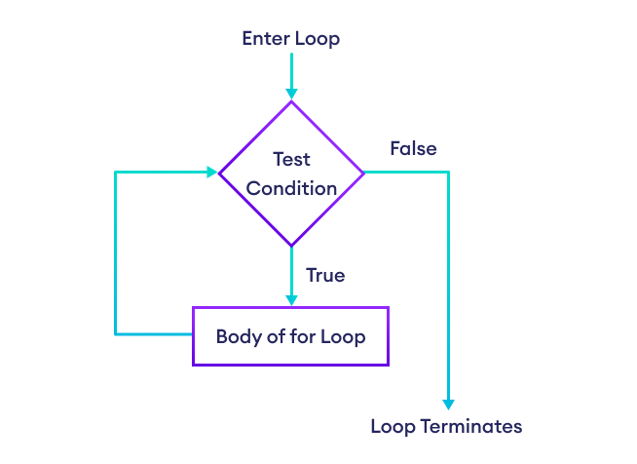
Loop flow chart

Slide 39
For loop loops through a block of code a number of times
for iterator_var in range (start, end+1, increment):
body
startIndex default = 0
Increment default = 1

Slide 40
For loop
Iterate list elements in for loop
For val in list_name:
print(val) # val variable will iterate through each elements

Slide 41
for loop with else
The else block will be executed immediately after for block finishes execution. If you break out of the loop, or if an exception is raised, it won’t be executed.
If you break out of the loop, or if an exception is raised, it won’t be executed.
for iterator_var in range (startIndex, endIndex+1, increment):
body
else:
body

Slide 42
While loop A while loop is used to execute a block of statements repeatedly until a given condition is satisfied. And when the condition becomes false, it will terminate the loop.
while condition:
body
Example:
count = 0
while (count < 4):
count = count + 1
print(“Logic360”)
Output:
Logic360
Logic360
Logic360
Logic360

Slide 43
While loop with else
The else clause is only executed when your while condition becomes false. If you break out of the loop, or if an exception is raised, it won’t be executed.
while condition:
body
else:
body

Slide 44
do while in python
Python doesn’t have do while, instead similar logic can be achieved.
while True:
if condition: # use if statement and break to control the loop flow
break

Slide 45
Do while example
secret_word = "python"
counter = 0
while True:
word = input("Enter the secret word: ").lower()
counter = counter + 1
if word == secret_word:
break
if word != secret_word and counter > 7:
break

Slide 46
Nested for loop syntax
for iterator_var1 in range (startIndex, endIndex+1, increment):
body
for iterator_var1 in range (startIndex, endIndex+1, increment):
body

Slide 47
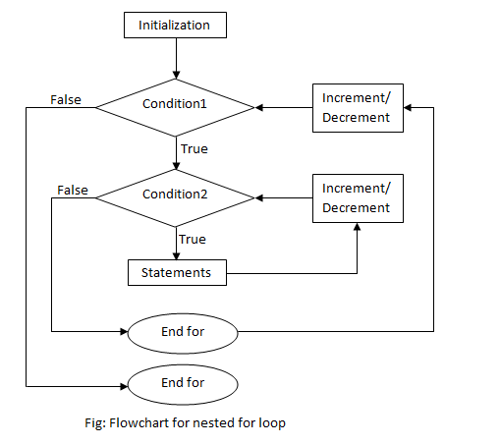
Nested loop flow chart

Slide 48
Nested for loop example
for i in range(3):
for j in range(3):
print(i,j)
Output:
0 0
0 1
0 2
1 0
1 1
1 2
2 0
2 1
2 2

Slide 49
Control statements
Break statement
Continue statement
Pass statement

Slide 50
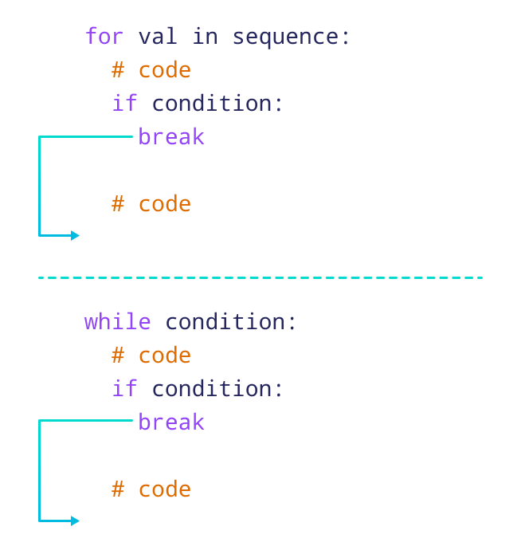
Break The break statement is used to terminate the loop or statement in which it is present.

Slide 51
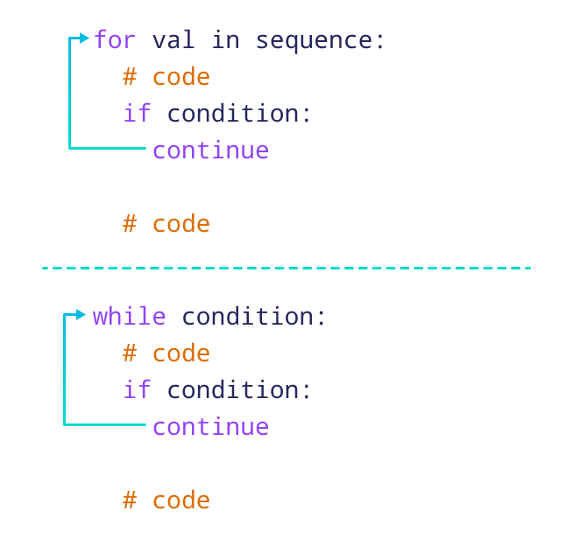
Continue continue statement is opposite to that of break statement, instead of terminating the loop, it forces to execute the next iteration of the loop.

Slide 52
Pass As the name suggests pass statement simply does nothing.
The pass statement in Python is used when a statement is required syntactically but you do not want any command or code to execute.
If condition:
pass
while condition:
pass

Slide 53
Lambda function
A lambda function is a small anonymous function. A lambda function can take any number of arguments, but can only have one expression.
Syntax:
Lambda arguments : expression
x = lambda a : a + 10 print(x(5))
Output:
15

Slide 54
Exception handling
Try except block is used to handle error with code
SyntaxError, cannot be handling
The try block lets you test a block of code for errors.
The except block lets you handle the error.
The else block lets you execute code when there is no error.
The finally block lets you execute code, regardless of the result of the try- and except blocks.

Slide 55
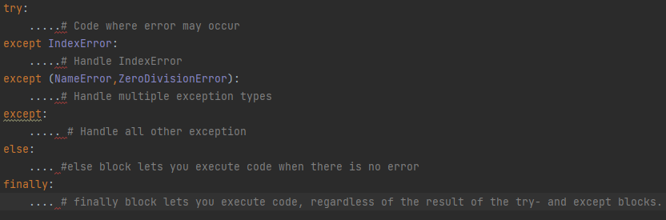
Try exception syntax

Slide 56
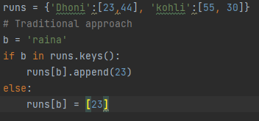
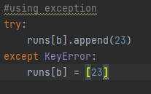

Slide 57
Sets
A set is an unordered collection with no duplicate elements
Basic uses include membership testing and eliminating duplicate entries.
Set objects also support mathematical operations like union, intersection, difference, and symmetric difference.

Slide 58
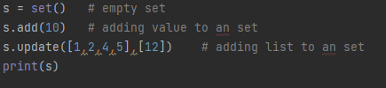
Sets syntax
Output:
{1, 2, 4, 5, 10, 12}

Slide 59
Set methods
S.remove(Value) # value will be removed but if it doesn’t exist it will raise an error
S.discard(Value) # value will be removed but if it doesn’t exist it won’t raise an error
S.add(Value) # to add an value to an set
S.update(iterable) # add multiple elements

Slide 60
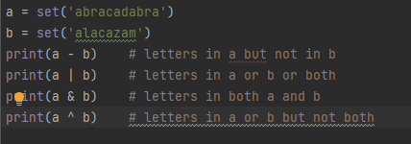
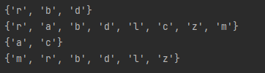
Sets mathematical operations
union, intersection, difference, and symmetric difference.

Slide 61
Map function
map() function returns a map object(which is an iterator) of the results after applying the given function to each item of a given iterable (list, tuple etc.)
Syntax:
map(fun, iter)
fun : It is a function to which map passes each element of given iterable.
iter : It is a iterable which is to be mapped.

Slide 62
def addition(n):
return n + n
# We double all numbers using map()
numbers = (1, 2, 3, 4)
result = map(addition, numbers)
print(list(result))
Output:
[2, 4, 6, 8]
# Add two lists using map and lambda
numbers1 = [1, 2, 3]
numbers2 = [4, 5, 6]
result = map(lambda x, y: x + y, numbers1, numbers2)
print(list(result))
Output:
[5, 7, 9]

Slide 63
Docstrings
Python documentation strings (or docstrings) provide a convenient way of associating documentation with Python modules, functions, classes, and methods.
The docstrings are declared using ”’triple single quotes”’ or “””triple double quotes””” just below the class, method or function declaration.

Slide 64
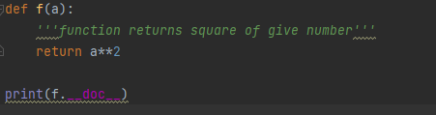
Docstrings Example
Output:
function returns square of give number

Slide 65
Iterators
An iterator is an object that contains a countable number of values.
iter() method which is used to get an iterator
next() method is used to move to next element

Slide 66
*args and **kwargs in Python
We can pass a variable number of arguments to a function using special symbols.
*args (Non-Keyword Arguments)
**kwargs (Keyword Arguments)
*args in function definitions in Python is used to pass a variable number of arguments to a function.
**kwargs in function definitions in Python is used to pass a keyworded, variable-length argument list.

Slide 67
def myFun(arg1, *argv):
print("First argument :", arg1)
for arg in argv:
print("Next argument through *argv :", arg)
myFun('Hello', 'Welcome', 'to', 'GeeksforGeeks')
def myFun(**kwargs):
for key, value in kwargs.items():
print(key, value)
# Driver code
myFun(first='Geeks', mid='for', last='Geeks')

Slide 68
Classes and Objects
Python is an object oriented programming language, almost everything in Python is an object, with its properties and methods.
A Class is like an object constructor, or a "blueprint" for creating objects.
An Object is an instance of a Class. A class is like a blueprint while an instance is a copy of the class with actual values.

Slide 69
An object consists
State: It is represented by the attributes of an object. It also reflects the properties of an object.
Behaviour: It is represented by the methods of an object. It also reflects the response of an object to other objects.

Slide 70
Class and Instance Attribute/Variables
An instance attribute is a Python variable belonging to one, and only one, object. This variable is only accessible in the scope of this object, and it’s defined inside the constructor function, __init__(self) of the class.
A class attribute is a Python variable that belongs to a class rather than a particular object. It’s shared between all the objects of this class and is defined outside the constructor function, __init__(self), of the class.
Example:
class ExampleClass(object):
class_attr = 0
def __init__(self, instance_attr):
self.instance_attr = instance_attr
instance_attr is an instance attribute defined inside the __init__
class_attr is a class attribute defined outside the __int__.

