Slide 1
Kubernetes
Container Orchestration
Notes:
1

Slide 2
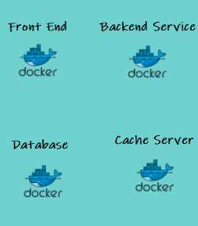
Container Orchestration
Notes:
Kubernetes is an orchestration tool which allow us to run manage container based workloads.
2

Slide 3
Challenges in Container infrastructure
Which container should run on which server ?
How do we deploy containers based on resource utilization of servers ?
How to monitor and manage all those server and schedule automate this process ?
Notes:
Kubernetes is an orchestration tool which allow us to run manage container based workloads.
3

Slide 4


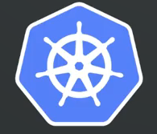
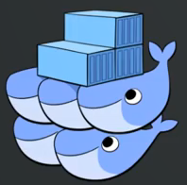
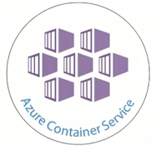
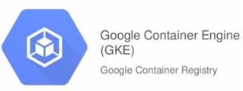
Container orchestration
Notes:
4

Slide 5
What is Kubernetes ?
Open source system for
Automating deployment
Scaling
Managing your containerized applications
Notes:
5

Slide 6
Why Kubernetes?
Orchestrate containers across multiple servers
Service discovery and Load balancing
Scale out and Scale in easily
Storage orchestration
Optimum hardware utilization
Notes:
6

Slide 7
Why Kubernetes?
Born from a Google internal project (Google BORG)
Based on an extensive experience from Google, over a long period of time
Large opensource community and support
Notes:
7

Slide 8
Installation
Hard way
Kubernetes Operations (kops)
Kubeadm
Kubicorn
Notes:
8

Slide 9







Kubernetes Architecture
Controller
kube-proxy
Notes:
Cloud repository to create, test and distribute docker images.
9

Slide 10
API Server
Client Authentication
Interface to external world
Validate the request
Update ETCD, scheduler and kubelet
Notes:
NAMESPACES is to limit what you see and identify system resources. Restrict what a process can or can’t see.
ls –l /proc/id/ns
10

Slide 11
ETCD Cluster
Stores configuration information
Highly available Key value store
Distributed among multiple nodes.
Accessible only by API server
Has sensitive information.
Notes:
NAMESPACES is to limit what you see and identify system resources. Restrict what a process can or can’t see.
ls –l /proc/id/ns
11

Slide 12
Controller Manager
Node Controller
Controller
Control loop that watches the shared state of the cluster
Replication Controller
Endpoint Controller
Regulates Kubernetes cluster
Service Account and Token Controller
Manages lifecycle functions
Notes:
Control loop that watches the shared state of the cluster
makes changes attempting to move the current state towards the desired state
Node Controller - Responsible for noticing and responding when nodes go down.
Replication Controller - Responsible for maintaining the correct number of pods for every replication controller object in the system.
Endpoint Controller -Populates the Endpoints object (that is, joins Services & Pods)
Service Accounts, Token controller Create default accounts and API access tokens for new namespaces.
- namespace creation and lifecycle,
- event garbage collection,
- terminated-pod garbage collection,
- cascading-deletion garbage collection,
- node garbage collection, etc.
12

Slide 13
KubeScheduler
Stores resources usage about each node
Schedules the tasks to worker nodes
Quality of Service
Affinity
Notes:
NAMESPACES is to limit what you see and identify system resources. Restrict what a process can or can’t see.
ls –l /proc/id/ns
13

Slide 14
Worker components
kube-proxy
PODS are running as per PodSpec provided by API server
Manages the Networking in the node
Notes:
“node agent” that runs on each node. Ensures pod spec it receive from API server are running and healthy
14

Slide 15


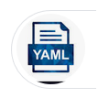







HOW IT WORKS ?
Notes:
15

Slide 16
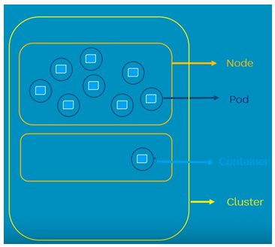
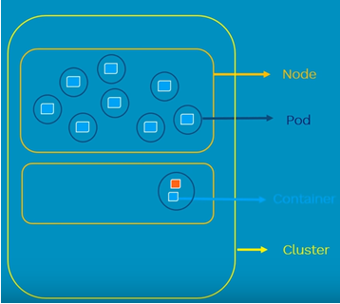
POD
Atomic unit of scheduling
Can have one or more container
Notes:
16

Slide 17
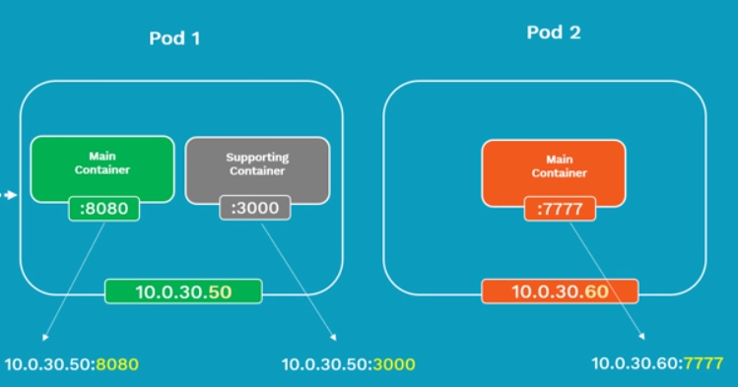
POD
Each POD will have a Pod IP address
Containers inside a POD share same network namespace and resources and can communicate using localhost
Notes:
17

Slide 18
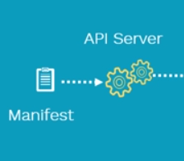
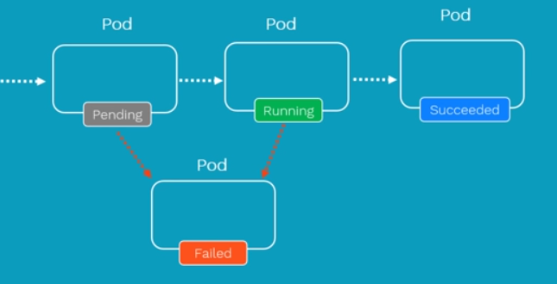


POD life cycle
Notes:
18

Slide 19
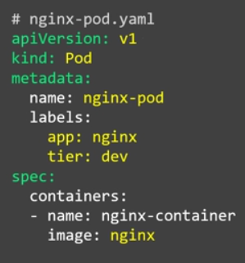
POD manifest file
kubectl create –f nginx-pod.yaml
kubectl get pods -o wide
Notes:
19

Slide 20
POD life cycle
Notes:
20

Slide 21
ReplicationController
Ensure that specified number of PODs are running at any point in time
If PODs fail, new ones are created to match the number
If more POD exists at any point in time, they are killed
ReplicationController and POD is associated using labels
Match is performed using equality based operator
Notes:
21

Slide 22
ReplicationController
Highly Availability
Load balancing
Notes:
22

Slide 23
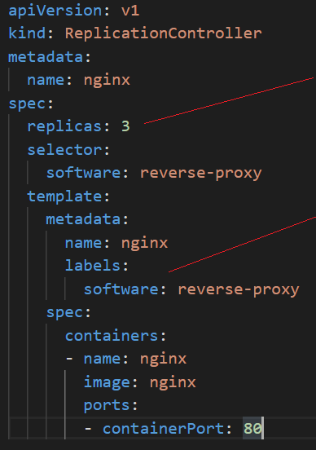
ReplicationController
kubectl create –f nginx-rc.yaml
kubectl get rc -o wide
kubectl get pods -o wide
Notes:
23

Slide 24
ReplicaSet
Ensure that specified number of PODs are running at any point in time
If PODs fail, new ones are created to match the number
If more POD exists at any point in time, they are killed
ReplicaSet and POD is associated using labels
Match is performed using set based operator
Notes:
24

Slide 25
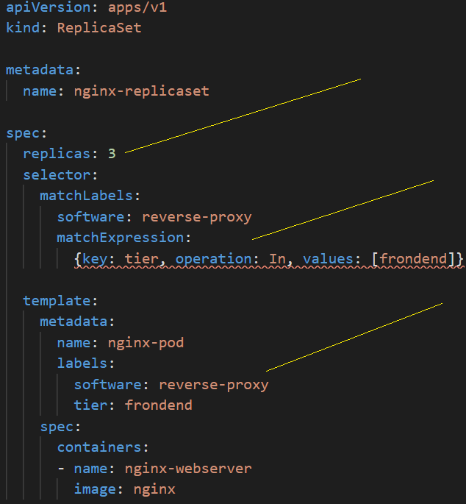
ReplicaSet
kubectl create –f nginx-rs.yaml
kubectl get rc -o wide
kubectl get pods -o wide
Notes:
25

Slide 26
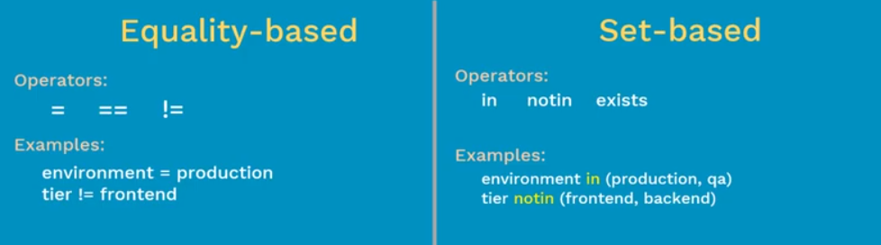
Replication Controller v/s and ReplicaSet
ReplicationController
ReplicaSet
Notes:
26

Slide 27
Deployment
Bring your application into desired state
Rollback deployment
Update pods
Pauses/Resume a deployment
Scale deployment
Notes:
27

Slide 28
Deployment Strategies
Define how to replace old pods by new ones
spec.strategy.type
Rolling update
Notes:
28

Slide 29
Deployment Strategies
Supported Strategy types
recreate: terminate the old version and release the new one
ramped: release a new version on a rolling update fashion, one after the other
blue/green: release a new version alongside the old version then switch traffic
canary: release a new version to a subset of users, then proceed to a full rollout
a/b testing: release a new version to a subset of users in a precise way
Notes:
29

Slide 30
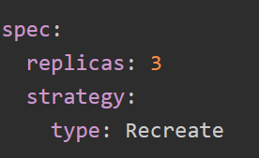
Deployment Strategies - Recreate
Terminate all the running instances then recreate them with the newer version
For Exp: - Development Environment
Notes:
30

Slide 31
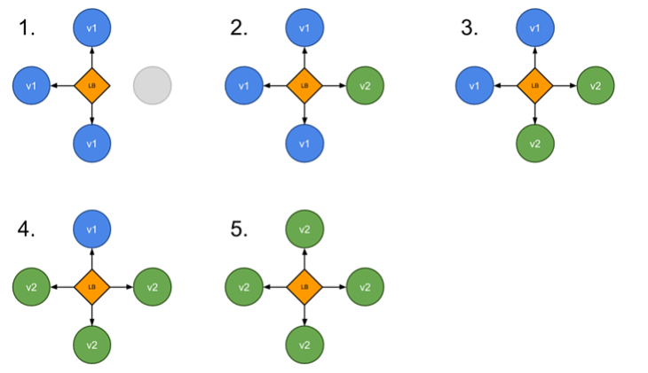
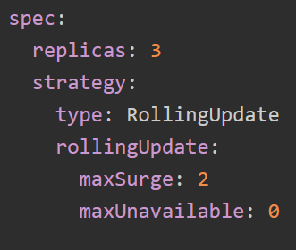
Deployment Strategies - Ramped
Slow Rollout
Notes:
31

Slide 32
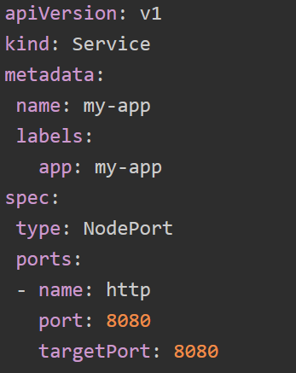
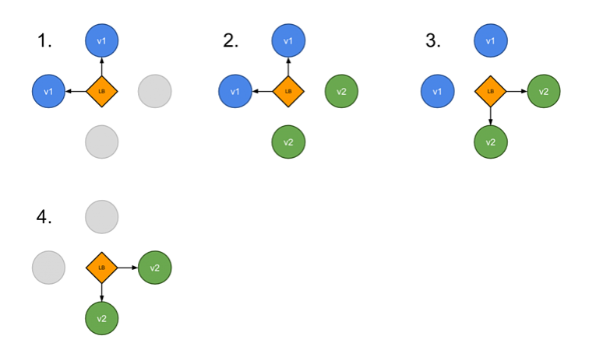
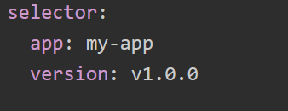
Deployment Strategies – Blue Green
Notes:
32

Slide 33
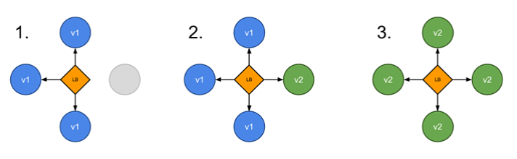

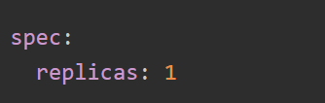
Deployment Strategies – Canary
Notes:
33

Slide 34
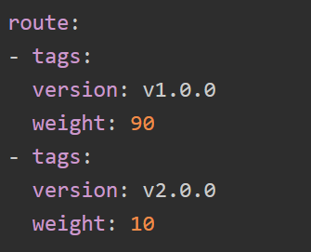
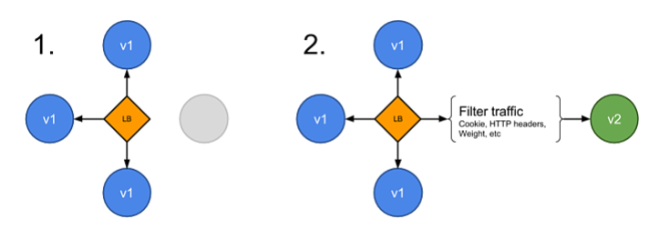
Deployment Strategies – A/B Testing
Notes:
34

Slide 35
Services
Collection of Pods that are exposed as an endpoint
Way of grouping of PODs running in a cluster and how to access them
Allow other applications and users to connect to services inside the cluster
Notes:
35

Slide 36
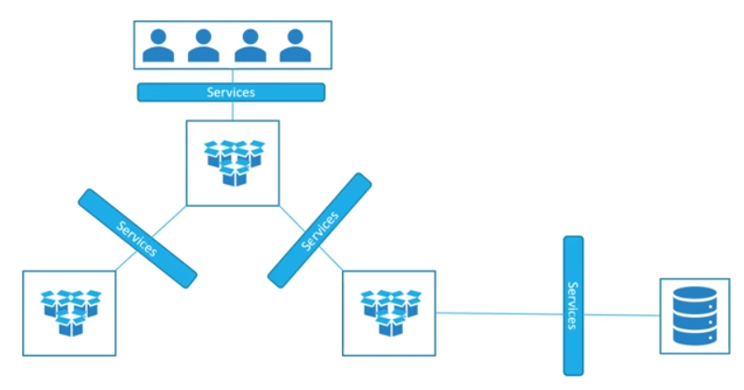
Services
Notes:
36

Slide 37
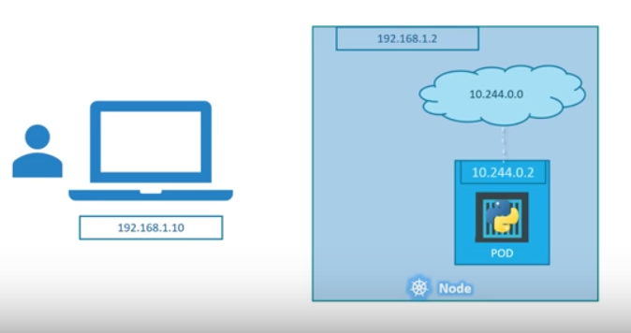



Services
Notes:
37

Slide 38
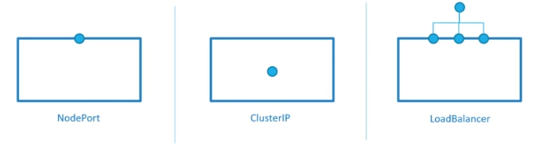
Types of Services
NodePort exposes the Service on each node's IP at a static port.
ClusterIP exposes the cluster's internal IP.
LoadBalancer exposes the Service externally
Notes:
38

Slide 39
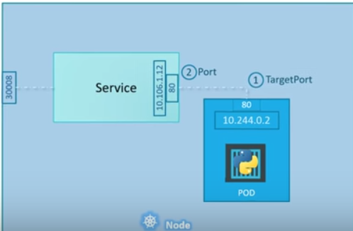
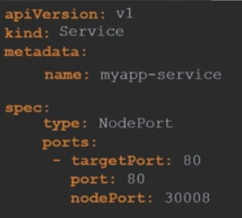


NodePort
Notes:
39

Slide 40
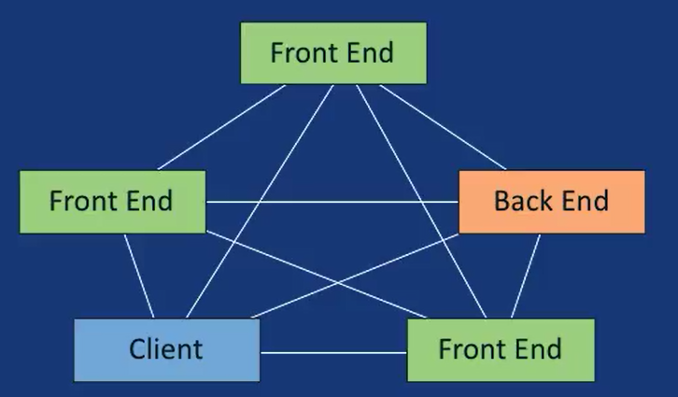
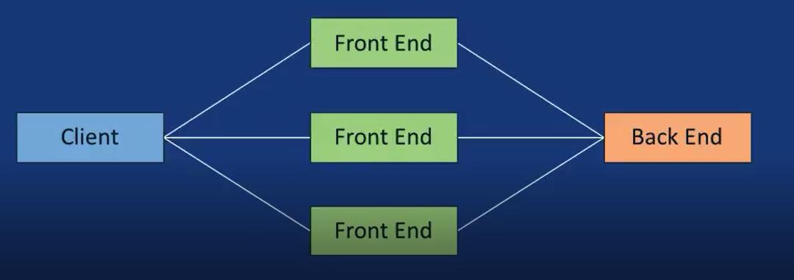
How to limit access to PODs
Default Behavior
Desired Behavior
Notes:
40

Slide 41
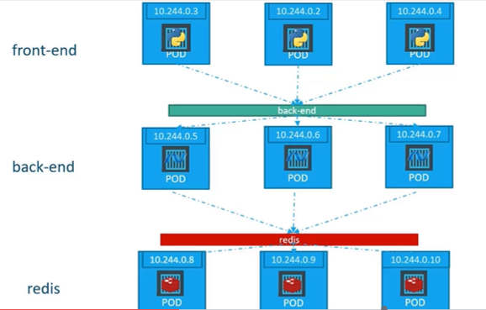
ClusterIP
It is a service inside your cluster that other
apps inside your cluster can access.
Notes:
41

Slide 42
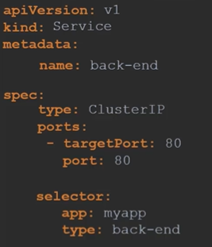
ClusterIP
Notes:
42

Slide 43
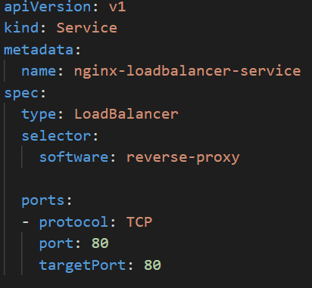
Loadbalancer
Why LoadBalancer :
Clients should not connect to a working IP.
A connecting IP can become inaccessible.
Notes:
43

Slide 44
DaemonSet
Restrict the number of POD instance to 1 in a node
POD instance should run on all nodes
When new nodes are added to cluster, Daemonset ensure PODs are created on those nodes also
For Exp:- Monitoring
Notes:
44

Slide 45
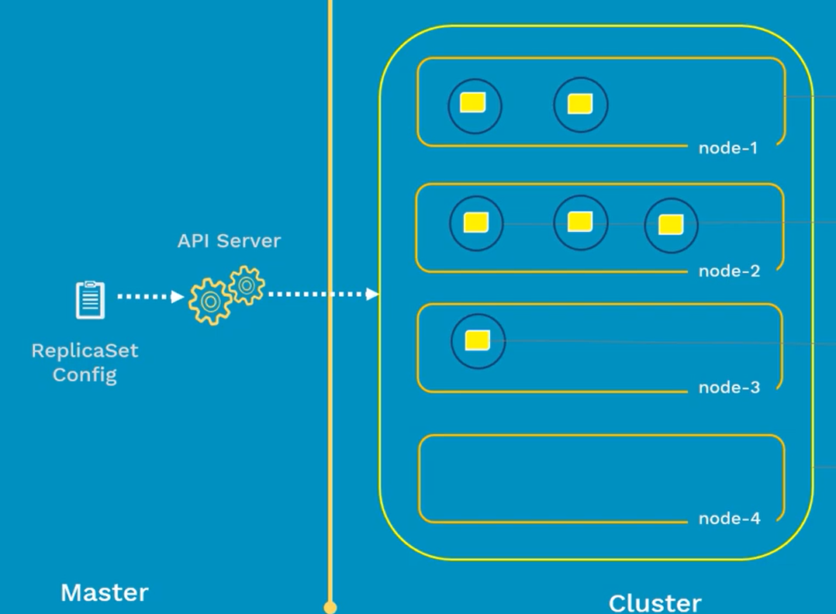
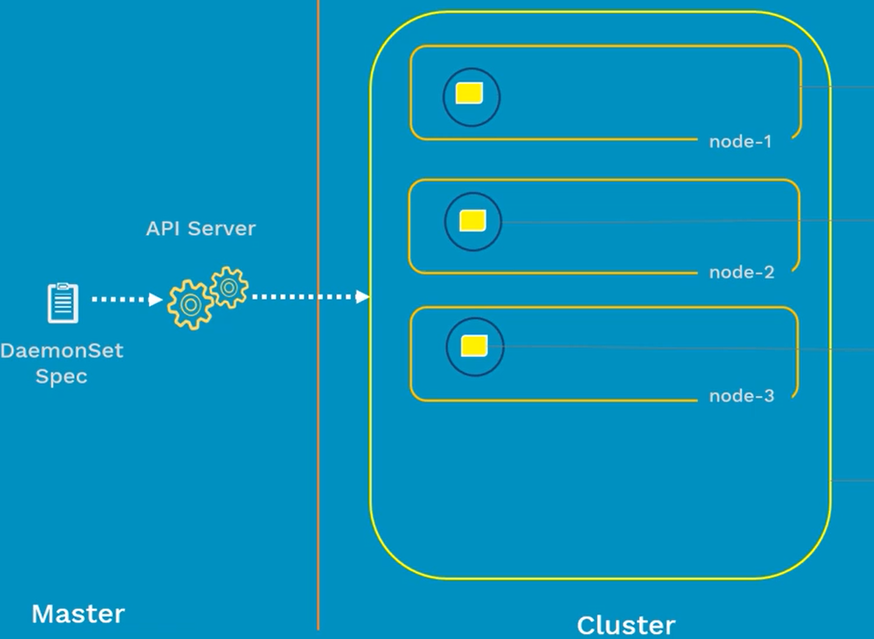
DaemonSet
Notes:
45

Slide 46
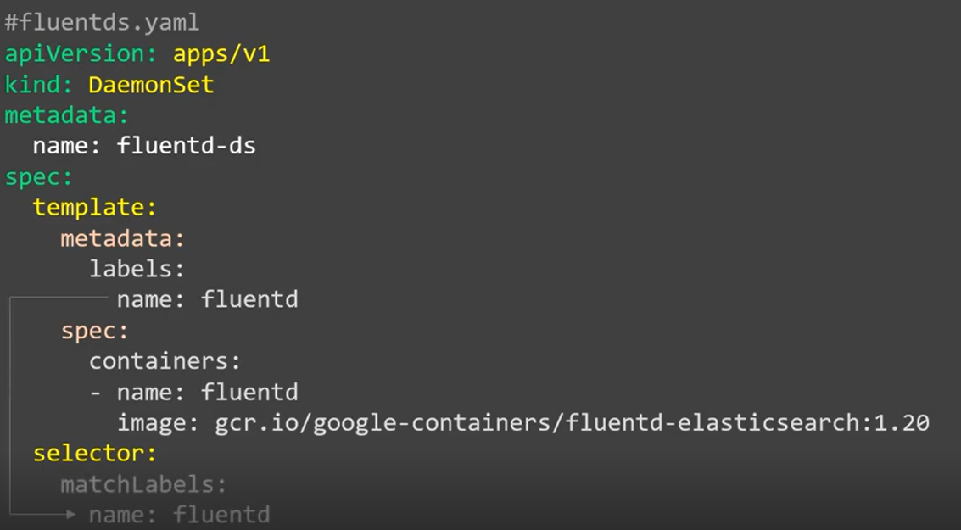
DaemonSet
kubectl get ds -o wide
Notes:
46

Slide 47
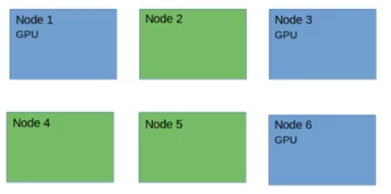
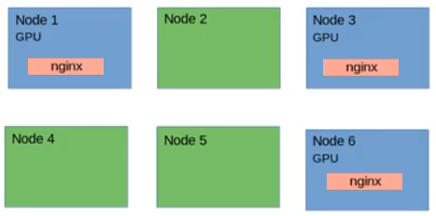
DaemonSet - Node Affinity
Notes:
47

Slide 48
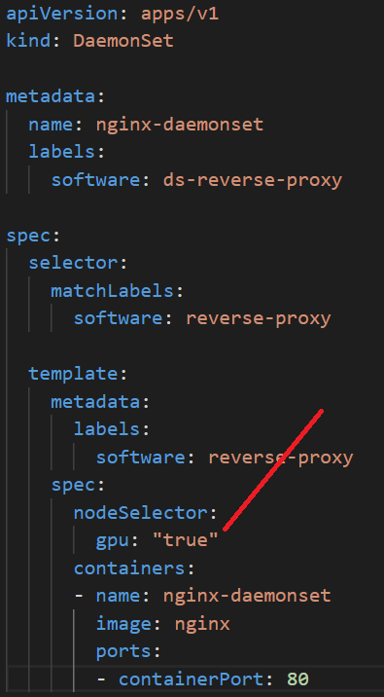
DaemonSet - Node Affinity
Daemonset ensure the PODs are deployed only on nodes which matches the label
Notes:
48

Slide 49
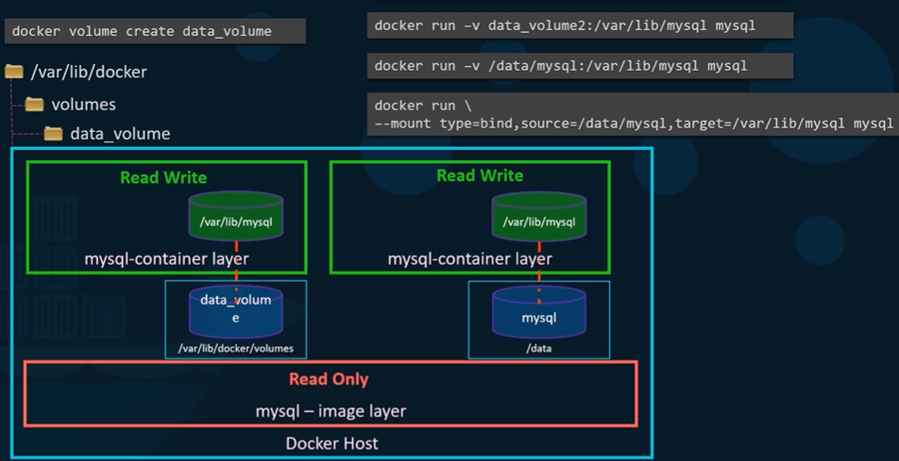
Volumes in Docker
Volume mounting
- docker default volume location
/var/lib/docker/volumes
Bind mounting
- Any location in the host
Notes:
49

Slide 50
Volumes
How can data persist through out the life cycle of a POD ?
How stateful applications (like Databases) manage the data ?
How can containers in a POD share data ?
Notes:
50

Slide 51
Volumes in Kubernetes
Volumes bring persistence to PODs
Volumes in Kubernetes are associated with the lifecycle of a POD
Support many types of volumes
Notes:
51

Slide 52
Volume types
Volume Types
Ephemeral
Durable
Notes:
52

Slide 53
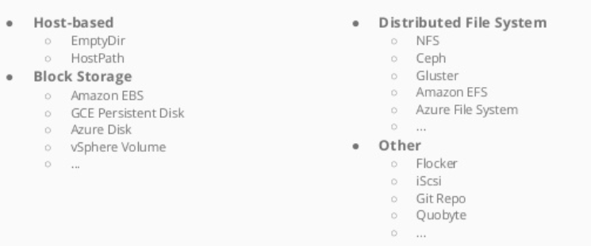
Volume types
Notes:
53

Slide 54
emptyDir
Creates and Empty Directory when a POD is assigned to a Node
Data stays as long as the POD is alive
emptyDir is removed when the POD is removed from the node
Notes:
54

Slide 55
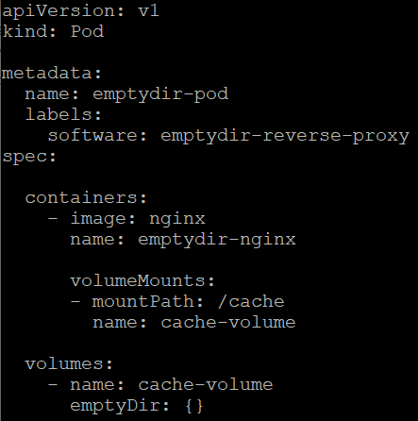
emptyDir
Use cases:-
Temporary scratch space
Local cache
Notes:
55

Slide 56
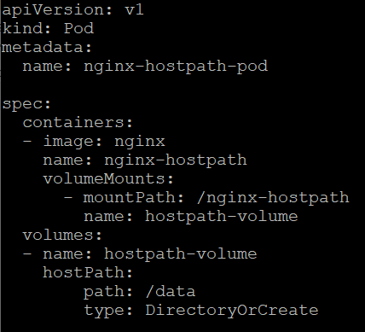
hostPath
Mounts a directory in the host’s file system into the POD
Remain even if the POD is removed
Notes:
56

Slide 57
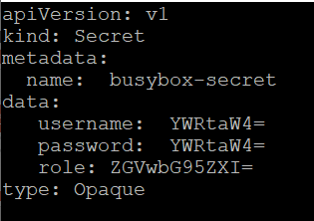
secrets
Secret is a Kubernetes object that stores sensitive data safely
Exp:-
SSH keys
Database passwords
OAuth tokens
API keys
Image registry keys
Notes:
57

Slide 58
Access secrets
Through Files Inside a Volume
Through Environment Variables
Notes:
58

Slide 59
ConfigMap
Dictionary of configuration settings to manage your containerized applications
Exp: - connection strings, analytics keys, and service URLs
Helps keep your application code separate from your configuration
Notes:
59

Slide 60
ConfigMap
Dictionary of configuration settings to manage your containerized applications
Exp: - connection strings, analytics keys, and service URLs
Helps keep your application code separate from your configuration
Improves Portability of your application
Notes:
60

Slide 61
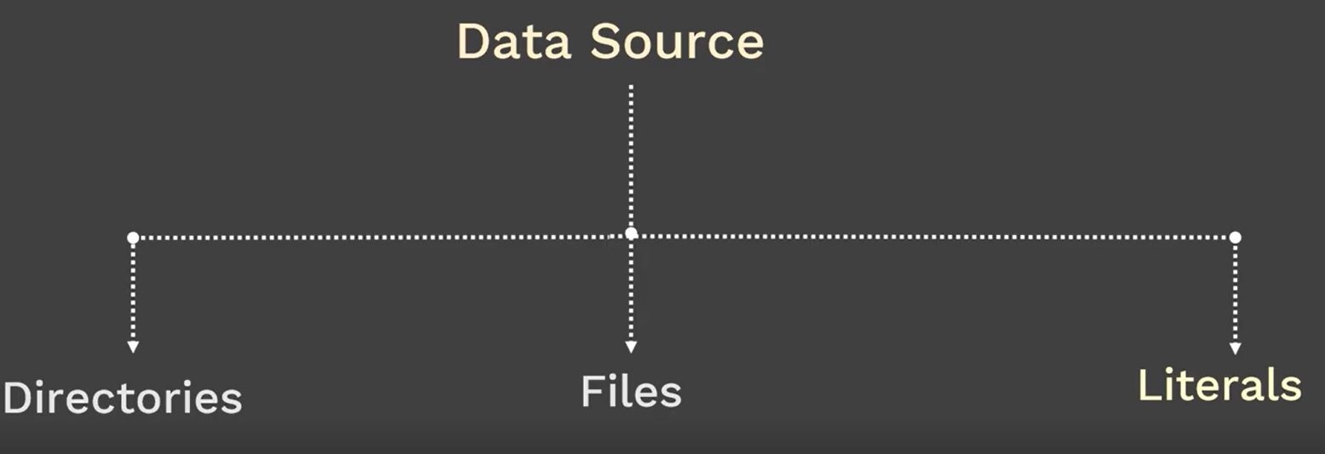
ConfigMap
Notes:
61

Slide 62
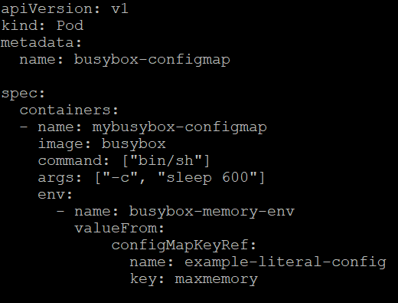
ConfigMap from Literals
kubectl create configmap example-literal-config
--from-literal=mem.max=100MB
Notes:
62

Slide 63
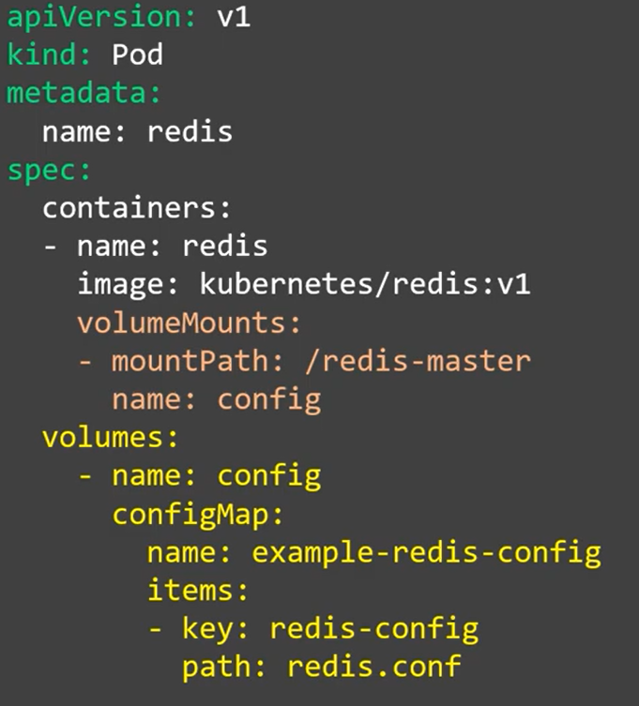
ConfigMap from file
kubectl create configmap example-redis-config
--from-file=redis-config
Notes:
63

