Slide 1

Package manager for Kubernetes

Slide 2

Helm Introduction
Package Manager to Kubernetes
Makes it easier to deploy applications and services which are highly repeatable

Slide 3
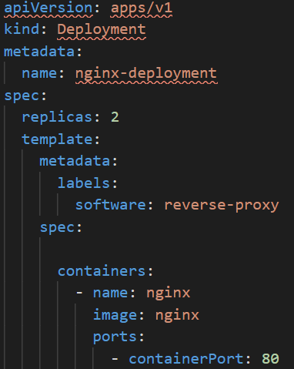
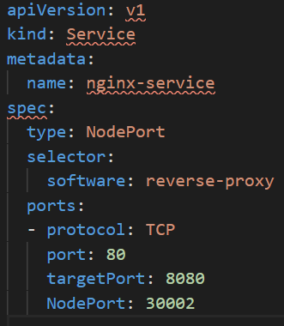
Problem statement?
How to manage the configuration part of the application by separating them out from the template?

Slide 4
Helm
Configuration which defines the values for the YAML
Template - Consists of all files which we are gong to be templating

Slide 5
Helm
Helm install mynginx
Helm upgrade mynginx
Helm rollback mynginx

Slide 6
Templates
Helm finds the YAML definitions for your Services, Deployments
and other Kubernetes objects from the templates

Slide 7
Helm
Helm Charts are source trees that contain a self-descriptor file, Chart.yaml, and one or more templates
Templates are Kubernetes manifest files that describe the resources you want to have on the cluster.
Helm chart packages all of Kubernetes manifests and also provides the version tag.
Helm provides Go-Template syntax for you. You can configure all the values, inject to manifests when deploying to the cluster.

Slide 8
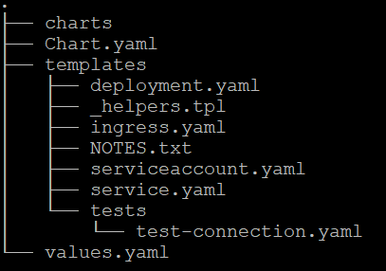
Helm Charts
Helm charts are the software packaging format for Helm.
Specifies a file and directory structure that you follow when packaging your manifests
Notes:
The data plane is composed of a set of intelligent proxies (Envoy) deployed as sidecars.
Primary Responsibilities of the Sidecar Proxy: Service Discovery, Load Balancing, Authentication and Authorization, Request Tracing, Traffic Management, Fault Injection, Rate Limiting, Observability

Slide 9
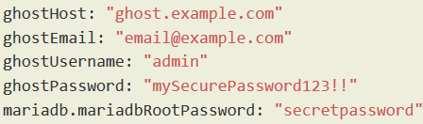
Helm Install
ghost-values.yaml
helm install --values=ghost-values.yaml stable/ghost --generate-name
helm status ghost-xxxxxxxxx

Slide 10
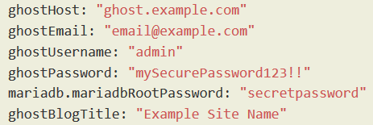
Helm Upgrade
ghost-values.yaml
helm upgrade --values=values.yaml stable/ghost ghost-1587351818
helm status ghost-xxxxxxxxx
helm rollback ghost-1576075187 1
helm uninstall ghost-1576075187

Slide 11
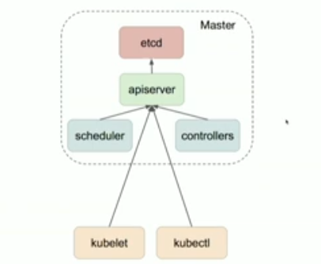
Kubernetes

Slide 12
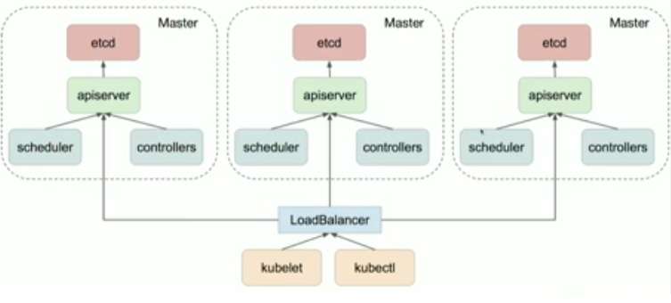
Kubernetes
Notes:
ETCD – IO
Api Server - Memory /IO
Sch Contr CPU intens

Slide 13
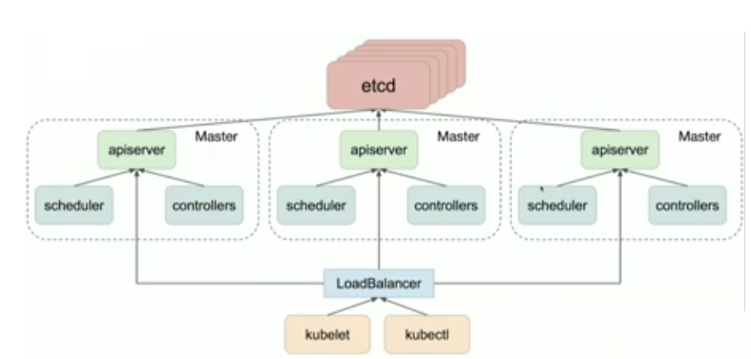
Kubernetes

Slide 14
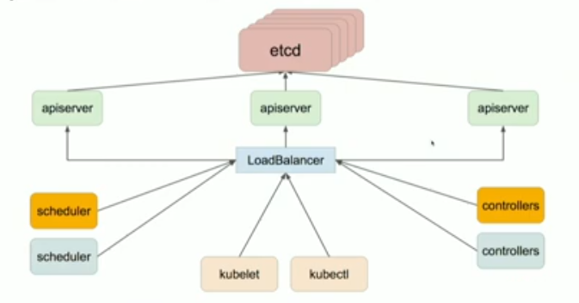
Kubernetes

