Slide 1

Smart TV Market Insights Through Web Scraping and
Data Analysis
A Comprehensive Analysis of Smart TV Market Dynamics Based on Flipkart Data
Presented by:
Nagaprasanna Dampetla

Slide 2
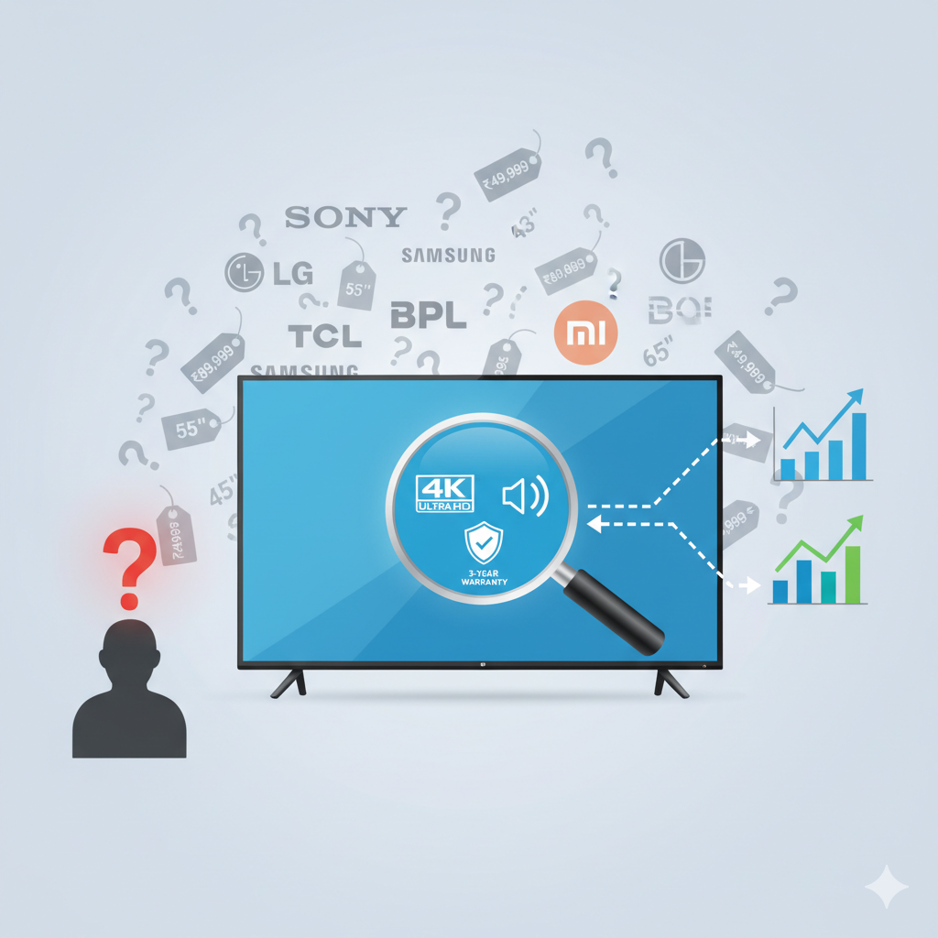
INTRODUCTION
The Smart TV market in India has become increasingly competitive, with numerous brands offering a wide range of models differing in size, technology, and price. Despite this variety, customers often face challenges in identifying the best value for their budget due to the overwhelming number of options and inconsistent feature listings. From a business analytics standpoint, understanding how different product attributes such as display type, resolution, and sound output affect pricing and customer satisfaction is crucial. This project aims to bridge that gap by analyzing Smart TV data from Flipkart to derive meaningful insights into market trends, feature impact, and consumer preference

Slide 3
AGENDA

Slide 4

Objective of the Project
The primary objective of this project is to extract, clean, and analyze Smart TV product data from Flipkart using Python-based web scraping techniques. Through data analysis, we aim to explore how various product features influence price and customer ratings, identify dominant display technologies, and examine pricing distribution across different market segments. Additionally, the study seeks to uncover trends in product launches and sound output configurations to better understand the current landscape of the Smart TV market. The insights generated can help consumers make informed decisions and assist businesses in understanding feature–price dynamics and customer expectations.

Slide 5
Web Scraping Methodology: Process Overview
Target Website
Flipkart Smart TV Product Listings
Libraries Used
requests, BeautifulSoup → for extracting and parsing web data
pandas, numpy → for structuring and cleaning data
re → for regular expressions and text cleaning
Technology Used:
Programming Language: Python
Tools: Jupyter Notebook
Method: Automated Web Scraping with HTML Parsing

Slide 6
PROCESS FOLLOWED:
1
Identified multiple Smart TV listing pages on Flipkart to capture a wide variety of brands and models.
2
Extracted key product attributes including:
Brand, Product Name, Display Size, Display Type, Sound Output, Warranty, Resolution, Original Price, Discounted Price, and Ratings
3
Used regular expressions to extract required data by identifying patterns.
4
Created a structured DataFrame using pandas, handled missing values, and converted data into appropriate formats (int, float, object)..
5
Combined all individual scraped pages into a single, cleaned dataset, ready for exploratory data analysis and visualization.

Slide 7
Data Summary: Scope of the Collected Dataset
616
12
50+
Total Records
Columns Analyzed
Brands
Number of unique Smart TV product entries collected.
Number of attributes extracted per product listing.
Diversity of manufacturers represented in the dataset.
The dataset provides a robust snapshot of the current Smart TV market, allowing for detailed comparative analysis across diverse product segments.

Slide 8
Key Dataset Attributes
The 12 extracted columns provide comprehensive data points covering core product identifiers, technical specifications, and consumer feedback.
Product & Brand Information
Brand: Manufacturer name
Model_Id: Unique product code
Product_Name: Full commercial name
Launch_Year: Year of market introduction
Technical Specifications
Display_inches: Screen size
Resolution: Screen pixel density (e.g., 4K, Full HD)
Display_Type: Panel technology (e.g., LED, OLED)
Sound_Output_Watt: Speaker output power
Pricing & Consumer Metrics
Original_Price: MSRP on the platform
Discounted_Price: Current selling price
Ratings: Average user rating (out of 5)
Warranty: Duration of product warranty

Slide 9
EXPLORATORY DATA ANALYSIS

Slide 10
Data Cleaning:
→ Removed duplicate records based on Model ID. Cleaned price columns by removing ₹ and “,” symbols and converted them to integer type.
→ Replaced blank and null values in the Warranty field with 0.
→ Extracted year from Launch_Year column (originally in YYYY-MM-DD format).
→ Standardized data types across all columns for uniformity.
Data Manipulation:
→ Created a new derived column Discount_Percentage to analyze price reductions.
→ Converted Display_inches from integer to object type to enable feature-based grouping.

Slide 11
UNIVARIATE ANALYSIS

Slide 12
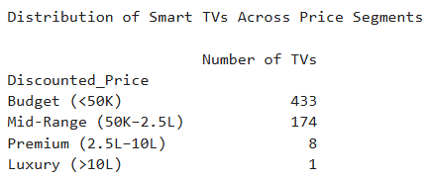
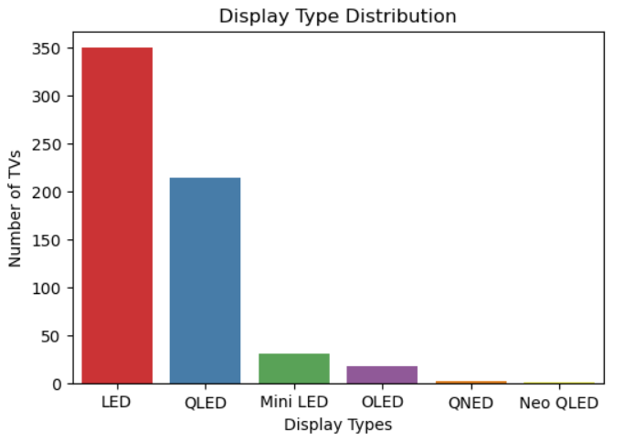
Smart TV Price Distribution Across Market Segments
Key Insights:
Majority of Smart TVs fall under the Budget Segment (<₹50K)
Mid-Range (₹50K–₹2.5L) segment forms the second largest share
Premium (₹2.5L–₹10L) TVs have very limited presence
Luxury Segment (>₹10L) is almost non-existent
Display Technology Trends in the Smart TV Market
Key Insights:
LED TVs dominate the market with the highest number of models.
QLED TVs form the second-largest share, mainly in mid to high price range.
Mini LED and OLED TVs are limited but growing gradually.
QNED and Neo QLED TVs have very few models - represent latest premium technology.

Slide 13
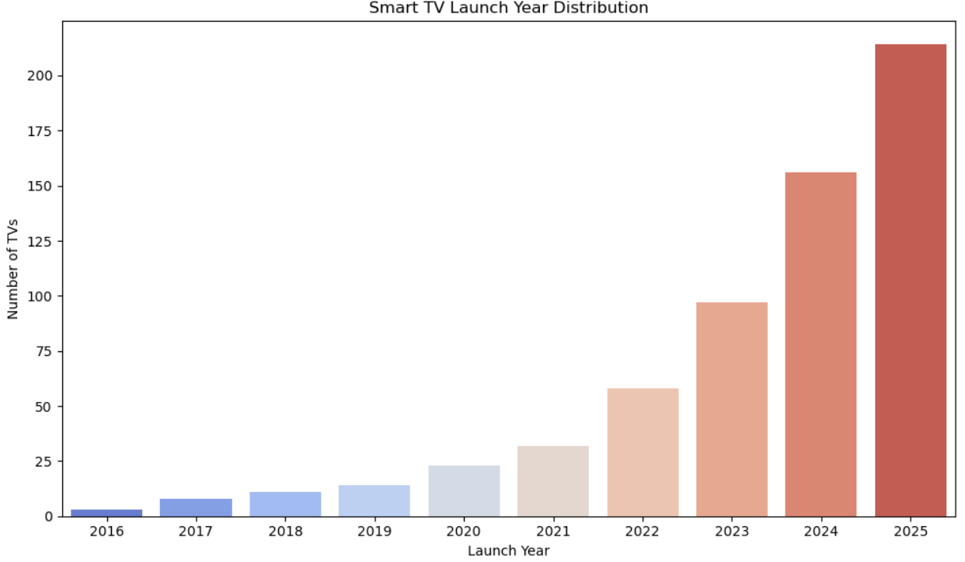
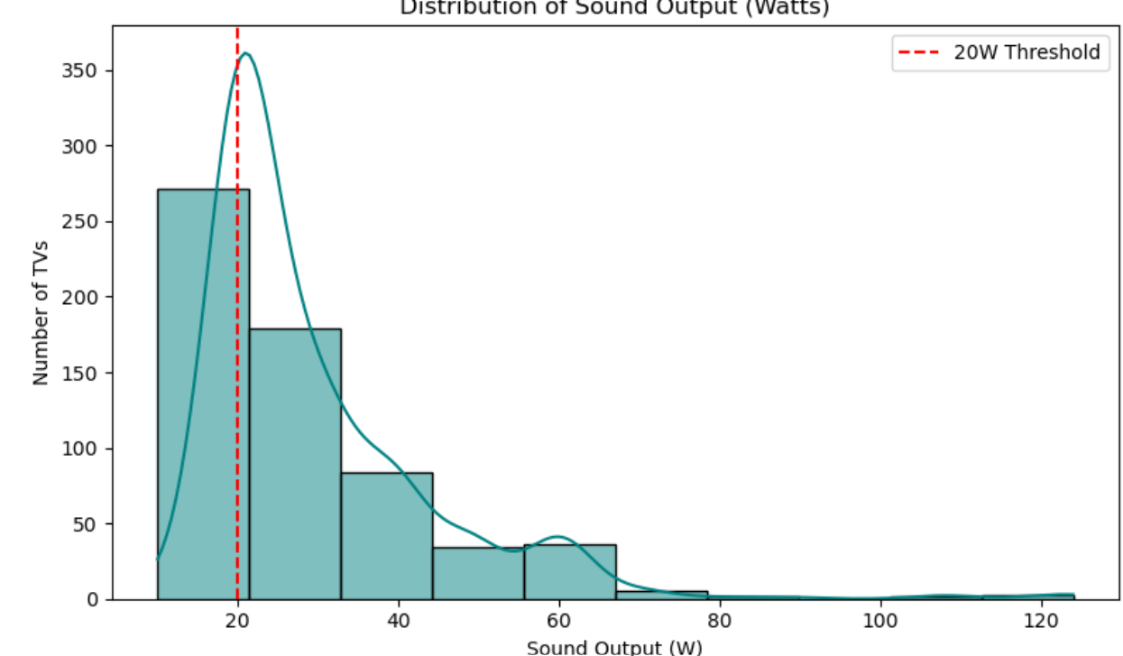
TVs were launched in the last 2 years is the catalog skewed toward newer models
Key Insights:
Manufacturers are increasingly releasing new smart TV models each year 2023 -2025
The current latest technologies and models launched in the most recent years.2025
The showing that the market is actively refreshed and focused on modern offerings.
What sound output levels are most commonly offered do most TVs cluster around 20W or higher
Key Insights:
Most TVs have a sound output around 20W, making it the most common level.
Only a few models go higher, so the majority are designed with standard 20W speakers.

Slide 14
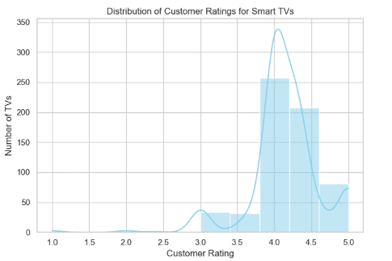
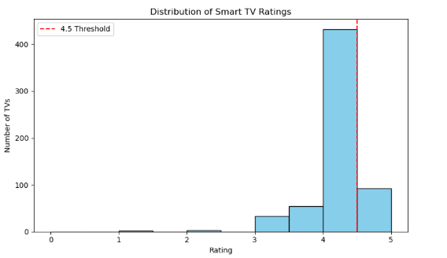
What is the distribution of Ratings across all smart TVs — and how many TVs are rated above 4.5?
Key Insights:
1.Customer satisfaction for the smart TVs in this dataset
is generally very high.
2.The distribution of ratings is heavily left-skewed,
meaning most products receive high scores.
3.The most frequent rating is around 4.0 to 4.2,
with significant clusters also rated around 4.5 and 5.0.
4.Very few TVs received ratings below 3.5.
What is the overall customer satisfaction level based on ratings?
Key Insights:
The histogram confirms high customer satisfaction, with the vast majority of ratings falling between 3.8 and 5.0.
Approximately 70 TVs in the dataset fall into the top-performing category with a rating above 4.5.

Slide 15
BiVARIATE ANALYSIS

Slide 16
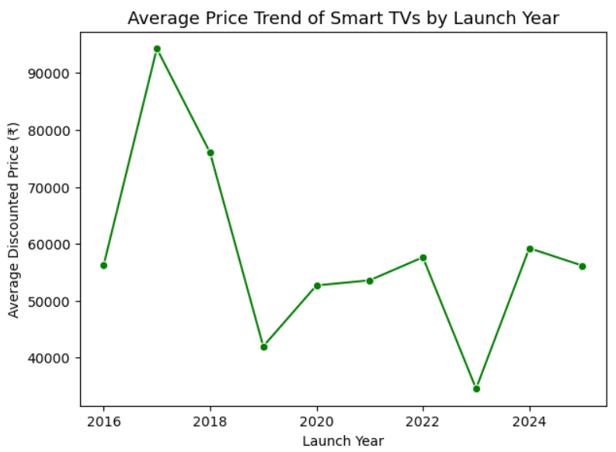
Price Trends Across Different Launch Years
Key Insights:
Smart TVs were most expensive around 2017–2018
Noticeable drop in prices after 2018
Prices stayed stable between 2020 and 2021
Slight price increase in 2024 model.

Slide 17
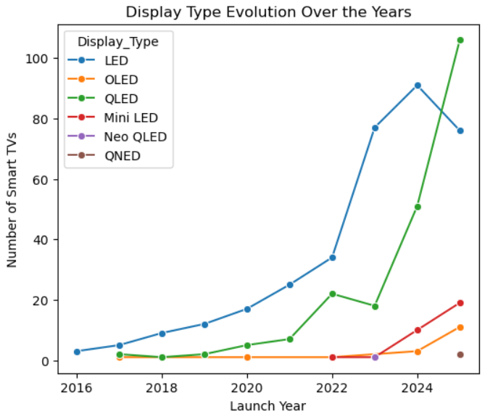
Evolution of Display Quality in Smart TVs Over the Years
Key Insights:
LED TVs are dominant across all years
QLED TVs grew strongly after 2022
OLED and Mini LED are slowly rising
New display types like Neo QLED and QNED just started

Slide 18
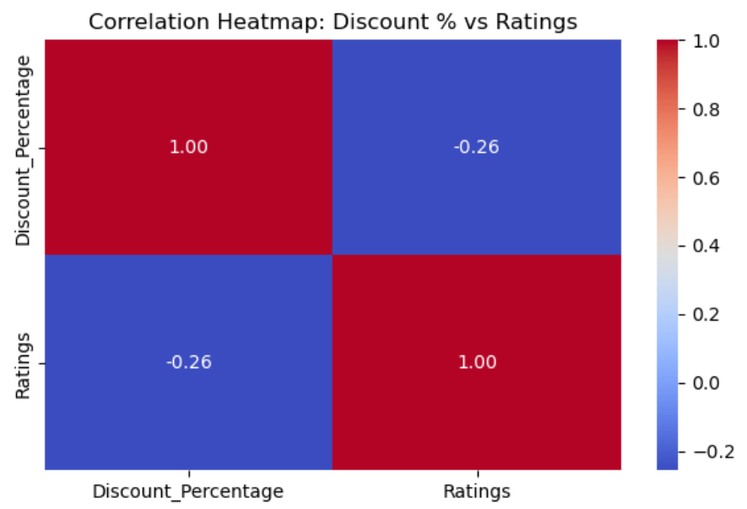
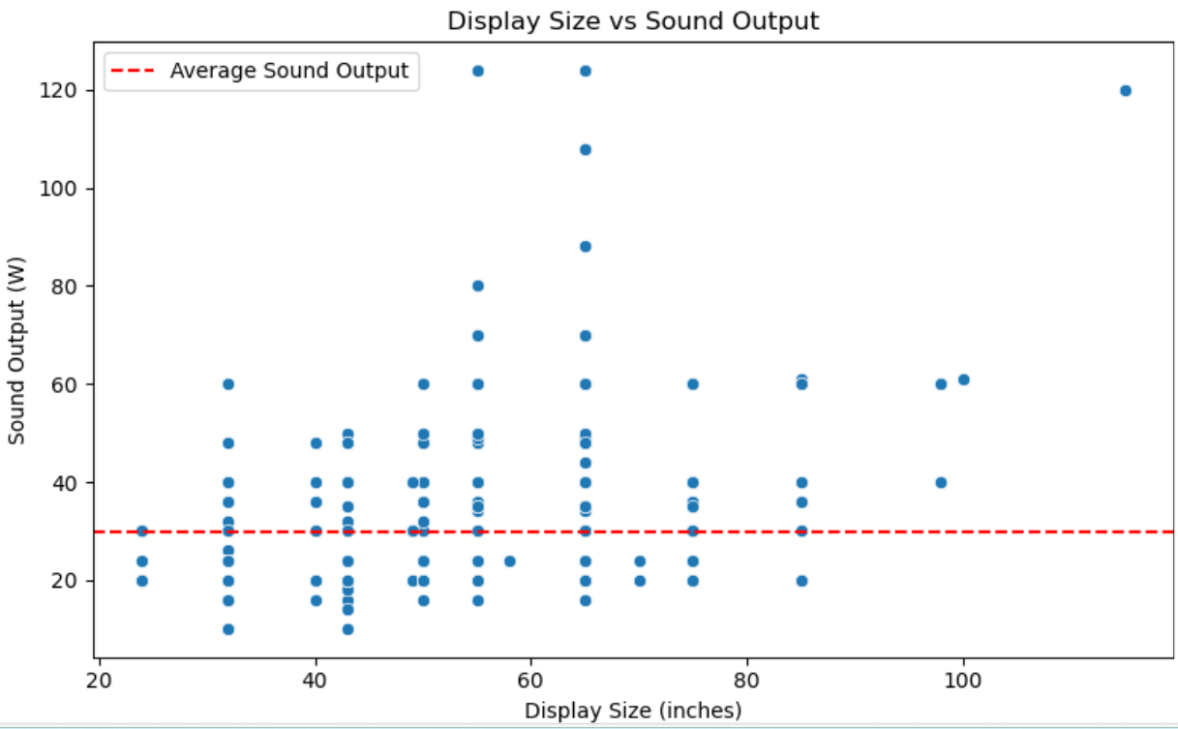
Do deeper discounts correlate with higher or lower customer satisfaction
Key Insights:
The heatmap shows a negative correlation (-0.26) between discount percentage and ratings.
customer ratings tend to drop a little products with higher discounts may not satisfy customers
Do larger TVs consistently offer higher sound output
Key Insights:
A clear positive correlation shows that larger TVs (≥ 55 inches) consistently feature higher-than-average sound output.

Slide 19
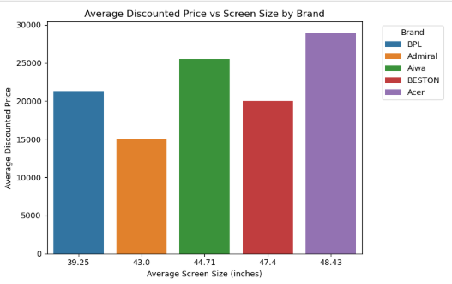
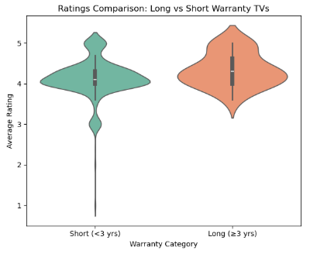
How does price vary across screen sizes within each brand?
Key Insights:
Generally, larger average screen sizes correlate with higher average prices (e.g., Acer).
This correlation isn't perfect, as Admiral offers a 43.0" size for the lowest price in the group.
Price isn't determined by size alone; BPL's small 39.25" TV costs more than Admiral's (43.0") and BESTON's (47.4").
Do TVs with longer warranties receive better ratings?
Key Insights:
The data strongly suggests a link between warranty length and customer satisfaction.Short-warranty TVs (<3 years) have widely spread ratings (3.0-5.0) centered around 4.2.Long-warranty TVs (≥3 years) have a higher median rating (around 4.5) and a tighter, more consistent distribution, indicating they are more reliable high-performers..

Slide 20
MuLtiVARIATE ANALYSIS

Slide 21
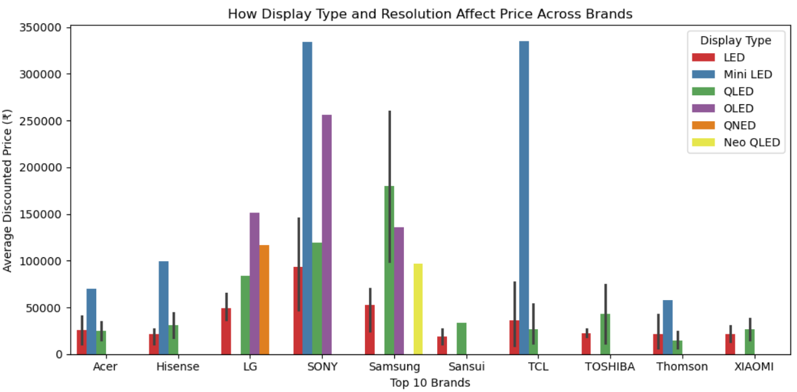
Impact of Display Type and Resolution on Price Across Top Brands
Key Insights:
Mini LED and OLED TVs are the most expensive.
Sony and TCL have the highest-priced models overall.
LG and Samsung offer both budget and premium options.
Budget brands mostly stick to LED or QLED.
QLED TVs are mid-range across brands.
Display type plays a major role in pricing.

Slide 22
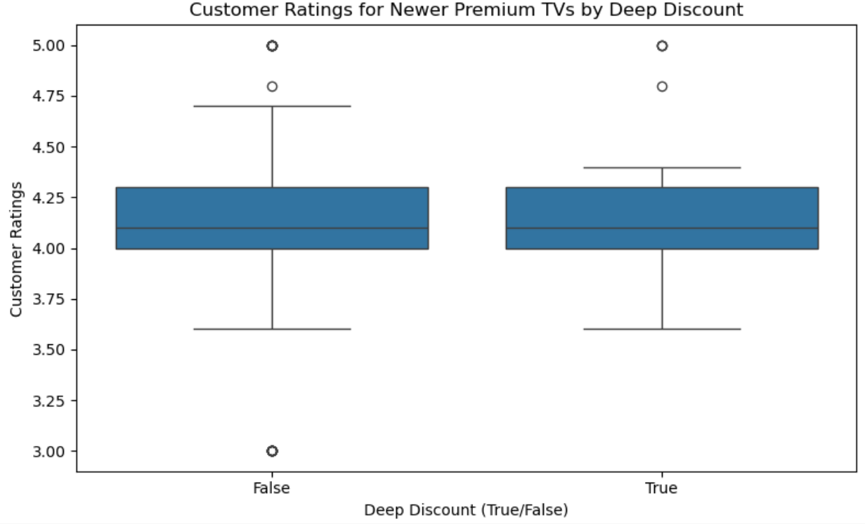
Do newer TVs with premium display types and deeper discounts consistently receive higher customer ratings
Key Insights:
TVs with deep discounts have similar median ratings(4.1) without indicating that discounting doesn’t customer satisfaction.
Premium quality drives consistent ratings both interquartile range(4.0-4.3) display quality stable customer ratings

Slide 23
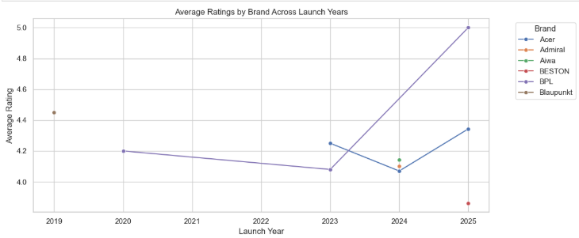
Which combination of brand, launch year, and rating reveals consistent customer satisfaction over time?
Key Insights:
This analysis, which was limited to the first 10 brand-year combinations in the data (primarily Adsun, BPL, and Blaupunkt), shows:
BPL demonstrated strong, consistent satisfaction, with its average rating holding steady around 4.2-4.3 between 2018 and 2021.
Blaupunkt also showed high consistency in its 2021 and 2022 models, with ratings around 4.3-4.4.
Adsun experienced a slight decline in average ratings from 2019 to 2021.

Slide 24
conclusion
Our analysis of 616 Flipkart Smart TVs shows the market is dominated by budget-friendly (<\₹50K) LED models, with a heavy focus on recent 2024-2025 launches. The biggest price driver is display technology, where premium Mini LED and OLED cost the most. While 20W is the standard audio output, larger screens (55"+) consistently offer higher-powered sound. Customer satisfaction is overwhelmingly high (most ratings 3.8-5.0), and we found a strong link between longer warranties (3+ years) and higher, more consistent ratings.

Slide 25

THANK YOU

