Slide 1
SDLC
Session 2
Prepared by
Subash B

Slide 2
SDLC Overview
Software Development Life Cycle (SDLC) is a process used by the software industry to design, develop and test high quality softwares
Stages of SDLC
Requirement gathering and analysis.
Define
Design.
Implementation or coding or Built
Testing.
Deployment.
Maintenance

Slide 3
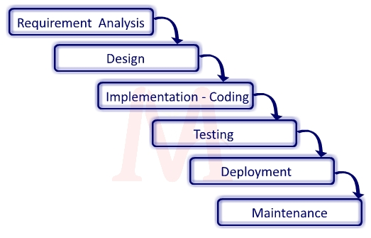

Slide 4
Requirement gathering and analysis
Requirement analysis first stage in SDLC.
Inputs will be gathered from the customer, the sales department, market surveys and domain experts in the industry.
This helps to plan the project approach

Slide 5
Defining Requirements
Documentation of the product requirements and get them approved from the customer or the market analysts.
This is done through an SRS (Software Requirement Specification) document which consists of all the product requirements to be designed and developed during the project life cycle.

Slide 6
Design
With the requirements specified in SRS, usually more than one design approach for the product architecture is proposed and documented in a DDS - Design Document Specification.
Programming language like Java, PHP and .NET
Database like Oracle, MySQL, etc.
High-level technical details of the project

Slide 7
Implementation or coding or Built
It includes programming the source, creating the graphics, and compiling the assets into an executable program
The programming code is generated as per DDS during this stage.

Slide 8
Testing
In this phase, you test the software to verify that it is built as per the specifications given by the client.
Here the product defects are reported, tracked, fixed and retested, until the product reaches the quality standards defined in the SRS.

Slide 9
Deployment in the Market and Maintenance
Once a program has passed the testing phase, it is ready for deployment.
Deploy the application in the respective environment

Slide 10
Maintenance
Maintenance of software can include software upgrades, repairs, and fixes of the software if it breaks.

Slide 11
SDLC Methodologies
WaterFall Model
V-Model Of Testing
Iterative Model
Spiral Model
Agile Model

Slide 12
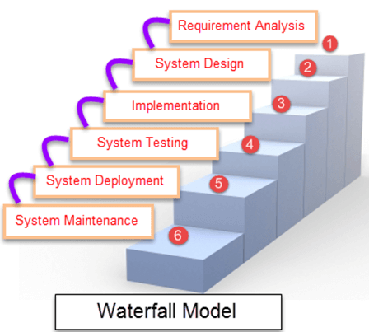

Slide 13
WaterFall Model
There are strict phases and each phase needs to be completed first before going to the next phase. There is no going back.
This model works best when all requirements are known and flexibility is not required and the project has a fixed timeline.
Disadvantage of waterfall model is that all requirements need to be known before development starts.
Therefore if a requirement is wrong or missing, it won’t become apparent until the late stages of the life cycle.

Slide 14
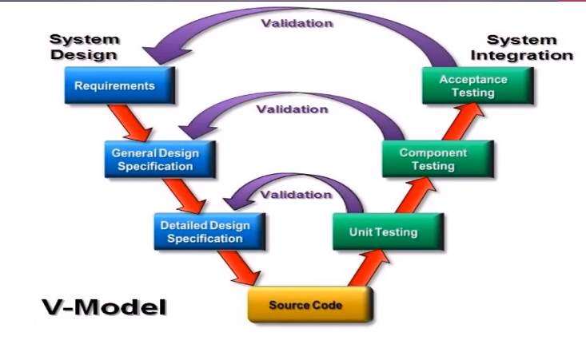

Slide 15
V Model
V Model is also known as the Verification and Validation model
It is introducing testing at each stage of development rather than at the end of the project.
The advantage of V Model is that each stage has a corresponding testing activity which helps to identify missing requirements, and incorrect design early in the life cycle.
The disadvantage is that the each stage has to wait for the previous stage to be finalized and signed off.

Slide 16
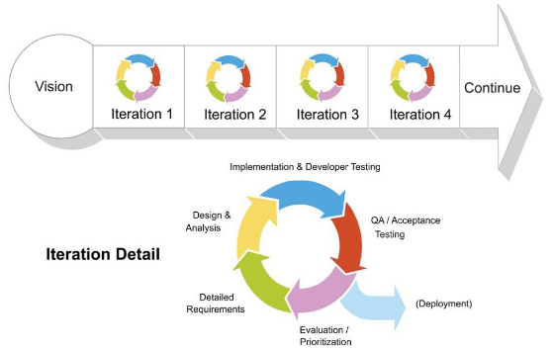

Slide 17
Agile Method
Agile Methodology is a development method in which requirements and solutions evolve in cross-functional teams through the collaborative effort.
Its approach aligns project and product development with requirements of the customer and overall company goals.
It is a methodology based on iterative development.

